Slide 1
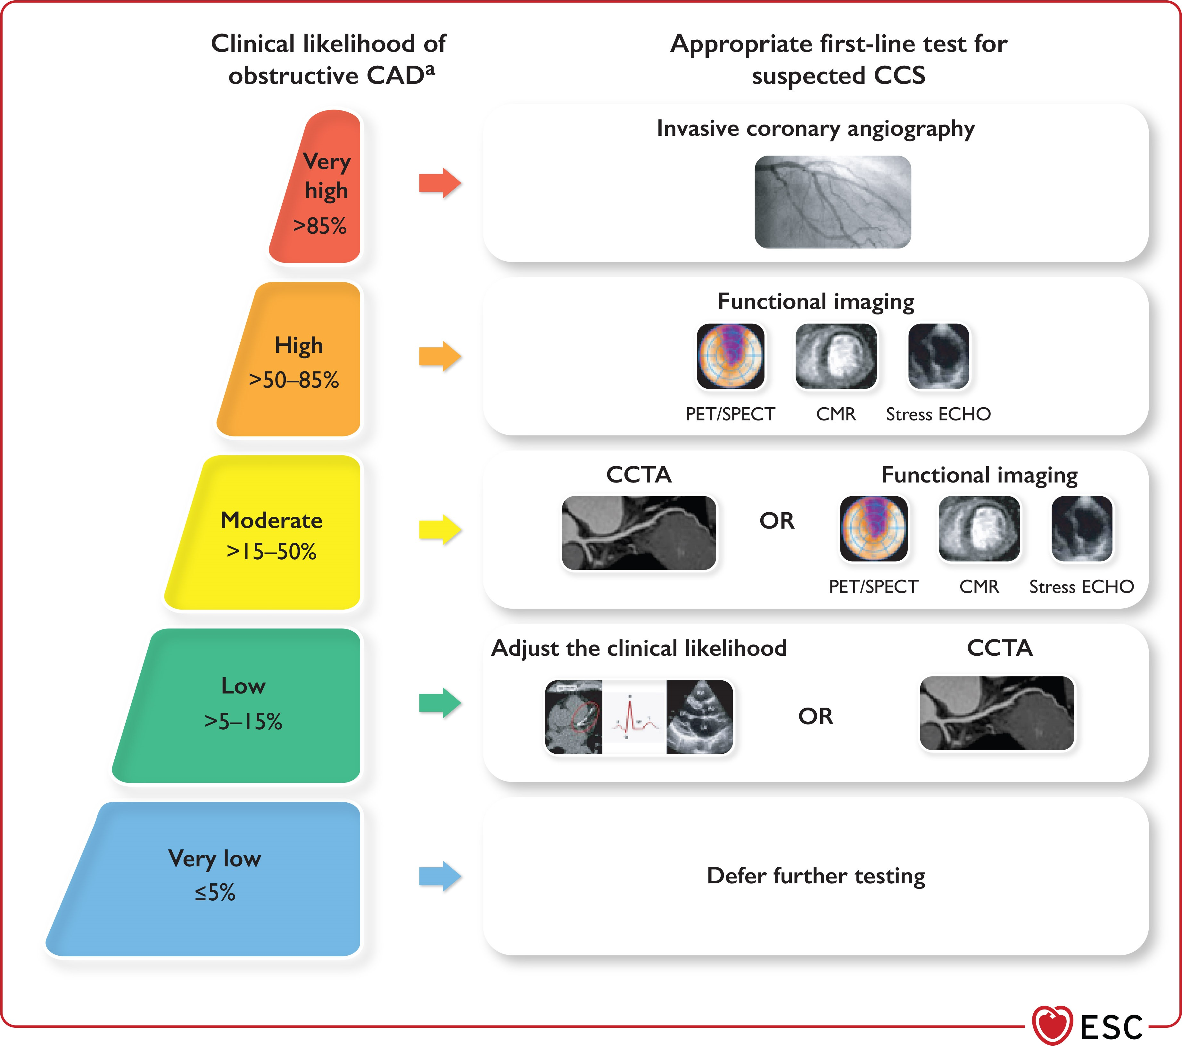

Slide 2
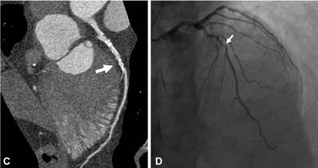

Slide 3
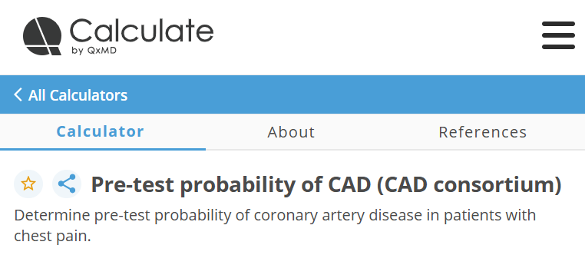

Slide 4


Slide 5
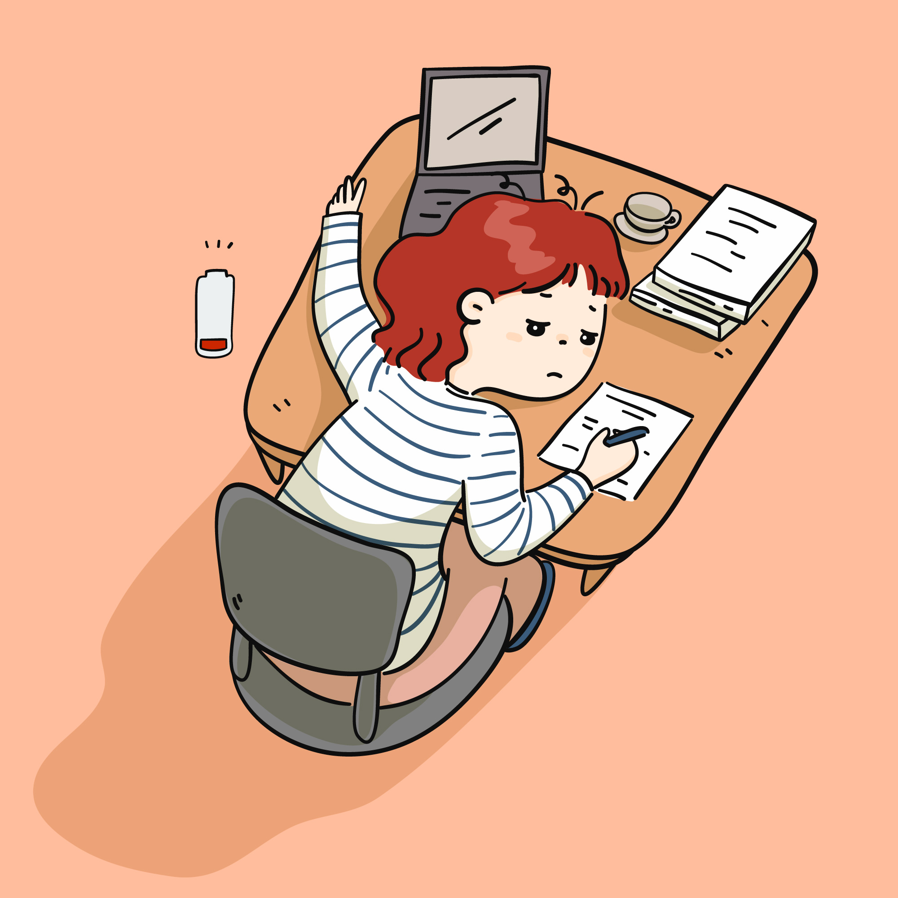
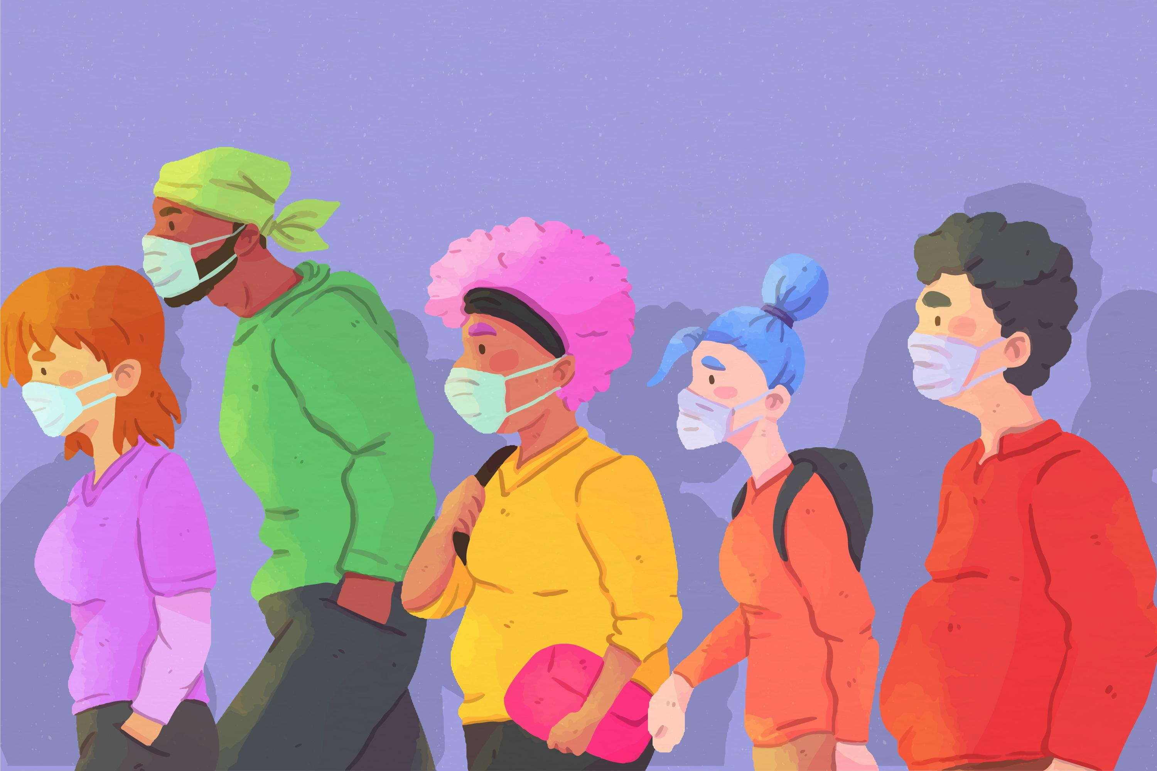
Hand drawn flat design overwhelmed people illustration designed by Freepik https://www.freepik.com/author/freepik
Crowd of people wearing face masks designed by Freepik https://www.freepik.com/author/freepik
https://www.freepik.com/free-vector/hand-drawn-flat-design-overwhelmed-people-illustration_24683083.htm
https://www.freepik.com/free-vector/crowd-people-wearing-face-masks_8445486.htm

Slide 6




Hand drawn college entrance exam illustration designed by Freepik https://www.freepik.com/author/freepik
https://www.freepik.com/free-vector/hand-drawn-college-entrance-exam-illustration_41156802.htm

