Slide 1
Connection to the internet
Week 1

Slide 2
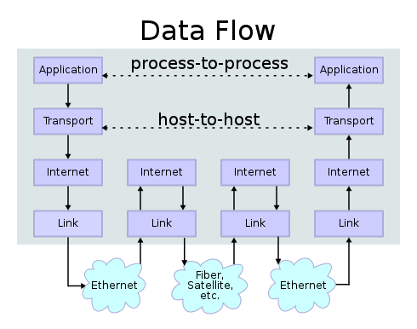
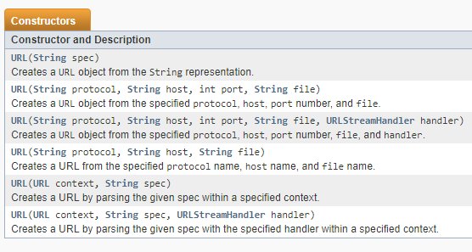
TCP
Let us ignore all the complexity of the TCP / IP model
And focus on the "peer-to-peer“ aspect
Class URL (https://docs.oracle.com/javase/7/docs/api/java/net/URL.html)
More info: http://www.net-intro.com/
By en:User:Kbrose - Prior Wikipedia artwork by en:User:Cburnett, CC BY-SA 3.0, https://commons.wikimedia.org/w/index.php?curid=1831900

Slide 3
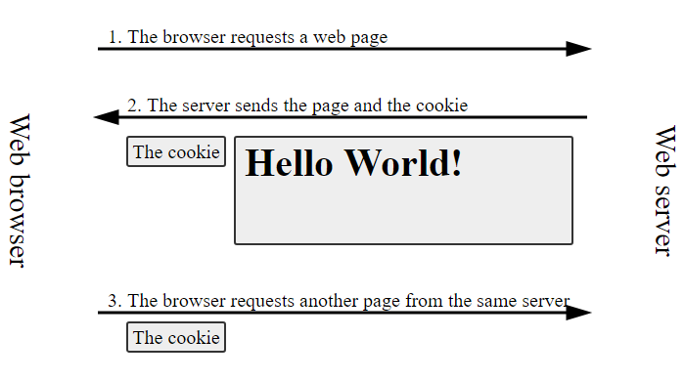
HTTP
Hypertext Transfer Protocol
Aplicational layer
Classes:
Url/UrlConnection
HttpComponents (Apache)
Socket

Slide 4
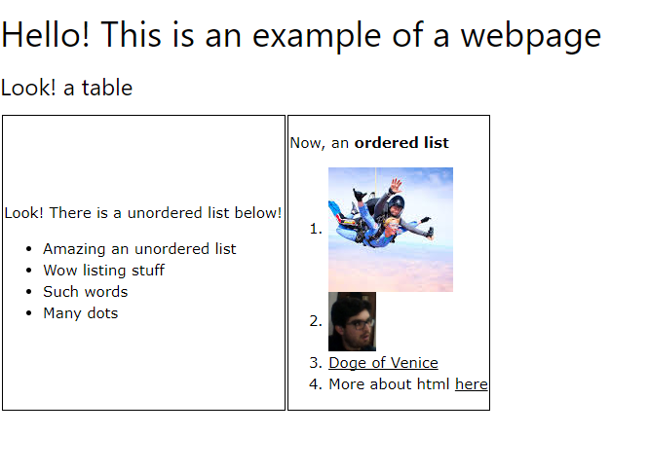
HTML
<!DOCTYPE html> <html> <head> <title>Example page</title> <meta charset="utf-8"> <link rel="stylesheet" href="https://www.w3schools.com/w3css/4/w3.css"> <script src='https://ajax.googleapis.com/ajax/libs/jquery/3.3.1/jquery.min.js'></script>
</head>
<body> <h1>Hello! This is an example of a webpage</h1> <h3>Look! a table</h3> <table> <tr> <td style="border: 1px black solid"> <p>Look! There is a unordered list below!</p> <ul> <li>Amazing an unordered list</li> <li>Wow listing stuff</li> <li>Such words</li> <li>Many dots</li> </ul> </td>
<td style="border: 1px black solid"> <p>Now, an <strong>ordered list</strong></p> <ol> <li><img src="http://lh3.googleusercontent.com/9eyLUVqzA-oLKFsQ4XI8aIF02c1QvwgSI5pg8IeLuk7rDkfHem_ET61FEoBXtT1GhVKgNHWU=w128-h128-n-no-v1"></li> <li><img src=".//heart.png"></li> <li><a href="https://en.wikipedia.org/wiki/Doge_of_Venice">Doge of Venice</a></li> <li>More about html <a href="https://www.w3schools.com/html/default.asp">here</a></li> </ol> </td> </tr> </table> </body> </html>
HyperText Markup Language
Structured representation of media and content
Tags

Slide 5
try {
//A tentar conectarmos com o url
URL url = new URL("https://java-mooc.github.io/Advanced-Java/ex1.html");
String textoRecebido = "";
//Aqui pedimos a página web em questão
URLConnection conexaoAoWebsite = url.openConnection();
//Stream onde recebemos os dados
InputStream streamDeLeitura = url.openStream();
//Buffer onde armazenamos os dados
BufferedReader buffer = new BufferedReader(new InputStreamReader(streamDeLeitura));
String textoDoBuffer;
while ((textoDoBuffer = buffer.readLine()) != null) {
textoRecebido += textoDoBuffer;
}
System.out.println(textoRecebido);
} catch (Exception e){
System.err.println("Ocorreu uma excepção!\n" + e.getMessage());
}

Slide 6


<!DOCTYPE html><html><head><title>Test</title></head><body><h1>This is a header!</h1><p>This is some text!</p></body></html>
But HTML was not meant to be used this way!
XML and JSON!

Slide 7
Exercise:
Save all images on the page: https://java-mooc.github.io/Advanced-Java/ex2.html
Links to included images!
Pause the video now, and try to solve this exercise.
Pssst! Some materials are available to assist you!
If you have difficulties, in the next video we present the resolution of the exercise.

