Slide 1
Parallelism
Week 3

Slide 2
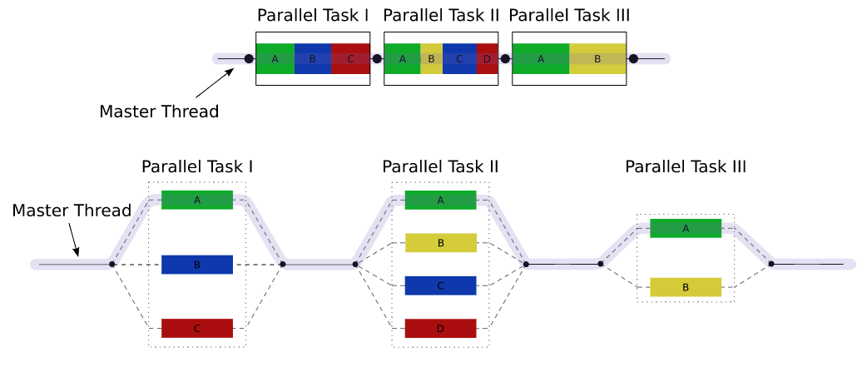
Definitions
Sun’s definition:
Parallelism: A condition that arises when at least two threads are executing simultaneously.
We are going to use ForkJoinPool and RecursiveAction.
See also: concurrency
By Wikipedia user A1
[GFDL (http://www.gnu.org/copyleft/fdl.html) or CC BY 3.0 (https://creativecommons.org/licenses/by/3.0)], via Wikimedia Commons
https://commons.wikimedia.org/wiki/File:Fork_join.svg

Slide 3
Why use it?
Let’s say we want to calculate the mean of the values of an array, we can do:
arr =
10 | 20 | 5 | 5 | 32 | 13 | 7 | 20 | 10 | 8
They are happening at the same time!
Mean (arr)
arr1
arr2
a = Mean (arr1)
b = Mean (arr2)
a + b

Slide 4
Exemplo
arr1 = [1,2,3…]
arr2 = [4,4,6…]
a = Mean (arr1)
a + b
FORK
b = Mean (arr2)
JOIN

Slide 5
Exercises!

