Slide 1
Paralelismo e Concurrência
Semana 3

Slide 2
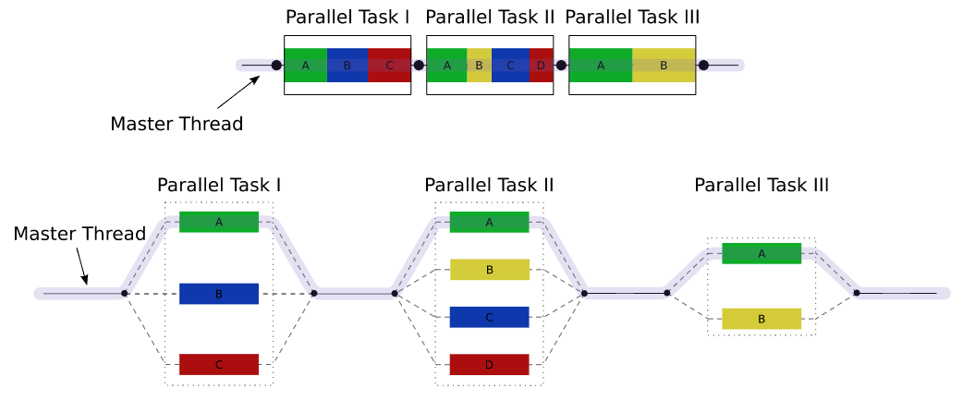
Definições
Definição da Sun:
Concurrency: A condition that exists when at least two threads are making progress. A more generalized form of parallelism that can include time-slicing as a form of virtual parallelism.
Parallelism: A condition that arises when at least two threads are executing simultaneously.
Não vamos abordá-las de forma separada, mas sim em conjunto!
By Wikipedia user A1
[GFDL (http://www.gnu.org/copyleft/fdl.html) or CC BY 3.0 (https://creativecommons.org/licenses/by/3.0)], via Wikimedia Commons
https://commons.wikimedia.org/wiki/File:Fork_join.svg

Slide 3
O que é uma API?
Definição

Slide 4
Exercícios!

