Slide 1

JAVA CAPSTONE PROJECT Compact Programming Course - Java
Team – 14
ANJALI Khanduri [7219034]
Nitika Deswal [7218799]
Madhukar Devendrappa [7219639]

Slide 2
Outline
Assignment
Flow Chart
Class Diagram
Project Overview
Unit Testing
Summary
Demonstration

Slide 3
Assignment
Develop simulation of the Car charging station with several alternative sources of energy
Several car charging stations are available with n location in it. Only one car can be in one charging location. Charging one car takes a fixed time. If all places are occupied, the car will not wait for more than a certain time and will go to another car charging station
Simulate the weather conditions to log the situation at the charging station and switch between the energy sources
Simulate the management system for the energy sources

Slide 4
Outline
Assignment
Flow Chart
Class Diagram
Project Overview
Unit Testing
Summary
Demonstration

Slide 5
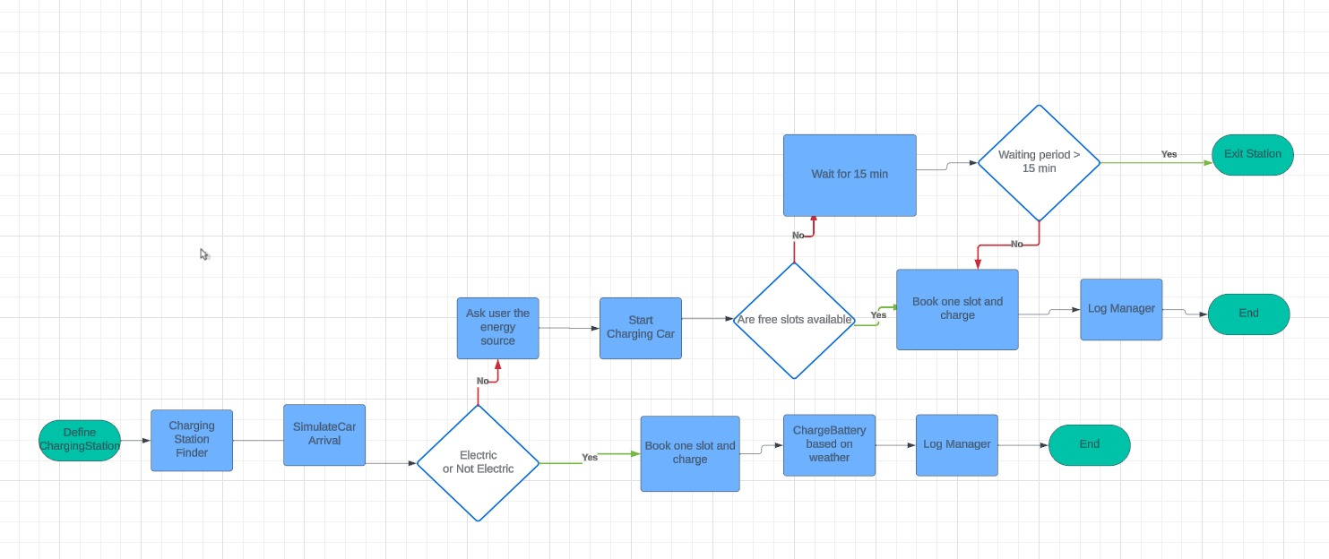
Flow Chart

Slide 6
Outline
Assignment
Flow Chart
Class Diagram
Project Overview
Unit Testing
Summary
Demonstration

Slide 7
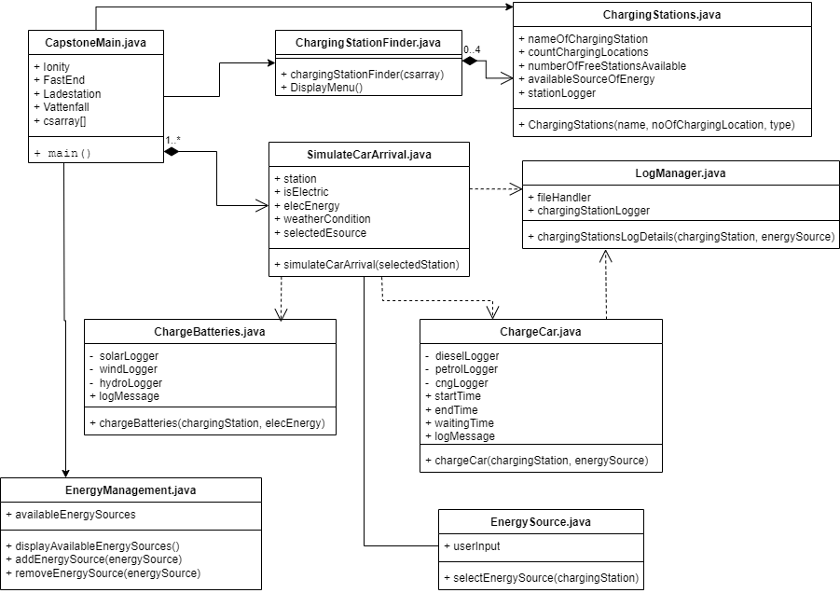
Class Diagram

Slide 8
Outline
Assignment
Flow Chart
Class Diagram
Project Overview
Unit Testing
Summary
Demonstration

Slide 9
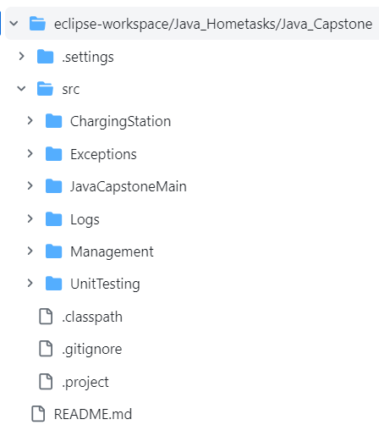
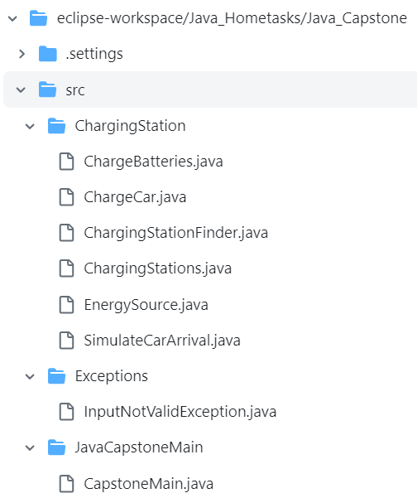
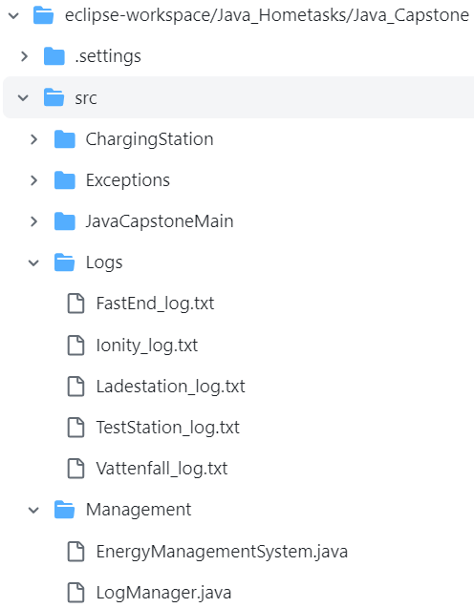
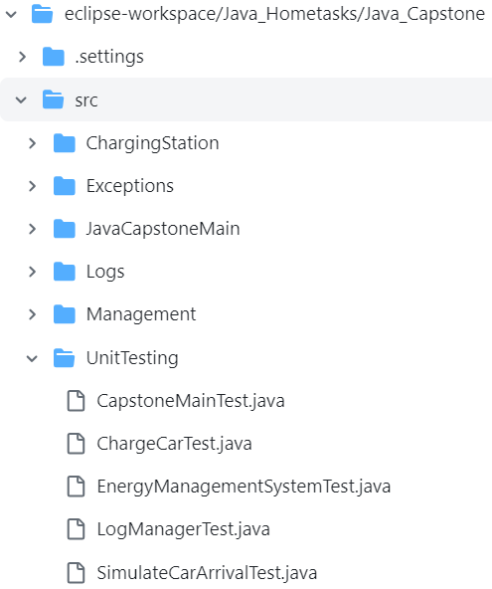
Project Overview
Project Structure:

Slide 10
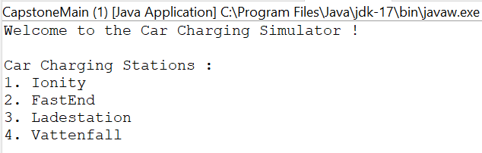
Project Overview (Continued..)
We have considered four charging stations with different sources of energy for our project:
Ionity
FastEnd
Ladestation
Vattenfall

Slide 11
Project Overview (Continued..)
Available sources of energy for different charging stations:
Sources of energy for charging batteries of electric vehicles:
Solar Energy
Wind Energy
Hydro Energy

Slide 12
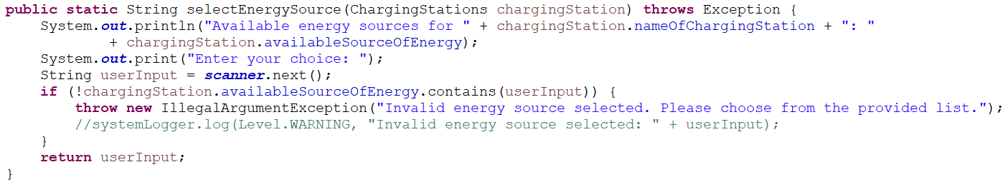
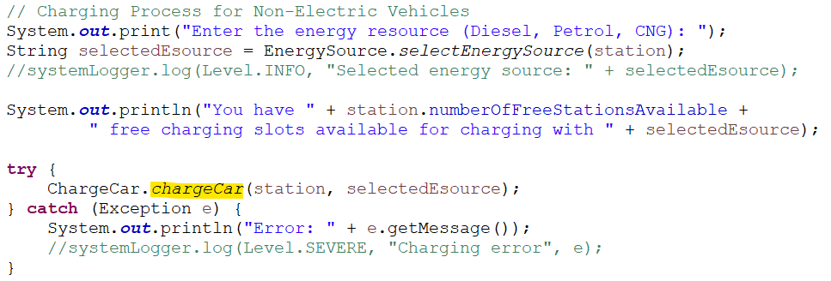
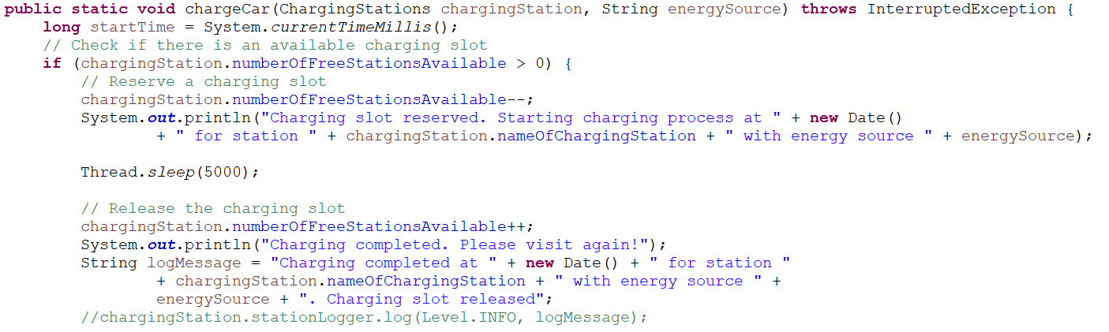
Project Overview (Continued..)
Charging stations are selected in the order as shown in Slide #10
Validation occurs for both electric and non-electric vehicles at each station
Depending on the input, the appropriate energy sources are then chosen

Slide 13
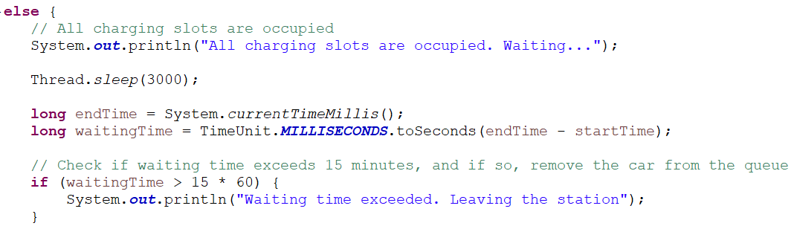
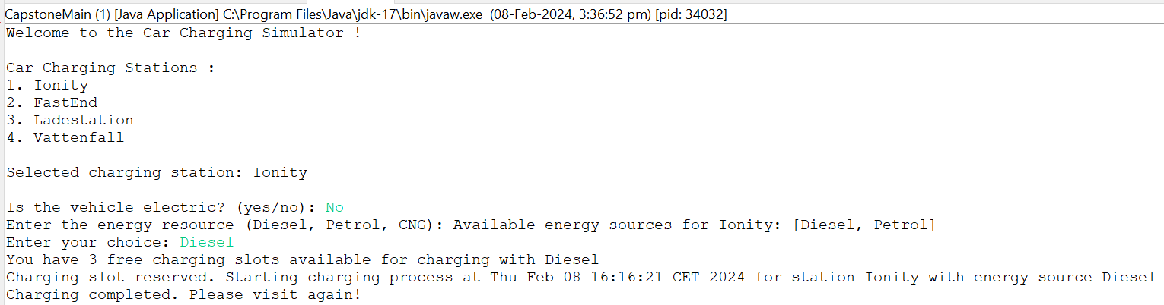
Project Overview (Continued..)
A car will not wait for more than 15 minutes in one charging station.

Slide 14
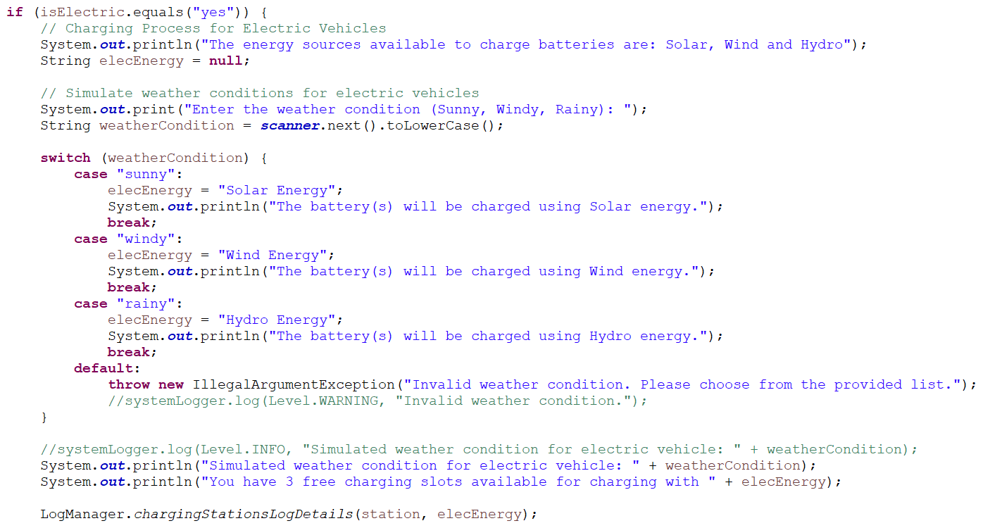
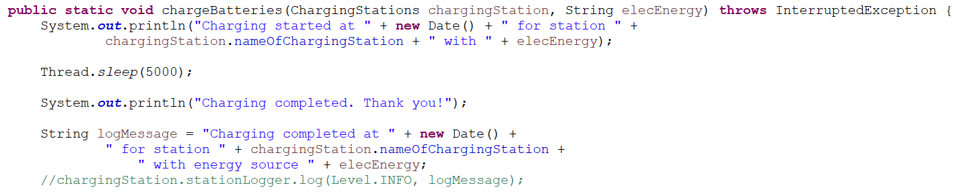
Project Overview (Continued..)
Batteries in electric vehicles get charged based on the weather condition

Slide 15
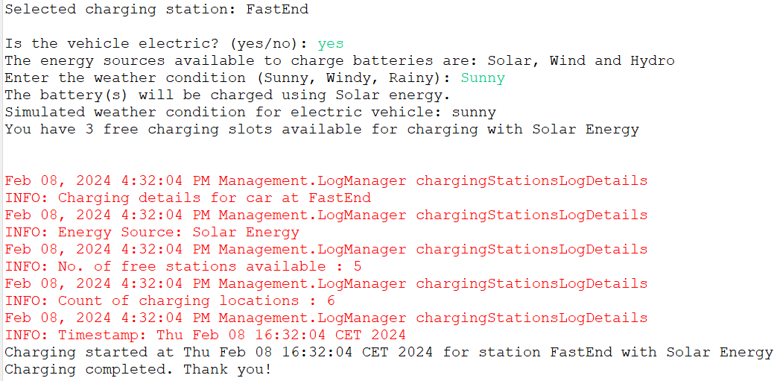
Project Overview (Continued..)

Slide 16
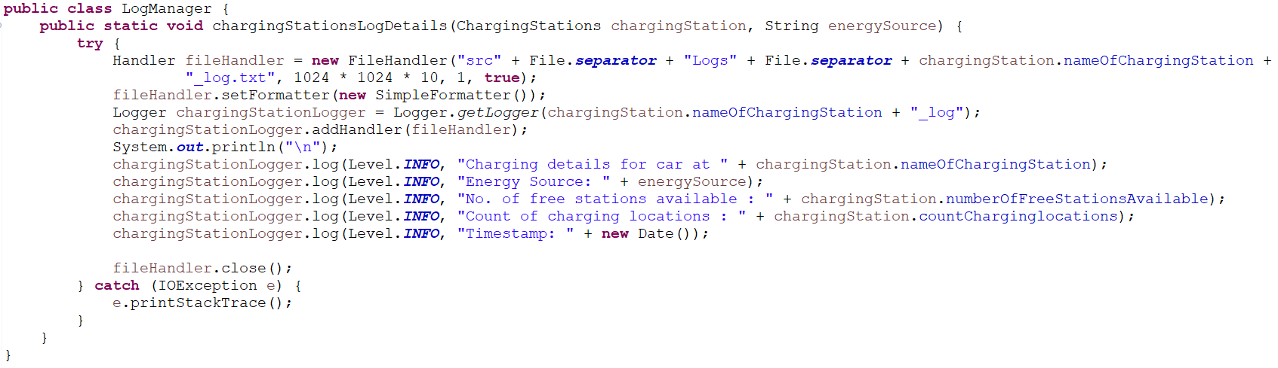
Project Overview (Continued..)
Detailed logs, including charging date, time, and energy resource used, are maintained for each charging station

Slide 17
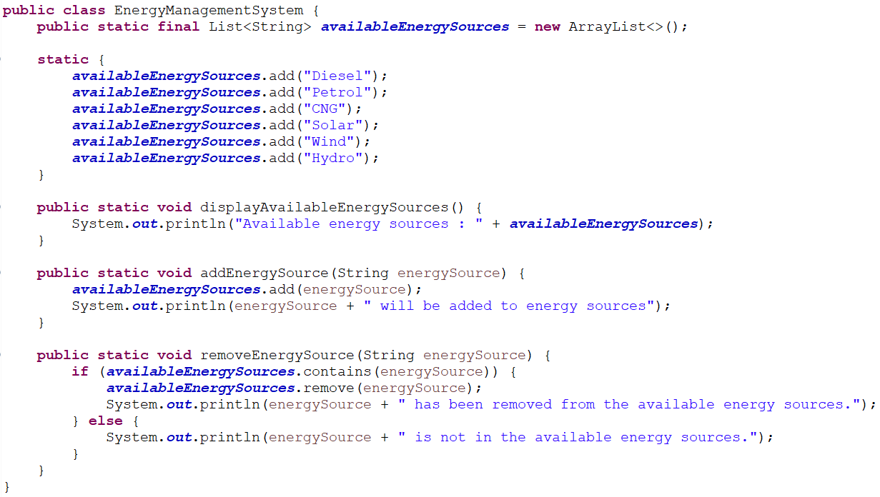
Project Overview (Continued..)
We have incorporated a feature to accommodate potential future energy resources, taking into account user input
Energy management is achieved through the implementation of functionalities that allow for the addition of new energy resources or the removal of existing ones

Slide 18
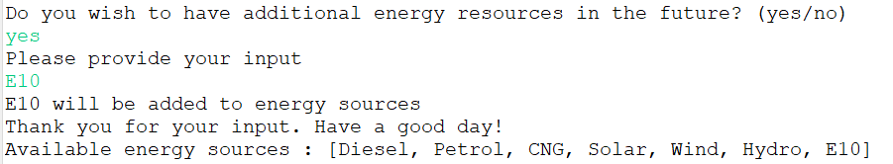
Project Overview (Continued..)

Slide 19
Outline
Assignment
Flow Chart
Class Diagram
Project Overview
Unit Testing
Summary
Demonstration

Slide 20
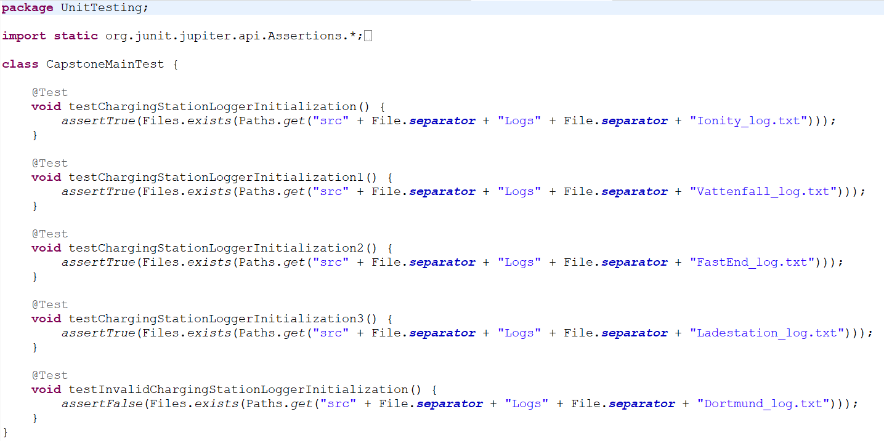
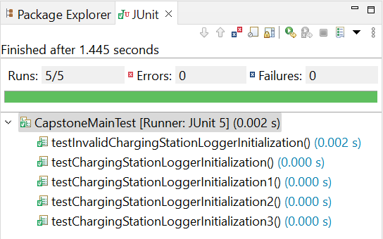
Unit Testing
We have defined unit test cases to some of the classes and are able to get positive result

Slide 21
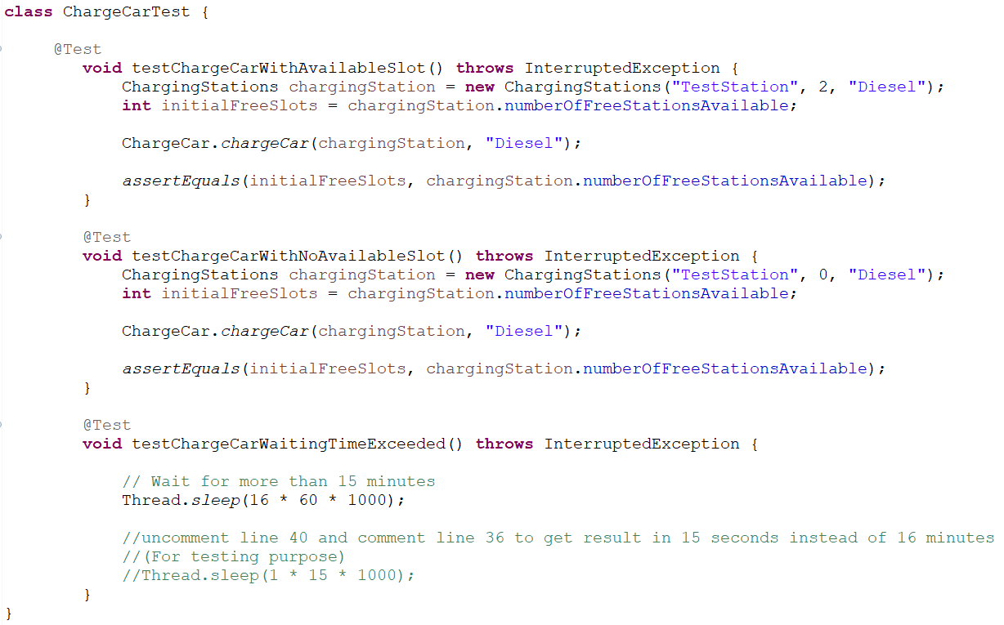
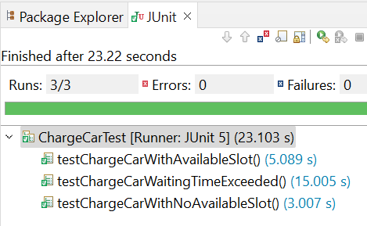
Unit Testing (Continued..)

Slide 22
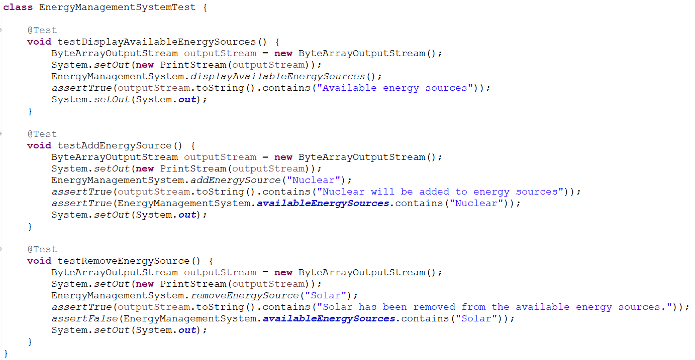
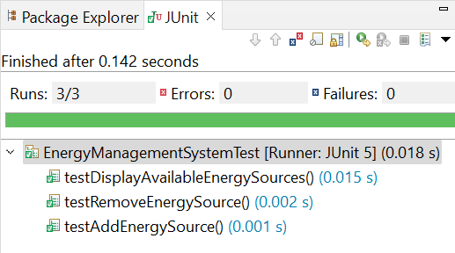
Unit Testing (Continued..)

Slide 23
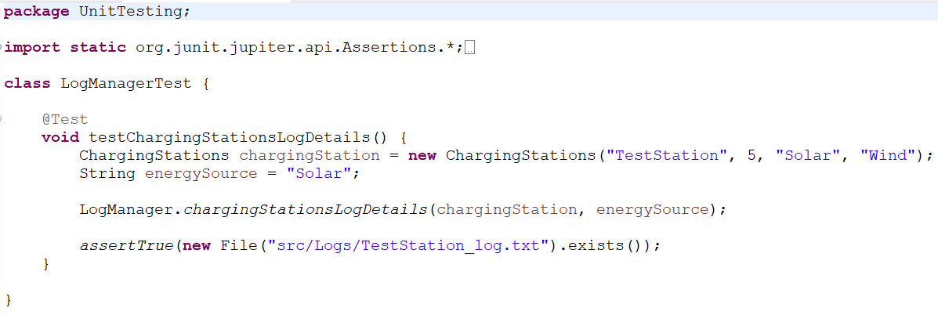
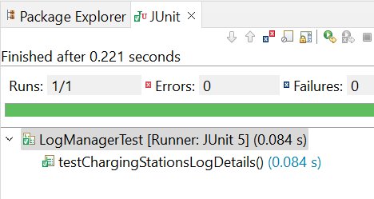
Unit Testing (Continued..)

Slide 24
Outline
Assignment
Flow Chart
Class Diagram
Project Overview
Unit Testing
Summary
Demonstration

Slide 25
Summary
The simulation involves the charging of two vehicle categories: electric and non-electric at four distinct charging stations — Ionity, FastEnd, Ladestation and Vattenfall
Upon entering a station, vehicles undergo validation for electric or non-electric classification, and accordingly charging is performed using available energy sources at the specific station
Electric vehicles are charged based on weather conditions (Sunny, Windy, Rainy) and each station has three slots dedicated to charging batteries
Detailed logs, including charging date, time, and energy resource used, are maintained for each charging station
Energy management is seamlessly executed through functionalities enabling the addition or removal of energy resources based on user input
The simulation is developed using Eclipse IDE and JDK 17
JUnit 5 is implemented to create unit test cases, ensuring the reliability and accuracy of the simulation

Slide 26
Outline
Assignment
Flow Chart
Class Diagram
Project Overview
Unit Testing
Summary
Demonstration

Slide 27
Demonstration
[ YouTube link : https://www.youtube.com/watch?v=QnUJMzFC_L8 ]
[ GitHub link : https://github.com/Java-Team14/Java_Capstone ]

Slide 28
Thank you !

