Slide 1
JSP
B.Ramasubramanian

Slide 2
JSP
What is JSP?
JSP is a server side technology that does all the processing at server. It is used for creating dynamic web applications, using java as programming language.
In JSP, you can embed Java code in HTML using JSP tags

Slide 3
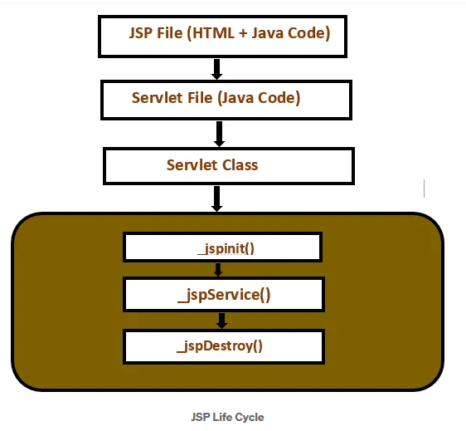
JSP Life Cycle

Slide 4
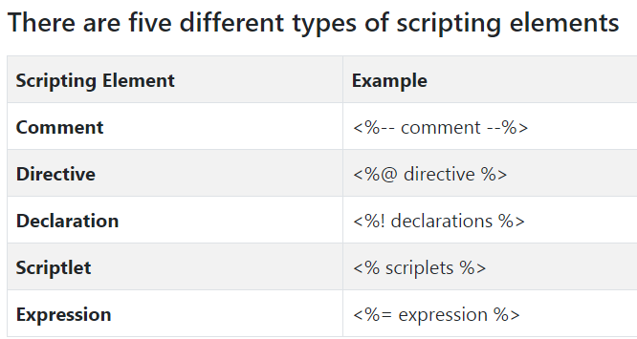
JSP Scripting elements

Slide 5
JSP Scripting elements
JSP Comments
JSP Comment is used when you are creating a JSP page and want to put in comments about what you are doing. JSP comments are only seen in the JSP page
<%-- JSP comment --%>

Slide 6
JSP Scripting elements
JSP Scriplet
Scriptlet Tag allows you to write java code inside JSP page.
<% JAVA CODE %>
JSP Declaration
when we declare a variable or method in JSP inside Declaration Tag, it means the declaration is made inside the Servlet class but outside the service(or any other) method
<%! declaration %>

Slide 7
JSP Scripting elements
JSP Directives
Directive Tag gives special instruction to Web Container at the time of page translation. Directive tags are of three types: page, include and taglib.

Slide 8
JSP Scripting elements
Page directive
defines a number of page dependent properties which communicates with the Web Container at the time of translation
<%@ page attribute="value" %>

Slide 9
JSP Scripting elements
Include directive
The include directive tells the Web Container to copy everything in the included file and paste it into current JSP file.
<%@ include file="filename.jsp" %>

Slide 10
JSP Scripting elements
JSP Expression
Expression Tag is used to print out java language expression that is put between the tags.
An expression tag can hold any java language expression that can be used as an argument to the out.print() method.
<%= Java Expression %>

Slide 11
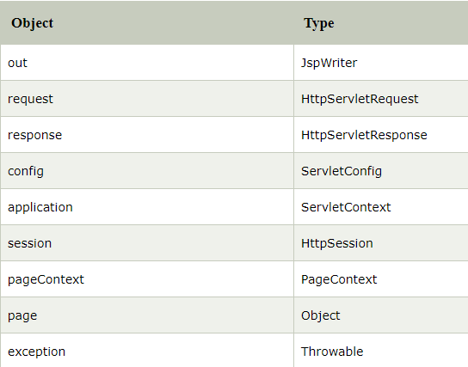
JSP Implicit objects
JSP provide access to some implicit object which represent some commonly used objects for servlets that JSP page developers might need to use.

Slide 12
JSTL Tags
The JSP Standard Tag Library (JSTL) represents a set of tags to simplify the JSP development.
Advantage of JSTL
Fast Development JSTL provides many tags that simplify the JSP.
Code Reusability We can use the JSTL tags on various pages.
No need to use scriptlet tag It avoids the use of scriptlet tag.

Slide 13
JSTL Tags
Types
1.Core tags
2.Function tags
3.Formatting tags
4.XML tags
5.SQL tags

Slide 14
JSTL Tags
JSTL core tags
The JSTL core tag provides variable support, URL management, flow control etc. The syntax used for including JSTL core library in your JSP is:
<%@ taglib uri="http://java.sun.com/jsp/jstl/core" prefix="c" %>

Slide 15
JSTL Tags
JSTL Core tags
<c:if>
The < c:if > tag is used for testing the condition and it display the body content, if the expression evaluated is true.
It is a simple conditional tag which is used for evaluating the body content, if the supplied condition is true.

Slide 16
Using Java classes in JSP
jsp:usebean action tag
The jsp:useBean action tag is used to locate or instantiate a bean class. If bean object of the Bean class is already created, it doesn't create the bean depending on the scope. But if object of bean is not created, it instantiates the bean.

