Slide 1

Cryptography (Encryption & Decryption)
Details of Group Member:
Member Name | Registration No
Harsh Ruhela | 12105121
Aryan Raj | 12113281
Marvin Mehta | 12109909

Slide 2
Introduction
Cryptography is a fascinating field of computer science that deals with the secure transmission and storage of information.
In today's world, where cybercrime is on the rise, cryptography has become an essential part of every application that deals with sensitive information. In this project, we are implementing AES algorithm using Java programming language.
Cryptography deals with various operations such as encryption, decryption, hashing, digital signatures, and more.
The main aim of cryptography is to ensure that only the intended recipients can access the information and to prevent unauthorized access.
To begin with, we have implemented this project in java using the AES algorithm. AES stands for Advanced Encryption Standard, and it is a symmetric encryption algorithm.

Slide 3
Features
Implementation of AES algorithm.
Secure Communication.
User-friendly Interface.
Advantages
Security.
Educational Value.
Easy to use because of User-friendly interface(GUI).

Slide 4
Future Scope
Incomplete Security Measures- While this Project provides Encryption and Decryption capabilities, it does not include other essential security measures such as access control, authentication and authorization. It is important to ensure that these measures are implemented in addition to Encryption and Decryption.
Lack some Features- Here we have done encryption and decryption of a text , text file and image. But addition to that a file can be of multiple pages and can be present in any format.
Improve the algorithm- In this project we have used AES Algorithm but there might be some other option of encryption and decryption as well which might be more secure and efficient.

Slide 5
Methodology
The algorithm used is AES (Advanced Encryption Standard).
AES is a block cipher.
The Key Size can be 128/192/256 bits.
Encrypts data in blocks of 128 bits each.
Working of the cipher :
AES performs operations on bytes of data rather than in bits. Since the block size is 128 bits, the cipher processes 128 bits (or 16 bytes) of the input data at a time.
The number of rounds depends on the key length as follows :
128 bit key – 10 rounds
192 bit key – 12 rounds
256 bit key – 14 rounds

Slide 6
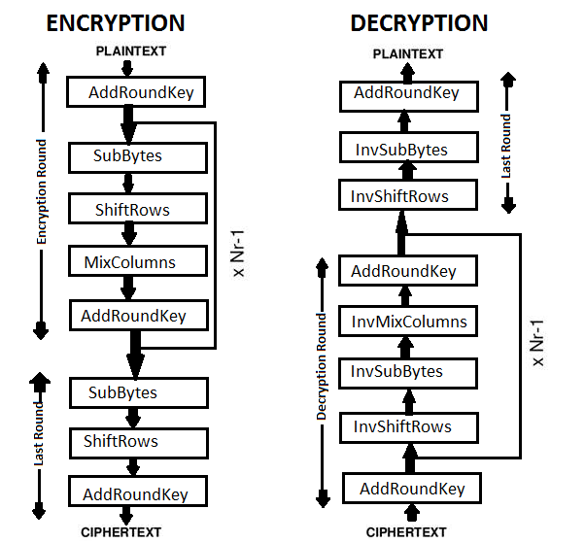
Flowchart of Encryption and Decryption

Slide 7

Results

Slide 8
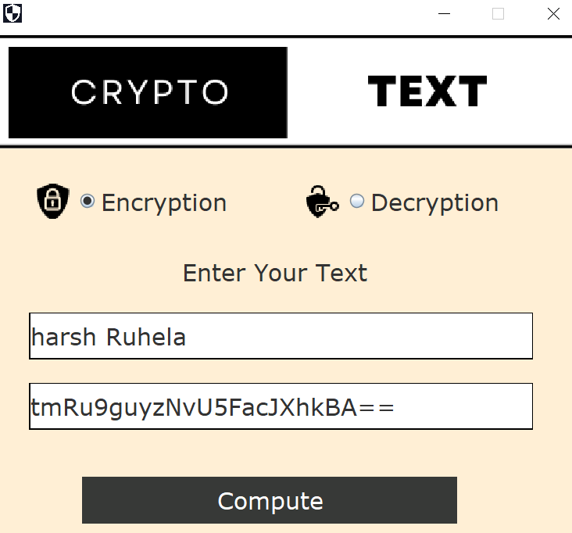
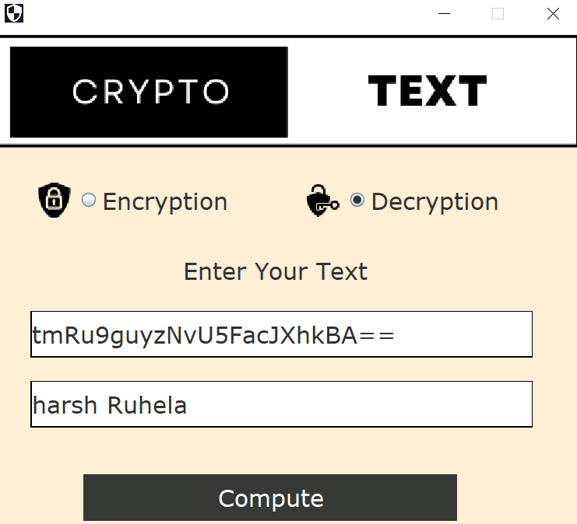
Encryption of Text

Slide 9
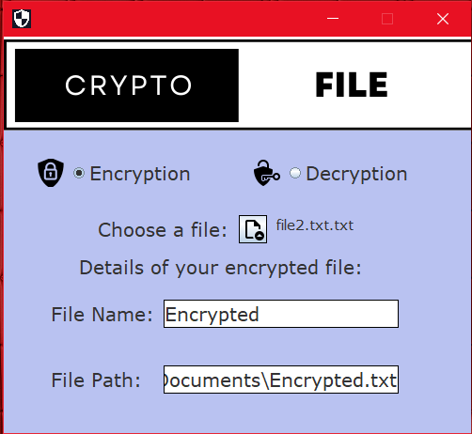
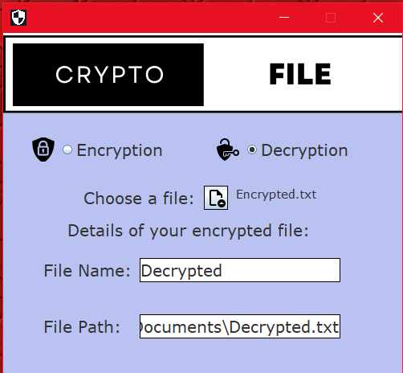
Encryption of file

Slide 10
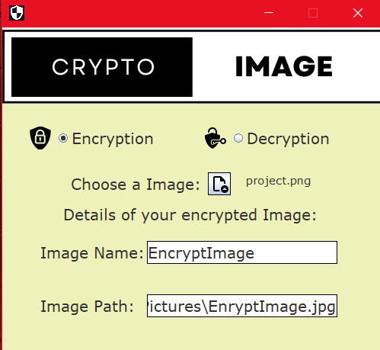
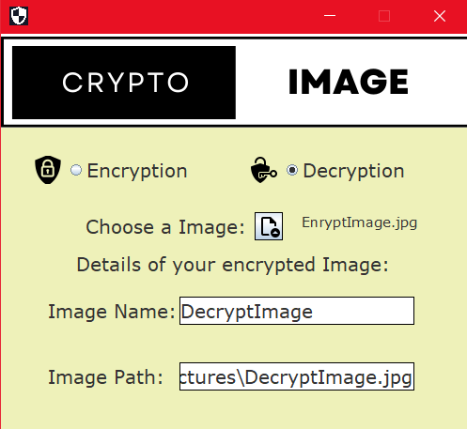
Encryption of Image

Slide 11
References
www.section.io
GUI Reference From Java Tpoint.
Geeksforgeeks.
Chatgpt.

