Slide 1


Inheritance
Spring Boot Programming

Slide 2
Inheritance
Inheritance is one of the fundamental principles of Object-Oriented Programming (OOP). It allows one class (called the subclass or child class) to inherit properties and behaviors (fields and methods) from another class (called the superclass or parent class). This promotes code reuse and allows for hierarchical classification.

Slide 3






Key Concepts of Inheritance in Java
Vehicle
Super class or parent class
Electric
Non-Electric
Super class for
Model 3, 7 Cybertruck
Sub classes
Model 3 Model 7 Cybertruck Civic Pilot Ridgeline

Slide 4
Key Concepts of Inheritance in Java
Model 3 is a vehicle car
Vehicle
Electric
Non-Electric
Model 3 Model 7 Cybertruck Civic Pilot Ridgeline

Slide 5
Key Concepts of Inheritance in Java
Model 3 is a Electric , Vehicle car
Vehicle
Electric
Non-Electric
Model 3 Model 7 Cybertruck Civic Pilot Ridgeline

Slide 6
Key Concepts of Inheritance in Java
Model 3 is not a Non-Electric car
Civic is not a Electric car
Vehicle
Electric
Non-Electric
Model 3 Model 7 Cybertruck Civic Pilot Ridgeline

Slide 7
Key Concepts of Inheritance in Java
Model 3 is a Electric car
Model 3 is a vehicle car
Model 7 is a Electric car
Model 7 is a vehicle car
Model 3 is not a Non-Electric vehicle car
Pilot is not a Electric vehicle car
Vehicle
Electric
Non-Electric
Model 3 Model 7 Cybertruck Civic Pilot Ridgeline

Slide 8
Key Concepts of Inheritance in Java
1. Superclass (Parent Class): The class from which properties and methods are inherited.
2. Subclass (Child Class): The class that inherits properties and methods from the superclass.
3. extends Keyword: Used to establish the inheritance relationship.

Slide 9
Key Concepts of Inheritance in Java
Electric class the super class of Model 3,
Model 7 and Cybertruck
Vehicle class the super class of Electric
Vehicle class the super (super) class of Model 3,
Model 7 and Cybertruck
Vehicle
Electric
Non-Electric
Model 3 Model 7 Cybertruck Civic Pilot Ridgeline

Slide 10
method Inheritance in Java
Vehicle
getVehicleID()
Electric
getElectricID()
getModel3ID()
Model 3 Model 7 Cybertruck

Slide 11
Variable Inheritance in Java
Vehicle
vehicleID=10
Electric
electricID=20
modelID=30
Model 3 Model 7 Cybertruck

Slide 12
Private members in Inheritance
In Java, private members are variables, methods, or constructors that are only accessible within the same class where they are declared. They cannot be accessed directly from outside the class, ensuring encapsulation and data hiding.
// Private member variable
private String name;
// private member method
Private void mem(){
…
}

Slide 13
Variable Inheritance in Java
Vehicle
vehicleID=10
Electric
Private electricID=20
modelID=30
Model 3 Model 7 Cybertruck

Slide 14
Example of Inheritance
// Superclass
class Vehicle {
void moving() {
System.out.println(" Vehicle is moving");
}
}
// Subclass
class Dog extends Animal {
void bark() {
System.out.println("The dog barks.");
}
}
public class Main {
public static void main(String[] args) {
Dog dog = new Dog(); // Creating an instance of the subclass
dog.eat(); // Inherited method from Animal class
dog.bark(); // Method from Dog class
}
}

Slide 15
Characteristics of Private Members:
1. Accessibility: Private members can only be accessed within the class in which they are declared.
2. Encapsulation: By making fields or methods private, the internal implementation details are hidden from the outside world, promoting encapsulation.
3. Controlled Access: You can provide controlled access to private members using getter and setter methods, allowing the class to control how its internal data is accessed or modified.

Slide 16
Inheritance rules for class
Can’t extend more than one class
Can extend more than one interface
Can implement more than one interface
vehicle Electric
Model 3
16

Slide 17
Inheritance rules for interface
Can’t extend more than one class
Can extend more than one interface
Can implement more than one interface
vehicle Electric
Model 3
17

Slide 18
Interface implementations
Class should implement the interface methods
Class can implement more than one interfaces
Interfaces→ IVehicle IElectric
Model 3. (class)
18

Slide 19
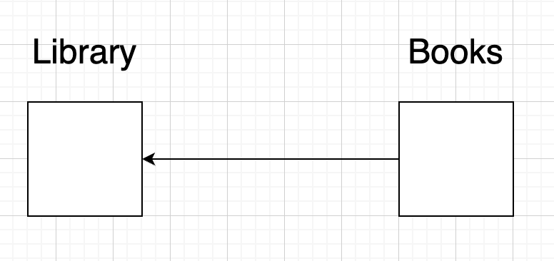
Aggregation
In Java, Aggregation is a relationship between two classes that represents a
“has-a” relationship, where one class contains a reference to another class as part of its attributes.
Aggregation is a form of association but with a stronger relationship, indicating that the contained
objects (parts) can exist independently of the container (whole).

Slide 20
Aggregation in Spring
Dependency Injection
In Java, Aggregation is a relationship between two classes that represents a
“has-a” relationship, where one class contains a reference to another class as part of its attributes.
Aggregation is a form of association but with a stronger relationship, indicating that the contained
objects (parts) can exist independently of the container (whole).
@Autowired

Slide 21
Example of Inheritance
Private member do not inherate
What is aggregation
Limitations
Public members are accessible
Default,
Protected
Interfaces?
Extend more than one class vs interface
Overload methods wth generics with diff return types (polymorphism )
in spring we use composition more than extending a class
Final class not for inheritance

