Slide 1


annotations: Lazy
Spring Boot Programming

Slide 2
Annotations: Lazy
In Spring Framework, “lazy annotation” refers to the @Lazy annotation, which is used to delay the initialization of beans until they are needed, rather than initializing them at application startup. By default, Spring creates all singleton beans eagerly at the startup of the application context. However, using the @Lazy annotation changes this behavior, allowing a bean to be instantiated lazily, i.e., only when it is requested for the first time.

Slide 3


Annotations: Lazy

Slide 4
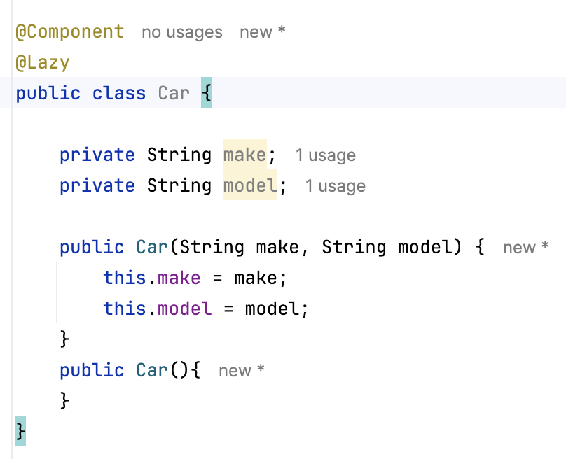
Annotations: Lazy

Slide 5
Annotations: Lazy value
@Lazy(value = true) equals to @Lazy
@Lazy(value = false) equals to remove @Lazy in the code

