Slide 1
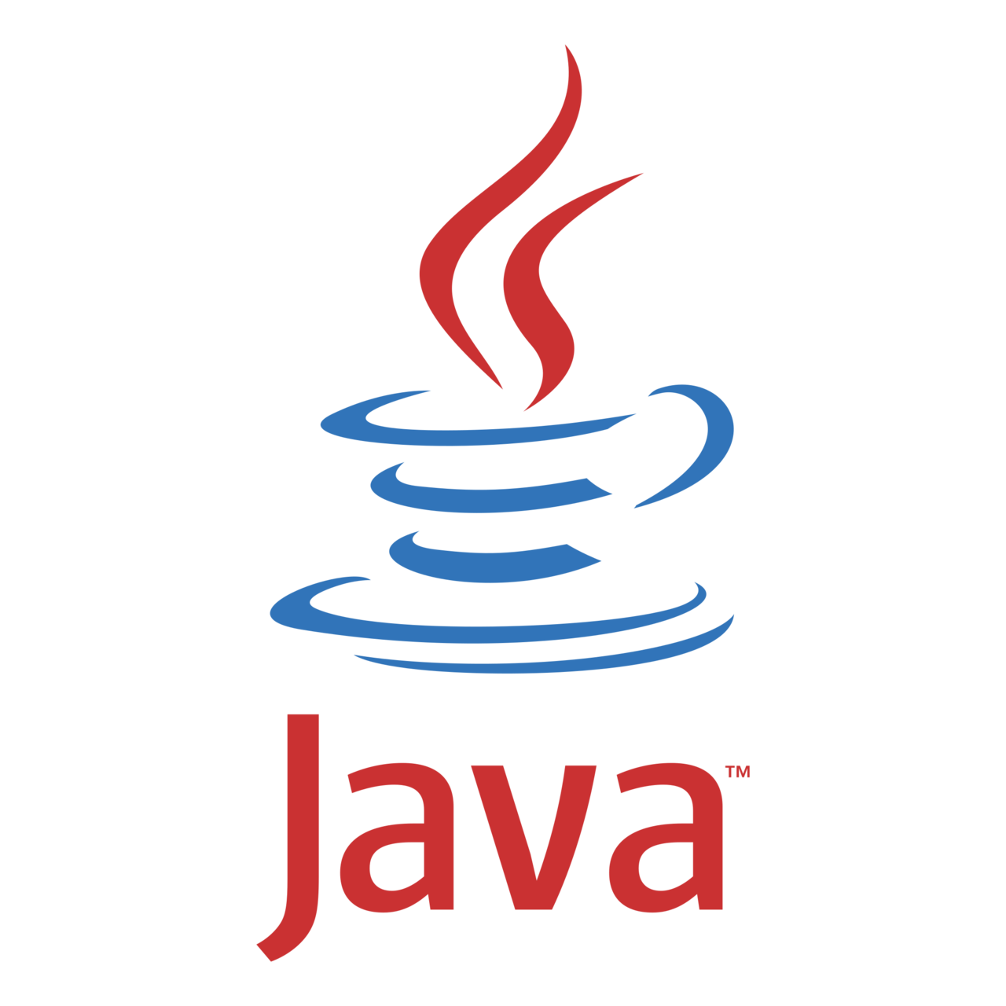

Frameworks: Spring
Spring Boot Programming

Slide 2
Programming Languages: C , C++ , Java, Python... etc
A programming language is a formal system used to write instructions that a computer can execute. These languages allow developers to create software, control hardware, process data, and automate tasks. Programming languages typically have a specific syntax and set of rules to define how instructions should be written. There are many programming languages, each with its own use cases, paradigms, and strengths.

Slide 3
Programming Languages: C , C++ , Java, Python... etc
High-level languages (closer to human languages):
• Python: Popular for web development, data science, AI, and scripting.
• Java: Widely used for enterprise applications, Android development, and backend services.
• JavaScript: Mainly for web development (both front-end and back-end).
• C++: Used for system software, game development, and performance-critical applications.
Low-level languages (closer to machine code):
• C: Used for system programming, embedded systems, and high-performance applications.
• Assembly language: Directly represents machine code instructions and is used in low-level programming.

Slide 4
Technologies or Library
Libraries are collections of pre-written code that developers can use to solve specific problems without writing code from scratch.
Examples:
• NumPy (Python): Library for numerical computing and data analysis.
• Lodash (JavaScript): Utility library for working with arrays, numbers, and objects.
• Hibernate (Java): Hibernate ORM is an object–relational mapping tool for the Java programming language. It provides a framework for mapping an object-oriented domain model to a relational database.
Junit, testNG.. Etc from Java

Slide 5
Frameworks
A framework is a pre-built structure or collection of libraries or frameworks that developers use to build applications more quickly and efficiently.
Examples:
• Django (Python): Web framework for rapid development.
• React (JavaScript): Framework for building user interfaces, primarily for web applications.
• Spring (Java): Framework for building enterprise Java applications.
In spring we use Junit, Hibernate, Maven… etc technologies

Slide 6

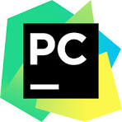

Integrated Development Environments (IDEs):
An IDE is a software application that provides comprehensive facilities to developers for writing, testing, and debugging code.
Examples:
• Visual Studio Code: A popular open-source IDE with support for multiple languages.
• PyCharm: A specialized IDE for Python development.
• Eclipse: A widely used IDE for Java development.

Slide 7
Java Programming Language
Java is a high-level, object-oriented programming language that was originally developed by Sun Microsystems (now owned by Oracle) in 1995. It is widely used for building a range of applications, from web and mobile apps to enterprise systems and embedded devices. Java is known for its “write once, run anywhere” philosophy, meaning that code written in Java can run on any system that supports Java without modification.
Java Platform, Standard Edition (Java SE)
Java Platform, Enterprise Edition (Java EE)

Slide 8
Java Technologies
Java Fundamentals:
Maven or Gradle:
JDBC (Java Database Connectivity):
Servlets and JSP (JavaServer Pages):
Basic HTML/CSS/JavaScript:
Testing Frameworks:
Version Control Systems (e.g., Git):

Slide 9


Spring Framework
The Spring Framework is a powerful, flexible, and comprehensive framework for building Java-based enterprise applications. It provides a wide range of tools and capabilities that make it easier for developers to create and manage applications, particularly those with complex business logic. Spring simplifies tasks like dependency injection, data access, transaction management, and web services development.

