Slide 1

Topic
Build Business Web Application (Contact System) with Java UI Framework (Vaadin)

Slide 2
Agenda
Vaadin Introduction
Demo
Bonus
Q & A?

Slide 3

Vaadin Framework 7.5.7 https://vaadin.com

Slide 4
Introduction
What is Vaadin?
Vaadin is a Java framework for building modern web applications that look great, perform well and make you and your users happy.
Positive aspects of Vaadin
Not having to write Javascript code
Not having to bother with browser compatibility
Ease of creating beautiful websites with minimal code
Ability to use themes to change the look and feel of the website

Slide 5
Introduction
Who can use Vaadin?
Anyone who knows Java with basic web technologies.

Slide 6
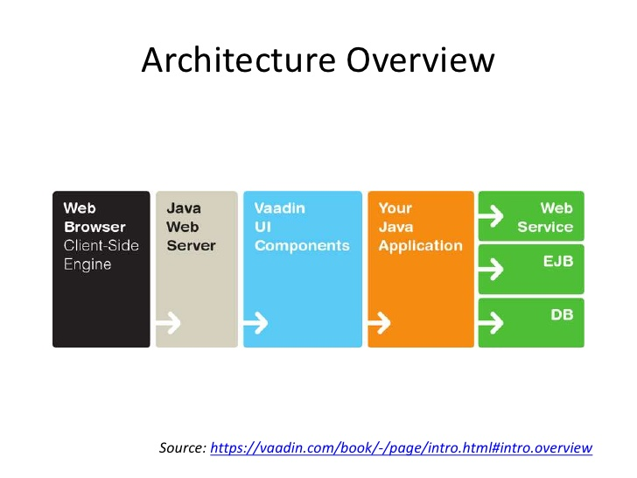

Slide 7
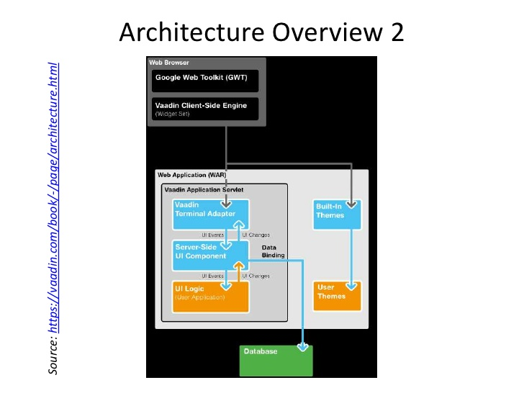

Slide 8
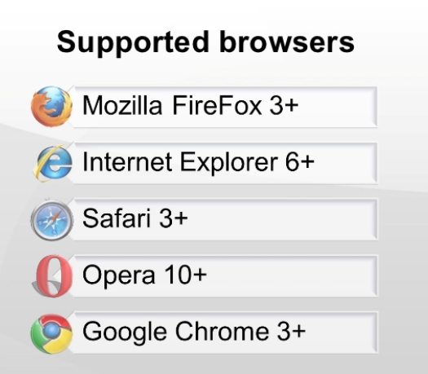

Slide 9
Think UI
AWT, Swing, or SWT - java desktop application

Slide 10

Think UI
Button
Java Code
Button btnAdd = new Button(“Add”);

Slide 11

Think UI
Text Field
Java Code
TextField firstName = new TextField("First Name :");
firstName.setValue(“”);

Slide 12
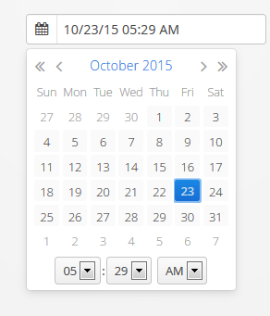
Think UI
Date Field
Java Code
DateField date = new DateField();
date.setValue(new Date());

Slide 13
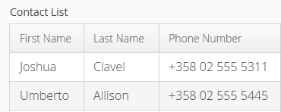
Think UI
Table
Java Code
Table contactTable = new Table("Contact List");
contactTable.setColumnHeaders("First Name", "Last Name", "Phone Number);

Slide 14
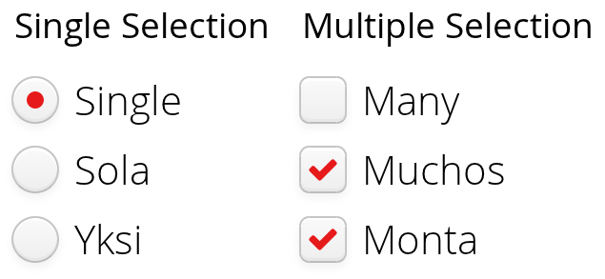
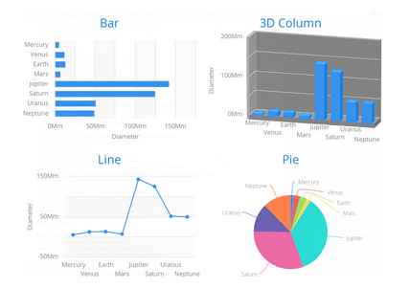
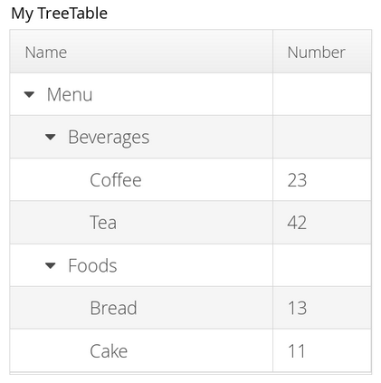
Think UI

Slide 15
Demo
Create a Vaadin project
(contact-system)

Slide 16
Using tools:
Java : JDK 1.8
IDE : Eclipse (Mars)
Maven
Vaadin archetype
Application server : Tomcat 8
Database : Mysql
Browser : Firefox

Slide 17
There are three steps to create Vaadin Project (Contact System)
Configure JRE
Create Maven Project with Vaadin archetype
Run on Server using Tomcat 8
Let’s Build Contact System

Slide 18
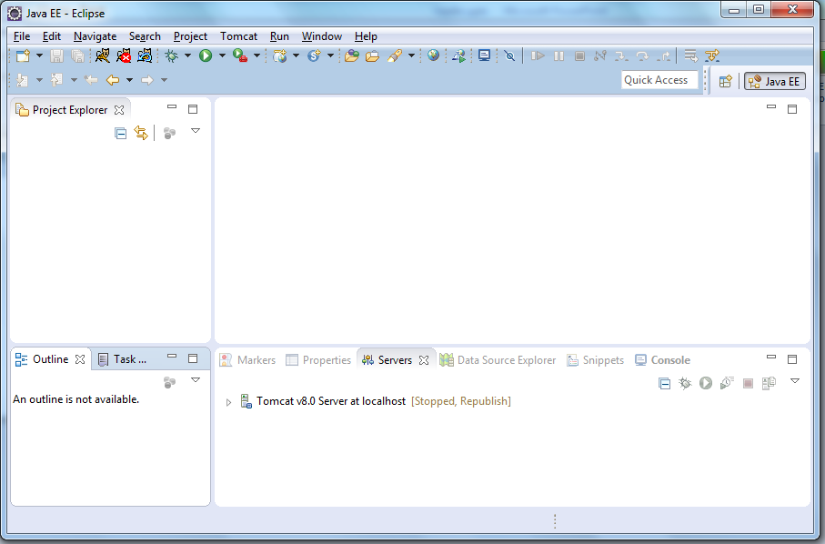
Eclipse (Mars)

Slide 19
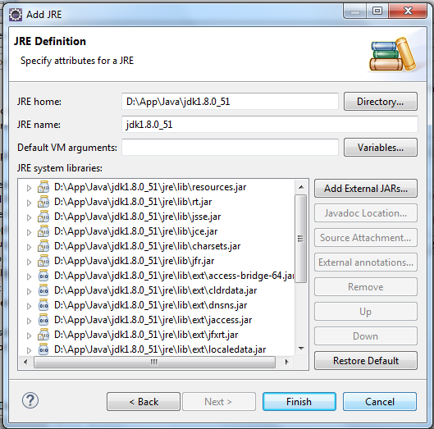
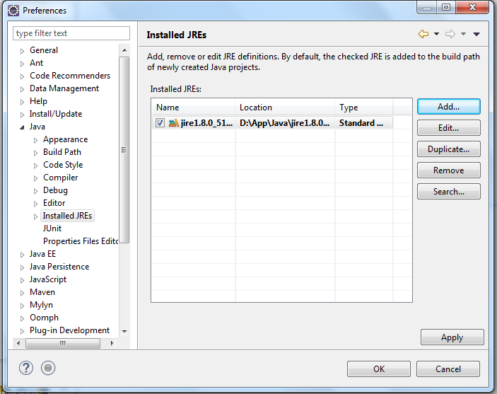
Step 1 : Configure JRE
You can do this by clicking on Window -> Preferences -> Java -> Installed JREs. Click on “Add” button.
Browse to the folder of jdk as below.

Slide 20
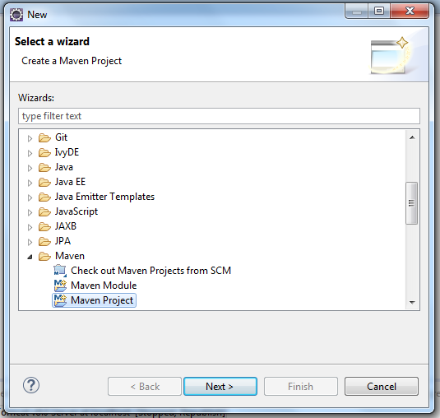
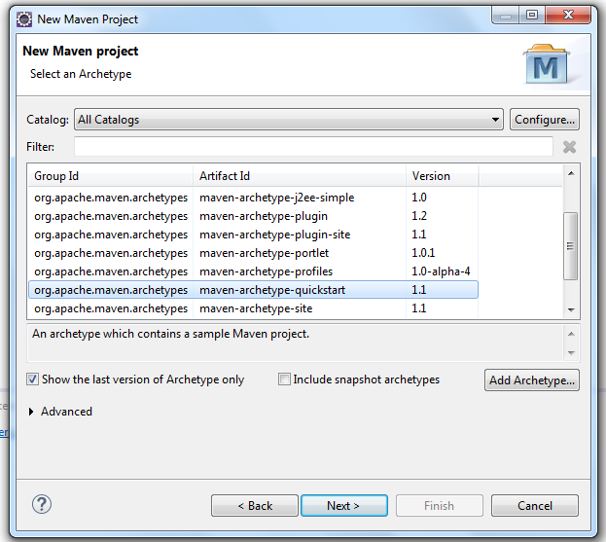
Step 2 : Create a Maven Project with Vaadin archetype
You can do this by clicking on File -> New -> Other and choosing Maven project as shown below.
Add the Vaadin archetype

Slide 21
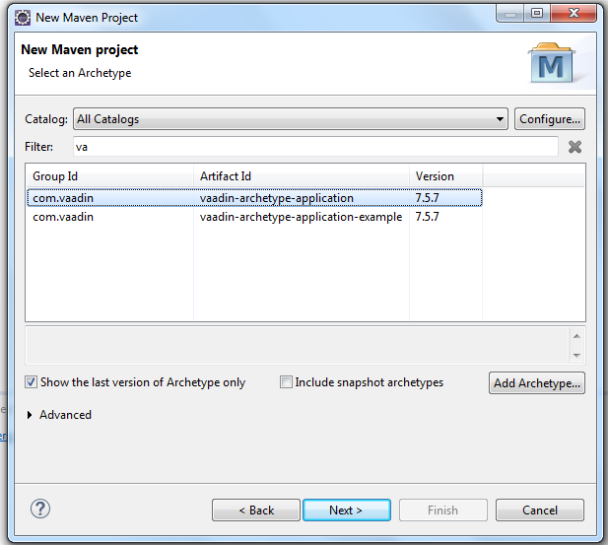
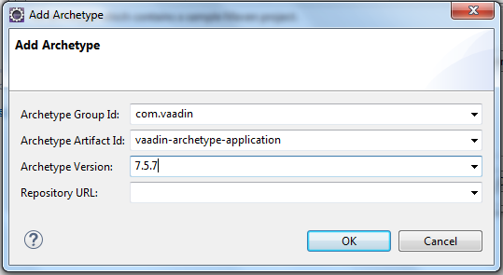
2/1. Add the Vaadin archetype details
Type in the following details, Archetype Group ID: com.vaadin Archetype Artifact ID: vaadin-archetype-application
Archetype Version: 7.5.7 or LATEST
See https://vaadin.com/maven#archetypes for other archetypes

Slide 22
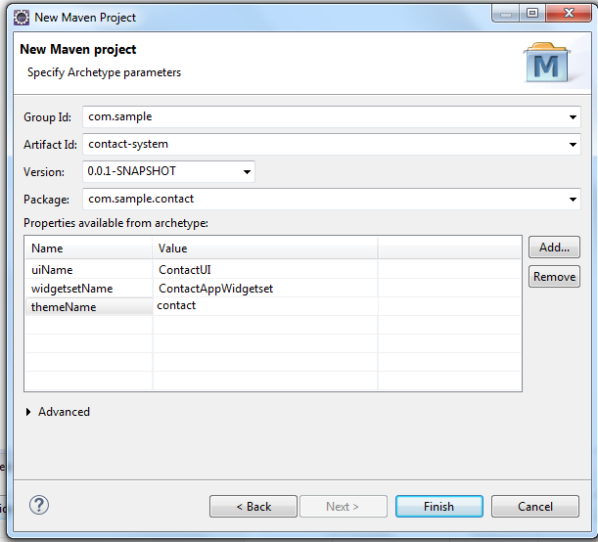
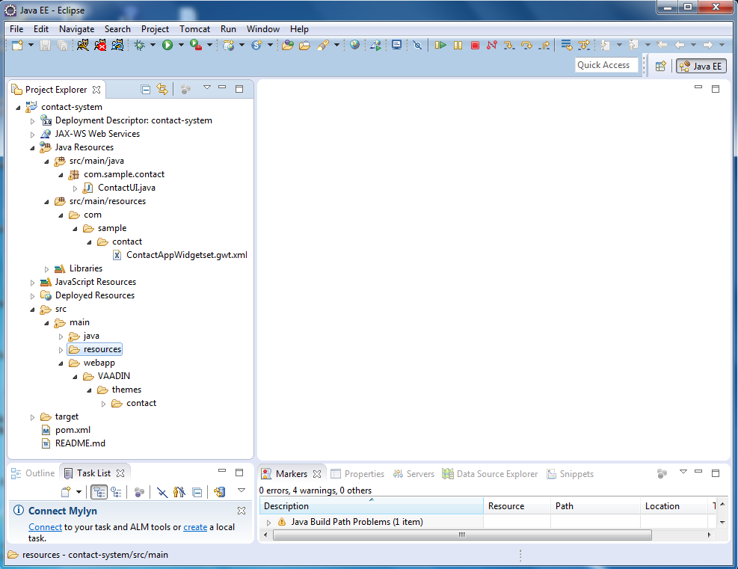
2/2. Put in your project details
Click Finish once you have filled it in.
“contact-system” project was created as below:

Slide 23
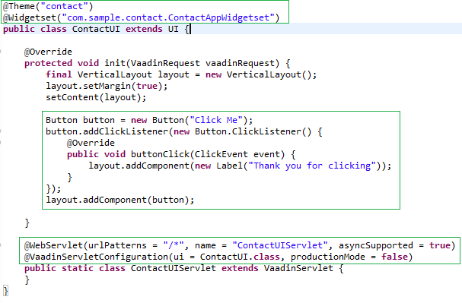
ContactUI.java

Slide 24
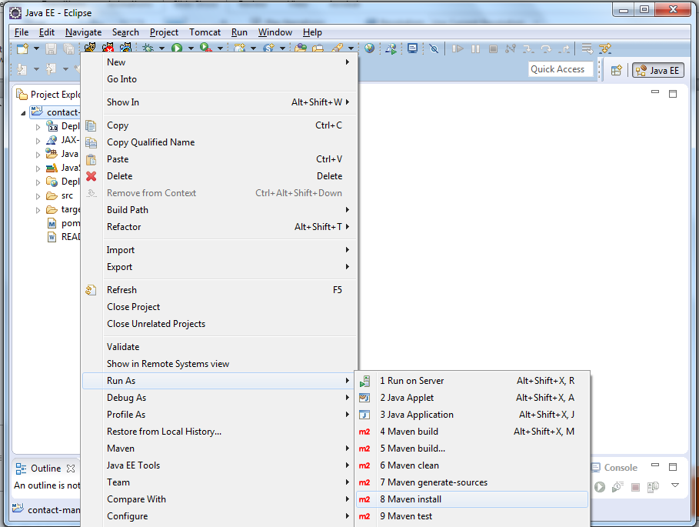
2/3. Build project with Maven Install
In the Project Explorer, right-click on your newly created project, and choose Run As -> Maven install.

Slide 25
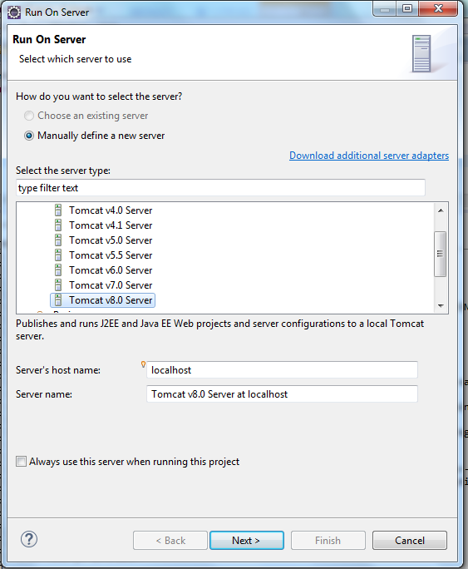
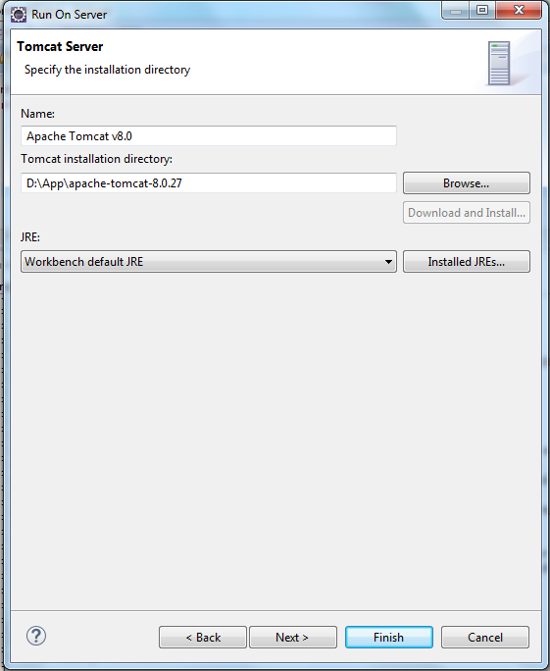
Step 3: Run on Server using Tomcat 8
In the Project Explorer, right-click on your newly created project, and choose Run As -> Run on Server

Slide 26
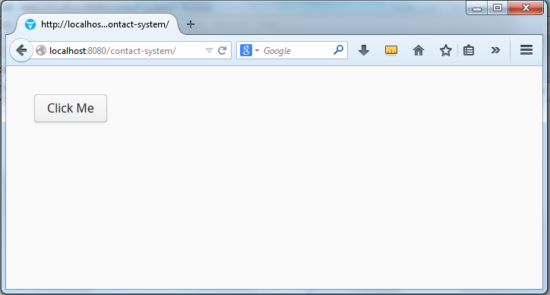
View “contact-system” application on a browser http://localhost:8080/contact-system

Slide 27
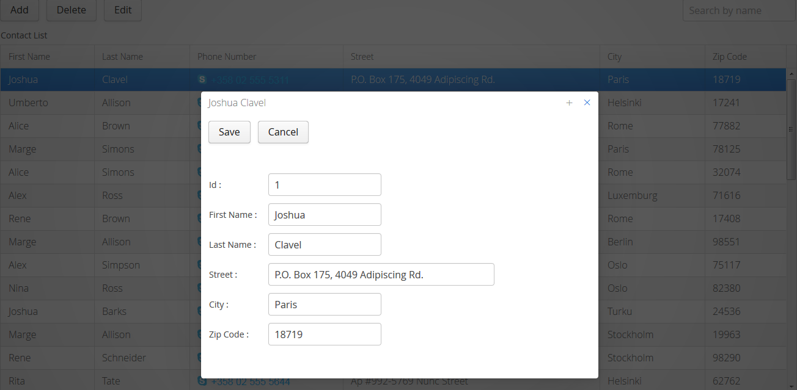
Step 4 : Let’s build Contact System!

Slide 28
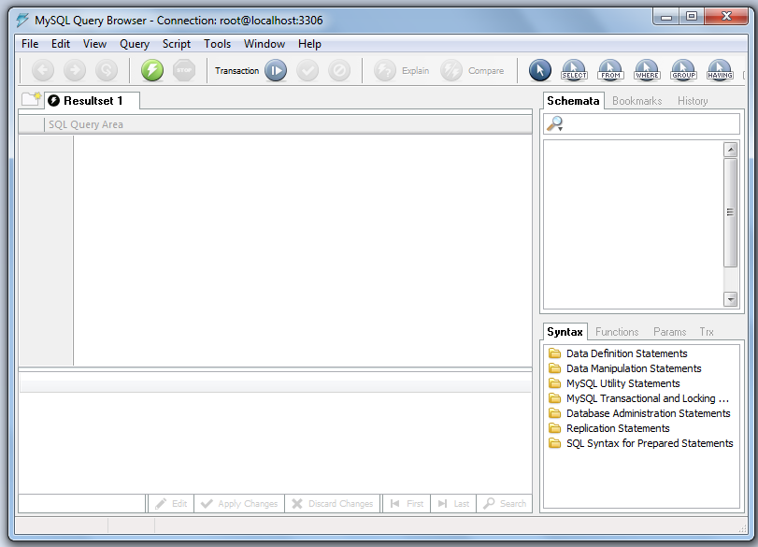
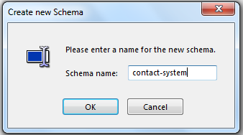
4/1. Create Mysql database “contact-system”

Slide 29
4/2. Add dependecy JPAContainer, EclipseLink and Mysql in pom.xml
…
<!-- Vaadin Jpacontainer -->
<dependency>
<groupId>com.vaadin.addon</groupId>
<artifactId>jpacontainer</artifactId>
<version>3.2.0</version>
</dependency>
<dependency>
<groupId>org.eclipse.persistence</groupId>
<artifactId>eclipselink</artifactId>
<version>2.2.0</version>
</dependency>
<dependency>
<groupId>org.eclipse.persistence</groupId>
<artifactId>javax.persistence</artifactId>
<version>2.0.0</version>
</dependency>
<!-- Mysql -->
<dependency>
<groupId>mysql</groupId>
<artifactId>mysql-connector-java</artifactId>
<version>5.1.6</version>
</dependency>
…

Slide 30
Add file persistence.xml in “src/main/resources/META-INF” folder
<?xml version="1.0" encoding="UTF-8"?>
<persistence xmlns="http://java.sun.com/xml/ns/persistence"
xmlns:xsi="http://www.w3.org/2001/XMLSchema-instance"
xsi:schemaLocation="http://java.sun.com/xml/ns/persistence http://java.sun.com/xml/ns/persistence/persistence_2_0.xsd"
version="2.0">
<persistence-unit name="contact">
<provider>org.eclipse.persistence.jpa.PersistenceProvider</provider>
<exclude-unlisted-classes>false</exclude-unlisted-classes>
<properties>
<property name="eclipselink.jdbc.driver" value="com.mysql.jdbc.Driver" />
<property name="eclipselink.jdbc.url" value="jdbc:mysql://localhost:3306/contact-system" />
<property name="eclipselink.jdbc.user" value="root" />
<property name="eclipselink.jdbc.password" value="root" />
<property name="eclipselink.logging.level" value="FINE" />
<property name="eclipselink.ddl-generation" value="drop-and-create-tables" />
<property name="eclipselink.ddl-generation.output-mode" value="database" />
</properties>
</persistence-unit>
</persistence>

Slide 31
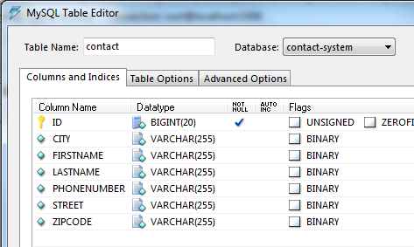
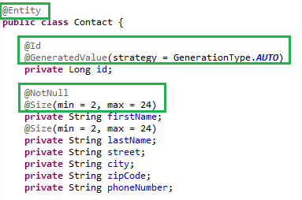
Model Mapping
Table name : Contact
Contact.java

Slide 32
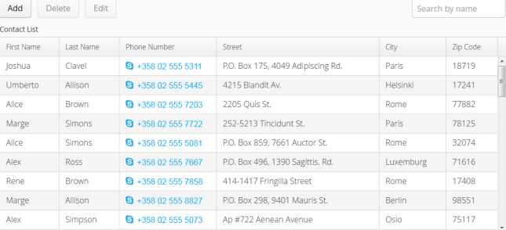
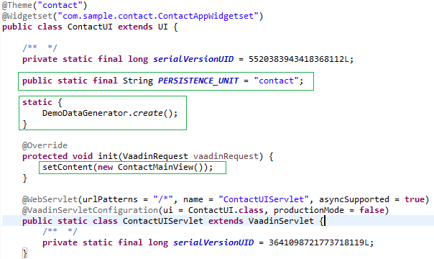
ContactUI.java

Slide 33



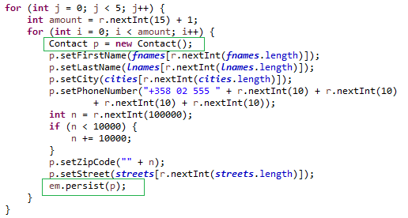
DemoDataGenerator.java

Slide 34
ContactMainView.java Declare Button and TextField
private Button newButton;
private Button deleteButton;
private Button editButton;
private TextField searchField;
private Component buildToolbar() {
newButton = new Button("Add");
deleteButton = new Button("Delete");
editButton = new Button("Edit");
searchField = new TextField();
searchField.setInputPrompt("Search by name");
HorizontalLayout toolbar = new HorizontalLayout();
toolbar.setSpacing(true);
toolbar.addComponents(newButton, deleteButton, editButton, searchField);
toolbar.setWidth("100%");
toolbar.setExpandRatio(searchField, 1);
toolbar.setComponentAlignment(searchField, Alignment.TOP_RIGHT);
return toolbar;
}

Slide 35
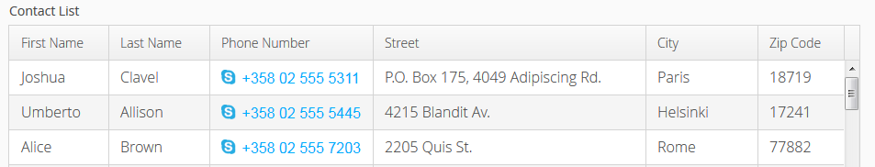
ContactMainView.java Get data and display in table
private JPAContainer<Contact> contacts;
private Table contactTable;
private Component buildTable() {
contacts = JPAContainerFactory.make(Contact.class, ContactUI.PERSISTENCE_UNIT);
contactTable = new Table("Contact List", contacts);
contactTable.setSizeFull();
contactTable.setSelectable(true);
contactTable.setImmediate(true);
contactTable.setVisibleColumns(new Object[] { "firstName", "lastName", "phoneNumber", "street", "city", "zipCode" });
contactTable.setColumnHeaders("First Name", "Last Name", "Phone Number", "Street", "City", "Zip Code");
return contactTable;
}

Slide 36
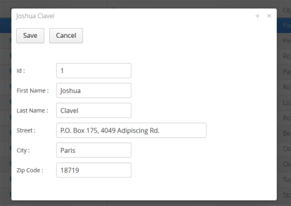

ContactMainView.java Add listener to the Button Control
editButton.addClickListener(new Button.ClickListener() {
public void buttonClick(ClickEvent event) {
if (contactTable.getValue() != null) {
Contact contact = (Contact) ((JPAContainerItem<?>)
contactTable.getItem(contactTable.getValue())).getEntity();
final BeanItem<Contact> editContactItem = new BeanItem<Contact>(contact);
ContactEditor personEditor = new ContactEditor(editContactItem);
personEditor.addListener(new EditorSavedListener() {
public void editorSaved(EditorSavedEvent event) {
contacts.addEntity(editContactItem.getBean());
}
});
UI.getCurrent().addWindow(personEditor);
}
}
});

Slide 37
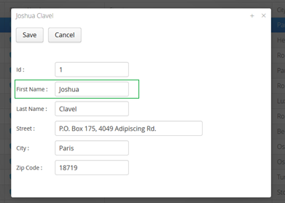
ContactEditor.java How to connect between UI and Data
private Item personItem;
private FieldGroup fieldGroup;
private Component buildForm() {
fieldGroup = new BeanFieldGroup<Contact>(Contact.class);
fieldGroup.setItemDataSource(this.personItem);
TextField id = new TextField("Id :");
TextField firstName = new TextField("First Name :");
TextField lastName = new TextField("Last Name :");
TextField phoneNumber = new TextField("Phone Number :");
TextField street = new TextField("Street :");
street.setWidth(370, Unit.PIXELS);
FormLayout formLayout = new FormLayout(id, firstName, lastName, phoneNumber, street);
fieldGroup.bind(id, "id");
fieldGroup.bind(firstName, "firstName");
fieldGroup.bind(lastName, "lastName");
fieldGroup.bind(phoneNumber, "phoneNumber");
fieldGroup.bind(street, "street");
return formLayout;
}

Slide 38
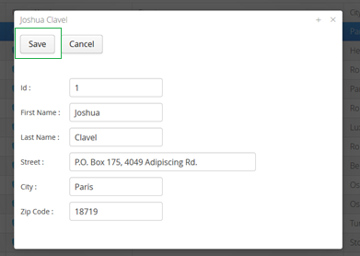
ContactEditor.java Commit data from Control
private Button saveButton;
private Button cancelButton;
private Component buildToolbar() {
saveButton = new Button("Save", this);
cancelButton = new Button("Cancel", this);
HorizontalLayout buttonLayout = new HorizontalLayout();
buttonLayout.setSpacing(true);
buttonLayout.addComponents(saveButton, cancelButton);
return buttonLayout;
}
public void buttonClick(ClickEvent event) {
if (event.getButton() == saveButton) {
try {
fieldGroup.commit();
} catch (CommitException e) {
e.printStackTrace();
}
fireEvent(new EditorSavedEvent(this, personItem));
}
close();
}

Slide 39
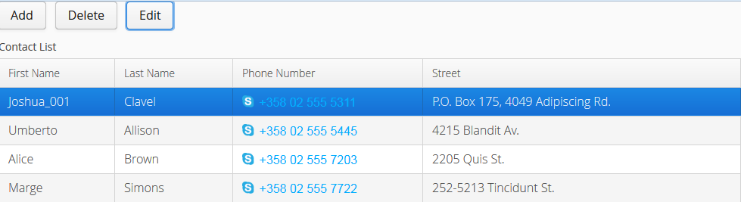
ContactMainView.java Add entity to JPAContainer
editButton.addClickListener(new Button.ClickListener() {
public void buttonClick(ClickEvent event) {
if (contactTable.getValue() != null) {
Contact contact = (Contact) ((JPAContainerItem<?>)
contactTable.getItem(contactTable.getValue())).getEntity();
final BeanItem<Contact> editContactItem = new BeanItem<Contact>(contact);
ContactEditor personEditor = new ContactEditor(editContactItem);
personEditor.addListener(new EditorSavedListener() {
public void editorSaved(EditorSavedEvent event) {
contacts.addEntity(editContactItem.getBean());
}
});
UI.getCurrent().addWindow(personEditor);
}
}
});

Slide 40
Demo Application
http://localhost:8080/contact-system

Slide 41
Bonus
Excellent document
https://vaadin.com/book
Sampler for available widgets
http://demo.vaadin.com/sampler
Dashboard
http://demo.vaadin.com/dashboard
Valo
https://vaadin.com/valo
Chart
http://demo.vaadin.com/charts
Success Stories
https://vaadin.com/success-stories

Slide 42
Q & A
You can download Slide and Sample project “Contact System” via
https://github.com/JavaCambodia/Vaadin-ContactSystem

Slide 43
Thank you !!!

