Slide 1

EMV: EUROPAY, MASTERCARD,VISA
UPDATE AT PROJECT MILESTONE: CODE IMPROVEMENT
TEAM MEMBERS
Niraj Kalra
Gajraj Kuldeep
Chintan Khanna

Slide 2
PROJECT MILESTONE
Repo modification completed
Perform security analysis completed
Code Improvement
Timing Analysis

Slide 3
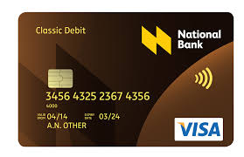
WHAT WE HAD INITIALLY ?
Only Applet code with issues
Abandoned code => scope for improvement
Lack of comments => Difficult to understand functioning
Incomplete Offline unencrypted PIN Verification => Insecure
No assumptions of Issuer and POS => Difficult to verify functionality

Slide 4
TASKS COMPLETED
04 x Issues fixed
SDA card authentication Implemented (lack of data from Issuer)
Encryption of Offline PIN
ATC persistent
Card blocking implemented
02 x New functionalities added
Depict Central Issuer
Depict Point of Sale (POS) terminal- serves as test code
.Best practices include code commenting
.Gradle build successful
.Travis code integration successful
.Improved github repository incl Readme file

Slide 5
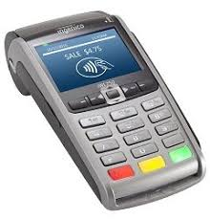
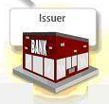
DESIGN FLOW OF IMPROVED CODE
2. Generate RSA Key pair
1. Initial hello
6. Read data
3. Public Key
7. Public key + sIgnature
5. sets signature
10. PIN verification
4. Generate Signature
8. Verifies
signature
9. Encrypted PIN

Slide 6
TIMING
Si. No | Command | Time Taken (msec)
1 | INS_ISSUER_SENDPUB | 1465
2 | INS_CARD_SIGNATURE | 202
3 | INS_GET_SIGNATURE | 52
4 | INS_VERIFYPIN | 115

