Slide 1
Cryptsetup- Javacard Phase-2
Hitesh Lilhare - 476356
Urvekumar C Shah-476355

Slide 2
Agenda
Brief description
Functionality offered + APDU Formats
Sensitive values that are protected
Cryptographic Algorithms and protocol used
Security review of code
Relevant attacker model
State model of applet

Slide 3
Brief Description
Cryptsetup
Cryptsetup is utility used to conveniently setup disk encryption based on DMCrypt kernel module.
Cryptsetup-javacard
A JavaCard key manager for Cryptsetup.
LUKS new partition
LUKS delete partition
Open LUKS partition

Slide 4
Functionality
Extract public-key of card
Establish DH session key for each transaction
Authenticate user using master password
Change master password
Partition key generation
Store partition-key to KeyStore in applet
Load partition-key from KeyStore
Delete partition-key from KeyStore
Reset session

Slide 5
INS_GETPUBKEY
INS_HANDSHAKE
INS_COMMAND
CMD_AUTH
CMD_CHANGEPW
CMD_GENKEY
CMD_STOREKEY
CMD_LOADKEY
CMD_DELKEY
CMD_CLOSE

Slide 6
APDU -I
INS-GETPUBKEY
Request APDU
Reponses APDU
CLA | INS_GETPUBKEY(0x50) | 0 | 0 | Lc | Le (1024)
Modulus 1st Byte | Modulus 2nd Byte | Exponent 1st Byte | Exponent 2nd Byte | SW1 | SW2

Slide 7
APDU -II
INS-HANDSHAKE
Request APDU
Response APDU
CLA | INS_HANDSAHK(0x51) | 0 | 0 | Lc | Pubkey length 1 | Pubkey length 2 | Pub key (Q Value) | Le (1024)
Signlenght 1 | Signlength 2 | Signature | PubKeyLen 1 | PubKeyLen2 | PubKey(Q Value) | DHpubkey length 1 | DHpubKey length 2 | DH Pub Key (W Value)

Slide 8
APDU -III
INS- COMMAND
Request APDU
Response APDU
CLA | INS_COMMAND(0x52) | 0 | 0 | Lc | HMAC-32 byte | Seq num-2byte | Iv – 16 byte | AES_cbc Enc(data) | Le (1024)
HMAC-32 byte | Seq num+1 (2byte) | Iv – 16 byte | AES_cbc Enc(data) | Sw1 | Sw2

Slide 9
APDU -IV
INS- COMMAND – CMD_AUTH
Request Data
Response Data
CMD_AUTH -0x00 | Master passwd lenghth 1 | Master passwd length 2 | UTF-8 Encoded Master Passwd
0 (2 byte)

Slide 10
APDU -V
INS- COMMAND – CMD_GENKEY
Request Data
Response Data
CMD_GENKEY-0x02 | data Length 1 | data Length 2 | Data (key size)
key size -02 byte | Key (key size)

Slide 11
APDU -VI
INS- COMMAND – CMD_STOREKEY
Request Data
Response Data
CMD_STOREKEY 0x03 | Data length 2 | Data Length 2 | UUID – 40 byte | Key length – 1 byte | Key
0 (2 byte)

Slide 12
APDU -VII
INS- COMMAND – CMD_LOADKEY
Request Data
Response Data
CMD_LOADKEY 0x04 | Data length 2 | Data Length 2 | UUID – 40 byte
key length | Key

Slide 13
APDU -VIII
INS- COMMAND – CMD_DELKEY
Request Data
Response Data
CMD_DELKEY 0x05 | Data length 2 | Data Length 2 | UUID – 40 byte
0 (2 byte)

Slide 14
APDU -IX
INS- COMMAND – CMD_CHANGEPW
Request Data
Response Data
CMD_CHANGEPW -0x01 | New passwd lenghth 1 | new passwd length 2 | UTF-8 Encoded new Passwd
0 (2 byte)

Slide 15
Sensitive values that are protected
Master password
Partition keys
UUID – related to LINUX Partition.

Slide 16
Cryptographic Algorithms and Protocol used
Signing:
Key Pair Generation: ALG_RSA_CRT of bit length 1024
Signature: RSA_SHA_PKCS1
DH Key Pair:
Key Pair Generation: ALG_EC_FP of bit length 192
Session Key Agreement:
ALG_EC_SVDP_DHC: Elliptic curve secret value derivation primitive, Diffie-Hellman version, with cofactor multiplication and compatibility mode, as per [IEEE P1363].
Note: This algorithm computes the SHA-1 message digest of the output of the derivation primitive to yield a 20 byte result.
Cipher Key:
ALG_AES_BLOCK_128_CBC_NOPAD
HMAC:
Message Digest ALG_SHA_256 with digest block size of 64 bytes.
Random Data:
ALG_SECURE_RANDOM

Slide 17
Security review of code
PINs and Keys are handled securely. Accessed via secure APIs
Sensitive data has been initialized at beginning and clear at the end of session.
CLEAR_ON_DESELECT for transient buffer handling sensitive data
TYPE_AES_TRANSIENT_DESELECT for cipher keys
Sensitive data stored in transient memory
All initialized buffers declared as static
Temporary entry points stored in local variables (not in class, instance variable etc.)

Slide 18
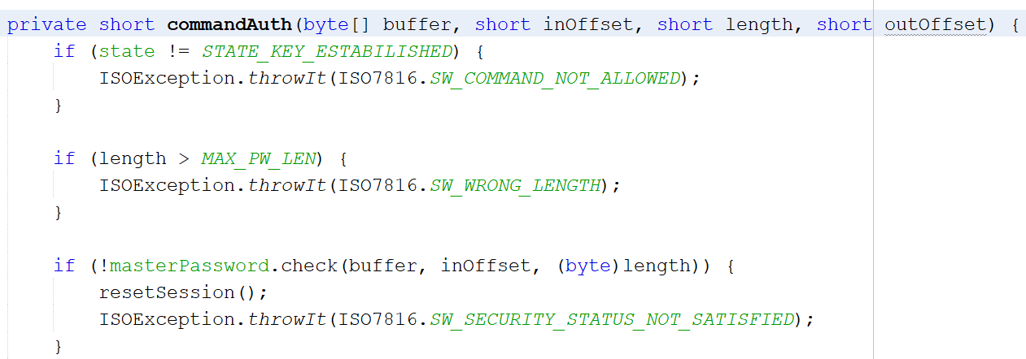
Attacker Model: Side channel attacks

Slide 19
Attacker Model: Fault induction attack
When processor increments the number of password tries counter, attacker can induce a fault which may prevent the processor to increment the counter resulting in more than 5 number of password tries which leads to the brute force attack on password.

Slide 20
State Diagram
CMD_CLOSE
Idle
KE
Load Key
Store Key
Delete Key
1.Get public key
DH Hand Shake
CMD_CLOSE
CMD_AUTH
AUTH
Change Pwd
Gen Key

Slide 21
Thank You for your attention.

Slide 22
Key Store: [64 Entries with 40(Partition Id)+128(Key Length)]
keyStore = new byte[(short)(MAX_KEY_ENTRIES * (short)(UUID_LENGTH + MAX_KEY_SIZE))];

