Slide 1

Board game with Knapsack
Cameron Caskey
Cade Reed
Vraj Patel
Jenil Goyani

Slide 2
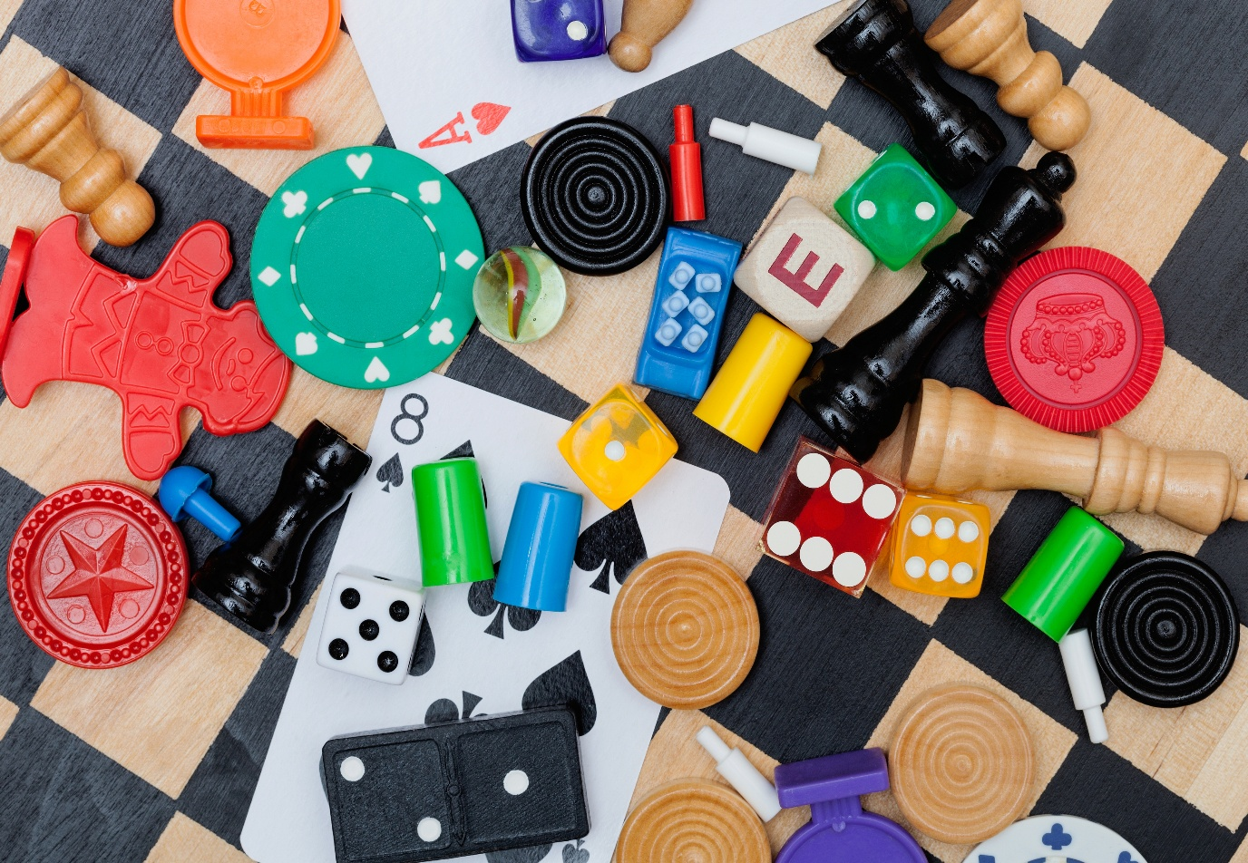
Overview
Choose the best set of pieces for a board-game prototype while staying under a fixed budget
Each piece has a cost and interestingness value; goal is to spend the money wisely while getting the most "fun" possible
The 3 ways we compared to solve it: Brute force, Top-down dynamic, Greedy. We chose these 3 because of their difference in speed and accuracy
Algorithm type | Time complexity
Brute force | O(2^n)
DP | O(nW)
Greedy | O(n log n)

Slide 3
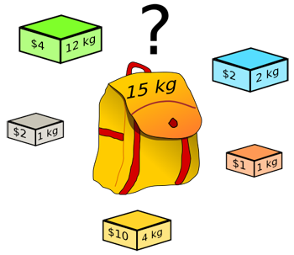
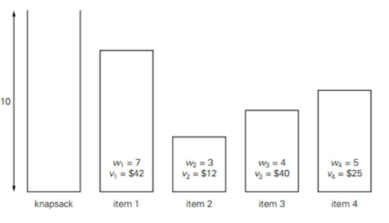
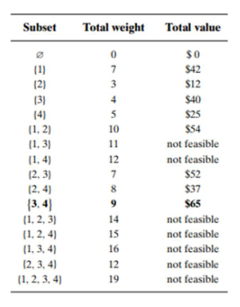
Knapsack logic example
*Very Classic
Example

Slide 4
Research Questions
How fast/slow is each method as the number of pieces and/or budget grows?
How much memory do they use?
How close is the greedy method to the optimal answer?
Which method would make the most sense for designing a board game?
We expected brute force to break early, DP to keep up, and greedy to be fast but imperfect.

Slide 5
Experimental implementation/data
Implemented with Python 3
Item counts tested: 10, 20, 50, 100
Budgets tested: 50, 100, 200, 500
Cost: random 1–50
Value: random 1–10
Random seed tied to n so each run is consistent

Slide 6
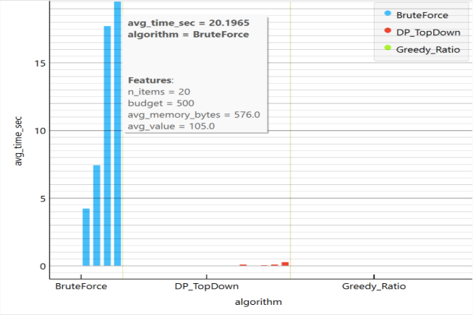
Experimental measurements
For each (n, budget):
Execution time
Peak memory
Total “interestingness” value
Whether it matched the optimal solution (when brute force or DP was available)

Slide 7
Runtime Results
Brute Force:
  Becomes impractical after n=20, algorithm can take hours or days depending on the size of n
Dynamic Programming:
  Increases at a small rate as n get large
Greedy:
  Fastest algorithm every time
  Most consistent, difference in time is most likely caused by background processes on machine rather than the value of n tested for this experiment
 | N=10 | N=20 | N=50 | N=100
Brute Force | 0.0098 seconds | 7.4631 seconds
Dynamic | 0.0012 seconds | 0.0030 seconds | 0.0068 seconds | 0.0466 seconds
Greedy | 0.000050 seconds | 0.000023 seconds | 0.000044 seconds | 0.000075 seconds

Slide 8
Memory results
Brute Force: low memory but massive computation. Did not compute n=50, n=100 due to high computation
DP: highest memory use (stores many subproblems)
Greedy: barely uses any memory
 | N=10 | N=20 | N=50 | N=100
Brute Force | 228.8 bytes | 424.0 bytes
DP | 11,492.8 bytes | 117,498.4 bytes | 779,660.8 bytes | 2,382,182.8 bytes
Greedy | 443.2 bytes | 541.2 bytes | 858.4 bytes | 1,254.0 bytes

Slide 9
Solution quality
DP and brute force always match exactly
Greedy usually gets very close, but sometimes misses the best combination
 | N=10 | N=20 | N=50 | N=100
DP/brute | 29.0 | 67.5 | 116.25 | 147.5
Greedy | 29.0 | 66.75 | 116.25 | 145.0

Slide 10
Limitations and future work
Only used random data
Didn’t test bottom-up DP or branch-and-bound
Brute force restricted to n ≤ 20
Only a few budget sizes tested
Possible Improvements:
Add real game pieces instead of random ones
Implement more rules to follow
Add automatic plotting
Run more experiment sizes

Slide 11
Gen Ai and sources
We used ChatGPT mainly for:
Help organize the project
Writing parts of the Python experiment script structure
All code was tested and modified by the team.
Other sources include lecture notes, project instructions, zyBooks, and sites such as Stack Overflow to help with code.

Slide 12
Team contribution
Task | Cade | Cameron | Vraj | Jenil
Idea + Planning | 50% | 10% | 25% | 15%
Coding | 15% | 15% | 35% | 35%
Experiment | 15% | 45% | 15% | 25%
Data/Graphs | 10% | 25% | 50% | 15%
Writing | 40% | 20% | 15% | 25%
Presentation | 10% | 50% | 15% | 25%

Slide 13
Challenges
Getting DP reconstruction to work correctly
Keeping runtimes reasonable for larger inputs
Making sure random data stayed consistent across runs
Coordinating schedules for testing and writing(Biggest problem)

