Slide 1
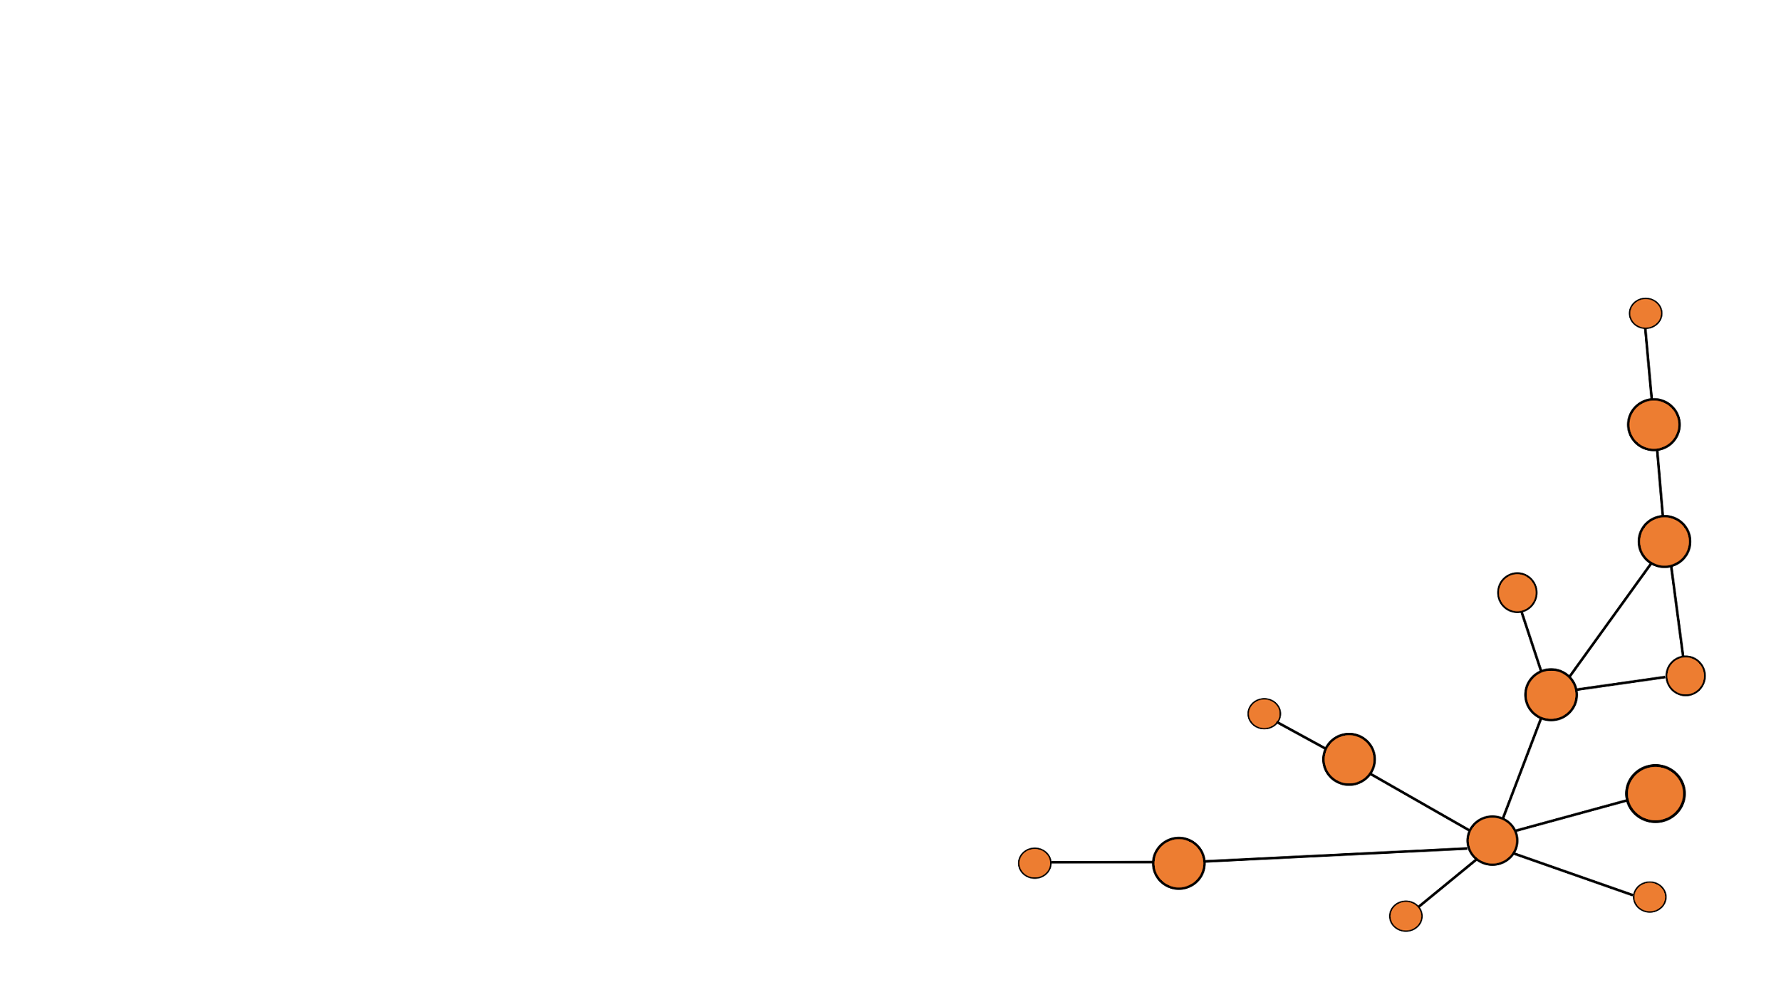
Hot Topics Of Generative AI: LLMs and Diffusion Models ”Yang et al. - Directional diffusion models for graph representation learning“
TU Dortmund – Department of Computer Science
Chair 9 – Prof. Dr. Müller
presented by Marlon Kapala
supervised by Tim Katzke

Slide 2
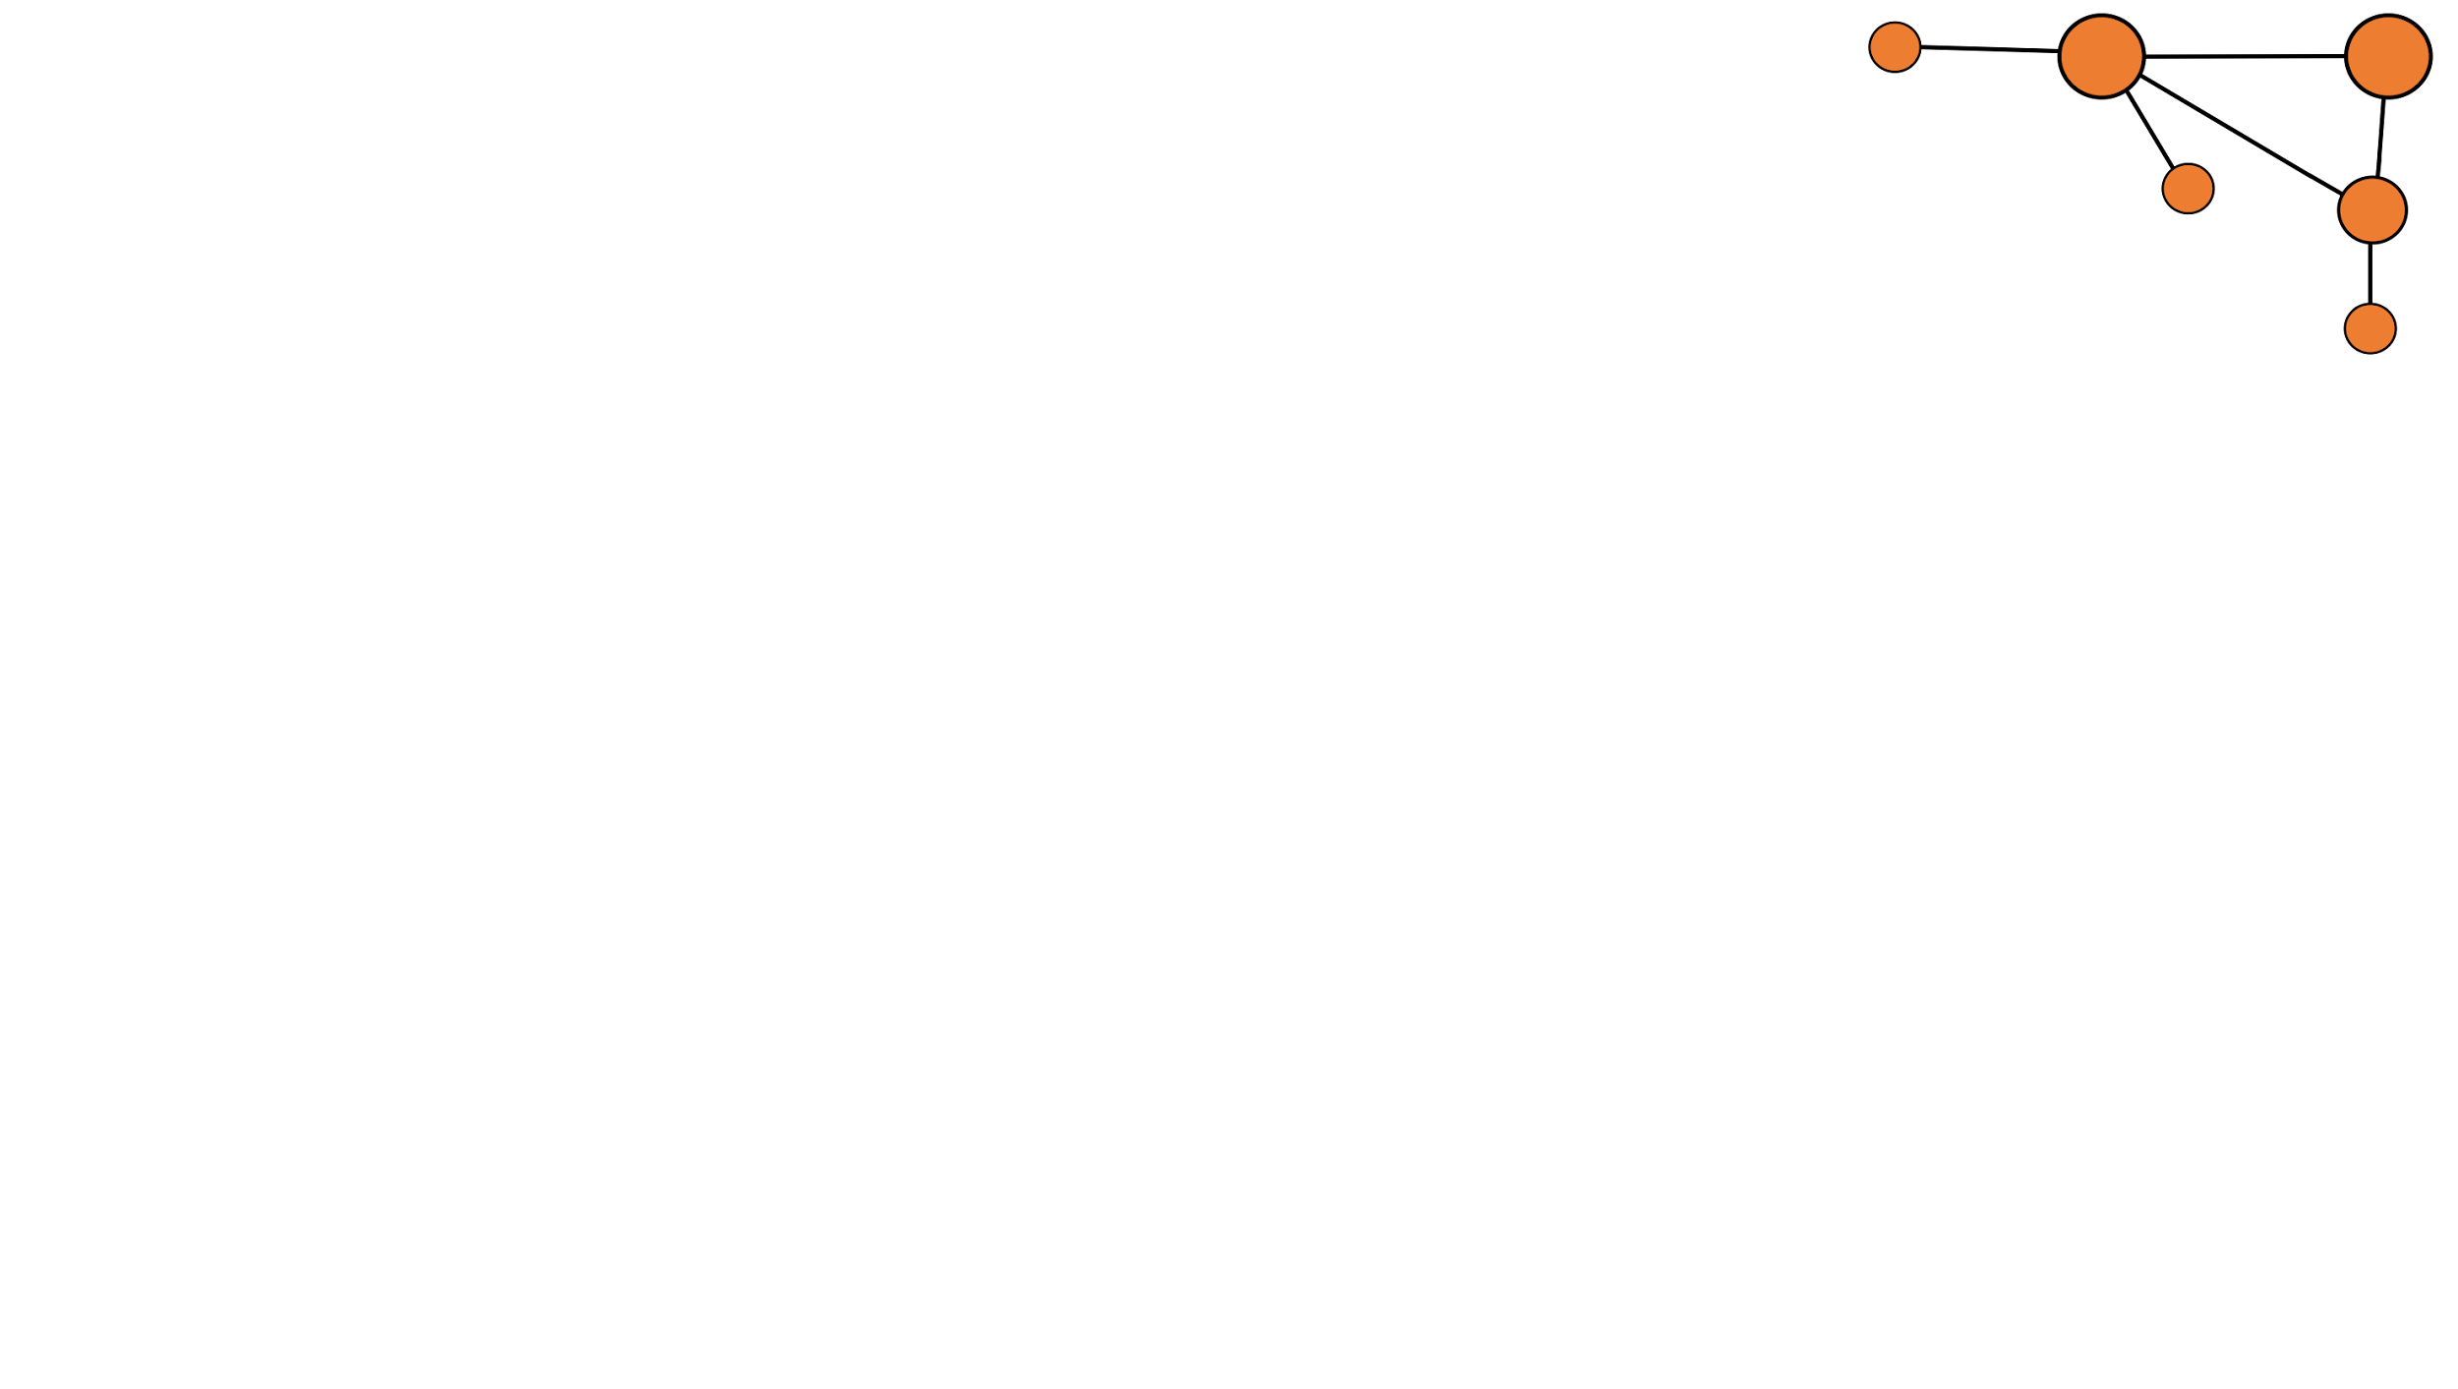
Agenda
Marlon Kapala - Department of Computer Science - TU Dortmund
1 What is Graph Representation Learning?
2 The Emergence of Diffusion Models
3 Graphs vs. Images
4 The Architecture of Directed Diffusion Models
5 Benchmarks
6 Conclusion
2 / 24

Slide 3
1 What is Graph Representation Learning?
Marlon Kapala - Department of Computer Science - TU Dortmund
3 / 24

Slide 4
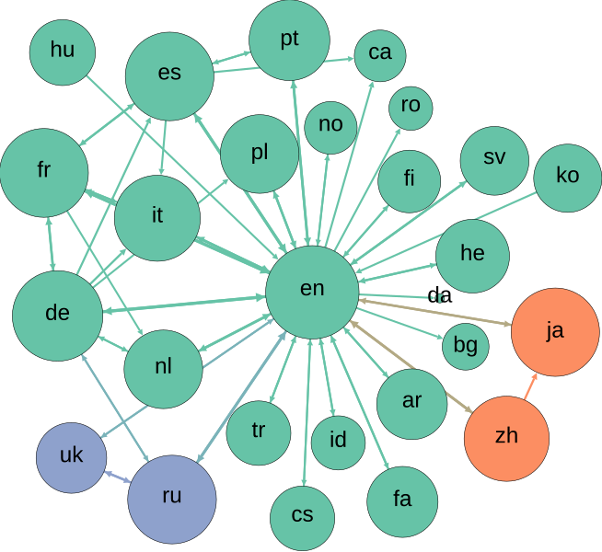
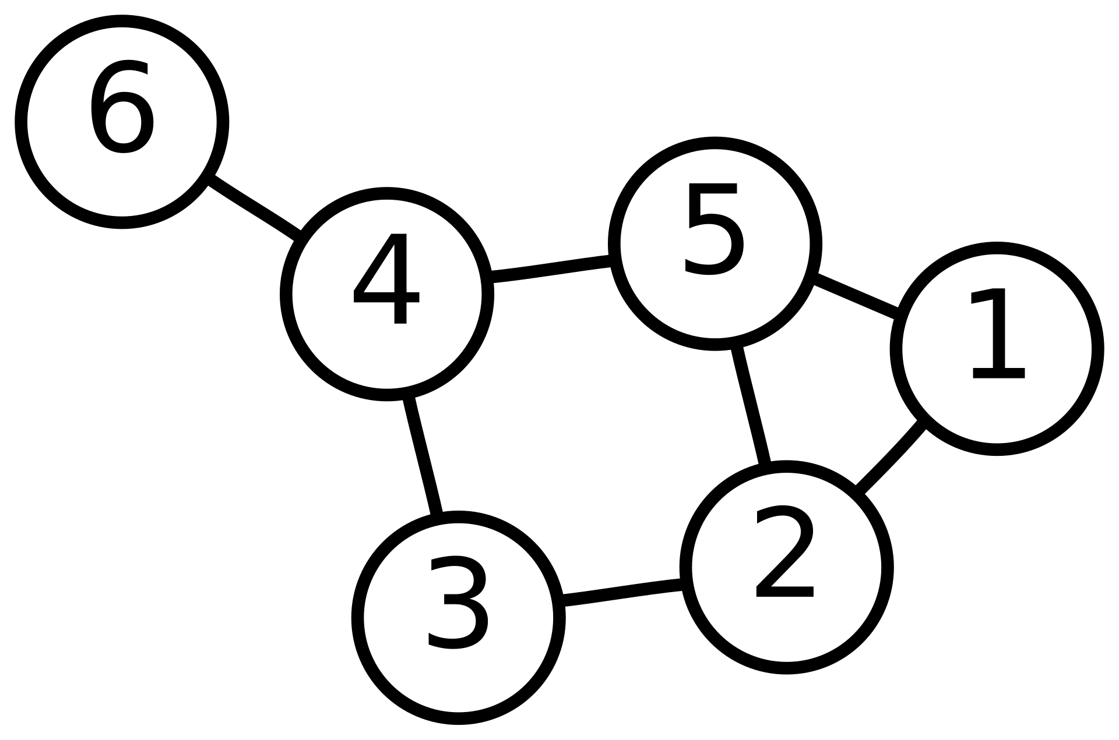
What is a graph?
Marlon Kapala - Department of Computer Science - TU Dortmund
► G = (V, E), vertices V and edges E
► Graphs can represent anything from molecules to road networks or social networks
User:AzaToth, Public domain, via Wikimedia Commons
Computermacgyver, CC BY-SA 3.0, via Wikimedia Commons
4 / 24

Slide 5
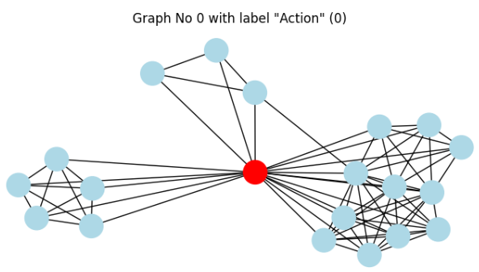
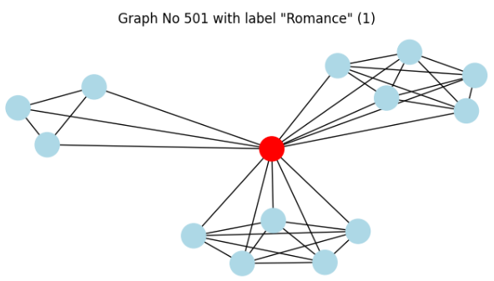
IMDB-Binary – A Graph Dataset
Marlon Kapala - Department of Computer Science - TU Dortmund
► Graph Learning on Graph Datasets enables the use of AI on those data structures
► IMDB-B contains ego-networks of actors from Action or Romance movies (Yanardag et al., 2015)
► From only the knowledge of which actors have co-starred, models can determine the genre with an accuracy of up to 95% (Nguyen et al., 2019)
5 / 24
Presentation Code

Slide 6
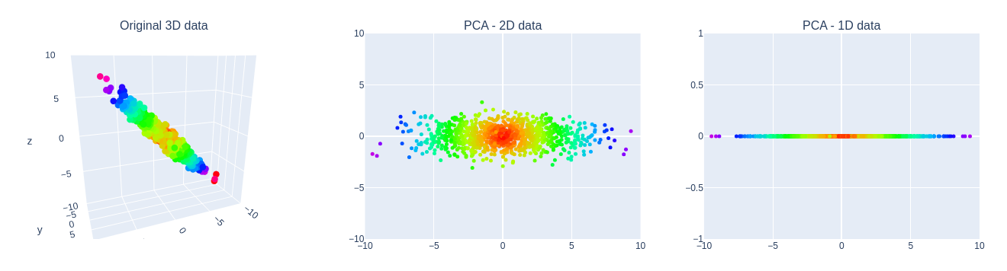
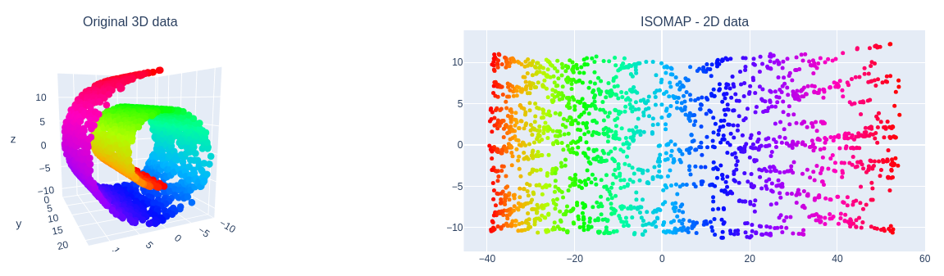
Representation Learning
Marlon Kapala - Department of Computer Science - TU Dortmund
► RL is an important part of Machine Learning that converts data to a form that can be worked with more easily
► Here, there is also a difference between unsupervised and supervised learning
► Dimensionality Reduction is a prominent subfield
Presentation Code
Presentation Code
6 / 24

Slide 7
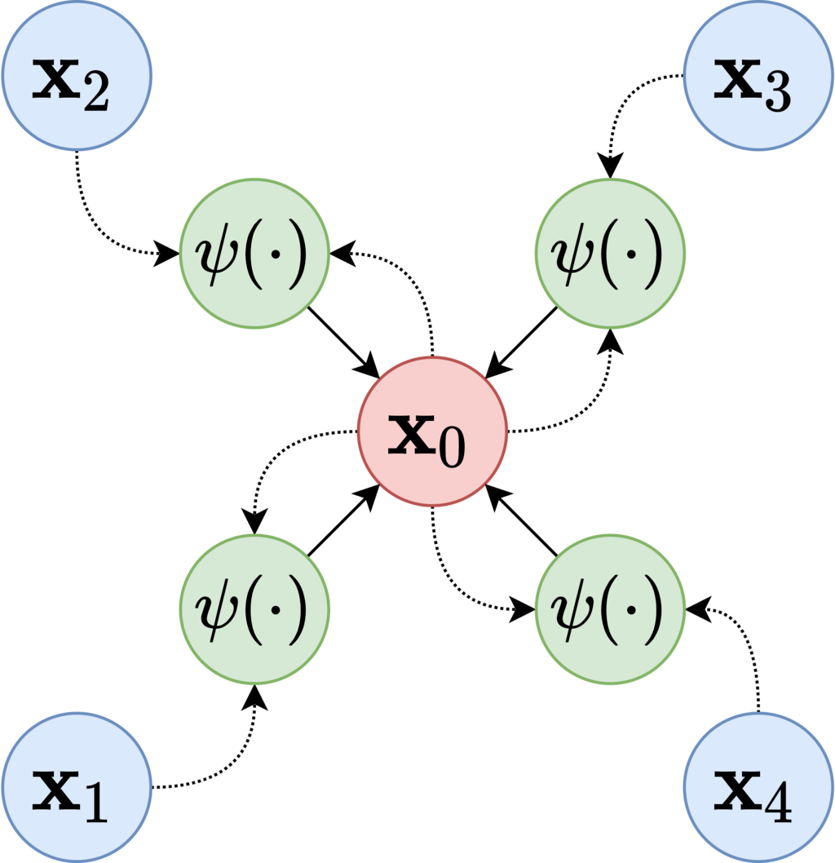
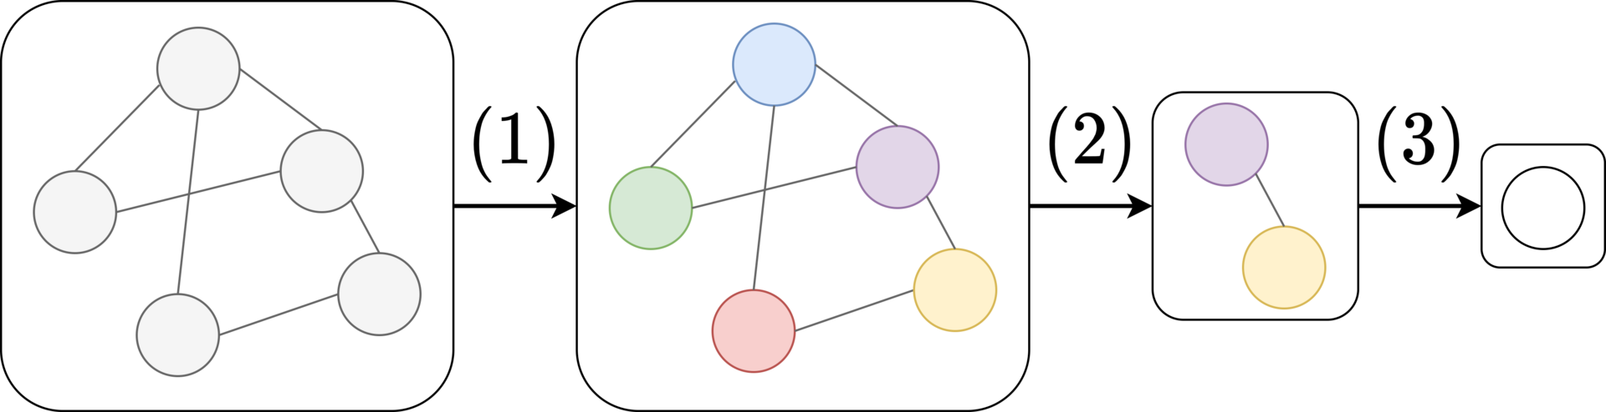
Graph Representation Learning - GNNs
Marlon Kapala - Department of Computer Science - TU Dortmund
► For RL on Graphs, Graph Neural Networks are often used
► They work similar to Convolutional Neural Networks (CNNs)
► Instead of using neighboring pixels, the adjacency matrix is used
By NickDiCicco - Own work, CC BY-SA 4.0
By NickDiCicco - Own work, CC BY-SA 4.0
7 / 24

Slide 8
2 The Successful Diffusion Model
Marlon Kapala - Department of Computer Science - TU Dortmund
8 / 24

Slide 9
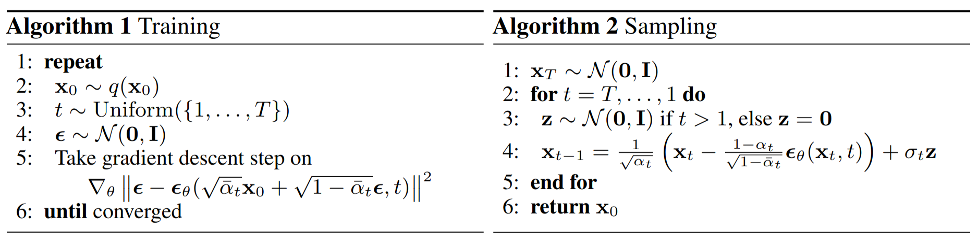
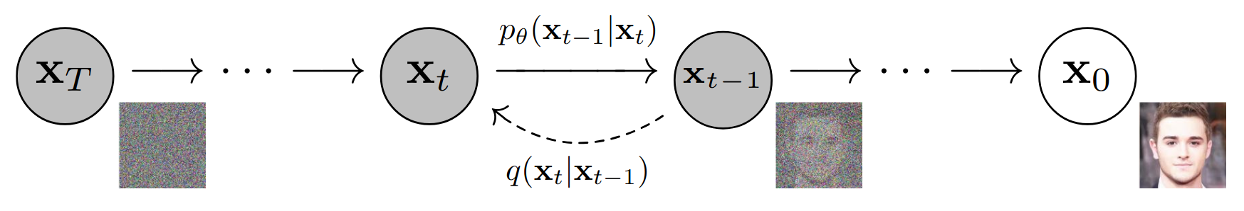
Denoising Probabilistic Diffusion Models
Marlon Kapala - Department of Computer Science - TU Dortmund
► Originally from thermodynamics
► Introduced to Machine Learning only recently (Ho et al., 2020), but has become the standard for image generation beating former SOTA technology (Dhariwal et al., 2021)
Ho et al., 2020
9 / 24
Ho et al., 2020

Slide 10
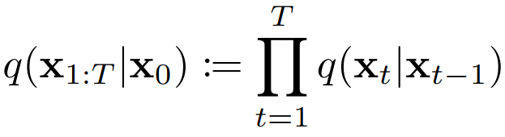
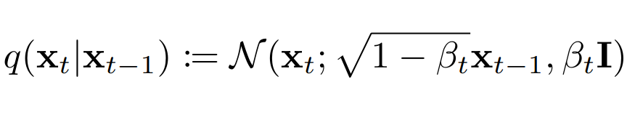
The DM’s forward step
Marlon Kapala - Department of Computer Science - TU Dortmund
► To gradually add noise to the images, Diffusion Models add Gaussian noise in each step
► Thus, all data is asymptotically converted to a standard Gaussian distribution (Ho et al., 2020)
10 / 24

Slide 11
3 Graphs vs. Images
Marlon Kapala - Department of Computer Science - TU Dortmund
11 / 24

Slide 12
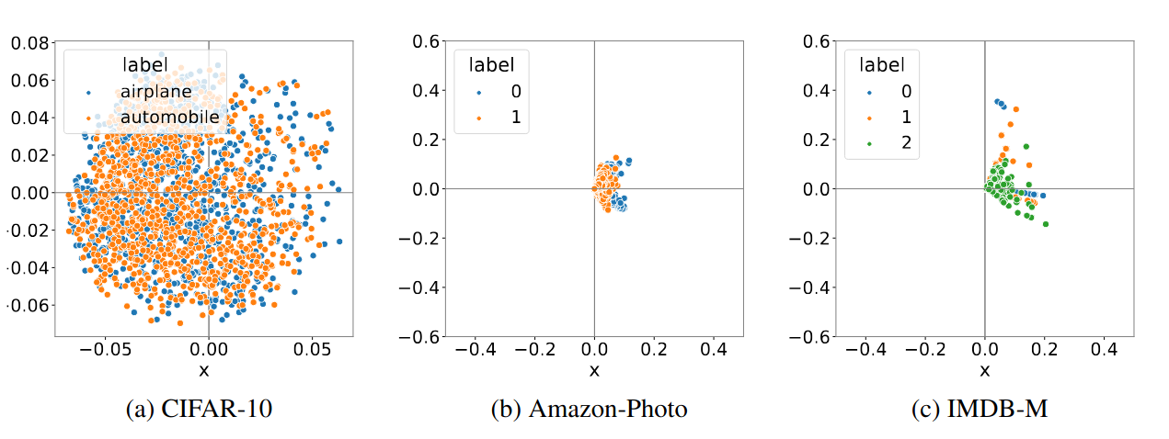
The Anisotropy of Graphs
Marlon Kapala - Department of Computer Science - TU Dortmund
► While images are naturally isotropic and euclidean, Graphs are anisotropic
(Yang et al., 2023)
12 / 24

Slide 13
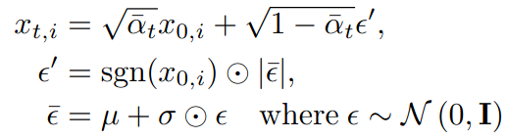
White Noise vs. Directed Noise
Marlon Kapala - Department of Computer Science - TU Dortmund
► The information density of a directed Gaussian declines quickly if White Noise is applied
► Hence, Yang et al. introduce “Directional Noise”:
Presentation Code
13 / 24

Slide 14
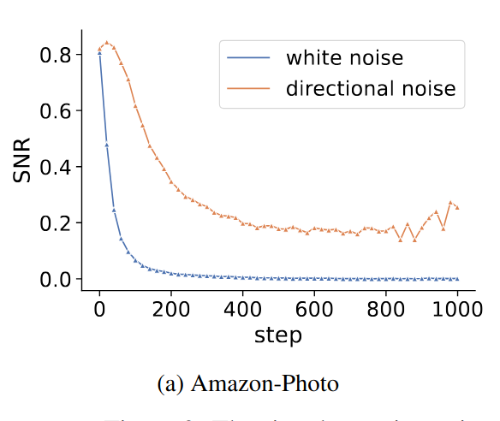
The effect on the Signal-To-Noise-Ratio
Marlon Kapala - Department of Computer Science - TU Dortmund
► The application of directional noise has a vital effect on the Signal-To-Noise-Ratio
► The SNR is fundamental for the learning process of Diffusion Models
Yang et al., 2023
14 / 24

Slide 15
4 Directed Diffusion Models - Architecture
Marlon Kapala - Department of Computer Science - TU Dortmund
15 / 24

Slide 16
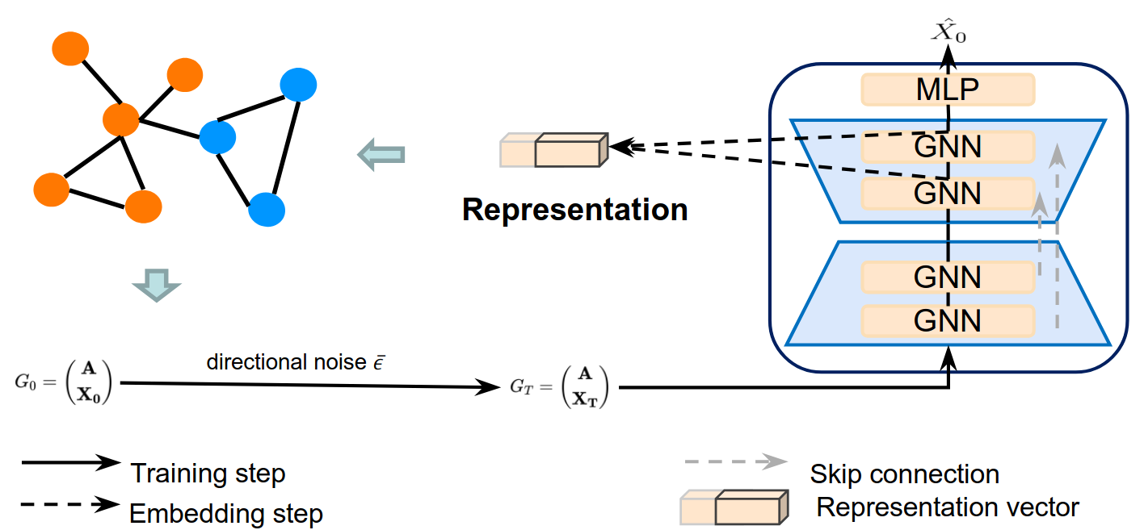
Components of the Model
Marlon Kapala - Department of Computer Science - TU Dortmund
Yang et al., 2023
16 / 24

Slide 17
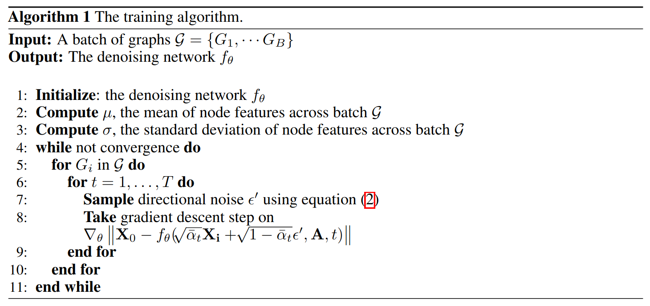
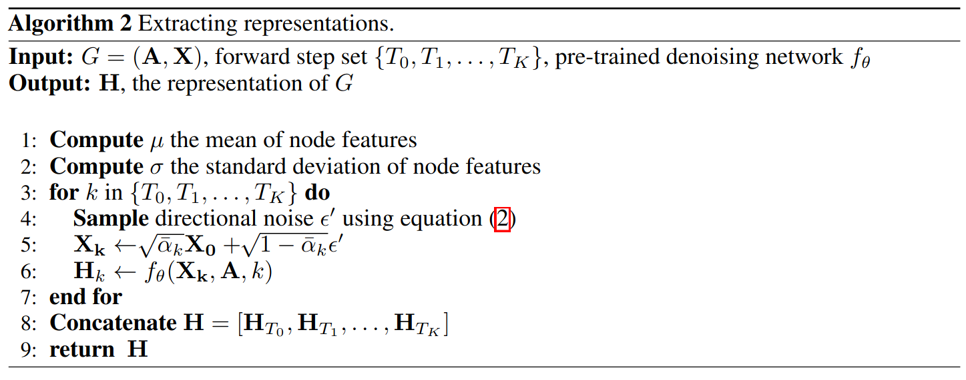
The Algorithm
Marlon Kapala - Department of Computer Science - TU Dortmund
► The two algorithms work similar to Ho’s algorithm
► Instead of generating an image, a representation is generated
Yang et al., 2023
17 / 24

Slide 18
5 Resulting Benchmarks
Marlon Kapala - Department of Computer Science - TU Dortmund
18 / 24

Slide 19
Graph Classification
Marlon Kapala - Department of Computer Science - TU Dortmund
► The paper compares multiple State-Of-The-Art models with DDMs
► The hyperparameters of the DDM were obtained by 10-fold cross validation
► SVMs are used on the learned representations
► While here only graph classification results are presented, the results from node classification are similarly promising
19 / 24

Slide 20
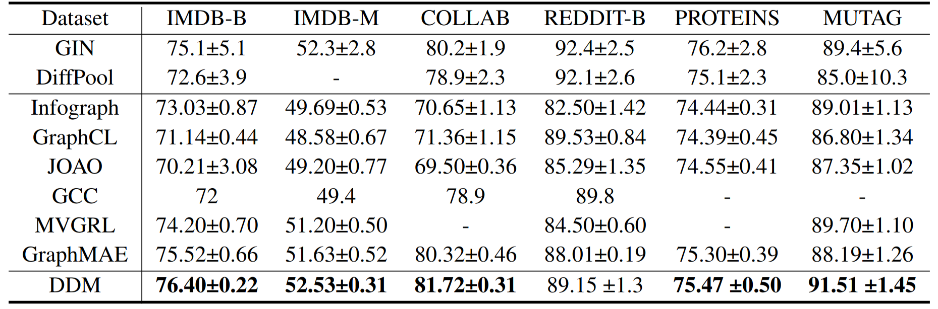
Results
Marlon Kapala - Department of Computer Science - TU Dortmund
Yang et al., 2023
20 / 24

Slide 21
6 Conclusion
Marlon Kapala - Department of Computer Science - TU Dortmund
21 / 24

Slide 22
Research Outlook
Marlon Kapala - Department of Computer Science - TU Dortmund
► Yang et al. only introduce the idea, they admit that their hyperparameters are not optimal yet
► One open question is how the optimal set of diffusion steps can be determined
► Variants of DDMs could bring value to areas such as computer vision and natural language processing
22 / 24

Slide 23
What makes this paper special?
Marlon Kapala - Department of Computer Science - TU Dortmund
► The benchmarks are remarkable
► As mentioned, the technology introduced holds great potential for the future
► The researchers consider themselves „among the pioneers in the literature“ regarding the „exploration of anisotropic structure in graph data“
23 / 24

Slide 24
References & Weblinks
Marlon Kapala - Department of Computer Science - TU Dortmund
► Yang et al. (2023). Directional diffusion models for graph representation
learning
► Yanardag et al. (2015). Deep Graph Kernels
► Nguyen et al. (2019). Universal Graph Transformer Self-Attention Networks
► Ho et al. (2020). Denoising Diffusion Probabilistic Model
► Dhariwal et al. (2021). Diffusion Models Beat GANs on Image Synthesis
► Presentation Code: https://github.com/JavaLangMarlon/ddm-proseminar-tu-dortmund
► CC BY-SA 3.0: https://creativecommons.org/licenses/by-sa/3.0
► CC BY-SA 4.0: https://creativecommons.org/licenses/by-sa/4.0
24 / 24

