Slide 1
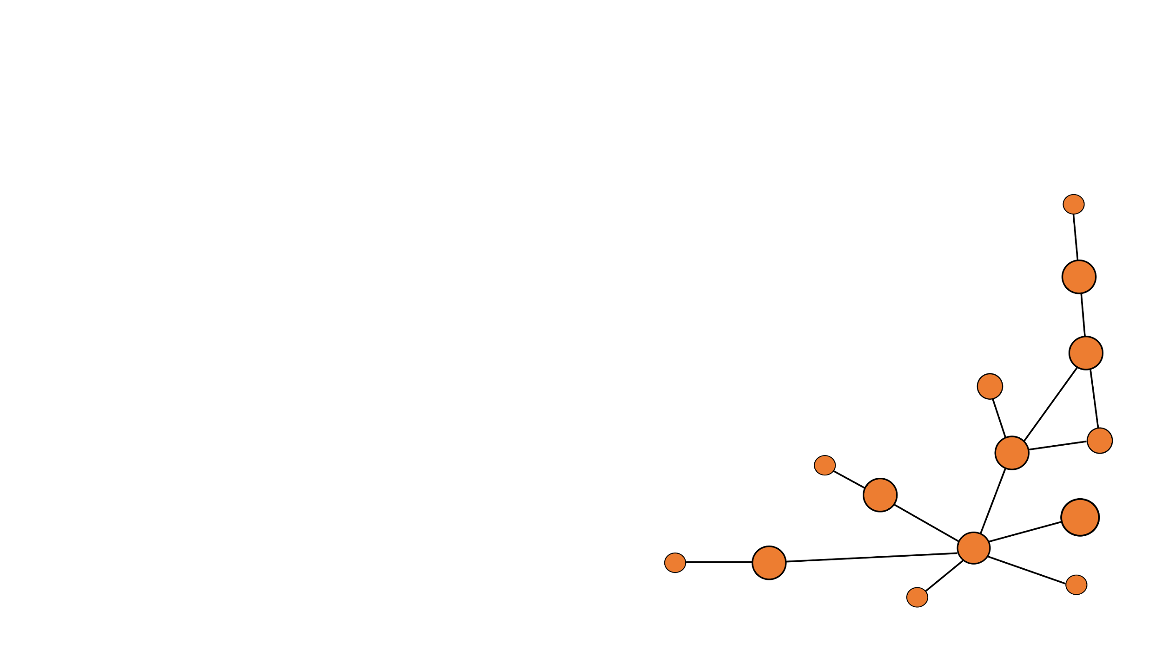
Hot Topics Of Generative AI:
LLMs and Diffusion Models
Yang et al. - “Directional diffusion models for graph
representation learning“
TU Dortmund – Department of Computer Science
Chair 9 – Prof. Dr. Müller
presented by Marlon Kapala
supervised by Tim Katzke

Slide 2
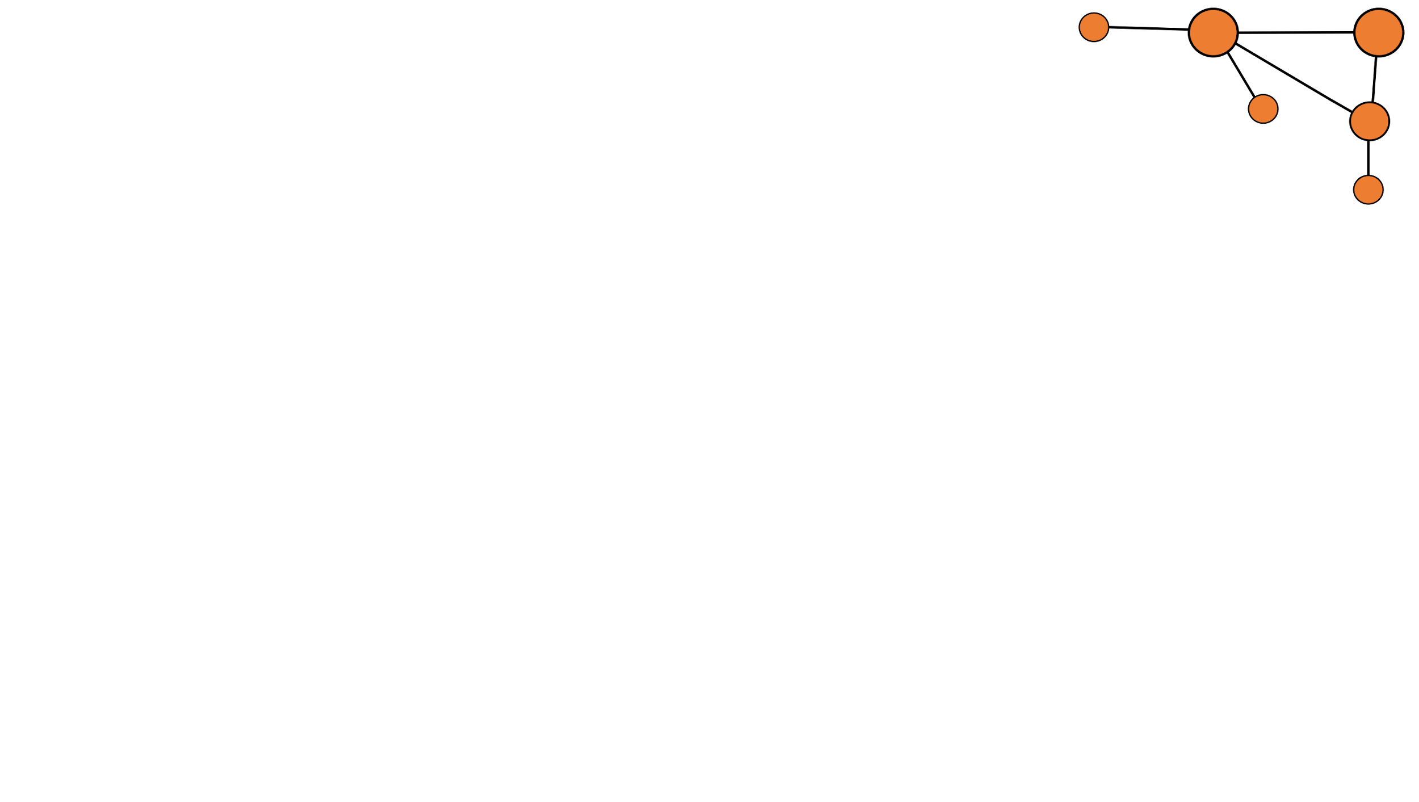
Marlon Kapala - Department of Computer Science - TU Dortmund
Agenda
1 What is Graph Representation Learning?
2 The Emergence of Diffusion Models
3 Graphs vs. Images
4 The Architecture of Directed Diffusion Models
5 Benchmarks
6 Conclusion
2 / 25

Slide 3
Marlon Kapala - Department of Computer Science - TU Dortmund
1 What is Graph Representation Learning?
3 / 25

Slide 4
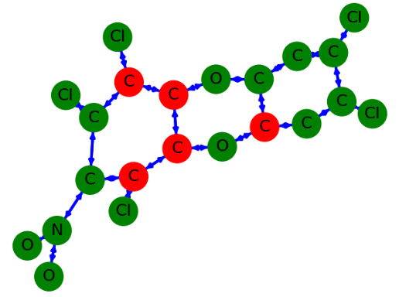
Marlon Kapala - Department of Computer Science - TU Dortmund
What is a graph?
► G = (V, E), vertices V and edges E
► Graphs can represent anything from molecules to road networks or social networks
► Nodes can also have node features X
4 / 25
Zhu et al., 2020

Slide 5
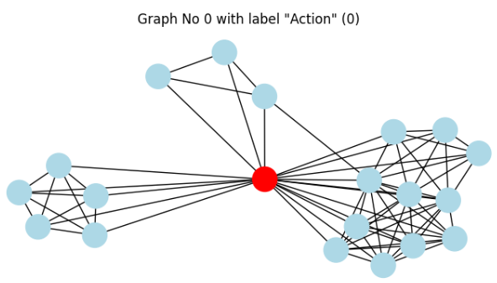
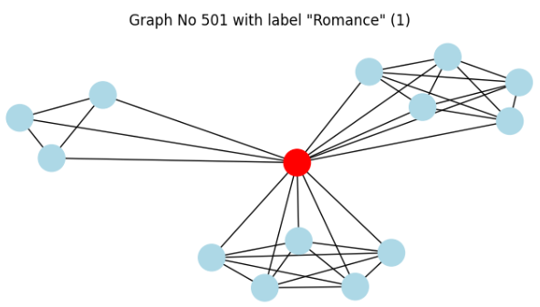
Marlon Kapala - Department of Computer Science - TU Dortmund
IMDB-Binary – A Graph Dataset
► Graph Learning works with Graph Datasets
► IMDB-B contains ego-networks of actors from
Action or Romance movies (Yanardag et al., 2015)
► From only the knowledge how actors have
co-starred, models can determine the genre with
an accuracy of up to 95% (Nguyen et al., 2019)
5 / 25

Slide 6
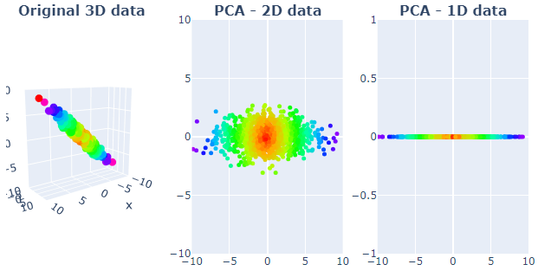
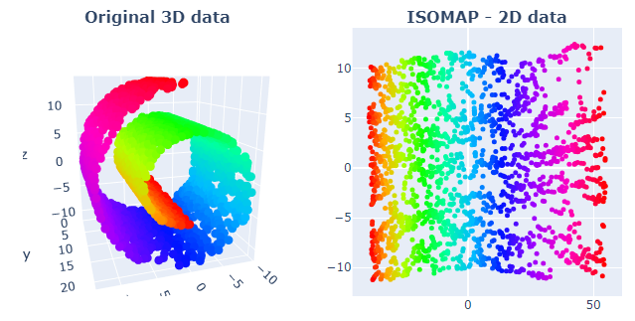
Marlon Kapala - Department of Computer Science - TU Dortmund
Representation Learning
► RL is an important part of Machine Learning that converts data to a form that can be worked with more easily
► Here, there is also a difference between
unsupervised (without labels) and
supervised learning (with labels)
► Dimensionality Reduction is
a prominent subfield
6 / 25

Slide 7
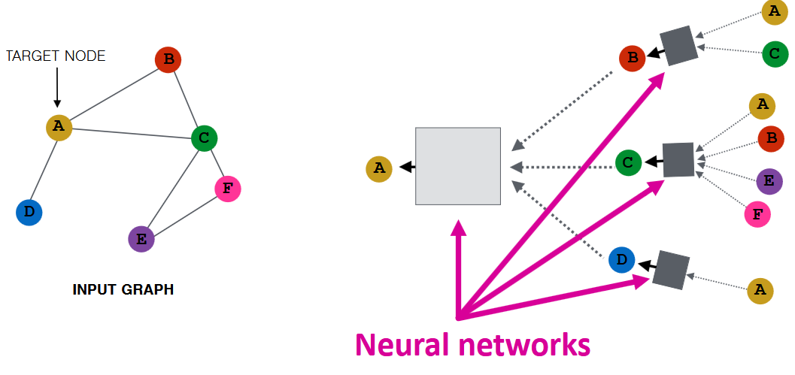
Marlon Kapala - Department of Computer Science - TU Dortmund
Graph Representation Learning - GNNs
► For RL on Graphs, Graph Neural Networks are often used
► They work similar to Convolutional Neural Networks (CNNs)
► Instead of using neighboring pixels, the adjacency matrix, which encodes the edges, is used
Jure Leskovec, Stanford CS224W: Machine Learning with Graphs
7 / 25

Slide 8
Marlon Kapala - Department of Computer Science - TU Dortmund
2 The Successful Diffusion Model
8 / 25

Slide 9
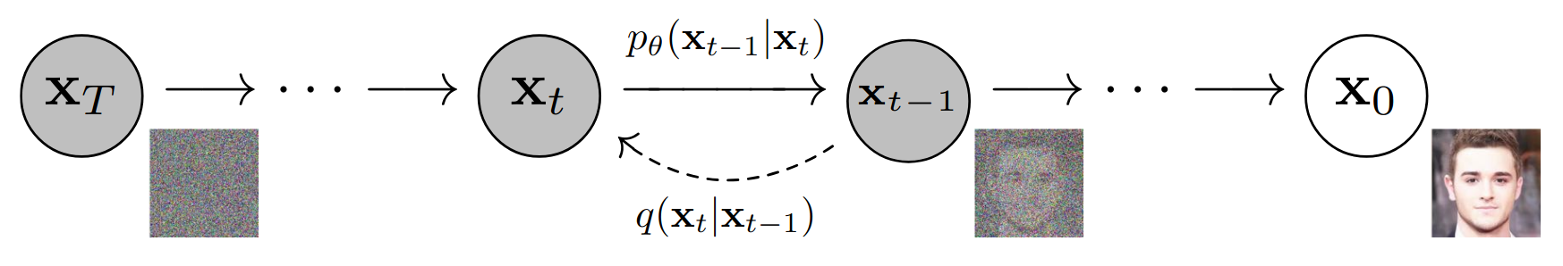
Marlon Kapala - Department of Computer Science - TU Dortmund
Denoising Probabilistic Diffusion Models
► Introduced to Machine Learning only recently (Ho et al., 2020), but has become the standard for image generation beating former SOTA technologies (Dhariwal et al., 2021)
Ho et al., 2020
9 / 25

Slide 10
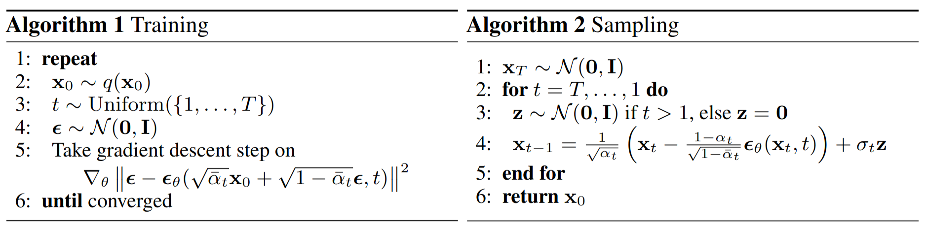
Marlon Kapala - Department of Computer Science - TU Dortmund
The DM’s Algorithm
► To add noise to the images, Diffusion Models add Gaussian noise in each training step
Ho et al., 2020
10 / 25

Slide 11
Marlon Kapala - Department of Computer Science - TU Dortmund
3 Graphs vs. Images
11 / 25

Slide 12
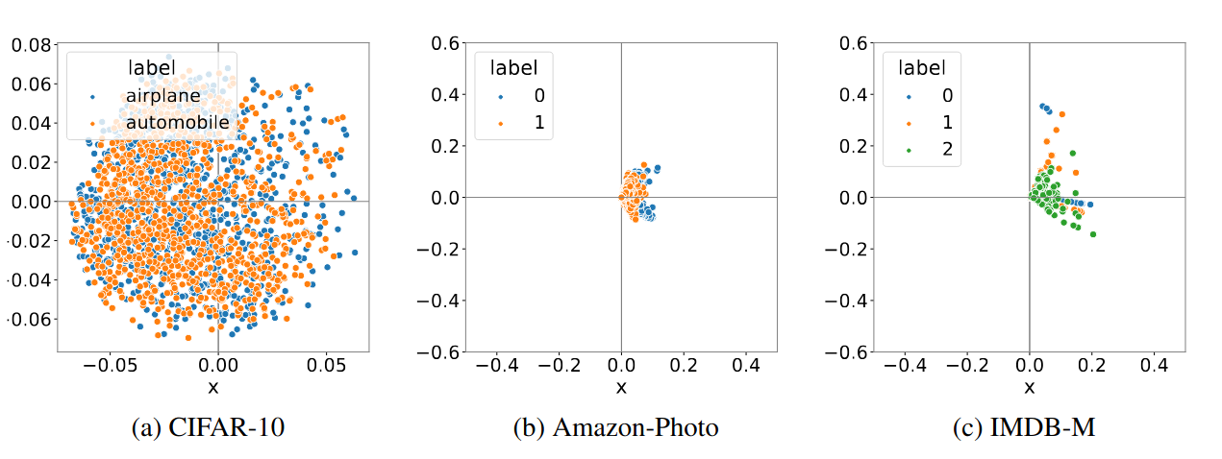
Marlon Kapala - Department of Computer Science - TU Dortmund
The Anisotropy of Graphs
► While images are naturally isotropic and euclidean, Graphs are anisotropic (i. e., properties vary with direction)
Yang et al., 2023
12 / 25

Slide 13
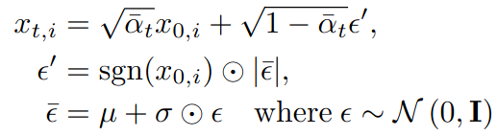
Marlon Kapala - Department of Computer Science - TU Dortmund
White Noise vs. Directional Noise
► Hence, Yang et al. introduce “Directional Noise”:
► α and β are the noise schedule
analogous to Ho’s paper
White Noise
Directional Noise
13 / 25

Slide 14
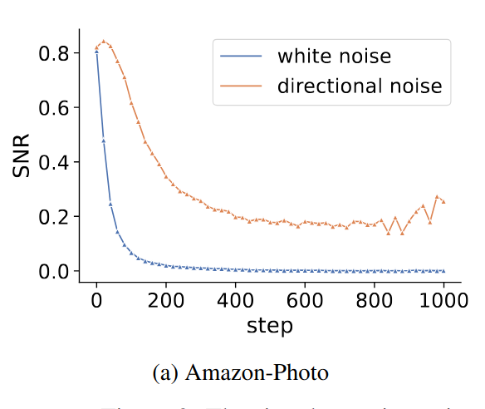
Marlon Kapala - Department of Computer Science - TU Dortmund
The effect on the Signal-To-Noise-Ratio
► The Signal-To-Noise-Ratio is fundamental for the learning process of Diffusion Models
► The application of directional noise has a vital effect on the SNR
14 / 25
Yang et al., 2023

Slide 15
Marlon Kapala - Department of Computer Science - TU Dortmund
4 Directional Diffusion Models - Architecture
15 / 25

Slide 16
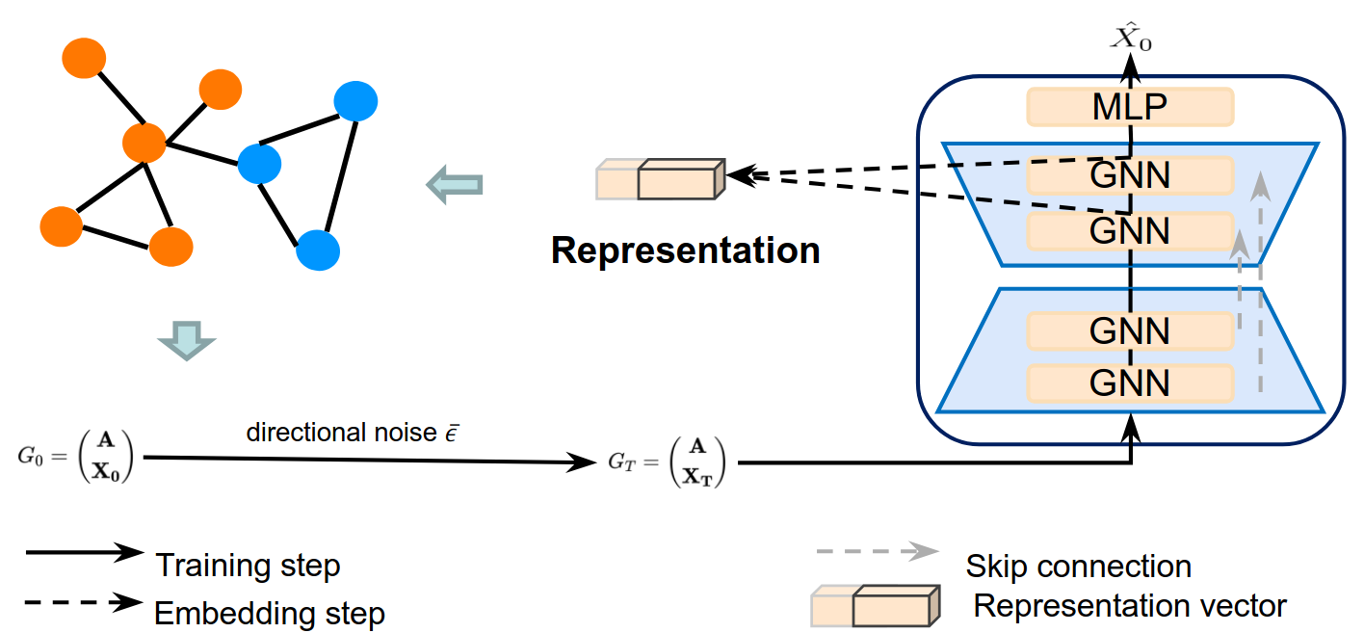
Marlon Kapala - Department of Computer Science - TU Dortmund
Components of the Model
Yang et al., 2023
16 / 25

Slide 17
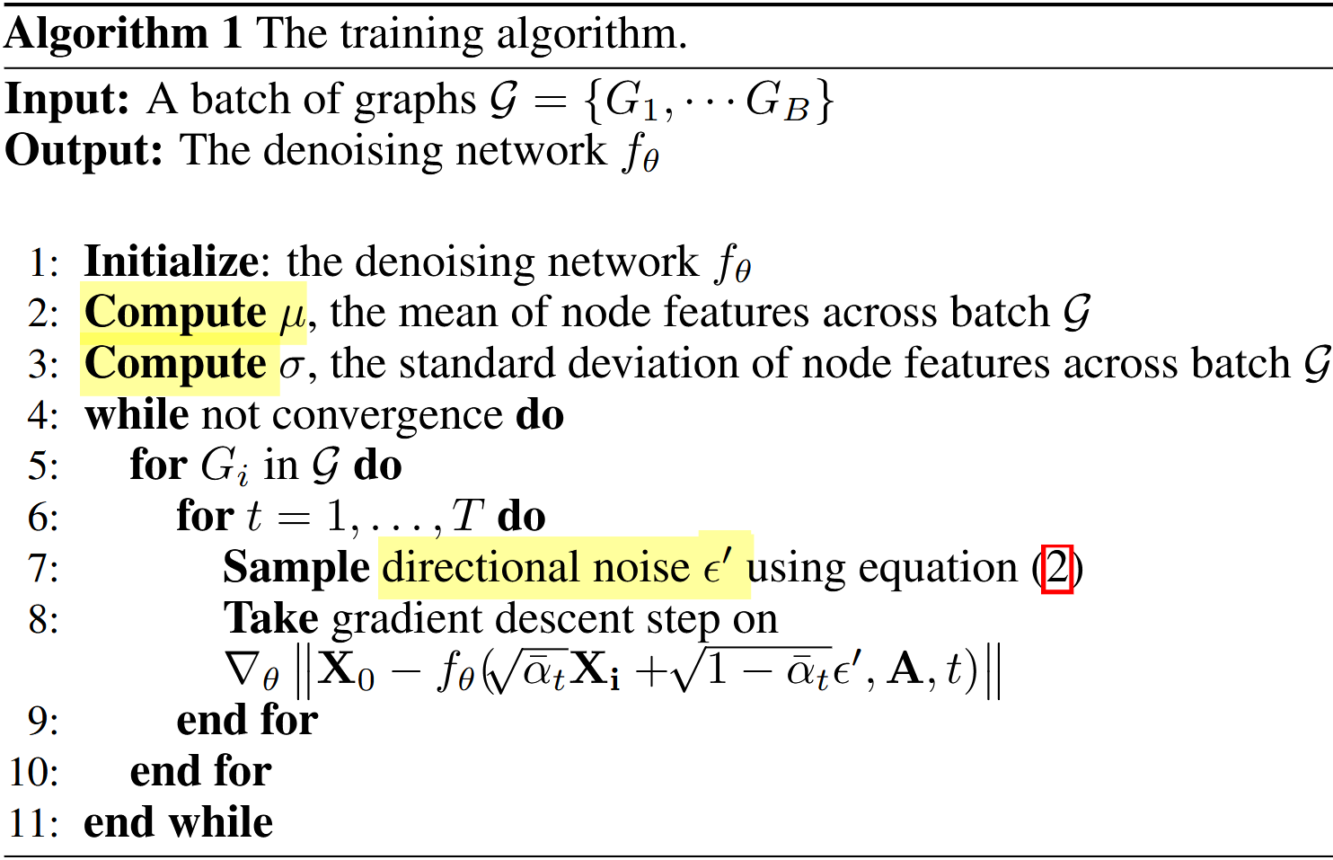
Marlon Kapala - Department of Computer Science - TU Dortmund
The Training Algorithm
► Similar to the DPDM algorithm
17 / 25
Yang et al., 2023

Slide 18
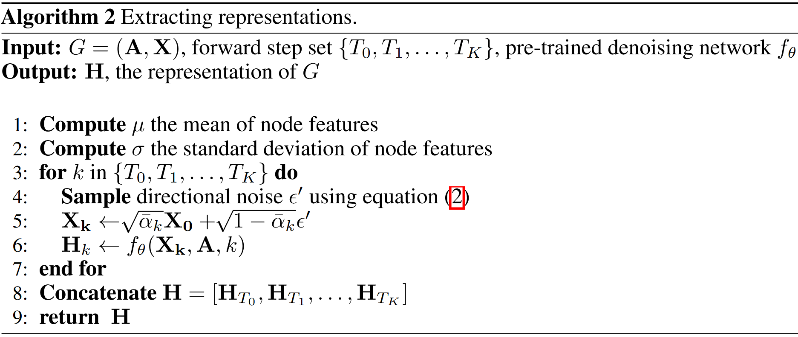
Marlon Kapala - Department of Computer Science - TU Dortmund
The Extraction Algorithm
► Instead of generating an image, a representation is generated
Yang et al., 2023
18 / 25

Slide 19
Marlon Kapala - Department of Computer Science - TU Dortmund
5 Resulting Benchmarks
19 / 25

Slide 20
Marlon Kapala - Department of Computer Science - TU Dortmund
Graph Classification
► The paper compares multiple State-Of-The-Art models with DDMs
► SVMs are used on the learned representations
► While here only graph classification results are presented, the results from node classification are similarly promising
20 / 25

Slide 21
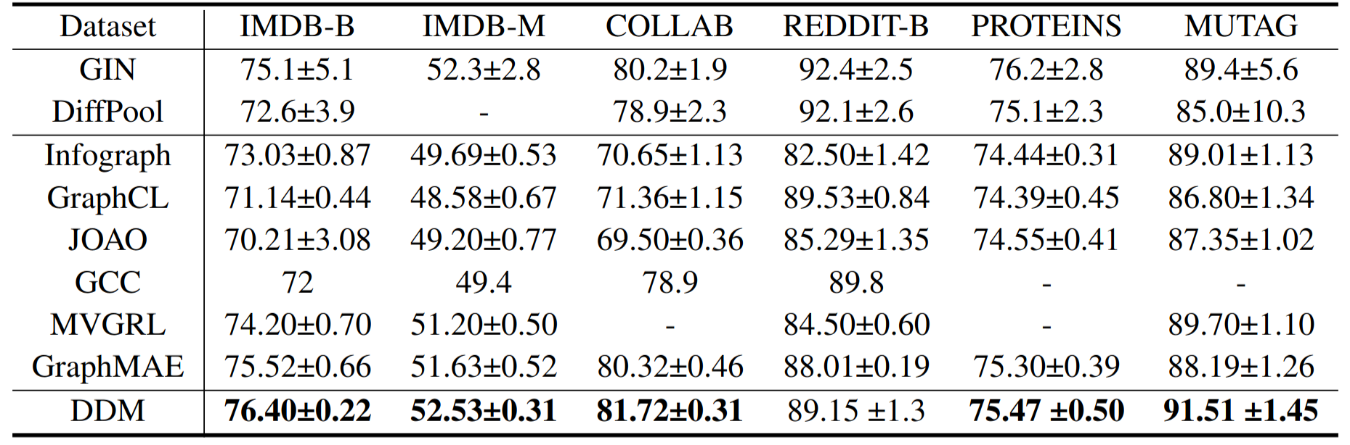
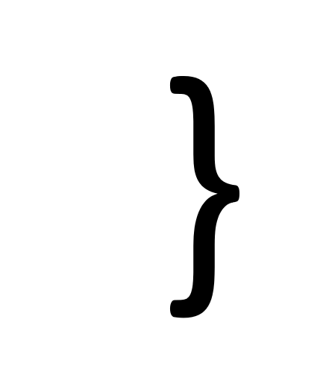

Marlon Kapala - Department of Computer Science - TU Dortmund
Results
supervised
unsupervised
Yang et al., 2023
21 / 25

Slide 22
Marlon Kapala - Department of Computer Science - TU Dortmund
6 Conclusion
22 / 25

Slide 23
Marlon Kapala - Department of Computer Science - TU Dortmund
Research Outlook
► Yang et al. only introduce the idea, they admit that their hyperparameters are not optimal yet
► One open question is how the optimal set of diffusion steps can be determined
► Variants of DDMs could bring value to areas such as computer vision and natural language processing
► To the best of my knowledge, nobody has yet continued their work
23 / 25

Slide 24
Marlon Kapala - Department of Computer Science - TU Dortmund
What makes this paper special?
► As mentioned, the technology introduced holds great potential for future research
► The benchmarks are remarkable, particularly compared to the supervised models
► The researchers consider themselves “among the pioneers in the literature“ regarding the “exploration of anisotropic structure in graph data“
24 / 25

Slide 25
Marlon Kapala - Department of Computer Science - TU Dortmund
References & Weblinks
► Yang et al. (2023). Directional diffusion models for graph representation learning
► Zhu et al. (2020). GSSNN: Graph Smoothing Splines Neural Networks
► Yanardag et al. (2015). Deep Graph Kernels
► Nguyen et al. (2019). Universal Graph Transformer Self-Attention Networks
► Ho et al. (2020). Denoising Diffusion Probabilistic Model
► Dhariwal et al. (2021). Diffusion Models Beat GANs on Image Synthesis
► Presentation Code: https://github.com/JavaLangMarlon/ddm-proseminar-tu-dortmund
► CC BY-SA 3.0: https://creativecommons.org/licenses/by-sa/3.0
► CC BY-SA 4.0: https://creativecommons.org/licenses/by-sa/4.0
25 / 25

