Slide 1

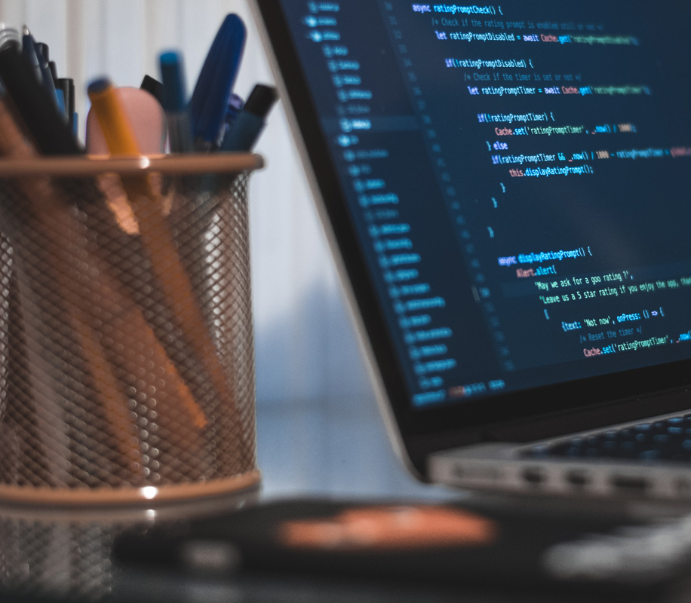

Machine Learning with Python
Course Overview

Slide 2
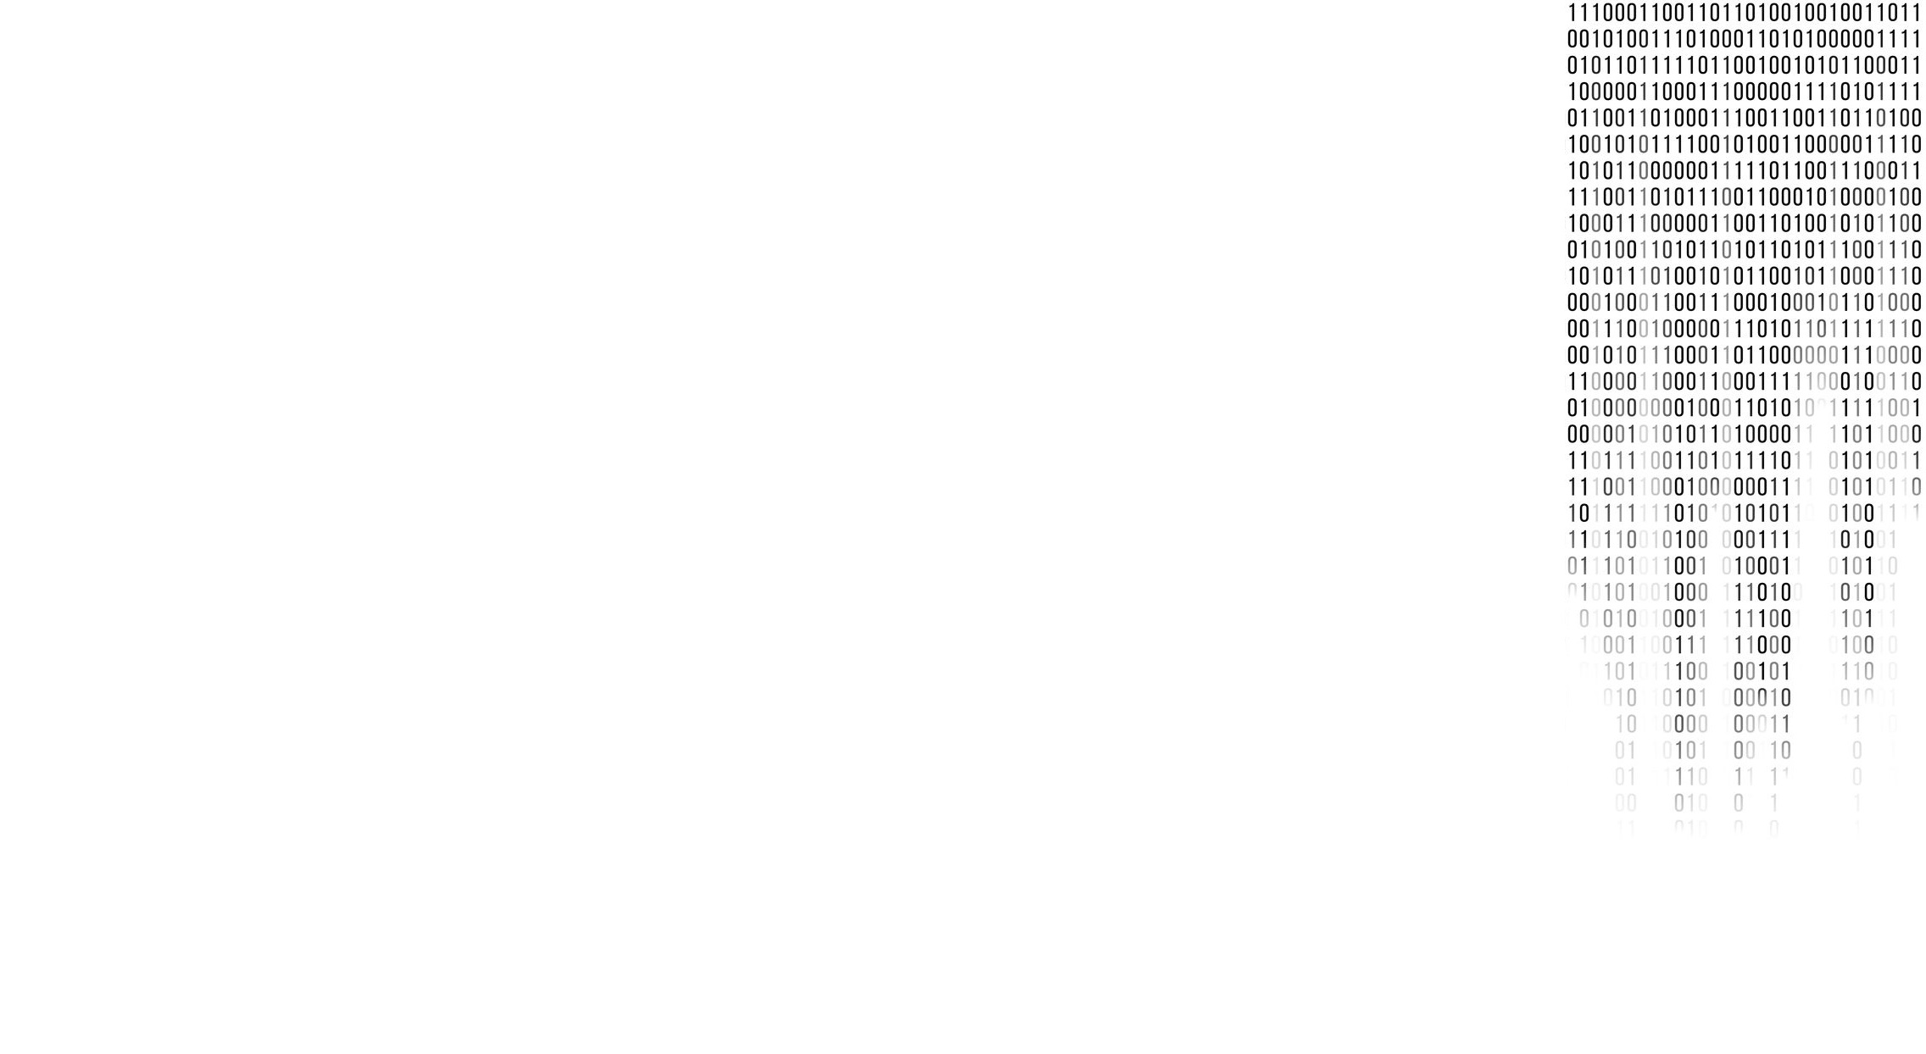
This course dives into the basics of machine learning using an approachable, and well-known programming language, Python.
In this course, we will be reviewing two main components:
First, you will be learning about the purpose of Machine Learning and where it applies to the real world.
Second, you will get a general overview of Machine Learning topics such as supervised vs unsupervised learning, model evaluation, and Machine Learning algorithms.

