Slide 1
LW262 Tort Law: Week 11: Lecture 3
Ursula Connolly, lecturer for tort law

Slide 2

Week 11 Snapshot
You should have:
Tort Law:
Finished Topic 4 Causation and 5 Remoteness
Tutorials: tutorial 3 (Week 11 and 12)
MCT: Finished – yay!

Slide 3
MCT Performance

Slide 4

Psychiatric Injury: Nervous Shock
What is it?
“Medically recognised psychiatric illness brought about as a result of a shock”

Slide 5
Issues
Background: reluctance to allow recovery, types of cases
Current Irish principles
English position
Irish position

Slide 6
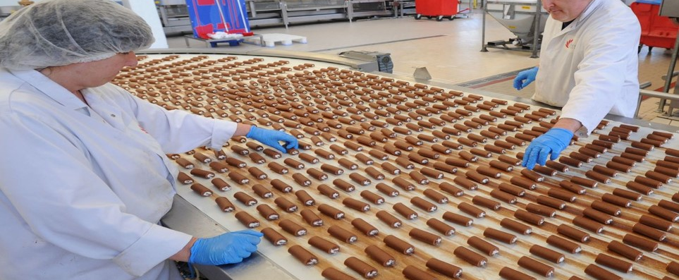
Employment: Curran v Cadbury (Ireland) Ltd (2000) ILT 140

Slide 7
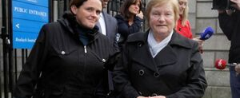
Killings: Madden v Doohan and Another [2012] IEHC 422

Slide 8
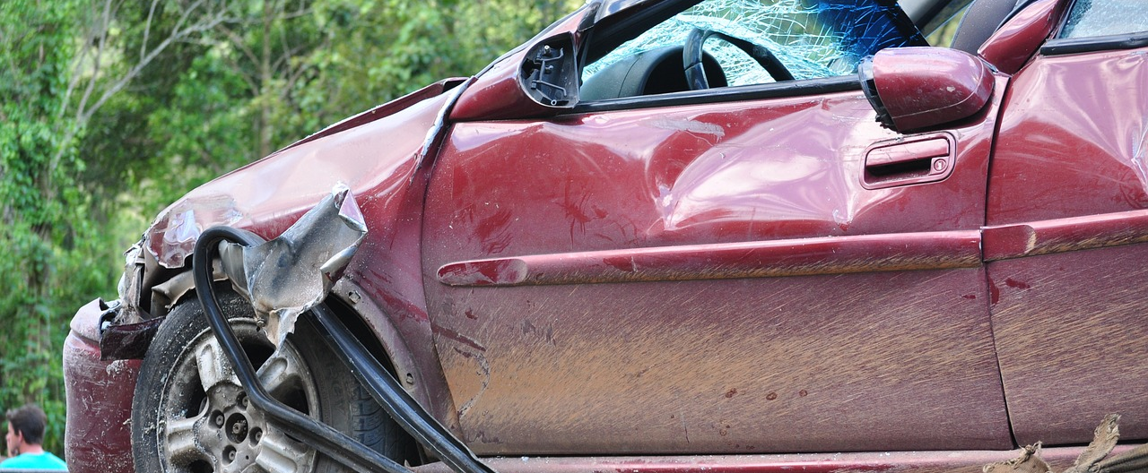
Car accidents (RTA: road traffic accidents (most recent is the Sheehan v Bus Éireann case)

Slide 9
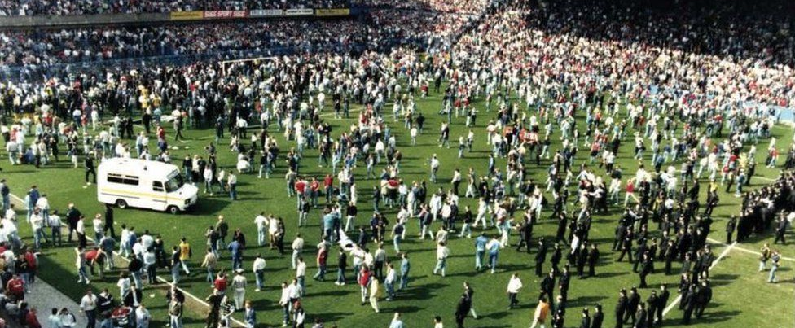
Hillsborough disaster (Alcock, White)

Slide 10
Seminal: Kelly v Hennessy [1995] 3 IR 253
Plaintiff must establish that they suffer from a recognisable psychiatric illness,
They must show that this was shock induced,
The nervous shock must have been caused by the defendant’s negligence,
The nervous shock must be by reason of actual or apprehended physical injury to the plaintiff or another person,
The plaintiff must show that the defendant owed a duty of care not to cause the reasonably foreseeable nervous shock. As regards this element Hamilton CJ stated that the relationship between the plaintiff and the person injured must be close, but did not specify particular relationships.

Slide 11
Early Cases
Ireland
United Kingdom
Byrne v Southern and Western Ry Co Court of Appeal, February 1884
Bell v G.N. Ry. Co. 26 LR (Ir) (1890) 428
Victoria Ry Commrs v Coultas (1888) 13 AC 222

Slide 12
‘Modern’ Cases
Ireland
United Kingdom
Mullally v Bus Eireann [1992] ILRM 722
Kelly v Hennessy [1995] 3 IR 253
Curran v Cadbury (Ireland) Ltd (2000) ILT 140
Cuddy v Mays [2003] IEHC 103
Courtney v Our Lady's Hospital Ltd t/a Our Lady's Hospital Crumlin & Ors [2011] IEHC 226
Sheehan v Bus Éireann [2020] IEHC 160
McLoughlin v O’Brian [1983] 1 AC 410
Attia v British Gas [1988] QB 304
Alcock v Chief Constable of South Yorkshire [1991] 3 W.L.R. 1057 (HL)10
White v Chief Constable of the South Yorkshire Police [1999] 2 AC 455

Slide 13
Hillsborough disaster: Alcock v Chief Constable of South Yorkshire [1991] 3 W.L.R. 1057 (HL)10

Slide 14
Claimants:
10 appellants
Brian Harrison: two brothers, at the match
Mr and Mrs Copoc: son, live on television, identified body
Brenda Hennessey: brother, watched live on television
Denise Hough: brother, learned of it from a friend, then watched television
Stephen Jones: brother, watched live on television
Robert Alcock: brother-in-law, at the match with brother-in-law’s son
Catherine Jones: brother, heard about it from a firend, then watched television
Joseph Kehoe: 14-year-old grandson, watched a recorded version.
Alexander Penk: fiancée, watched it live.

Slide 15
Principles
Primary: Those actually in danger, those who perceive themselves to be in danger, and rescuers.
Such a person will succeed so long as they could show that psychiatric injury was foreseeable to a person of reasonable fortitude.
Secondary: These are ‘non-participants’, those who believe themselves to be in no personal danger. These would be for instance those who witness the event, or hear about it either at the time or later.
In order to succeed in a claim they must prove more than mere foreseeability. They must show:
a close tie of love and affection with the immediate victim, McFarlane v EE Caledonia Ltd [1994] 2 All ER 1.
proximity in time and space to the accident or its immediate aftermath,
perception of the accident or its aftermath by sight or hearing.

Slide 16
Finding
“Only two plaintiffs, Mr and Mrs Copoc, lost a son, but they saw the disaster on television and Mr Copoc identified the body on the following morning having already been informed that his son was dead. No plaintiff lost a spouse. None of the other plaintiffs who lost relatives sought to establish that they had relationships of love and affection with a victim comparable to that of a spouse or parent. In any event only two of them were present on the ground and the remainder saw the scenes on simultaneous or recorded television. In these circumstances none of the plaintiffs have satisfied both the tests of reasonable foreseeability and proximity and I would dismiss all the appeals.”

Slide 17

Questions?
This Photo by Unknown Author is licensed under CC BY-SA

