Slide 1
LW262 Tort Law: Week 12: Lecture 1
Ursula Connolly, lecturer for tort law

Slide 2

Week 12 Snapshot
You should have:
Tort Law:
Finished Topic 4 Causation and Topic 5 Remoteness
Topic 6: Nervous Shock Week 11 and 12
Tutorials: tutorial 3 (Week 11 and 12)

Slide 3

Psychiatric Injury: Nervous Shock
What is it?
“Medically recognised psychiatric illness brought about as a result of a shock”

Slide 4
Issues
Background: reluctance to allow recovery, types of cases
Current Irish principles
English position
Irish position

Slide 5
Early Cases
Ireland
United Kingdom
Byrne v Southern and Western Ry Co Court of Appeal, February 1884
Bell v G.N. Ry. Co. 26 LR (Ir) (1890) 428
Murphy J, stated that it was ‘immaterial whether the injuries be called nervous shock, brain disturbance, mental injury or shock. The only questions to be considered, in my opinion, are: was the health or capacity of the plaintiff for the discharge of her duties and enjoyment of life affected by what occurred to here whilst in the carriage? Next, was this caused by the negligence of the defendants?.’
Victoria Ry Commrs v Coultas (1888) 13 AC 222

Slide 6
‘Modern’ Cases
Ireland
United Kingdom
Mullally v Bus Eireann [1992] ILRM 722
Kelly v Hennessy [1995] 3 IR 253
Curran v Cadbury (Ireland) Ltd (2000) ILT 140
Cuddy v Mays [2003] IEHC 103
Courtney v Our Lady's Hospital Ltd t/a Our Lady's Hospital Crumlin & Ors [2011] IEHC 226
Sheehan v Bus Éireann [2020] IEHC 160
McLoughlin v O’Brian [1983] 1 AC 410
Attia v British Gas [1988] QB 304
Alcock v Chief Constable of South Yorkshire [1991] 3 W.L.R. 1057 (HL)10
White v Chief Constable of the South Yorkshire Police [1999] 2 AC 455

Slide 7
Seminal: Kelly v Hennessy [1995] 3 IR 253
Plaintiff must establish that they suffer from a recognisable psychiatric illness,
They must show that this was shock induced,
The nervous shock must have been caused by the defendant’s negligence,
The nervous shock must be by reason of actual or apprehended physical injury to the plaintiff or another person,
The plaintiff must show that the defendant owed a duty of care not to cause the reasonably foreseeable nervous shock. As regards this element Hamilton CJ stated that the relationship between the plaintiff and the person injured must be close, but did not specify particular relationships.

Slide 8

Employment: Curran v Cadbury (Ireland) Ltd (2000) ILT 140
McMahon J:
Distinction between primary and secondary did not do ‘anything to assist the development of legal principles that should guide the courts in this complex area of law’.
He further stated that ‘The law on this topic is far from settled, a divergence of approach between the two jurisdictions is becoming increasingly obvious and perhaps inevitable...’.

Slide 9

Killings: Madden v Doohan and Another [2012] IEHC 422

Slide 10
Devlin v National Maternity Hospital [2008] 2 IR 222
Facts:
This case arose from the ‘retention of organs’ scandal, where certain hospitals retained the organs of deceased infants, without informing the parents.
The plaintiff learned, through a letter sent to her by the HSE, that her deceased child’s organs were retained.
She developed PTSD.

Slide 11
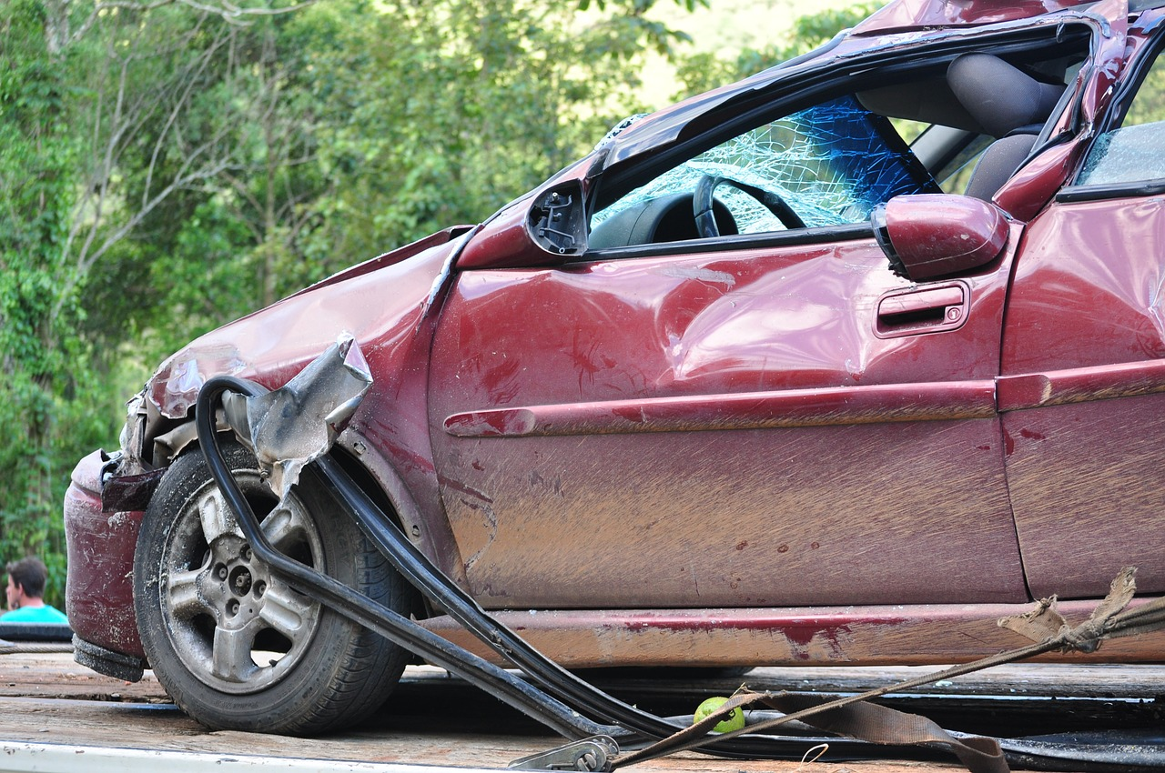
Sheehan v Bus Éireann
“First, the test for liability for negligently inflicted psychiatric injury is that set out by Hamilton CJ in Kelly. The test for the existing of a duty of care, the fifth requirement of the test in Kelly, is that articulated by Keane CJ in Glencar Exploration Inc. A rigid primary/secondary distinctions, entailing an inflexible adherence to the Alcock control mechanisms, has no role to play in the application of either.”

Slide 12
Issues
Should Ireland have special rules for psychiatric injury?
Should the rules adopt the primary/secondary distinction?
Should those who do not know the victims be able to recover for psychiatric injury? If so, always? Or sometimes? How do we decide?
If you were an appeal judge in Sheehan how would you find?

Slide 13

Questions?
This Photo by Unknown Author is licensed under CC BY-SA

