Slide 1
LW262 Tort Law: Week 12: Lecture 3
Ursula Connolly, lecturer for tort law

Slide 2

Week 12 Snapshot
You should have:
Tort Law:
Finished Topic 4 Causation and Topic 5 Remoteness
Topic 6: Nervous Shock Week 12
Tutorials: tutorial 5 (Week 11 and 12)

Slide 3
Nervous Shock Overview
Historical reluctance
Divergence between Irish and English law (evident from 1880s but certainly post Alcock)
England: Primary and secondary victims: Alcock, White.
Ireland: Kelly v Hennessy, Courtney, Cuddy, Sheehan, Devlin.

Slide 4
Issues
Should Ireland have special rules for psychiatric injury?
Should the rules adopt the primary/secondary distinction?
Should those who do not know the victims be able to recover for psychiatric injury? If so, always? Or sometimes? How do we decide?
If you were an appeal judge in Sheehan how would you find?

Slide 5
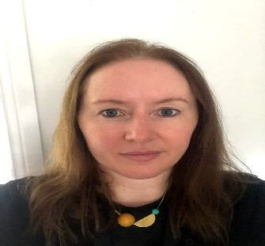
Next Semester
Modules
Tort Law will continue: end of term 2 hour exam worth 85%
Tutorials:
Tort Law
CÉIM
Lecturer: Dr Edel Hughes

Slide 6

Questions?
This Photo by Unknown Author is licensed under CC BY-SA

