Slide 1

Pavel Šeps, Jan Humpál, Daniel Hryzbil, Ivan Kratochvíl
https://github.com/JavaMugs/CloneHero

Slide 2
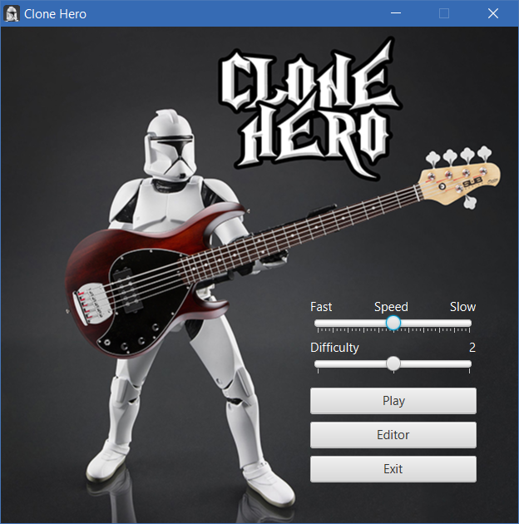
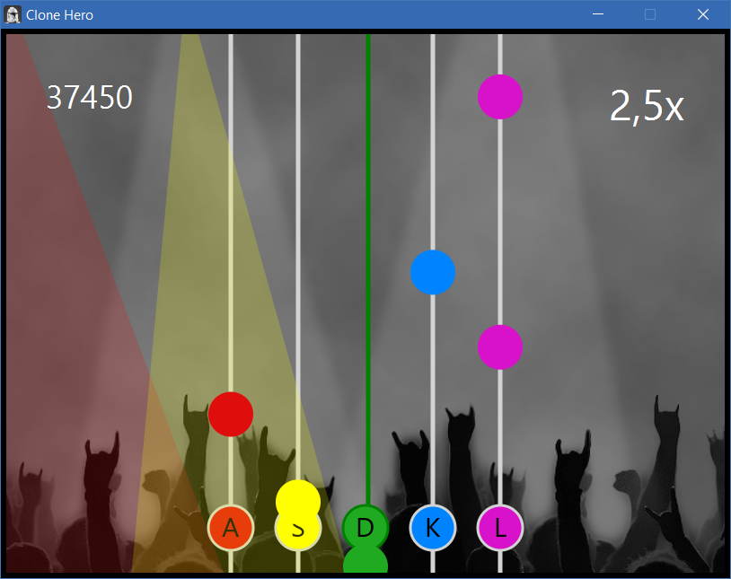

Slide 3
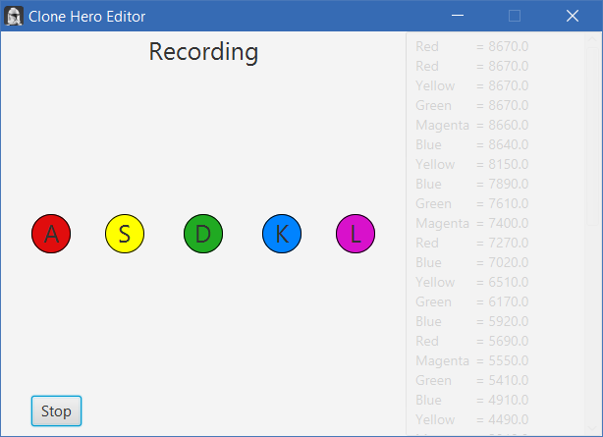
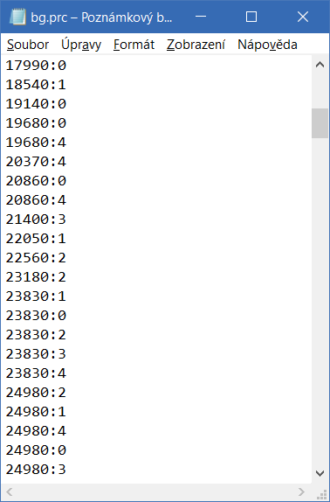

Slide 4
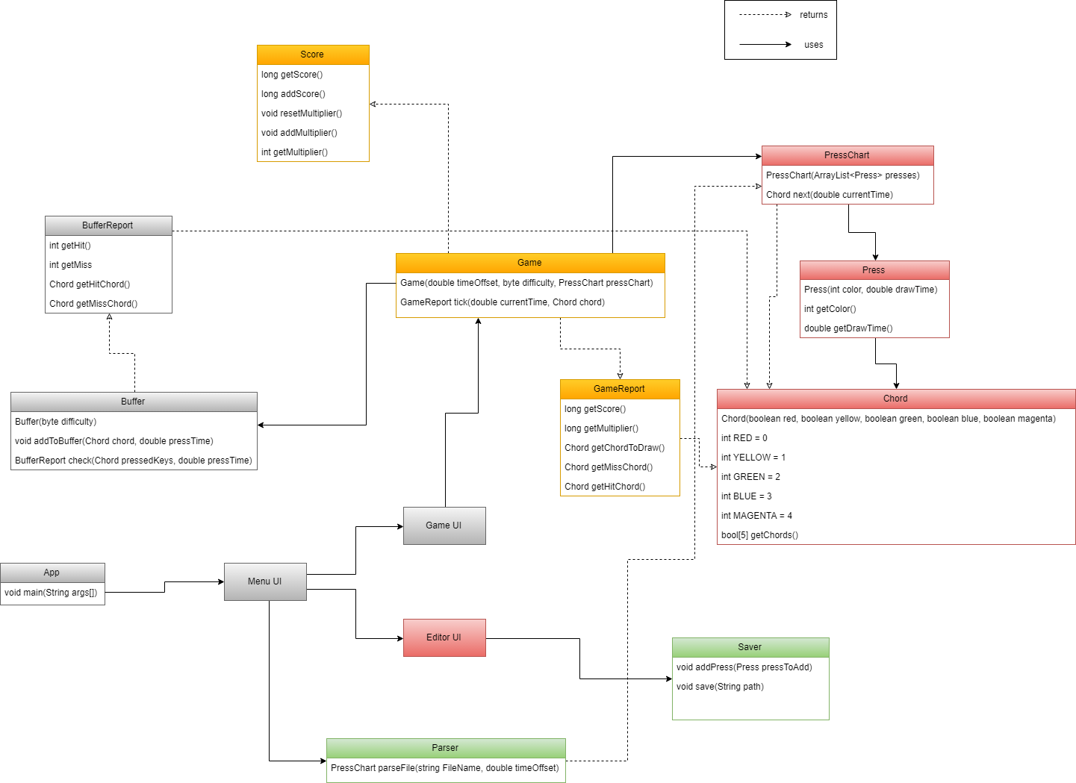

Slide 5
