Slide 2
LECTURE 4
INTRODUCTION TO PROBABILITY
Saidgozi Saydumarov Sherzodbek Safarov
QM Module Leaders
ssaydumarov@wiut.uz
s.safarov@wiut.uz
Office hours: Monday 16:00-18:00 and Tuesday 10:00-12:00
Room ATB308
EXT: 664

Slide 3
ANNOUNCEMENT!
QM In class test next week (October 21-26)
Topics covered Teaching week 1-4
Part of your formal assessment

Slide 4
Lecture outline
The meaning of probability and relevant concepts
The basic operations of probability
Sets, combination, and permutation
Mathematical expectation

Slide 5
Experiment vs Sample Space
The probability is a chance or likelihood of an event to happen
An experiment is an activity with an observable result
The trials – repetition of an experiment
The outcomes – results of each trial
A sample space is the set of all possible outcomes
A sample point is an element of the sample space
An Event is a subset of the sample space

Slide 6
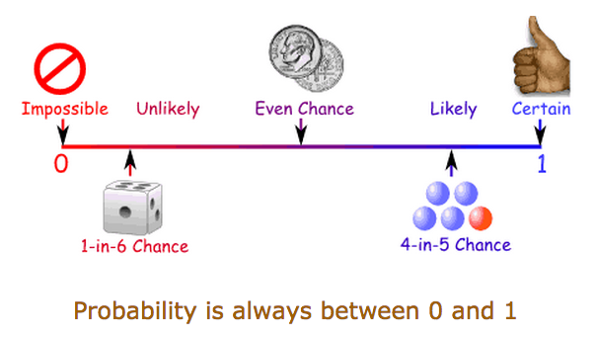
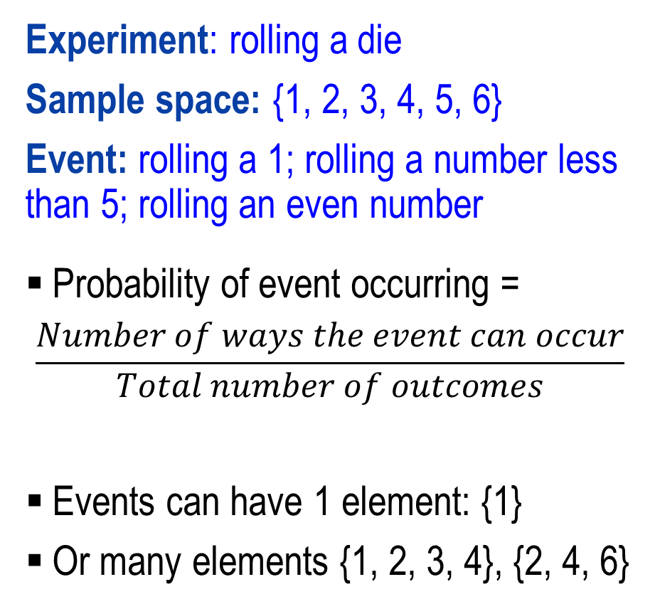
Experiment vs Sample Space
Experiment: rolling a die
Sample space: {1, 2, 3, 4, 5, 6}
Event: rolling a 1; rolling a number less than 5; rolling an even number
Probability of event occurring =
$$\frac{Number of ways the event can occur}{Total number of outcomes}$$
Events can have 1 element: {1}
Or many elements {1, 2, 3, 4}, {2, 4, 6}
Probability is a numerical measure of the chance (or likelihood) that a particular event will occur.
Probability values are always assigned on a scale of 0 to 1:
0 indicates that an event is very unlikely to occur
1 indicates that an even is almost certain to occur

Slide 7
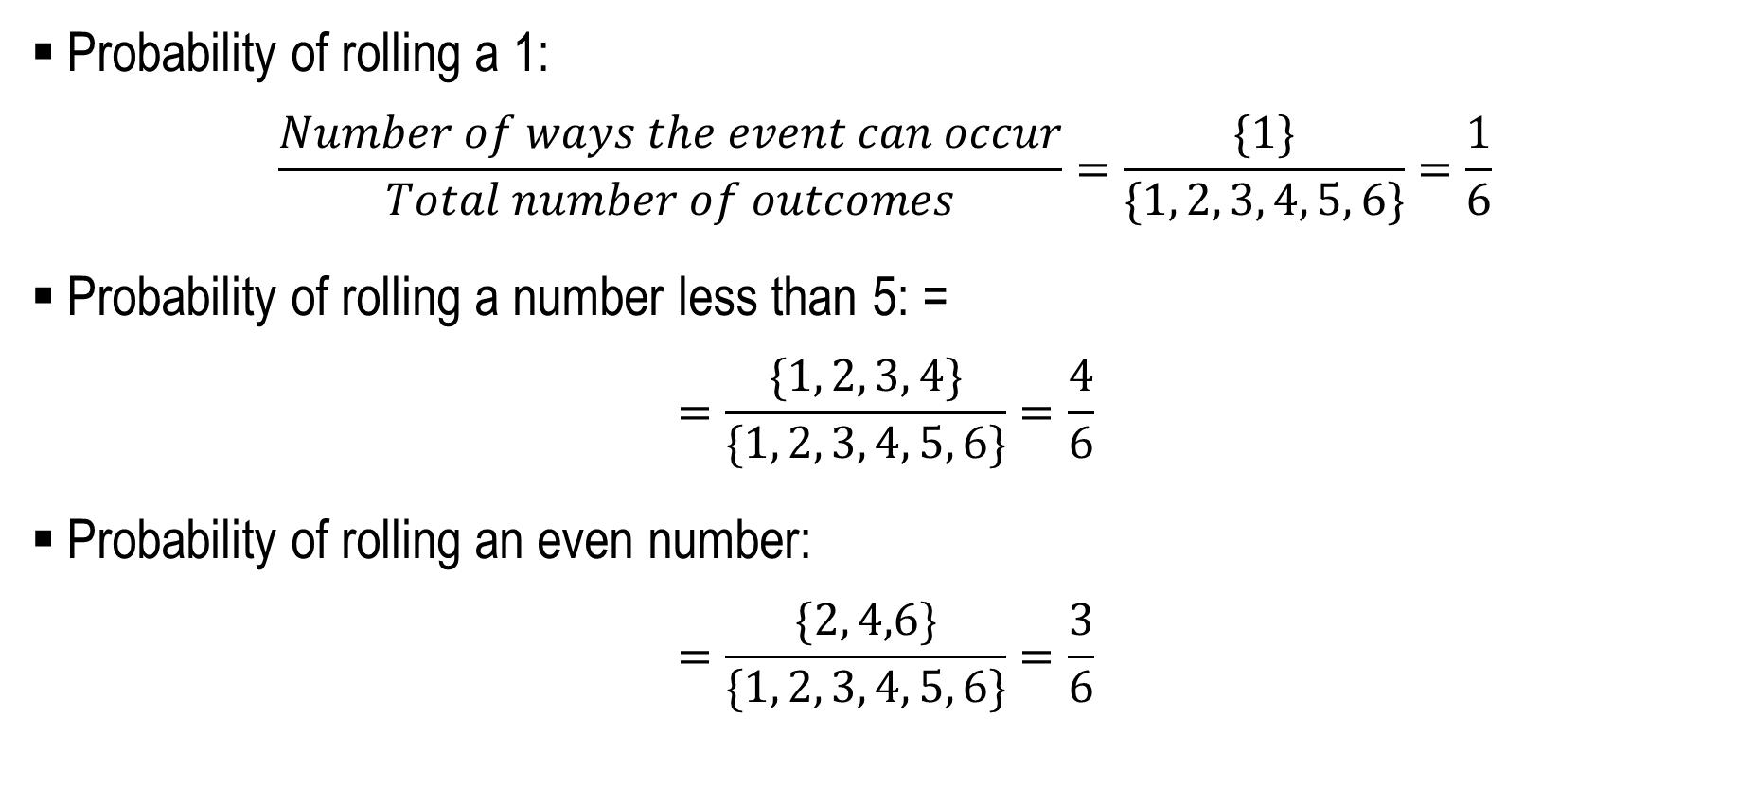
Experiment vs Sample Space
Probability of rolling a 1:
$$\frac{Number of ways the event can occur}{Total number of outcomes}=\frac{\{1\}}{\{1, 2, 3, 4, 5, 6\}}=\frac{1}{6}$$
Probability of rolling a number less than 5: =
$$=\frac{\{1, 2, 3, 4\}}{\{1, 2, 3, 4, 5, 6\}}=\frac{4}{6}$$
Probability of rolling an even number:
$$=\frac{\{2, 4,6\}}{\{1, 2, 3, 4, 5, 6\}}=\frac{3}{6}$$

Slide 8
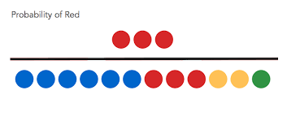
Calculation of probability
There are 6 blue, 3 red, 2 yellow, and 1 green marbles in the box.
What is the probability of picking a red marble?

Slide 9
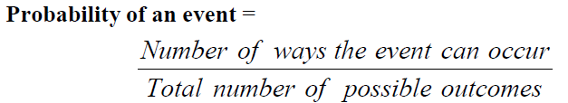
Calculation of probability
There are 6 blue, 3 red, 2 yellow, and 1 green marbles in the box.
What is the probability of picking a red marble?
Thus, the probability of picking a red marbles is: 3/12=0.25 or 25%

Slide 10
Calculation of probability
If there are n experimental outcomes, the sum of the probabilities for all the experimental outcomes must be equal to 1
In the marble scenario,
P(blue) + P(red) + P(yellow) + P(green) =
= 0.5 + 0.25 + 1/6 + 1/12 = 1

Slide 11
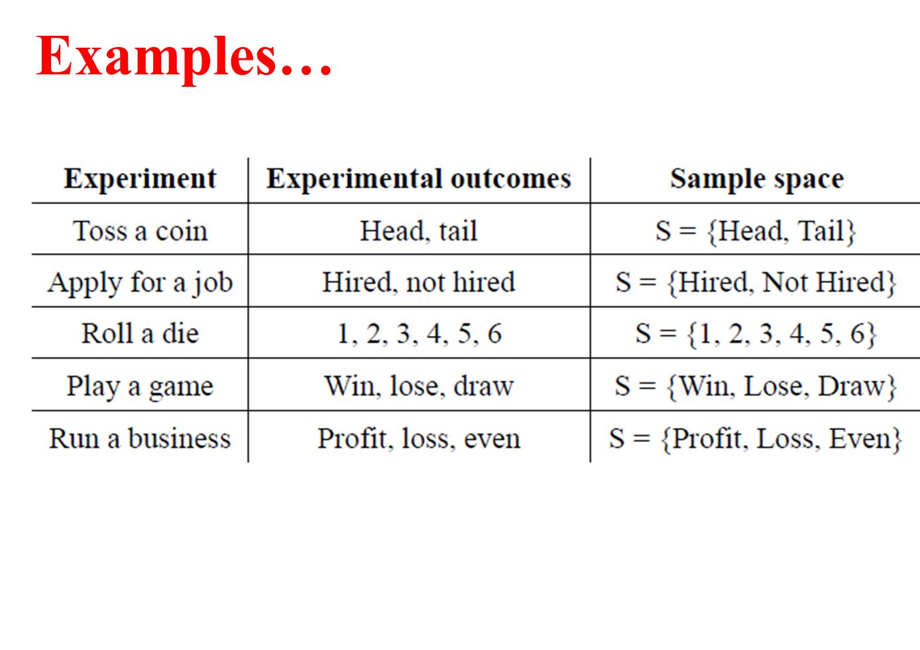

Slide 12
Types of counting rules
Multiple step
Combination
Permutation

Slide 13
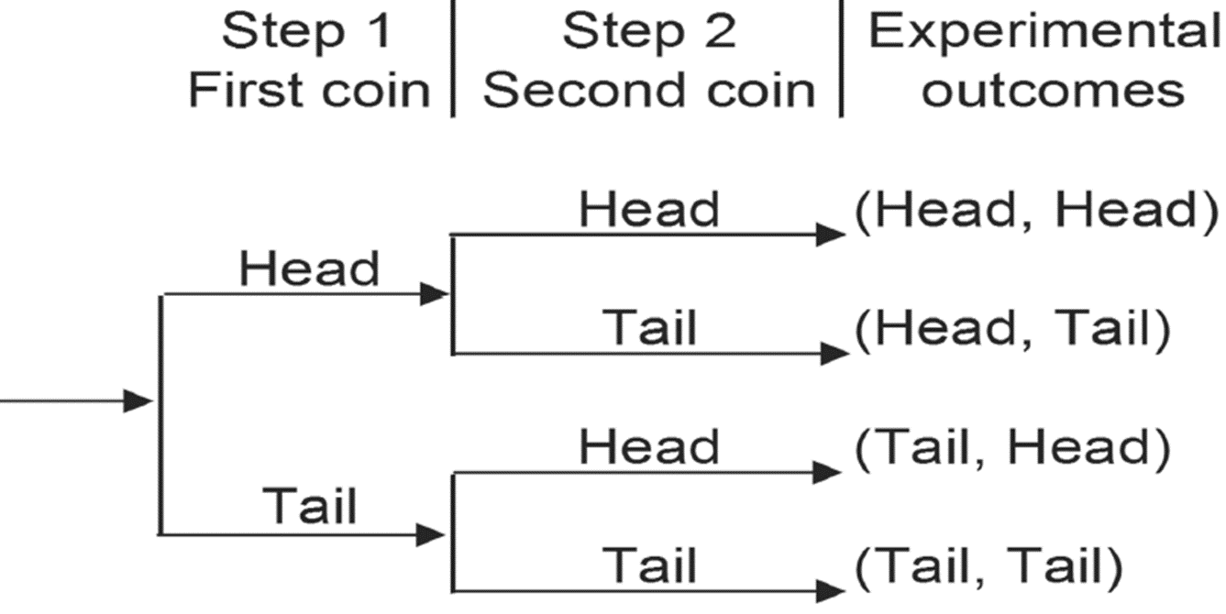

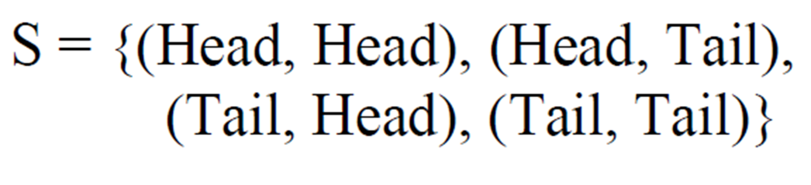
Multiple step experiment
Experiment of a sequence of k steps
Total number of experimental outcomes is the product of number of outcomes in each step
(n₁)(n₂)(n₃)…(n_{k-1})(n_{k})
Example: let’s toss the coin twice
Graphically…
Total number of outcomes = (n₁)(n₂) =2*2=4
Thus, sample space is

Slide 14
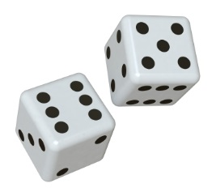
Self exam-training task:
Find the sample space for rolling a die three times

Slide 15
Combination
Example:
In this classroom, a lecturer randomly picks two of five students (let’s say Alisher, Bekzod, Clara, Davron and Eva) to test their knowledge of probability. In a group of five smart students, how many combinations of two students may be selected?
(sequence of selection does not matter)
Verbal solution: a lecturer may have 10 picks
Alisher with Bekzod
Alisher with Clara
Alisher with Davron
Alisher with Eva
Bekzod with Clara
Bekzod with Davron
Bekzod with Eva
Leyla with Davron
Leyla with Eva
Davron with Eva

Slide 16

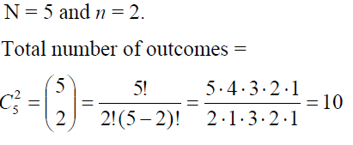
Combination
Combination formula: n objects are to be selected from a set of N objects, where the order of selection is not important.
Where, n! = n·(n-1) ·(n-2)…3·2·1
Example: 5! = 5·4·3·2·1 = 120
Solution:

Slide 17
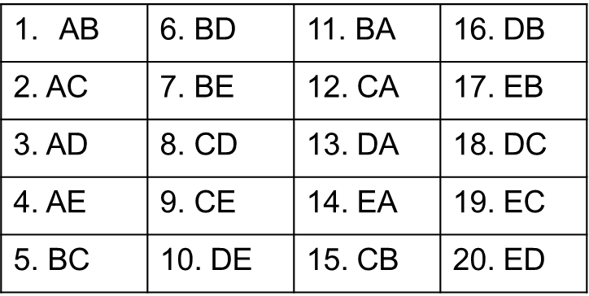
Permutation
Example:
In this classroom, out of these five students, let’s assume their names are again Alisher, Bekzod, Clara, Davron and Eva, how may ways do we have in order to have one interviewer and one interviewee?
Verbal solution: a lecturer may have 20 picks

Slide 18

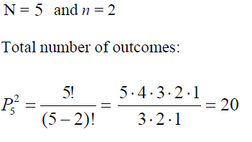
Permutation
Permutation formula: n objects are to be selected from a set of N objects, where the order of selection is important.
Solution:

Slide 19



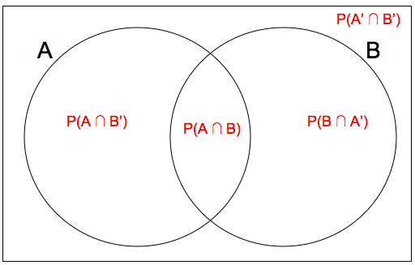
Operations with events
The union of events A and B is the event containing all experimental outcomes belonging to A or B or both.
The intersection of A and B is the event containing the experimental outcomes belonging to both A and B.
The complement of an event A is an event consisting of all experimental outcomes that are not in A.

Slide 20
Operations with events
Toss a die and observe the number that appears on top
S = {1, 2, 3, 4, 5, 6} (sample space)
A = {2, 4, 6} (even numbers)
B = {1, 3, 5} (odd numbers)
C = {2, 3, 5} (prime numbers)
AUC = {2, 3, 4, 5, 6) - the event that an even number or a prime number is observed
B∩C = {3, 5} - the event that an odd prime number is observed
C^{C} = {1, 4, 6} - the event that a non prime number is observed
Exercises:
Find 1) BUC; 2) A∩C; 3) (BUC)^{C}

Slide 21

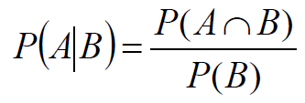

Relationship of events
Mutually exclusive events -
The events A and B do not have any experimental outcomes in common
Dependent events
The event A has an influence on the event B
Independent events
The event A has no influence on the event B

Slide 22
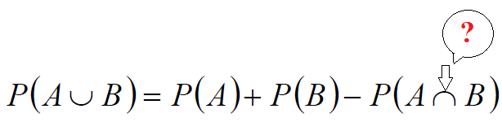
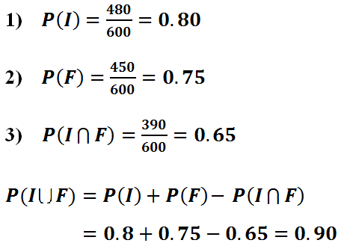
Addition rule for union
Question: On Quantitative Methods module for 600 CIFS students at WIUT, 480 passed the in-class test and 450 passed the final exam, 390 students passed both exams.
Due to high failure rate, the module leader decides to give a passing grade to any student who passed at least one of the two exams.
What is the probability of passing this module?
The addition rule is used to compute the probability of the union of two events:

Slide 23
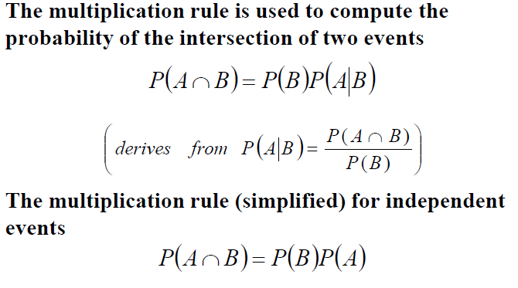
Multiplication rule for intersection

Slide 24

Mathematical expectation
365bet.com sent you following offers for coming El-Classico game depending on your betting:
If Barcelona wins, they will triple your money
If Real Madrid wins, they will double your money
If game results in a draw, they will quadruple your money
If you would like to bet for $100, assuming the possibilities of outcomes are equally likely, what will be the expected sum of your money?
Your possible earnings:
$200 or $0 if you bet on Barcelona’s victory
$300 or $0 if you bet on Real Madrid’s victory
$400 or $0 if you bet on a draw
Hence, the expected sum of your income will be

Slide 25
Concluding remarks
Today, you learned:
Basic concepts within probability theory
Basic operations of calculating the sample space and number of probable events (combinations, permutations)
Union rules

Slide 26
Essential readings
Louise Swift “Quantitative methods…”, Ch P1 (p. 311-..)

