Slide 1
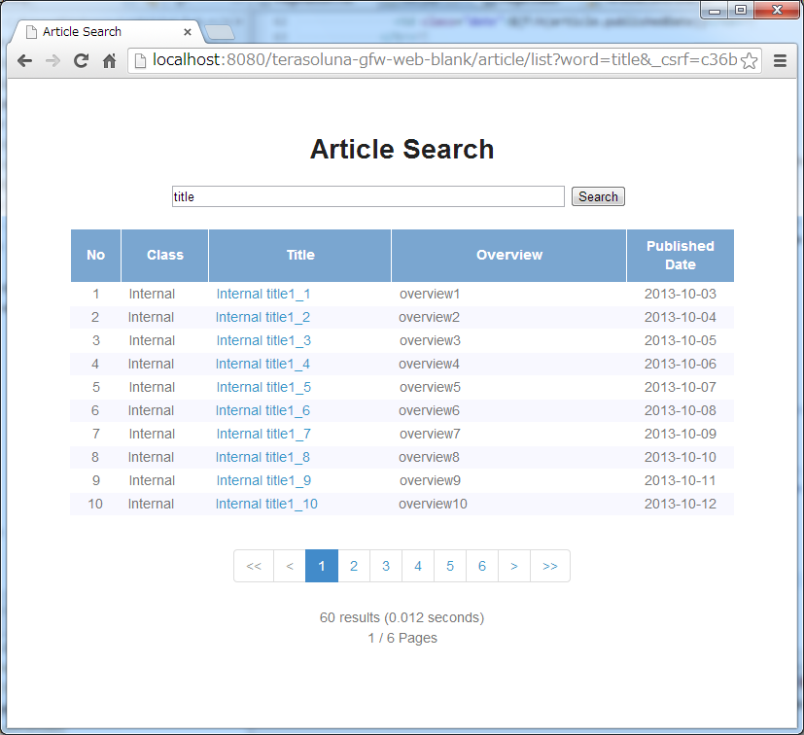
(1)
Pagination Links
(2)
Pagination Information

Slide 2



Server
<Spring Data>
Pageable
page = 0
Size = 3
<Spring Data>
Pageable
HandlerMethod
ArgumentResolver
(1)
(2)
?page=0&size=3&word=title
Aricle
Controller
(7)
(3)
<Spring Data>
Pageable
<Spring Data>
Page
totalElements = 18
(9)
Article List
JSP
Article
Service
<Spring Data>
Pageable
Article
Article
Article
(8)
(4)
<Spring Data>
Pageable
(6)
<library>
PaginationTag
Article
Repositry
<t:pagination page=“${page}” />
(5)
Total
Elements
(10)
Article
Article
Article
?page=2&size=3&word=title
Database

Slide 3

(2)
(4)
(1)
(3)
(5)

Slide 4

(7)
(6)

Slide 5
<ul>
<li class="disabled">
<a href=“javascript:void(0)">&lt;&lt;</a>
</li>
<li class="disabled">
<a href="javascript:void(0)">&lt;</a>
</li>
<li class="active">
<a href="javascript:void(0)">1</a>
</li>
<li>
<a href="?page=1&size=6">2</a>
</li>
<!-- ... -->
<li>
<a href="?page=9&size=6">10</a>
</li>
<li>
<a href="?page=1&size=6">&gt;</a>
</li>
<li>
<a href="?page=9&size=6">&gt;&gt;</a>
</li>
</ul>
(1)
(6)
(2)
(7)
(3)
(4)
(5)

Slide 6
(1)
(2)
Outer Element
<ul class=“{Outer Element Class}”>
<li class={Inner Element Class}>
<a href=“{Page Link URL}">
{Page Link Text}
</a>
</li>
<!-- … -->
</ul>
(3)
(4)
Inner Element
(5)
Page Link
(6)
(7)

Slide 7

(1)(2)
Outer Element
(3)(4)
Inner Element
(5)(6)(7)
Page Link

Slide 8
(2)
(1)
<div class="pagination">
<span class="hiddenPageLink">
<a href=“javascript:void(0)">First</a>
</span>
<span class="hiddenPageLink">
<a href=“javascript:void(0)">Prev</a>
</span>
<span class="currentPageLink">
<a href="javascript:void(0)">1</a>
</span>
<!-- …. -->
<span>
<a href="?page=4&size=6">5</a>
</span>
<span>
<a href="?page=1&size=6">Next</a>
</span>
<span>
<a href="?page=9&size=6">Last</a>
</span>
</div>
(4)
(3)
(6)
(7)
(5)
(10)
(8)
(9)

Slide 9
<ul>
<li class="disabled">
<a href=“#">&lt;&lt;</a>
</li>
<li class="disabled">
<a href=“#">&lt;</a>
</li>
<li class="active">
<a href=“/webapp/article/list/0/6?sort=publishedDate,DESC&word=title">1</a>
</li>
<!-- ... -->
<li>
<a href="/webapp/article/list/9/6?sort=publishedDate,DESC&word=title">10</a>
</li>
<li>
<a href="/webapp/article/list/1/6?sort=publishedDate,DESC&word=title">&gt;</a>
</li>
<li>
<a href="/webapp/article/list/9/6?sort=publishedDate,DESC&word=title">&gt;&gt;</a>
</li>
</ul>
(1)
(6)
(2)
(3)
(4)

Slide 10
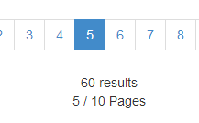
(1)
(2)
(3)

Slide 11
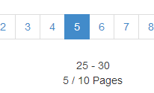
(4)
(5)

Slide 12



Removed.

Slide 13



Removed.

Slide 14




Hide.

Slide 15

Changed
max display count.
default(10) -> 5

Slide 16


Removed.

Slide 17
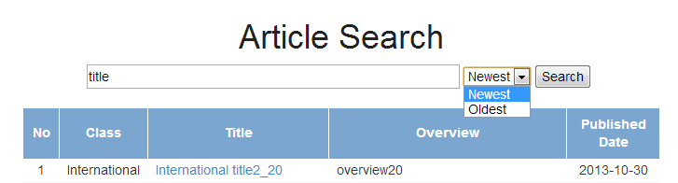

Slide 18
SessionArticleSearchController
<servlet>
HttpSession
SessionArticleSearchForm
(1)
SessionArticleSearchForm
SessionArticleSearchForm
Pageable
Pageable
(2)
SessionArticleDetailController
戻る

Slide 19
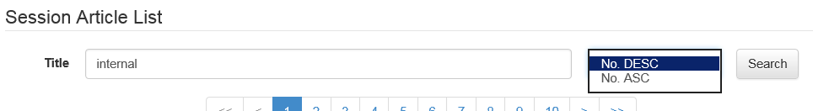
(1)
(2)

