Slide 1

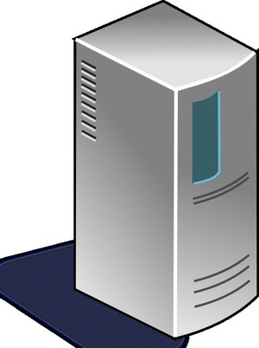

Web Browser
(Client Side)
Web Application
(Server Side)
HTTP(S)
(1) request(no session)
(2) new
<servlet>
HttpSession
Id=SESSION01
(4) response
Set-Cookie:JSESSIONID= SESSION01
(3) set
Session ID
(5) request
Cookie:JSESSIONID= SESSION01
Data
(Object)
Session ID
(6) get
(7) response
Session ID
Session ID
・
・
・
logical session of web application

Slide 2
Web Browser
(Client Side)
Web Application
(Server Side)
HTTP(S)
login request
new
<servlet>
HttpSession
Id=SESSION01
・
・
・
(1) logout request
(2) invalidate
<servlet>
HttpSession
HttpSession of "id=SESSION01" is not found.
(3) login request
Cookie:JSESSIONID= SESSION01
new
<servlet>
HttpSession
Id=SESSION02
Set-Cookie:JSESSIONID= SESSION02

Slide 3
Web Browser
(Client Side)
Web Application
(Server Side)
HTTP(S)
Login request
new
<servlet>
HttpSession
Id=SESSION01
no request.
(1)
Detected Session timeout by Application Server.
Session timeout
(2) invalidate
<servlet>
HttpSession
(3) request
Cookie:JSESSIONID= SESSION01
Session Error

Slide 4
Web Browser
(Client Side)
Web Application
(Server Side)
HTTP(S)
Login request
new
<servlet>
HttpSession
Id=SESSION01
no request.
Session timeout
<servlet>
HttpSession
(1)
Detected Session timeout by Application Server.
(1’) invalidate
(3)
Detected a request of after Session timeout by Spring Security.
(2) request
Cookie:JSESSIONID= SESSION01
(4) response
302 Found(Redirect)
Session Error

Slide 5
Controller
Wizard Form
1/3
Next
Wizard Form
2/3
<servlet>
HttpSession
Back
Next
Wizard Form
3/3
WizardForm
Back
Next
Confirm
Back
OK
Complete

Slide 6
OrderItemController
Item
Add
CartController
<servlet>
HttpSession
Cart
Cart
Go To Order
Edit
OrderController
Order
Order
Confirm
Order
Complete

Slide 7
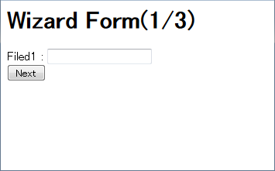
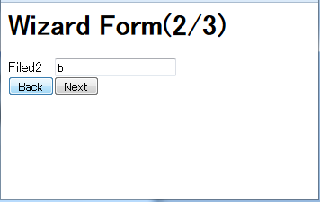
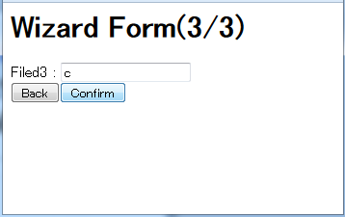
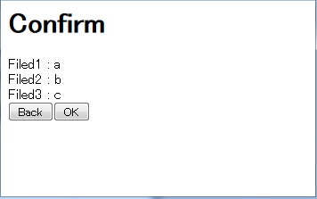
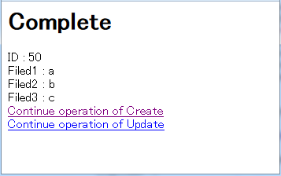

Slide 8
