Slide 1
TEAM "STATICE BLUE"

Slide 2
Team Members
Yavor Ivanov a.k.a (divoom12)
Silvia Slavcheva a.k.a (SilviaSlavcheva)
Mario Mishev a.k.a (Mishev)
Petar Genov a.k.a (genov1824)

Slide 3

Game

Slide 4
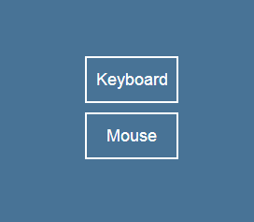
Controllers

Slide 5

The Hard Job

Slide 6
PING PONG
GitHub: https://github.com/JavaScript-Basics-Teamwork/JavaScript-Teamwork-Files

