Slide 1
Color Theory and Typography
By Js Bits

Slide 2
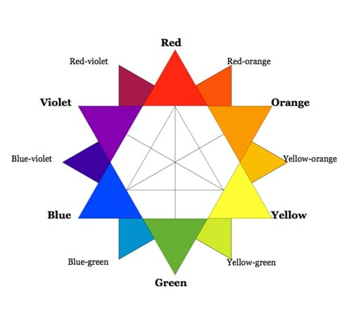
What is Color Theory
Color theory is a science and art unto itself, which some build entire careers on, as color consultants or sometimes brand consultants. Knowing the effects color has on a majority of people is an incredibly valuable expertise that designers can master and offer to their clients.
This is the first in section on color theory. Here we’ll discuss the meanings behind the different color families, and give some examples of how these colors are used (with a bit of analysis for each).

Slide 3
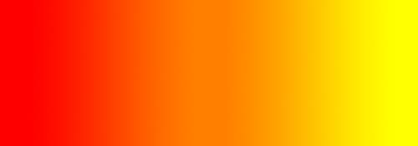
Warm Colors
Warm colors include red, orange, and yellow, and variations of those three colors. These are the colors of fire, of fall leaves, and of sunsets and sunrises, and are generally energizing, passionate, and positive.
Red and yellow are both primary colors, with orange falling in the middle (making it a secondary color), which means warm colors are all truly warm and aren’t created by combining a warm color with a cool color. Use warm colors in your designs to reflect passion, happiness, enthusiasm, and energy.

Slide 4
RED (PRIMARY COLOR)
Red is a very hot color. It’s associated with fire, violence, and warfare. It’s also associated with love and passion. In history, it’s been associated with both the Devil and Cupid. Red can actually have a physical effect on people, raising blood pressure and respiration rates. It’s been shown to enhance human metabolism, too.
Red can be associated with anger, but is also associated with importance (think of the red carpet at awards shows and celebrity events). Red also indicates danger (the reason stop lights and signs are red, and that warning labels are often red).
Outside the western world, red has different associations. For example, in China, red is the color of prosperity and happiness. It can also be used to attract good luck. In other eastern cultures, red is worn by brides on their wedding days. In South Africa, however, red is the color of mourning. Red is also associated with communism.
Red has become the color associated with AIDS awareness in Africa due to the popularity of the [RED] campaign.
In design, red can be a powerful accent color. It can have an overwhelming effect if it’s used too much in designs, especially in its purest form. It’s a great color to use when power or passion want to be portrayed in the design. Red can be very versatile, though, with brighter versions being more energetic and darker shades being more powerful and elegant.

Slide 5
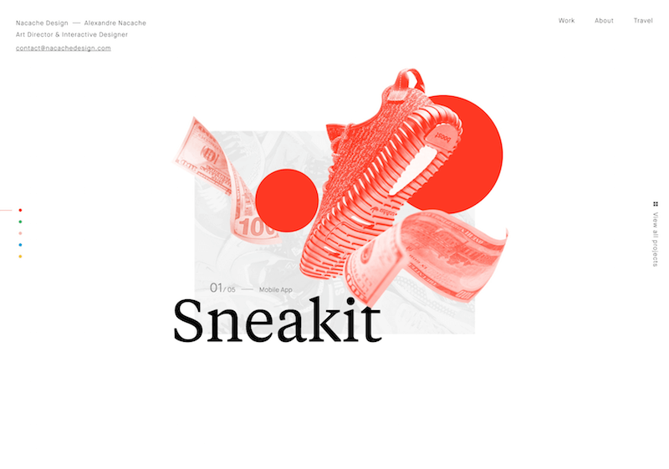
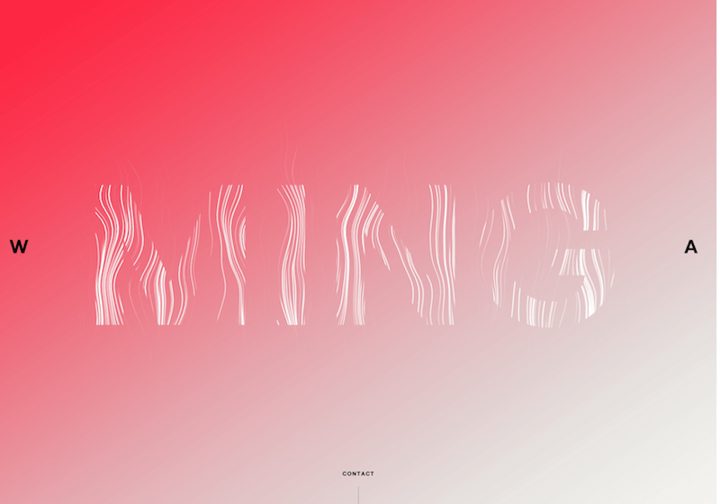
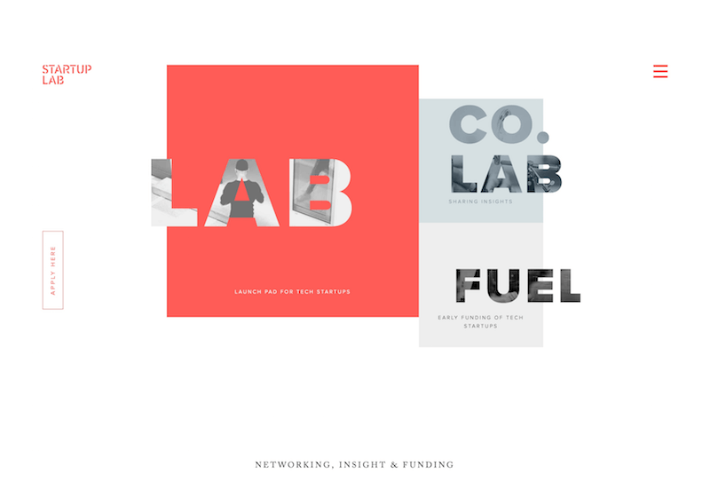
Examples

Slide 6
ORANGE
Orange is a very vibrant and energetic color. In its muted forms it can be associated with the earth and with autumn. Because of its association with the changing seasons, orange can represent change and movement in general. Orange is also strongly associated with creativity.
Because orange is associated with the fruit of the same name, it can be associated with health and vitality. In designs, orange commands attention without being as overpowering as red. It’s often considered more friendly and inviting, and less in–your–face.

Slide 7
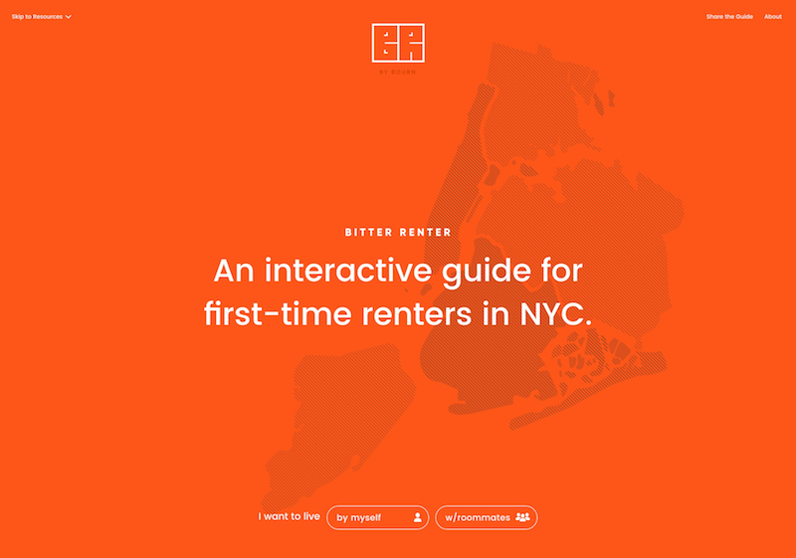
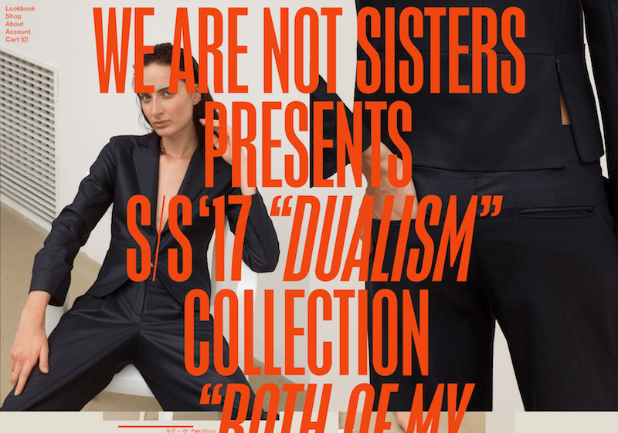
Examples

Slide 8

Cool Colors
Cool colors include green, blue, and purple, are often more subdued than warm colors. They are the colors of night, of water, of nature, and are usually calming, relaxing, and somewhat reserved.
Blue is the only primary color within the cool spectrum, which means the other colors are created by combining blue with a warm color (yellow for green and red for purple).
Because of this, green takes on some of the attributes of yellow, and purple takes on some of the attributes of red. Use cool colors in your designs to give a

Slide 9
GREEN (SECONDARY COLOR)
Green is a very down–to–earth color. It can represent new beginnings and growth. It also signifies renewal and abundance. Alternatively, green can also represent envy or jealousy, and a lack of experience.
Green has many of the same calming attributes that blue has, but it also incorporates some of the energy of yellow. In design, green can have a balancing and harmonizing effect, and is very stable.
It’s appropriate for designs related to wealth, stability, renewal, and nature. Brighter greens are more energizing and vibrant, while olive greens are more representative of the natural world. Dark greens are the most stable and representative of affluence.

Slide 10
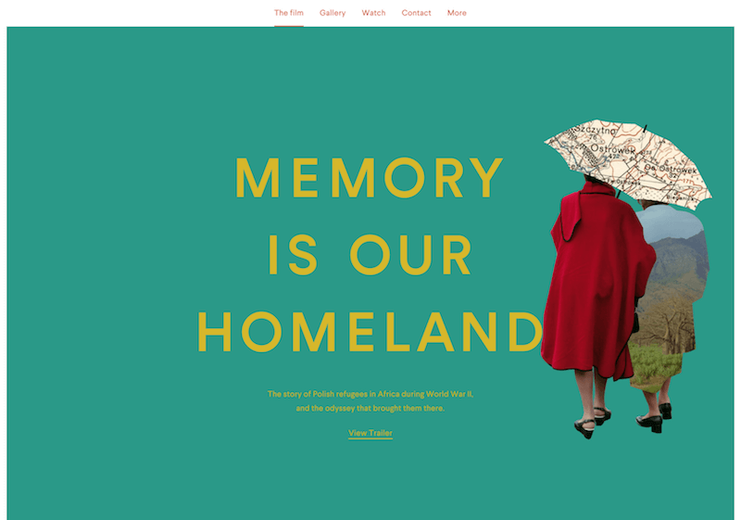
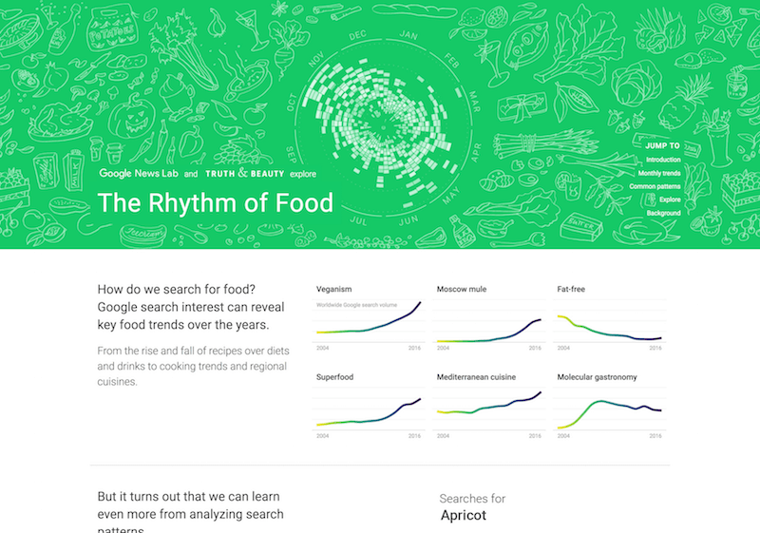
Examples

Slide 11
BLUE (PRIMARY COLOR)
Blue is often associated with sadness in the English language. Blue is also used extensively to represent calmness and responsibility. Light blues can be refreshing and friendly. Dark blues are more strong and reliable. Blue is also associated with peace and has spiritual and religious connotations in many cultures and traditions (for example, the Virgin Mary is generally depicted wearing blue robes).
The meaning of blue is widely affected depending on the exact shade and hue. In design, the exact shade of blue you select will have a huge impact on how your designs are perceived. Light blues are often relaxed and calming. Bright blues can be energizing and refreshing. Dark blues, like navy, are excellent for corporate sites or designs where strength and reliability are important.

Slide 12


Examples

Slide 13
Color and Their Meanings
Below is a quick reference guide for the common meanings of the colors discussed above:
Red: Passion, Love, Anger
Orange: Energy, Happiness, Vitality
Yellow: Happiness, Hope, Deceit
Green: New Beginnings, Abundance, Nature
Blue: Calm, Responsible, Sadness
Purple: Creativity, Royalty, Wealth
Black: Mystery, Elegance, Evil
Gray: Moody, Conservative, Formality
White: Purity, Cleanliness, Virtue
Brown: Nature, Wholesomeness, Dependability
Tan or Beige: Conservative, Piety, Dull
Cream or Ivory: Calm, Elegant, Purity

Slide 14
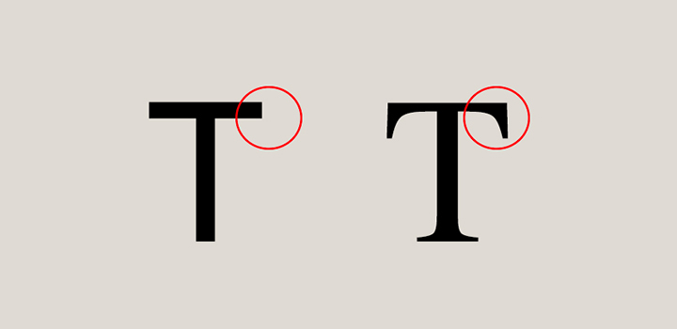
Typography
Typography involves font style, appearance, and structure, which aims to elicit certain emotions and convey specific messages. In short, typography is what brings the text to life.

Slide 15
What are serifs?
Serifs are the small lines attached to letters. Their origins are a mystery; one theory suggests they arose when scribes using brushes or quills left small marks with the writing implement as they finished each stroke. This evolved into deliberately adding smaller strokes in more regular, artful ways, and those decorative strokes became an expected part of the letters.

