Slide 1

WELCOME TO

Slide 2

FOOD & LOCATION SPONSOR

Slide 3

BRONZE SPONSOR

Slide 4


SWAG SPONSORS
USE CODE ‘ug367’ TO SAVE 36% ON ANY PURCHASE AT MANNING.COM!

Slide 5
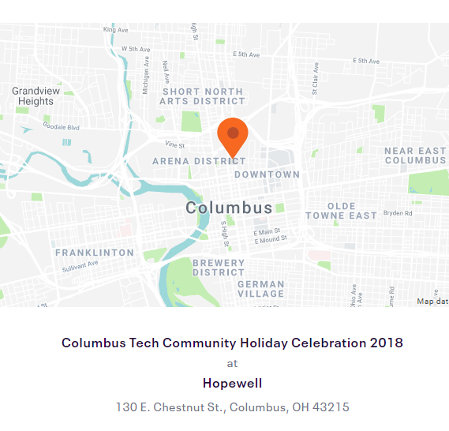
2018 Holiday Party
No December Meetup!
Thursday, December 13th
6:00pm – 9:00pm
RSVP at
http://bit.ly/CBUSTECHHOLIDAY-2018

Slide 6
2019 HACKATHON
February 2019, exact date(s) TBD
Build a VueJS Website for a Local Non-Profit!
If you know of a non-profit, please nominate them!
Email vue.columbus@outlook.com

Slide 7
2019 SCHEDULE
January
Jonathan Norstrom - TBD
February
Hackathon!
March
First Time Speaker(s) - TBD
April
Available!
May
Available!
June
Available!
July
Available!
August
Available!
September
Available!
October
Available!
November
Available!
December
Holiday Party!

