Slide 1

WELCOME TO

Slide 2

FOOD & LOCATION SPONSOR

Slide 3
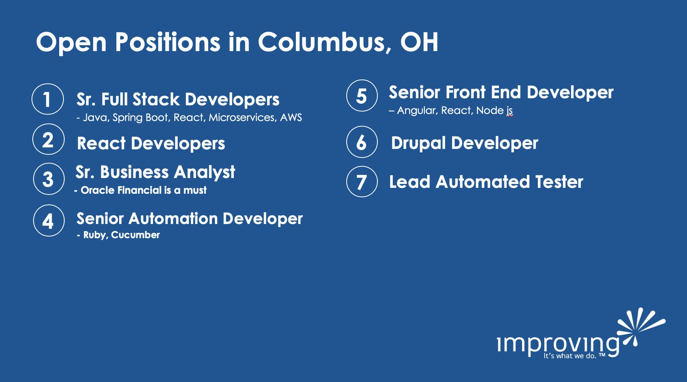

Open Positions in Columbus, OH
1
Sr. Full Stack Developers
- Java, Spring Boot, React, Microservices, AWS
5
Senior Front End Developer
– Angular, React, Node js
2
React Developers
6
Drupal Developer
3
Sr. Business Analyst
- Oracle Financial is a must
7
Lead Automated Tester
4
Senior Automation Developer
- Ruby, Cucumber

Slide 4
Upcoming Training in Columbus
Professional Scrum Master
Professional Scrum Product Owner
*** Training Discount Code: UG2019
$500 off
For more information: improving.com/training

Slide 5

BRONZE SPONSOR

Slide 6


SWAG SPONSORS
USE CODE ‘ug367’ TO SAVE 36% ON ANY PURCHASE AT MANNING.COM!

Slide 7





Helping Developers Be Successful
Thanks to our sponsor
Modern UI Made Easy
Powering millions of .NET,
JavaScript & Chatbot Apps
Build Better Web Apps Faster
Bring Your Framework
Native Mobile Apps with JS
OSS | X-Platform | Any Tools
telerik.com
kendoui.com
nativescript.org

Slide 8

VueConf.US 2019
$50 off Main Conference
VUECONFMTUP50
$100 off Main Conference + Workshop
VUECONFMTUP-WORKSHOP100
THREE WEEKS TO USE!

Slide 9
2019 HACKATHON
February 2019, exact date(s) TBD
Build a VueJS Website for a Local Non-Profit!
If you know of a non-profit, please nominate them!
Email vue.columbus@outlook.com

Slide 10
2019 SCHEDULE
January
James MacIvor – Nuxt Level Vue
February
Hackathon!
March
First Time Speaker(s) - TBD
April
Available!
May
Available!
June
Available!
July
Available!
August
Available!
September
Available!
October
Available!
November
Available!
December
Holiday Party!

