Slide 1


Slide 2
WELCOME… Let us start!

Slide 3
DS0 – Introduction to Basic Programming Concepts
Algorithms, Data Types, If-Statements, Loops, …

Slide 4
Agenda
1 | Introduction: Programming & Algorithms
2 | Data Types
3 | Basics – Operators & Variables
4 | Data Structures
5 | If-Statements & Loops
6 | Functions

Slide 5
Learning Goals
After this training you should be able to …

Slide 6
DS0 – Introduction to Basic Programming Concepts What do you should learn in this training?
You should…
… get an impression about the possibilities of programming.
… get basic understanding for the concepts of programming.
… know how to structure your data.
… know the conventions of programming.
… be able to write your own (small) scripts.
1
2
3
4
5

Slide 7
Programming & Algorithms
Why we should write scripts? What is an algorithm?

Slide 8
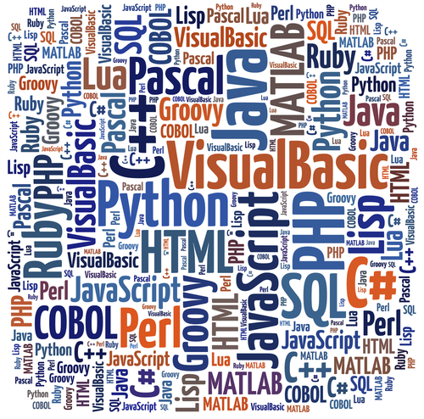
DS0 – Introduction to Basic Programming Concepts Programming Languages
1
Machine Language/ Machine code
e.g. Assembler
Imperative Programming
e.g. Basic
Procedural Programming
e.g. Pascal, C
Object oriented Programming
e.g. Java, JavaScript, C++, C#, Python
2
3
4

Slide 9
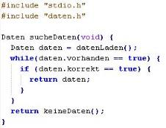
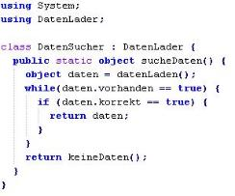
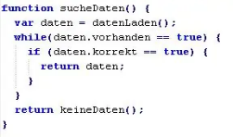
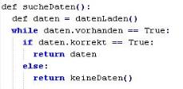
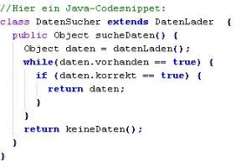
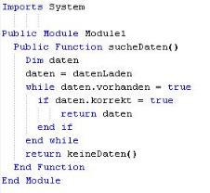
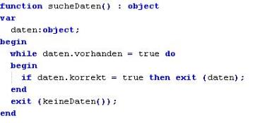
DS0 – Introduction to Basic Programming Concepts Programming Languages
Javascript:
C and C++:
Python:
C#:
Java:
Visual Basic:
Pascal:

Slide 10
DS0 – Introduction to Basic Programming Concepts Programming Languages
Javascript:
C and C++:
Python:
C#:
Java:
Visual Basic:
Pascal:

Slide 11
DS0 – Introduction to Basic Programming Concepts Programming Languages
Javascript:
C and C++:
Python:
C#:
Java:
Visual Basic:
Pascal:

Slide 12


DS0 – Introduction to Basic Programming Concepts Syntax & Semantics
“Syntax refers to the ways symbols may be combined to create well-formed sentences (or programs) in the language. Syntax defines the formal relations between the constituents of a language, thereby providing a structural description of the various expressions that make up legal strings in the language. Syntax deals solely with the form and structure of symbols in a language without any consideration given to their meaning.”
“Semantics reveals the meaning of syntactically valid strings in a language. For natural languages, this means correlating sentences and phrases with the objects, thoughts, and feelings of our experiences. For programming languages, semantics describes the behavior that a computer follows when executing a program in the language. We might disclose this behavior by describing the relationship between the input and output of a program or by a step-by-step explanation of how a program will execute on a real or an abstract machine.”

Slide 13

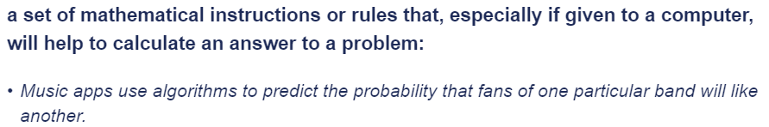
DS0 – Introduction to Basic Programming Concepts Algorithms
1
Generality The algorithm solves a lot of the same problems, a whole class of problems.
Repeatability With the same prerequisite, an algorithm always delivers the same result.
Uniqueness At each point the following step is clearly defined.
Finitude/terminality The algorithm consists of a finite number of steps and always comes to an end. The sequence of statements must also be described in a finite text.
Executability The instructions must also be clearly formulated and executable (Not for you, but for the computer).
2
3
4
5

Slide 14

DS0 – Introduction to Basic Programming Concepts Programming – Why?
1
It‘s simple and easy
Implement your own visions and ideas
Become independent of other programs
Understand the computer
You train your brain!
2
3
4
5

Slide 15
Data Types
Why do we need data types?

Slide 16
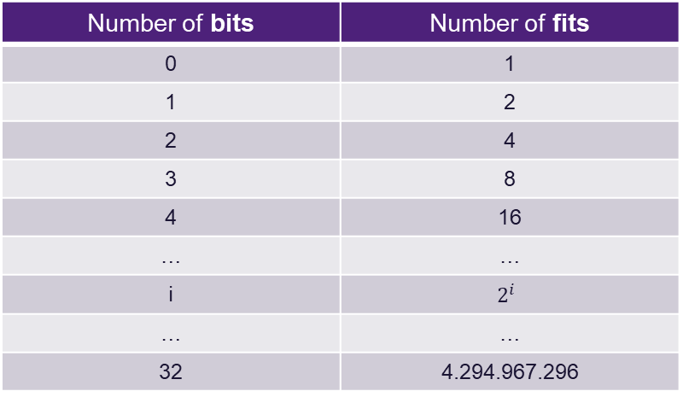
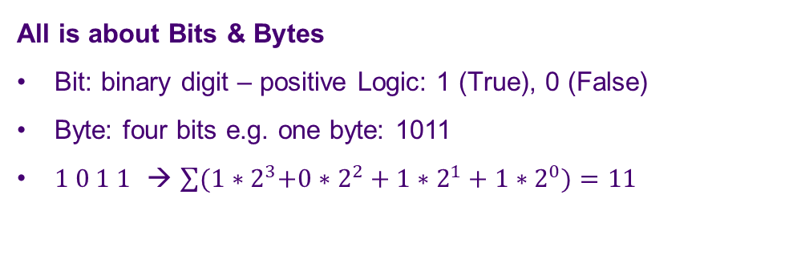
DS0 – Introduction to Basic Programming Concepts Data Types
Why do we need data types?
Every Computer has only limited capacities/ resources, but e.g. the space of integers is infinitely large
→ we have to limit the space of integers
You have to know the characteristics of the basic data types and also their advantages and disadvantages
→ choose your data type wisely and adjusted to you use case
All is about Bits & Bytes
Bit: binary digit – positive Logic: 1 (True), 0 (False)
Byte: four bits e.g. one byte: 1011
$1 0 1 1$ → $\sum{{(1∗2}^{3}+0∗2^{2}+1∗2^{1}+1∗2^{0})}=11$
Number of bits | Number of fits
0 | 1
1 | 2
2 | 4
3 | 8
4 | 16
… | …
i | $$2^{i}$$
… | …
32 | 4.294.967.296

Slide 17


DS0 – Introduction to Basic Programming Concepts Programming – Why?
C
R
Q
Z
N
complex numbers
real numbers
rational numbers
integer numbers
natural numbers
C
$$\sqrt{−4}$$
7j+7
-8
½
R
$$\sqrt{5}$$
1
½
¾
Q
e
-½
-5
-1
87
Z
1
N
148
75

Slide 18
DS0 – Introduction to Basic Programming Concepts Data Types
byte integer number (8 Bit) → - 128 to 127
short integer number (16 Bit) → - 32 768 to 32 767
int integer number (32 Bit) → - 2 147 483 648 to 2 147 483 647
long integer number (64 Bit) → - 9 223 372 036 854 775 808 to 9 223 372 036 854 775 80
float floating-point number (32 Bit) → -3.4*10^38 to +3,4*10^38
double floating-point number (64 Bit) → -1.7*10^308 to +1.7*10^308
boolean Only True/ False → True or False
char character string (16 bit) → 65 536 characters
string character string (no limit*) → no limit*
* theoretical, limited by capacity of your computer

Slide 19
DS0 – Introduction to Basic Programming Concepts Data Types
Example:
RAM: 8 GB (Gigabyte)
8 GB = 8 000 MegaByte
8 000 MegaByte = 8 000 000 Byte = 32 000 000 Bit
short integer number (16 Bit) → Two Million Variables in range of -32 768 to 32 767
int integer number (32 Bit) → One Million Variables in range of -2 147 483 648 to 2 147 483 647
long integer number (64 Bit) → Half a Million Variables in range of -9 223 372 036 854 775 808 to 9 223 372 036 854 775 80
float floating-point number (32 Bit) → One Million Variables in range of -3.4*10^38 to +3,4*10^38
double floating-point number (64 Bit) → Half a Million Variables -1.7*10^308 to +1.7*10^308
boolean Only True/ False → 32 Million Variables with True or False
char character string (16 bit) → Two Million Variables with 65 536 characters

Slide 20

DS0 – Introduction to Basic Programming Concepts Exercise 01
Data Types
What is the solution of the following calculations?
Please think about the solution.
10 minutes
calculation | solution | data type of the solution
13 + 7 =
’13’ + ‘7’ =
13 + ‘7’ =
13 * ‘7’ =
7 * ‘s’ =

Slide 21



Slide 22

- Energy AI-Video einfügen
- Übung vorführen

Slide 23
DS0 – Introduction to Basic Programming Concepts Exercise 01
Data Types
What is the solution of the following calculations?
Please think about the solution.
10 minutes
calculation | solution | data type of the solution
13 + 7 = | 20 | Int
’13’ + ‘7’ =
13 + ‘7’ =
13 * ‘7’ =
7 * ‘s’ =

Slide 24
DS0 – Introduction to Basic Programming Concepts Exercise 01
Data Types
What is the solution of the following calculations?
Please think about the solution.
10 minutes
calculation | solution | data type of the solution
13 + 7 = | 20 | Int
’13’ + ‘7’ = | 137 | String
13 + ‘7’ =
13 * ‘7’ =
7 * ‘s’ =

Slide 25
DS0 – Introduction to Basic Programming Concepts Exercise 01
Data Types
What is the solution of the following calculations?
Please think about the solution.
10 minutes
calculation | solution | data type of the solution
13 + 7 = | 20 | Int
’13’ + ‘7’ = | 137 | String
13 + ‘7’ = | TypeError: unsupported operand type(s) for +: 'int' and 'str'
13 * ‘7’ =
7 * ‘s’ =

Slide 26
DS0 – Introduction to Basic Programming Concepts Exercise 01
Data Types
What is the solution of the following calculations?
Please think about the solution.
10 minutes
calculation | solution | data type of the solution
13 + 7 = | 20 | Int
’13’ + ‘7’ = | 137 | String
13 + ‘7’ = | TypeError: unsupported operand type(s) for +: 'int' and 'str'
13 * ‘7’ = | 7777777777777 | String
7 * ‘s’ =

Slide 27
DS0 – Introduction to Basic Programming Concepts Exercise 01
Data Types
What is the solution of the following calculations?
Please think about the solution.
10 minutes
calculation | solution | data type of the solution
13 + 7 = | 20 | Int
’13’ + ‘7’ = | 137 | String
13 + ‘7’ = | TypeError: unsupported operand type(s) for +: 'int' and 'str'
13 * ‘7’ = | 7777777777777 | String
7 * ‘s’ = | sssssss | String

Slide 28
Basics
Variables, Functions, Rules

Slide 29
DS0 – Introduction to Basic Programming Concepts Allocation & Calculation Operators
Description | Syntax | Short Operator | Long Operator
Allocation | = | x = y
Addition | +
Subtraction | -
Multiplication | *
Division | /
Addition | += | x += y | x = x + y
Subtraction | -= | x -= y | x = x – y
Multiplication | *= | x *= y | x = x * y
Division | /= | x /= y | x = x / y
Modulo | %= | x %= y | x = x % y
Increase by one | ++ | x++ | x = x + 1
Decrease by one | -- | x-- | x = x – 1
Calculation Operators |  | Allocation Operators

Slide 30
DS0 – Introduction to Basic Programming Concepts Comparison & Logical Operators
Description | Syntax | Example
Equal | == | 5 == 5 → true
Is not equal | != | 5 != “4” → true
Strict equal | === | 5 === 5 → true
Is not strict equal | !== | 5 !== 4 → true
Greater than | > | 5 > 4 → true
Less than | < | 4 < 5 → true
Greater than or equal | >= | 5 >= 5 → true
Less than or equal | <= | 5 <= 5 → true
AND | && (in Python AND) | (5 == 5) && (4 != 5) → true (5 === “5”) && (5 == 5) → false
OR | || (in Python OR) | (5 == 5) || (4 != 5) → true (5 === “5”) || (5 == 5) → true
Comparison Operators |  | Logical Operators

Slide 31
DS0 – Introduction to Basic Programming Concepts Variables
Variables
is an abstract container for data
the value of the data is replaceable/ changeable
every variable reserves storage
Constants
constants are unchangeable variables
a change of a constant will occur an error

Slide 32
DS0 – Introduction to Basic Programming Concepts Declaration, Definition, Initialization
Declaration
allocation of a name to a variable
Definition
allocation of a memory area to a variable
Initialization
allocation of a value to a variable
(Referencing)
is not the same as an initialization
Declaration
var i;
Definition
var i=int;
Initialization
var i=0;
(Referencing)
var a = 4; var b = 5; var c = int;
c = b + a;

Slide 33
DS0 – Introduction to Basic Programming Concepts Recommendations for Scripting
Declaration of variables
Naming convention depends on the used programming language, but in general the following recommendations are valid:
a name of a variables must be unique
variables must be declared before first usage
variables must not contain spaces
the first character should be an letter (it must not be a numbers or a special character)
its recommended to use Camel-Case Notation instead of underlines ‘_’
lowerCamelCase: thisIsAnExample
UpperCamelCase: ThisIsAnExample (also known as Pascal Case)

Slide 34
DS0 – Introduction to Basic Programming Concepts Recommendations for Scripting
Declaration of variables
Naming convention depends on the used programming language, but in general the following recommendations are valid:
Constants should be written in Capital Letters e.g.:
EULERS_NUMBER = 2,71828182845904523536
do not use reserved words for variables (e.g.: int, double, import, var … - depends on language)
use descriptive identifiers e.g.: Price = ValueAddedTax * PurchasePrice * Margin
instead of
Factor1 = F2 * F3 * F4

Slide 35
DS0 – Introduction to Basic Programming Concepts Recommendations for Scripting
Additional recommendation for writing a good script
use spaces after an operation (=, +, -, …)
use indentations for better readability and understanding
Make comments: your script will be so much easier to understand for external people (and for you in future!)
<script>
var o=document.getElementById(‘o’)
for(i=0;i<=6;i++){o.innerHTML+=i;};
</script>
<script>
var output = document.getElementById(‘output’)
//count from 0 to 6 and write the number into an output
for(i = 0; i <= 6; i++) {
output.innerHTML += i;
};
</script>
do it better

Slide 36
DS0 – Introduction to Basic Programming Concepts Exercise 02
Variables & Operators
Check if the following comparisons are true or false.
10 minutes
calculation | solution
3 == “3” →
3 == int(“3”) →
(3 == 4) AND (3 == 3) →
(3 == 4) OR (3 == 3) →

Slide 37
Data Structures
Why should/ must we structure our data?

Slide 38
DS0 – Introduction to Basic Programming Concepts Data Structures - Python
 | Description | Usefull for… | Example
Lists | Store collection of heterogeneous items – immutable and mutable objects | Simple listing Special programming techniques (Stacks, Queue, Graphs, Trees) | [item, item, item]
Dictionaries | Collection of key-value pairs Key: immutable objects Value: heterogeneous items – immutable and mutable objects | Creating loops to do the same operation on many dataset | {key1:item1, key2:item2}
Files | Store and retrieve previously stored information |  | .csv, .hdf5, .xlsx
Tuples | Tuples are data structures in which the content can not be changed after creation (no deletion, add or edit) | Prevents data manipulation | (item, item, item)
Sets | Collection of unique objects | Creating lists that only hold unique values Helpful when going through huge dataset | {item, item, item}
Numpy ND-Arrays | Store collection of data of the same type | Dealing with large collection of homogeneous data types: easier to use, faster and uses lesser memory than lists Support vectorized operations Work efficiently with large datasets with lots of empty cells | [[1. 1. 2.] [3. 5. 8.] [5. 3. 2.]]
Dataframes | 2-dimensional labeled data structure Columns don’t have to have the same data type | Data mining / manipulation Labeling Multiindexing | Like this table
Series | One-dimensional labeled array capable of holding any data types | Axis labels | a 1 b 2 c 3

Slide 39
DS0 – Introduction to Basic Programming Concepts Data Structures - General
Arrays
Static → fixed size
fast & direct access to data
good, if the size of the Data-Storage is known & fast access is needed
not good, if the size is not known and you need a flexible structure
dimension of an array is not limited
1D-Array:
1 | 2 | 3 | 4 | 5 | 6 | 7 | 8 | … | i
43 | 32 | 18 | 77 | 4 | 98 | 17 | 846 | … | 42
2D-Array:
 | 1 | 2 | 3 | 4 | 5 | 6 | 7 | 8 | … | i
1 | 43 | 32 | 18 | 77 | 4 | 98 | 17 | 846 | … | 42
… | … | … | … | … | … | … | … | … | … | …
j | 14 | 536 | 124 | 2 | 58 | 943 | 2 | 12 | 796 | 8

Slide 40
DS0 – Introduction to Basic Programming Concepts Data Structures - General
Lists
Dynamic → size is not fixed
Concatenation of Objects
insert/delete data at beginning, at end od in middle is possible → a list can raise or shrink
Sequential access →
good, if the size of the Data-Storage is not known
not good, if the size is known and constant and if you need a flexible storage
Tuple: “the constants under the lists”
Value 1 | o
Value 2 | o
Value 3 | o
Value 4 | o
Example: single concatenated lists
every object contains information about the following object

Slide 41
DS0 – Introduction to Basic Programming Concepts Data Structures - General
Organize your Data!
Single Values?
yes
no
Variables
Data Structures
Changeable?
Changeable?
yes
no
yes
no
Variable
Constant
Dictionaries
Arrays
Lists
Tuples

Slide 42
DS0 – Introduction to Basic Programming Concepts Exercise 03
Data Structures
Use the given array to build the following string:
array = [[‘to our new’, 'Siemens Energy'],[‘Welcome’, ’company:’]]
String (goal) → ‚Welcome to our new company: Siemens Energy‘
Example: array[Col][Row]
10 minutes
 | 0 | 1
0 | to our new | Welcome
1 | Siemens Energy | company:

Slide 43
If-Statements & Loops
What are loops used for? Why we should use them?

Slide 44
DS0 – Introduction to Basic Programming Concepts If-Statements
If-Statement
Allows to skip parts of the script, if a given condition is not true
If-Else-Statement
Combination of if-statements
Example:
if(hours <= 18){
output = ‘Good Day’;
}
else {
output = ‘Good Evening’;
};
If Condition
False
True
Instruction A
If Condition
Else Condition
False
False
True
True
Instruction A
Instruction B

Slide 45
DS0 – Introduction to Basic Programming Concepts Loops
Instruction block (sequence)
Loops
Head Controlled
Action 1
Instruction
Action 2
Foot Controlled
Instruction
Action 3

Slide 46
DS0 – Introduction to Basic Programming Concepts Loops: for
Head Controlled: the condition is proven before the instruction are executed
is used, when the number of iterations is known → a number for counting is needed
First Step: Initialization of Count-Variable
Second Step: Proof, if the condition is true
Third Step: If Condition is True, execute the Instructions
Fourth Step: Update the Count-Variable
Fifth Step: Proof if the condition is still true
Sixth Step: If condition is not true anymore, quit the loop
Initialization
Condition
False
True
Instruction
Update

Slide 47
DS0 – Introduction to Basic Programming Concepts Loops: while
Head Controlled: the condition is proven before the instruction are executed
is used, when the number of iterations is not known e.g. if the number of iterations depends on a changing variable
First Step: Proof if the condition is true
Second Step: Execute the instructions
Third Step: Proof if the condition is still true
Fourth Step: If the condition is not true anymore, quit the loop
→ The Condition must be able to be false, otherwise the loop will repeat infinitely!
Condition
False
True
Instruction

Slide 48
DS0 – Introduction to Basic Programming Concepts Loops: Continue & Break
Continue:
i=0
while(i < 6):
i = i+1
if(i == 4):
continue
print(i)
>>> 1
>>> 2
>>> 3
>>> 5
>>> 6
there are several reasons to end a loop prematurely
there are two possibilities for end a loop:
Continue: end the iteration and begin the loop again
Break: end the iteration and terminate the loop
Break:
i=0
while(i < 6):
i = i+1
if(i == 4):
break
print(i)
>>> 1
>>> 2
>>> 3

Slide 49
DS0 – Introduction to Basic Programming Concepts Exercise 04
Loops
Check out the differences between for-Loop and while-Loop and between continue and break.
Write two different Loops:
- First you should write a for-Loop that counts from 0 to 9.<br>
- The second loop should be a while loop, counting from 0 to the length of the array named exampleArray_01
Have a look on the last two loops (while-loops). Try them out and clearify, what the difference is between using 'continue' and using 'break'.
15 minutes

Slide 50
Functions
The smart way to writing good scripts.

Slide 51
DS0 – Introduction to Basic Programming Concepts Functions
name of your function
function MyFirstFunction(y1, y2)
{
var x=0;
x = y1 + y2;
return(x)
};
var x1=0;
x1 = MyFirstFunction(8, 2);
Console.log(x1);
>> 10
are used, if (complex) instructions are needed an different places in script
allows you to shorten your script and keep it clear
passed variables
(initialed local)
Returned Object (e.g. variable)
Function Call

Slide 52
DS0 – Introduction to Basic Programming Concepts Functions
Initialization
def myFirstFunction(a, b, operation="multiplication"):
"""
##### Description #####
a: float
b: float
operation: string, please choose between "addition", "subtraction", "multiplication" or "division"
"""
assert (type(a) == float) | (type(a) == int), "Error: a must be a float or int"
assert (type(b) == float) | (type(a) == int), "Error: b must be a float or int"
assert (operation == "addition") | (operation == "subtraction") | (operation == "multiplication") | (operation == "division"), “Error: please choose between 'addition', 'subtraction', 'multiplication' or 'division'"
if(operation == "addition"):
c = a + b
if(operation == "subtraction"):
c = a - b
if(operation == "multiplication"):
c = a * b
if(operation == "division"):
c = a / b
return c

Slide 53
DS0 – Introduction to Basic Programming Concepts Functions
Description
def myFirstFunction(a, b, operation="multiplication"):
"""
##### Description #####
a: float
b: float
operation: string, please choose between "addition", "subtraction", "multiplication" or "division"
"""
assert (type(a) == float) | (type(a) == int), "Error: a must be a float or int"
assert (type(b) == float) | (type(a) == int), "Error: b must be a float or int"
assert (operation == "addition") | (operation == "subtraction") | (operation == "multiplication") | (operation == "division"), “Error: please choose between 'addition', 'subtraction', 'multiplication' or 'division'"
if(operation == "addition"):
c = a + b
if(operation == "subtraction"):
c = a - b
if(operation == "multiplication"):
c = a * b
if(operation == "division"):
c = a / b
return c

Slide 54
DS0 – Introduction to Basic Programming Concepts Functions
def myFirstFunction(a, b, operation="multiplication"):
"""
##### Description #####
a: float
b: float
operation: string, please choose between "addition", "subtraction", "multiplication" or "division"
"""
assert (type(a) == float) | (type(a) == int), "Error: a must be a float or int"
assert (type(b) == float) | (type(a) == int), "Error: b must be a float or int"
assert (operation == "addition") | (operation == "subtraction") | (operation == "multiplication") | (operation == "division"), “Error: please choose between 'addition', 'subtraction', 'multiplication' or 'division'"
if(operation == "addition"):
c = a + b
if(operation == "subtraction"):
c = a - b
if(operation == "multiplication"):
c = a * b
if(operation == "division"):
c = a / b
return c
Error Messages

Slide 55
DS0 – Introduction to Basic Programming Concepts Functions
def myFirstFunction(a, b, operation="multiplication"):
"""
##### Description #####
a: float
b: float
operation: string, please choose between "addition", "subtraction", "multiplication" or "division"
"""
assert (type(a) == float) | (type(a) == int), "Error: a must be a float or int"
assert (type(b) == float) | (type(a) == int), "Error: b must be a float or int"
assert (operation == "addition") | (operation == "subtraction") | (operation == "multiplication") | (operation == "division"), “Error: please choose between 'addition', 'subtraction', 'multiplication' or 'division'"
if(operation == "addition"):
c = a + b
if(operation == "subtraction"):
c = a - b
if(operation == "multiplication"):
c = a * b
if(operation == "division"):
c = a / b
return c
Instructions

Slide 56
DS0 – Introduction to Basic Programming Concepts Exercise 05
Functions
Please write your own first little Function.
Your function should compare two values and return, if the first value is smaller/ bigger/ equal to the second value.
e.g.: the following code should return "21 is smaller than 3"
result = compareFunction(21,3)
print(result)
>>> 21 is smaller than 3
Attention: You have to parse the integer value of a and b into a string, so that you can stick it to the string "is smaller than"/ "is bigger than"/ "is equal to"
20 minutes

Slide 57
DS0 – Introduction to Basic Programming Concepts The n-Commandments
Beautiful is better than ugly.
Explicit is better than implicit.
Simple is better than complex.
Complex is better than complicated.
Flat is better than nested.
Sparse is better than dense.
Readability counts.
Special cases aren't special enough to break the rules.
Errors should never pass silently.
In the face of ambiguity, refuse the temptation to guess.
There should be one -- and preferably only one -- obvious way to do it.
Now is better than never.
If the implementation is hard to explain, it's a bad idea/ If the implementation is easy to explain, it may be a good idea.
https://www.w3schools.com/python/

Slide 58
Thank you very much for your attention.

Slide 59
DS0 – Introduction to Basic Programming Concepts Contact
Nicolas Schneider
Dual Student
SE G QPI QM P
Mellinghofer Straße 55 45468 Mülheim an der Ruhr Germany
Phone: +49 173 4278041
nicolas.schneider@siemens.com
siemens-energy.com
® Published by Siemens Energy

