Slide 1
Microservices

Slide 2
Quick interview
Surname
Role in the company
Prior knowledge of the topic
Current problem
Specific individual goals

Slide 3
initial situation

Slide 4
Primary task software development
Actor
service
Operations
Data schema

Slide 5
Expectations of the “customer”
New features
Earlier
Fixed release planning with time scale of months/years
Today
New services/actors are available “continuously” = immediately
A few days / weeks
Availability
Earlier
Maintenance windows were accepted
Today
24*7
Data volume / scalability
Earlier
Static capacity planning
Today
Dynamic up & down scaling

Slide 6
Implementation: Monolithic
service
implementation
Stateless
DB_A
Actor
API
Operations
Data schema
Persistent
Algorithms
DB_B

Slide 7
Rating
The Monolith is designed for a special actor
Size results from the complexity of the algorithms to be implemented
trend
"Too big"
Agile software development with extensions is then difficult

Slide 8
Implementation: Modular
Actor
module
API
Algorithms
Data sinks are not yet taken into account here… -> later
module
Actor_B
API
Algorithms
Module3
Actor_C
API
Algorithms

Slide 9
Rating
The smaller modules ensure better maintainability/reusability
Testability is given
If a module has become too large, it can be broken down into smaller modules by “refactoring”.
This makes it possible to develop a single module in a much more agile manner
A modularized application can still be monolithic

Slide 10
Implementation: Modularized monolith
Actor
module
API
Algorithms
test
module
API
Algorithms
test
Module3
API
Algorithms

Slide 11
Implementing a modularized monolith
Spring Boot Application
Consists of a wide variety of @Components
Context & Dependency Injection keeps all the components together consistently
YEE
Quarkus

Slide 12
From monolith to service-oriented application
Introduction of multiprocessing and network communication
Calls via network
Actor
service
API
Algorithms
service
API
Algorithms
service
API
Algorithms

Slide 13
Service in detail
service
Impl
Dependencies on resources
Actor
API
Abstract Programming Interface
Operations
Scheme
Implementation of the necessary algorithms executable in an environment
List of “things” on which the impl depends

Slide 14
Service documentation
API documentation
Very easy to formalize, no need for prose text, no “description”
<operation name=”create”><params type=book>....</operations>
<description>The created book is stored in the XYZ database in the BOOKS table</description>
Implementation documentation
Specification of the algorithms
e.g. UML, class and sequence diagrams
e.g. classic specification in prose text according to ISO…
Runtime
Dependencies
API coordinates of another service or resource in particular database
Endpoint address (e.g. host)
Name of the service as URL (api/books)
Version number hints according to Major.Minor. Patch .Qualifier

Slide 15
Who needs to know/maintain which documentation?
Knowledge of the implementation details is necessary
for the team that implements the service
Earlier
Runtime had to be provided by the company
Today
Runtime is translated by the DevOps process into an image that is operated by operations as a container
Every actor must know the API
The actor knows the service via its coordinates
The dependencies
-> Page 17

Slide 16
Excursus: Dependencies
Registry for API documentation
Key: Service coordinate
Value: API document
Optional: tagging + search
Service Consumer
e.g. Dependency List as part of the build process
e.g. Kubernetes services in the cloud

Slide 17
Dependencies
Are problematic
The problem is solved through communication and specification “Which versions of which services are available?”, “Which applications use which other services”
service
books schema:3.5
API
dep
Actor
Database
books schema:2.1
Problem: “Transitive dependencies” can lead to inconsistencies in the overall application

Slide 18
thesis
As soon as service dependencies appear, there is a great risk that the overall application will ultimately remain monolithic despite services

Slide 19
Microservices

Slide 20
Solving the dependency problem
Microservices have no dependencies.
Actors are not microservices
The size of a microservice doesn't matter at all
Microservices can be deployed (almost) without regard to anything else
Release planning is independent
Fast: Actors have to be taken into account
Direct interaction between microservices is not planned
A notice:
The following images and arguments will make you say “That’s not possible”
A real landscape of enterprise applications will always be a mix of services (with dependencies) and microservices

Slide 21
From services to microservices
Actor
Microservice1
API
Algorithms
Unavoidable redundant data storage
Note: Synchronization of the data sets is not apparent from this image
Microservice2
Actor2
API
Algorithms
Microservice3
Actor3
API
Algorithms

Slide 22
Doesn't always work straight away!
Actor as Microservice Orchestrator, page 23

Slide 23
From services to microservices
Microservice1
API
Algorithms
Actor
Microservice2
API
Algorithms
Microservice3
API
Algorithms

Slide 24
From services to microservices
Microservice1
API
Algorithms
service
Actor
API
Microservice2
API
Algorithms
Microservice3
API
Algorithms

Slide 25
From services to microservices
service
Microservice1
API
Algorithms
Actor
API
Microservice2
API
Algorithms
network
Microservice3
API
Algorithms

Slide 26
From services to microservices
Microservice
Module1
API
Algorithms
Actor
API
Module2
API
Algorithms
Local
Module3
API
Algorithms

Slide 27
From services to microservices
Microservice
Module1
API
Algorithms
Actor
API
Module2
API
Algorithms
Local
Module3
API
Algorithms

Slide 28
Microservices expectations
Independent release cycles
Not necessarily “agile” / fast
Characteristics of Microservice: “Can be fully implemented in a typical Scrum Spring of 3 weeks”
Microservices can operate independently
Each microservice completely contains algorithms + data storage
Technologies used / the runtime of a microservice can be defined independently
Dynamic scalability (up and down) is provided
Availability
No dead times

Slide 29
Excursus: Data storage in distributed systems

Slide 30
A landscape of systems
Microservice
Problem: How can redundant data storage be synchronized?
Microservice2
Microservice3

Slide 31
Scalable database systems
Limit reached
2 categories of scaling
Vertical scaling
Horizontal scaling (-> Microservices)
CPU
R.A.M.
Storage
migration
CPU
R.A.M.
Storage
Migration (almost) inevitably leads to maintenance windows and application downtime
CPU
R.A.M.
Storage
Rebalancing
CPU
R.A.M.
Storage
Rebalancing requires communication between the individual nodes

Slide 32
Resilience in horizontally scaling systems
Data replication
A subset of the cluster's nodes contains data replicas
The replicas must be synchronized by the individual nodes (-> Microservices)
This synchronization logic is implemented in the database systems
Gossip Protocol
Anti-entropy algorithms
…
Taking technical constraints into account
In particular, the network between nodes
This does not mean the network between client and database!
Caution: Microservices do not have something like this automatically, you have to implement it yourself!

Slide 33
Quality dimensions of distributed data storage
Consistency​
The overall system of database nodes delivers consistent data at all times
A availability
As soon as a client can communicate with a node in the cluster, the client receives a response
Partition Tolerance
A failure of the network between nodes of the cluster is tolerated

Slide 34
To do
Can all quality dimensions be met at the same time?
All 3?
2 out of 3 ?
Only 1?
From an application architecture perspective: What do you think is the “most important” quality dimension?
Availability
Consistency

Slide 35
Technical additional condition
Thesis: Partition errors are unavoidable
Thesis: Detecting partition errors is not trivial at all
This leaves CAP
C.P
AP
“Consistency doesn’t matter” -> nonsense
Consistency at any given time is unattainable
BASE architecture
Basic Availability
Soft state
Eventual consistency
Eventual = Eventually, time windows of inconsistency are possible, but the system will “eventually be consistent”

Slide 36
Related to microservices
Horizontally scalable database systems consist of equivalent nodes
A microservice corresponds to a node
“All nodes are different”
Data replication keeps the same data on different nodes
Microservices introduce redundant data storage
Each microservice holds the data that its algorithms need
Database systems are usually BASE
Microservices too
Database systems implement eventual consistency internally
Microservices: MUST BE IMPLEMENTED YOURSELF!

Slide 37
Microservices and BASE architecture

Slide 38
Orchestration of microservice calls
Microservice1
e.g. create, query and pay invoices
API
Algorithms
REG
Actor
Microservice2
e.g. reminder
DUNN
API
Algorithms
Microservice3
API
Algorithms

Slide 39
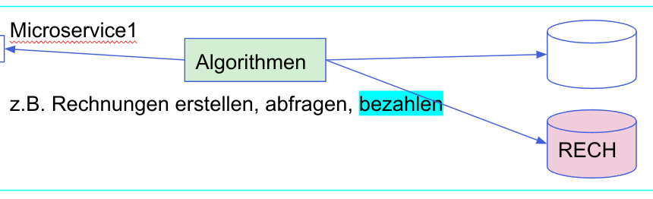
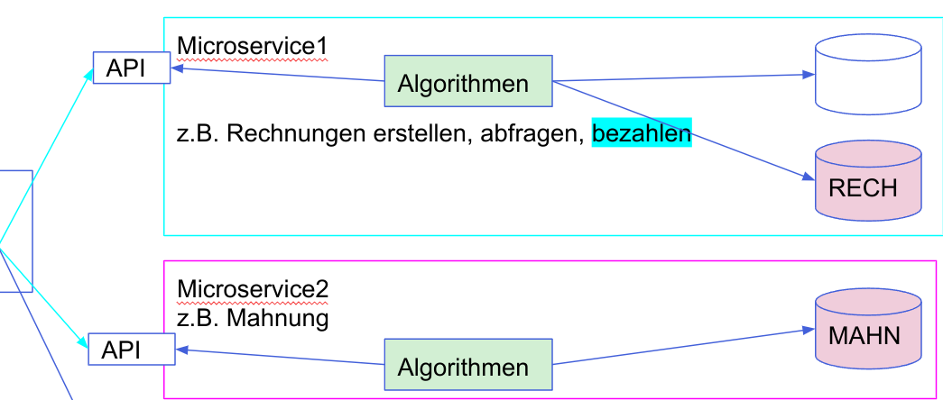
Excursus: BASE vs ACID
ACID transactions avoid inconsistencies through atomic commit/rollback at the database level
“Local” transactions within a single database instance
Actually trivial
XA transactions with 2 phase commit protocol
For this purpose, a so-called XID is used, which makes transactions identifiable in the individual database systems
Microservices and ACID
ACID within a microservice is “normal” programming
ACID microservice call-across: forget that
Instead: compensation actions

Slide 40
Interaction between microservices to align redundancies
Microservice1
e.g. create, query and pay invoices
API
Algorithms
REG
Actor
Impl
Update/Query API
Update/Query API
Microservice2
e.g. reminder
Impl
DUNN
API
Algorithms
Microservice3
API
Algorithms

Slide 41
Event-driven architecture
Event bus
Microservice1
e.g. create, query and pay invoices
API
Algorithms
REG
publish
Actor
Microservice2
e.g. reminder
topic
subscribe
DUNN
API
Algorithms
Microservice3
API
Algorithms

Slide 42
Details on the topic
Due to the topic, microservices are definitely linked to each other
For the entire application to work correctly, the microservices must communicate with each other via the correct topics
“Dependency”, which also needs to be documented
The coupling itself is loose and therefore there is no dependency between the microservices!
The term “topic” comes from the world of classic messaging systems
This means that classic messaging is in principle suitable as an event bus
but not in practice...

Slide 43
Excursus: Messaging
News distribution strategies
Point-to-point messaging with queues
A message is processed by exactly one consumer process
Publish/Subscribe with Topics
A message is processed by all active consumers
If no consumer is active -> message is not processed at all
Durable subscriptions
A message is processed by all registered consumers
The messages are stored in the topic until the last consumer has become active

Slide 44
Excursus: Messaging as an event bus
News distribution strategies
Point-to-point messaging with queues
A message is processed by exactly one consumer process
Publish/Subscribe with Topics
A message is processed by all active consumers
If no consumer is active -> message is not processed at all
Non-active microservices can definitely happen
Durable subscription
A message is processed by all registered consumers
The messages are stored in the topic until the last consumer has become active
Microservices implementations, if implemented incorrectly, can mark messages as processed even though they are incorrectly processed
A leased microservice should then also be able to “reset up”.

Slide 45
Need: New product
Specially adapted to microservices communication
feature
“Durable subscription with history”
Highest available system
Scalable
Status 200x
Start of the “Apache Kafka” project
Throughput measurements show: Kafka is clearly superior to classic messaging systems in the “event bus for microservices” application area
Note: As of 2022
Classic messaging systems have become “Kafkaesque”.
Kafka was also equipped with features of a messaging system

Slide 46
Summary
State of the art is the implementation of event-driven microservice architectures
This means that a BASE architecture can be implemented
Eventual consistency can thus be achieved
However, redundant data storage is still available
Data transfer via network is unavoidable for synchronization
Estimating the amount of data to be transferred provides a criterion for the usefulness of the microservices
This already provides a criterion for the size/granularity of microservices

Slide 47
Direct interaction between microservices
“Discussion”: Are these even microservices?
Teaching: “independent deployment…”
a bit idle now...
If there is direct interaction, then definitely not
synchronously blocking
with errors being passed on
Error message “The invoice cannot be created by the billing service” with stacktrace “connection refused: reminders” not permitted

Slide 48
The “Circuit Breaker” design pattern
Client
server
Client
server
Circuit breakers
Tasks
Holds an internal state (Closed, Open, Semi-Closed)
Every client request is analyzed and, if necessary, a status change is made
Retry, monitoring response time, exceptions
Calls via the Circuit Breaker are always asynchronous
State can always be queried by the client

Slide 49
e.g. Spring application
@Component
class Actor{
@Autowired CircuitBreaker<InvoiceService> cb;
public void newInvoice(){
if (cb.isClosed()){
cb.newInvoice(param, Actor::updateNewInvoice)
}else{...}
}
public void updateNewInvoice(){
//…
}
}

Slide 50
A microservices landscape with circuit breakers
Actor
MS1
MS2
MS3
MS4
Surveillance/monitoring

Slide 51
Circuit Breaker status
Typically
Analysis of all client requests
Health check through scheduled calls to a special server API
Administrative change

Slide 52
Microservices and Circuit Breakers
Dealing with a fault situation in Circuit Breaker
Further propagation of the error
This means that we also have a cascading of errors here
This should be avoided
Logging and returning a normal response with risk of inconsistency
Circuit breakers are only used for updates/queries

Slide 53
Synchronization of data storage
Microservices 1
Update Success
Actor
API
Impl
Update failure
Scheduler
Circuit breakers
Update API
Microservices 2

Slide 54
Modeling the API

Slide 55
Entity Relational Model
Publisher
Surname
n
1
Book
+ isbn
+ title
+ price
Author
lastName
first name
n
m

Slide 56
Entity operations
CRUD operations including parameterization
Create
Read
Update
Delete

Slide 57
Excursus: CRUD vs REST
What is the difference between CRUD services and REST services?
CRUD is the basis of REST
Extensions to REST
REST defines a resource ID through which the resource can be requested
REST defines an endpoint, i.e. a URL / URI that uniquely defines the resource worldwide
Resource formats
Server provides a set of formats
Client: Defines the accepted formats
Cache policy, i.e. the validity period of read data
A tag represents the data values

Slide 58
Microservices and entity operations
Microservices as RESTful WebServices?
CRUD
Resource ID and endpoint concept
The de facto standard for the data format is JSON
XML also widely used
Cache policy
optional / flat rate
ETags are less common

Slide 59
Is a typical REST API sufficient for microservices?
Example
h2908727.stratoserver.net:8080/swagger-ui.html
Answer: No
Excursus: The other implementation of REST is SQL
It is missing
Projection queries
select this, that from
Criteria query specification
WHERE
An idea for a meaningful extension of the REST specification
GraphQL

Slide 60
Implementation of an entity model
Relational model
Implements the associations in the entity model as a combination of foreign keys and link tables
Book table is expanded with a foreign key of the publisher ID
Books_Authors link table
Constraints on Book and Author tables
Server-side join through a query language extension
JOIN…ON
Document-oriented model
Implementation of associations through a link

Slide 61
Starting point: relational model
Relational database
P
b
B.A
A
Tables

Slide 62
Starting point: document model
Document database
P
A
b
Buckets/Collections

Slide 63
Starting point: relational model
Microservice
Relational database
REST API
OP
O.A
IF
P
Impl
b
B.A
A
Tables
ACID without necessary redundancies

Slide 64
Starting point: document model
Microservice
Document database
REST API
OP
O.A
IF
P
A
Impl
b
Buckets/Collections
ACID without necessary redundancies

Slide 65
scenario
“Both previous slides look a bit monolithic” :-)
Refactoring towards smaller services / microservices
Both starting bases must be taken into account (relational, document)
Goal
PublishersService
BooksService
AuthorsService

Slide 66
Refactoring 1: Relational Model
service
REST API
OP
Impl
Relational database
service
REST API
O.A
Impl
P
b
B.A
A
service
ACID with XA transactions, without necessary redundancies
REST API
IF
Impl

Slide 67
Refactoring 1: Document Model
service
REST API
OP
Impl
Document database
service
REST API
O.A
Impl
P
A
b
service
ACID with XA transactions, without necessary redundancies
REST API
IF
Impl

Slide 68
Refactoring 2: Document Model
Microservice
Document database
REST API
OP
Impl
P
BASE,
almost without redundancies
Micros service
Document database
REST API
O.A
Impl
A
Micros service
Document database
REST API
IF
Impl
b

Slide 69
Refactoring 2: Relational Model
Relational database
Microservice
REST API
OP
Impl
P
Relational database
Micros service
REST API
O.A
Impl
A
B.A
Relational database
Micros service
REST API
IF
Impl
B.A
b

Slide 70
Initial situation: microservices based on documents
Microservice
Document database
REST API
OP
Impl
P
BASE,
almost without redundancies
Micros service
Document database
REST API
O.A
Impl
A
Micros service
Document database
REST API
IF
Impl
b

Slide 71
Example queries
select * from publishers
Number of microservices calls: 1 (PublishersService)
select * from books where publisher_id = 42
Number of microservices calls: 1 (BooksService)
select book.title. publisher.name from books
Number of microservices calls: 2 (BooksService -> pub_id ->PublishersService)
select publisher_name, book.title where publisher_id = 42
Number of microservices calls: 2 (PublishersService -> List of Book ISBNs ->BooksService)
The multiple calls to the microservices are orchestrated by the actor or an upstream service

Slide 72
Optimization: “Query First”
The data should be stored in such a way that the number of necessary network calls from the actor to the microservice is 1
implementation
Chaining microservices calls internally
Redundant data storage
Actor
MS1
MS2
Service Mash
next page

Slide 73
Microservices based on documents with query first
Microservice
Document database
A_Proj2
REST API
OP
Impl
P
B_Proj1
BASE,
with redundancies
Micros service
Document database
REST API
O.A
Impl
A
A_Proj1
Micros service
Document database
REST API
IF
Impl
b
P_Proj1

