Slide 1

Task 4.2
Performance Maximization under Maximum Affordable Error in Cloud and Edge
High Performance Computing Center, Stuttgart-HLRS
Javad Fadaie Ghotbi
21/09/22
Reporting Period 1 - Review Meeting
<number>

Slide 2
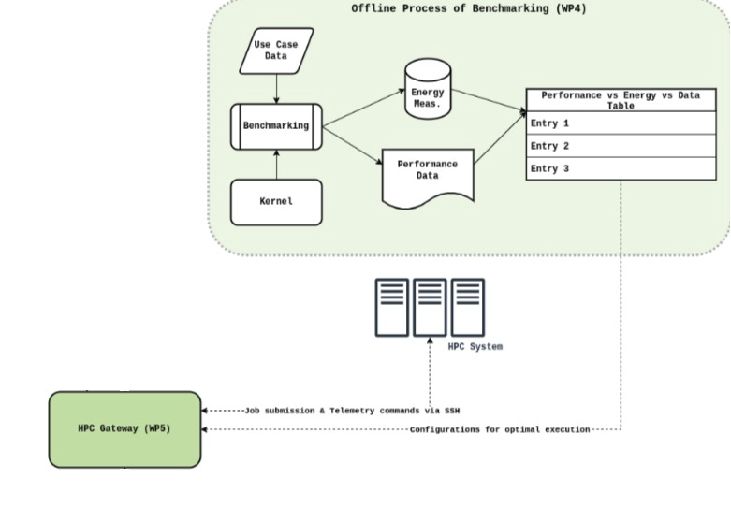
Acceleration of Kernels in HPC system
Hybrid parallel implementation of different Kernels
Reporting Period 1 - Review Meeting
<number>
21/09/22

Slide 3
Acceleration of Kernels in HPC system
Hybrid parallel implementation of different Kernels
Parallel shared and distributed memory implementation of :
Kalman Filter
FFT Filter
Min-Max Filter
Savitkey-Golay Filter
KNN (K-nearest neighbor) Classification method
K-Means Clustering method
<number>
21/09/22
Reporting Period 1 - Review Meeting

Slide 4
Acceleration of Kernels in HPC system
Hybrid parallel implementation of different Kernels
Parallel shared and distributed memory implementation of :
Kalman Filter
FFT Filter
Min-Max Filter
Savitkey-Golay Filter
KNN (K-nearest neighbor) Classification method
K-Means Clustering method
Benchmarking of Kernels with different data sizes
<number>
21/09/22
Reporting Period 1 - Review Meeting

Slide 5
Acceleration of Kernels in HPC system
Hybrid parallel implementation of different Kernels
Parallel shared and distributed memory implementation of :
Kalman Filter
FFT Filter
Min-Max Filter
Savitkey-Golay Filter
KNN (K-nearest neighbor) Classification method
K-Means Clustering method
Benchmarking of Kernels with different data sizes
Applying different data (signals) sizes {1GB, 5GB, 10GB}
<number>
21/09/22
Reporting Period 1 - Review Meeting

Slide 6
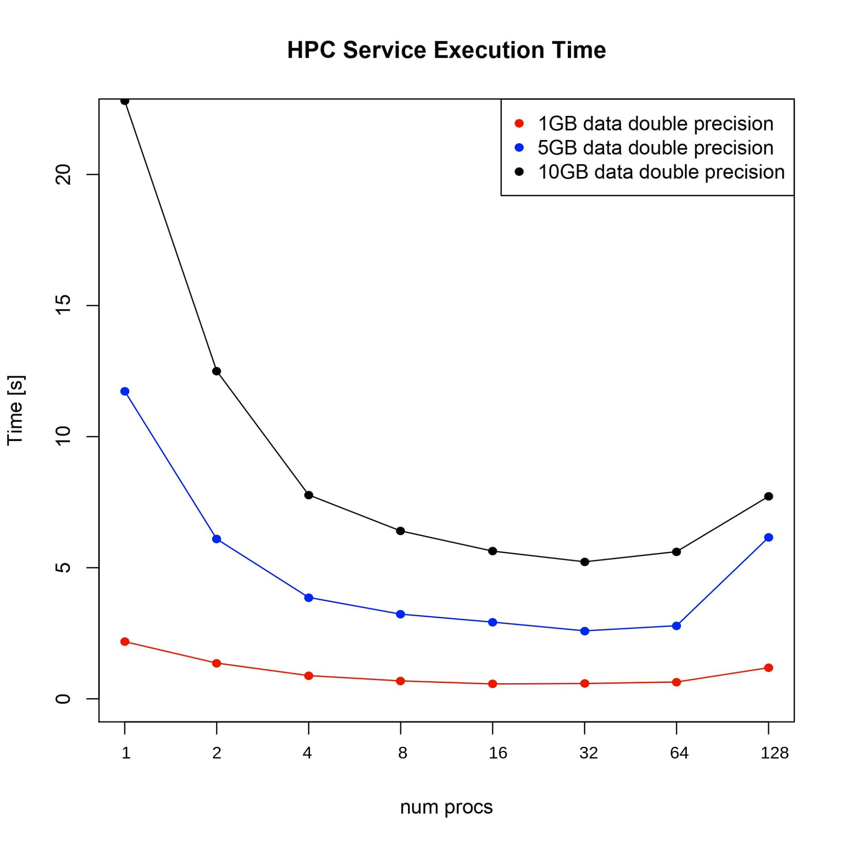
Acceleration of Kernels in HPC system
Hybrid parallel implementation of different Kernels
Parallel shared and distributed memory implementation of :
Kalman Filter
FFT Filter
Min-Max Filter
Savitkey-Golay Filter
KNN (K-nearest neighbor) Classification method
K-Means Clustering method
Benchmarking of Kernels with different data sizes
Applying different data (signals) sizes {1GB, 5GB, 10GB}
Execution runtime
<number>
21/09/22
Reporting Period 1 - Review Meeting

Slide 7
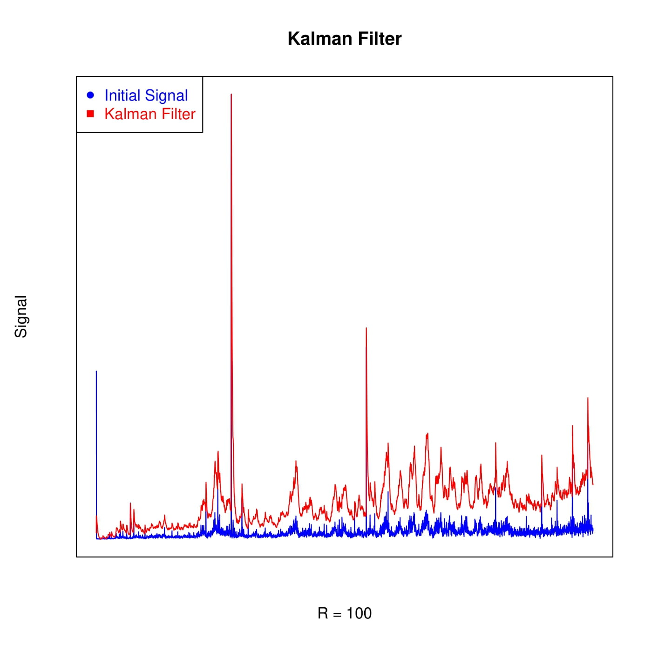
T4.2-Acceleration of Kernels in HPC system
Hybrid parallel implementation of different Kernels
Parallel shared and distributed memory implementation of :
Kalman Filter
FFT Filter
Min-Max Filter
Savitkey-Golay Filter
KNN (K-nearest neighbor) Classification method
K-Means Clustering method
Benchmarking of Kernels with different data sizes
Applying different data (signals) sizes {1GB, 5GB, 10GB}
Execution runtime
Application’s accuracy (error computation)
<number>
21/09/22
Reporting Period 1 - Review Meeting

Slide 8
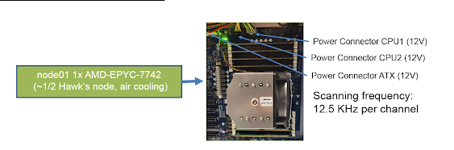
T4.2-Acceleration of Kernels in HPC system
Hybrid parallel implementation of different Kernels
Parallel shared and distributed memory implementation of :
Kalman Filter
FFT Filter
Min-Max Filter
Savitkey-Golay Filter
KNN (K-nearest neighbor) Classification method
K-Means Clustering method
Benchmarking of Kernels with different data sizes
Applying different data (signals) sizes {1GB, 5GB, 10GB}
Execution runtime
Application’s accuracy (error computation)
Energy consumption
<number>
21/09/22
Reporting Period 1 - Review Meeting

Slide 9
T4.2-Acceleration of Kernels in HPC system
Hybrid parallel implementation of different Kernels
Parallel shared and distributed memory implementation of :
Kalman Filter
FFT Filter
Min-Max Filter
Savitkey-Golay Filter
KNN (K-nearest neighbor) Classification method
K-Means Clustering method
Benchmarking of Kernels with different data sizes
Applying different data (signals) sizes {1GB, 5GB, 10GB}
Execution runtime
Application’s accuracy (error computation)
Energy consumption
Kernel | Speedup | Energy Consumption
Kalman Filter | 47X | 31X
<number>
21/09/22
Reporting Period 1 - Review Meeting

Slide 10
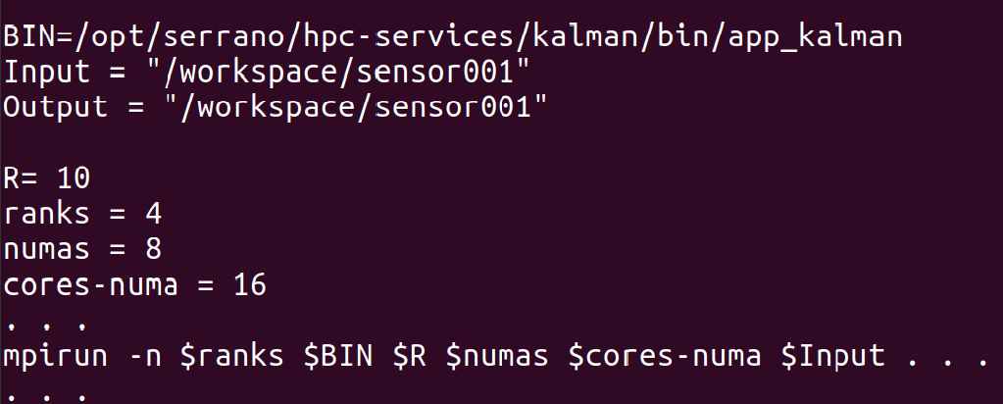
T4.2-Acceleration of Kernels in HPC system
Hybrid parallel implementation of different Kernels
Parallel shared and distributed memory implementation of :
Kalman Filter
FFT Filter
Min-Max Filter
Savitkey-Golay Filter
KNN (K-nearest neighbor) Classification method
K-Means Clustering method
Benchmarking of Kernels with different data sizes
Applying different data (signals) sizes {1GB, 5GB, 10GB}
Execution runtime
Application’s accuracy (error computation)
Energy consumption
Implementing the Interface of HPC service
<number>
21/09/22
Reporting Period 1 - Review Meeting

Slide 11
T4.2-Acceleration of Kernels in HPC system
Hybrid parallel implementation of different Kernels
Parallel shared and distributed memory implementation of :
Kalman Filter
FFT Filter
Min-Max Filter
Savitkey-Golay Filter
KNN (K-nearest neighbor) Classification method
K-Means Clustering method
Benchmarking of Kernels with different data sizes
Applying different data (signals) sizes {1GB, 5GB, 10GB}
Execution runtime
Application’s accuracy (error computation)
Energy consumption
Implementing the Interface of HPC-Service
Finding best parallel parameter to achieve the maximum performance
<number>
21/09/22
Reporting Period 1 - Review Meeting

Slide 12
T4.2-Transprecision and Approximate Computing Techniques
Resolving the challenges like limited storage and computation resources
21/09/22
Reporting Period 1 - Review Meeting
<number>

Slide 13
T4.2-Transprecision and Approximate Computing Techniques
Resolving the challenges like limited storage and computation resources
Applying the approximate computing techniques :
21/09/22
Reporting Period 1 - Review Meeting
<number>

Slide 14
T4.2-Transprecision and Approximate Computing Techniques
Resolving the challenges like limited storage and computation resources
Applying the approximate computing techniques :
Subset of iteration of a loop are executed to reduce the total workload of a kernel
21/09/22
Reporting Period 1 - Review Meeting
<number>

Slide 15
T4.2-Transprecision and Approximate Computing Techniques
Resolving the challenges like limited storage and computation resources
Applying the approximate computing techniques :
Subset of iteration of a loop are executed to reduce the total workload of a kernel
Reduces computation time at the cost of changing the accuracy of the result
21/09/22
Reporting Period 1 - Review Meeting
<number>

Slide 16
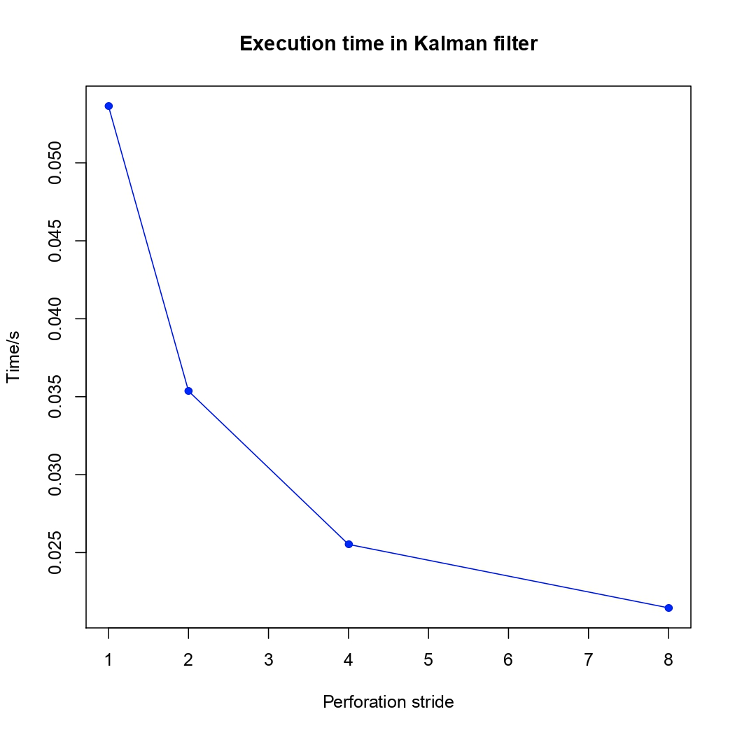
T4.2-Transprecision and Approximate Computing Techniques
Resolving the challenges like limited storage and computation resources
Applying the approximate computing techniques :
Subset of iteration of a loop are executed to reduce the total workload of a kernel
Reduces computation time at the cost of changing the accuracy of the result
21/09/22
Reporting Period 1 - Review Meeting
<number>

Slide 17
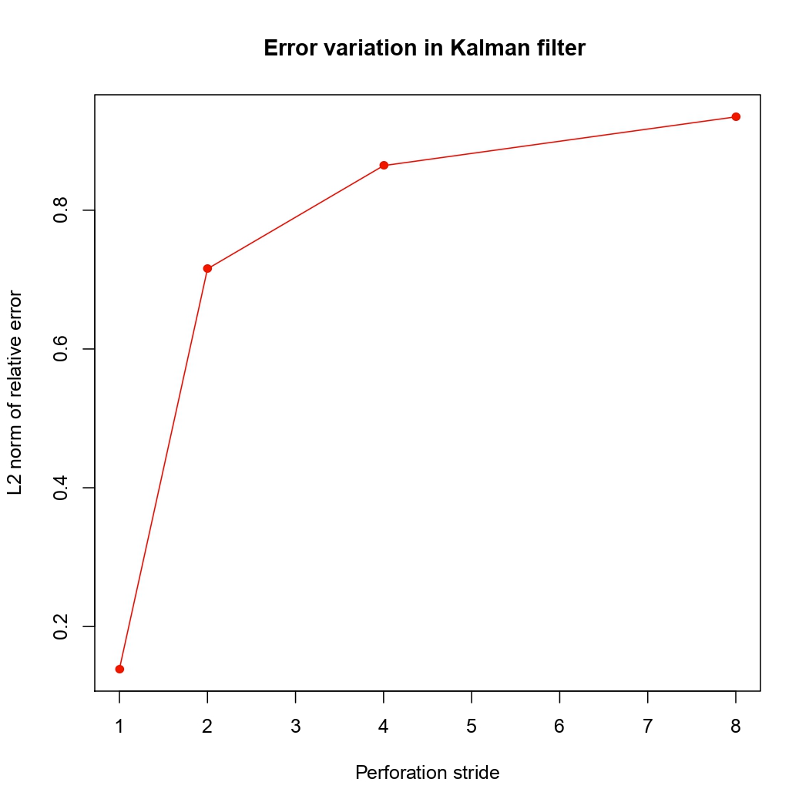
T4.2-Transprecision and Approximate Computing Techniques
Resolving the challenges like limited storage and computation resources
Applying the approximate computing techniques :
Subset of iteration of a loop are executed to reduce the total workload of a kernel
Reduces computation time at the cost of changing the accuracy of the result
Reporting Period 1 - Review Meeting
<number>
21/09/22

Slide 18
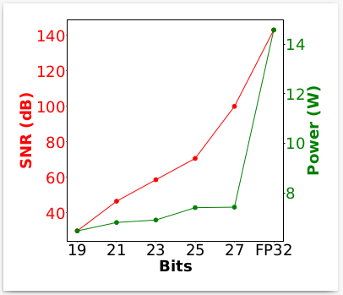
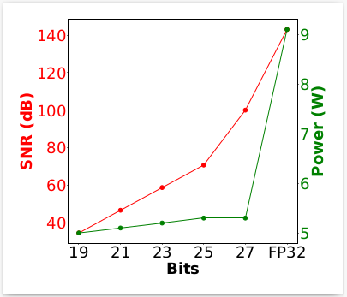
T4.2-Transprecision and Approximate Computing Techniques
Kalman Filter
Applied app-specific approximation (batching) and precision scaling
Kalman filter approximation leads to a x65.9 speedup and a x51.8 decrease in energy consumption compared to the accurate FPGA kernel (KPI ACC.3)
Fast Fourier Transform
Applied precision scaling (preliminary results)
Alveo U200 (Cloud FPGA)
MPSoC ZCU104 (Edge FPGA)
21/09/22
Reporting Period 1 - Review Meeting
<number>

Slide 19
T4.2-Transprecision and Approximate Computing Techniques
Resolving the challenges like limited storage and computation resources
Applying the approximate computing techniques :
21/09/22
Reporting Period 1 - Review Meeting
<number>

Slide 20

T4.2-Transprecision and Approximate Computing Techniques
Resolving the challenges like limited storage and computation resources
Applying the approximate computing techniques :
Choosing different precision and minimizes execution time without losing solution accuracy
21/09/22
Reporting Period 1 - Review Meeting
<number>

Slide 21
T4.2-Transprecision and Approximate Computing Techniques
Resolving the challenges like limited storage and computation resources
Applying the transprecision computing techniques :
Choosing different precision and minimizes execution time without losing solution accuracy
Reducing memory footprints and transmission costs
21/09/22
Reporting Period 1 - Review Meeting
<number>

Slide 22
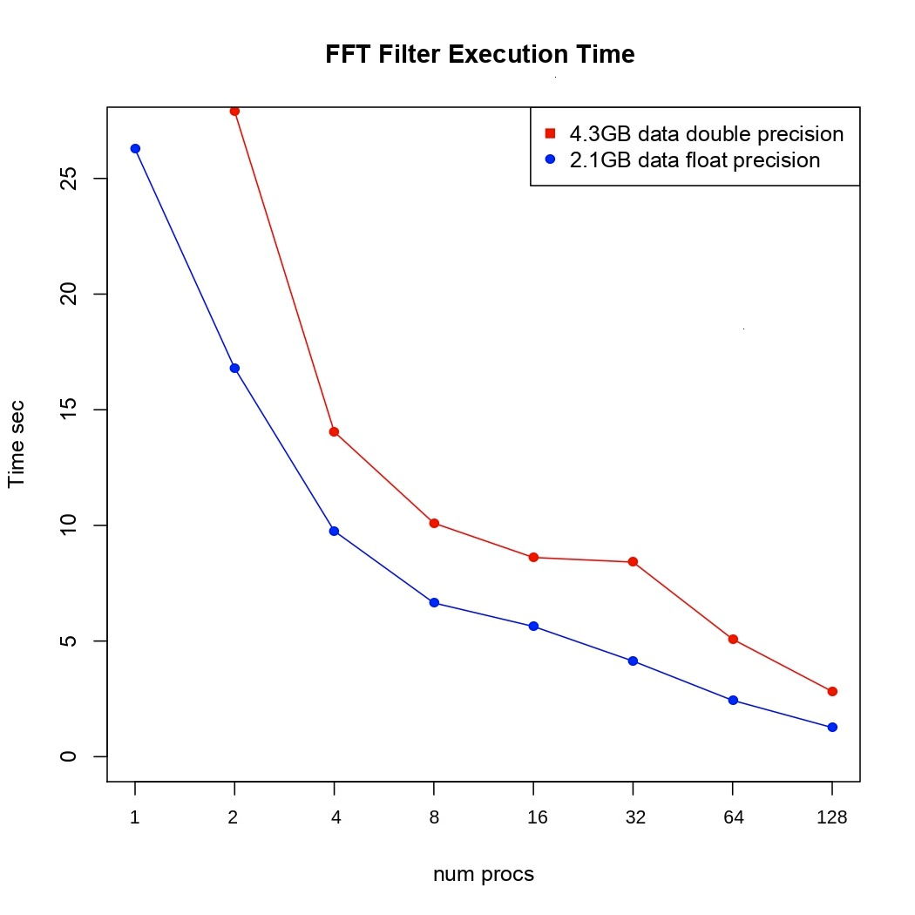
T4.2-Transprecision and Approximate Computing Techniques
Resolving the challenges like limited storage and computation resources
Applying the approximate computing techniques :
Choosing different precision and minimizes execution time without losing solution accuracy
Reducing memory footprints and transmission costs
21/09/22
Reporting Period 1 - Review Meeting
<number>

Slide 23
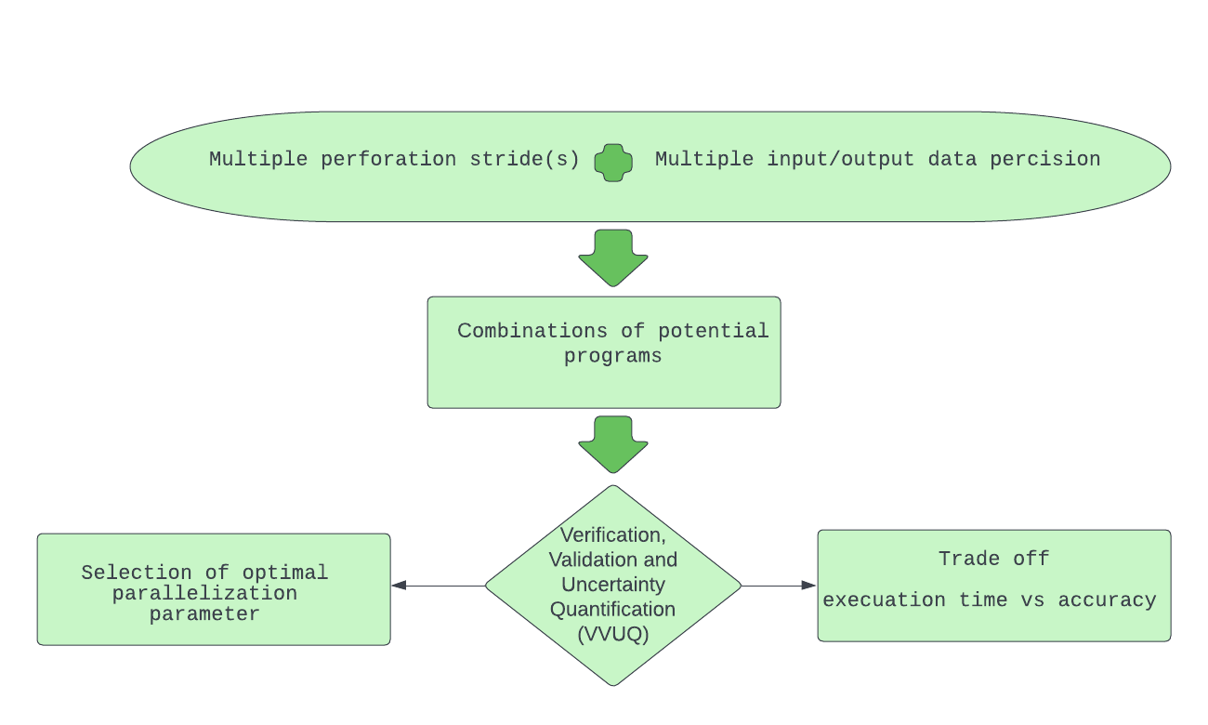

T4.2-Transprecision and Approximate Computing Techniques
21/09/22
Reporting Period 1 - Review Meeting
<number>

Slide 24

T4.2-Transprecision and Approximate Computing Techniques
21/09/22
Reporting Period 1 - Review Meeting
<number>

Slide 25

T4.2-Transprecision and Approximate Computing Techniques
21/09/22
Reporting Period 1 - Review Meeting
<number>

Slide 26
T4.2-Transprecision and Approximate Computing Techniques
21/09/22
Reporting Period 1 - Review Meeting
<number>

Slide 27
T4.2-Transprecision and approximate computing techniques
21/09/22
Reporting Period 1 - Review Meeting
<number>

Slide 28
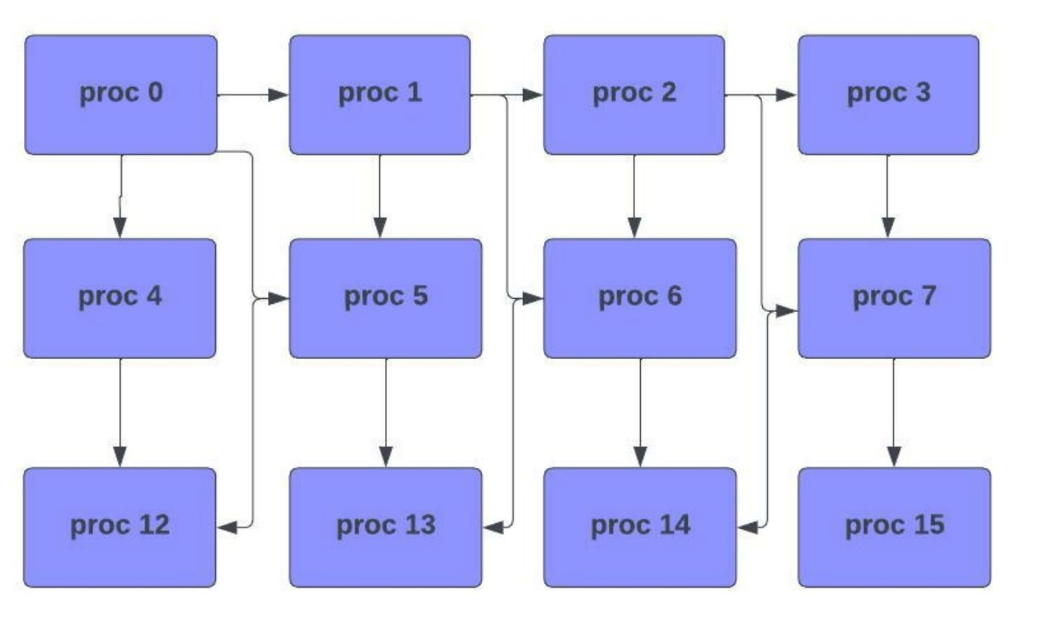
T4.2-Integration of the HPC Service toward VVUQ
Development of framework for Verification, Validation and Uncertainty Quantification (VVUQ)
Analyze the uncertainty and validate the result for multiple input precision
Integrating the parallel implementation into group communicator
21/09/22
Reporting Period 1 - Review Meeting
<number>

Slide 29
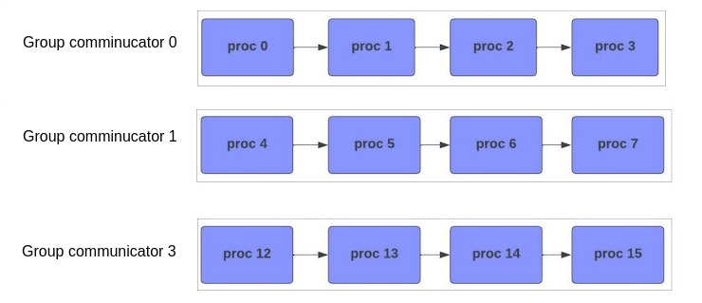
T4.2-Integration of the HPC Service toward VVUQ
Development of framework for Verification, Validation and Uncertainty Quantification (VVUQ)
Analyze the uncertainty and validate the result for multiple input precision
Integrating the parallel implementation into group communicator
21/09/22
Reporting Period 1 - Review Meeting

Slide 30
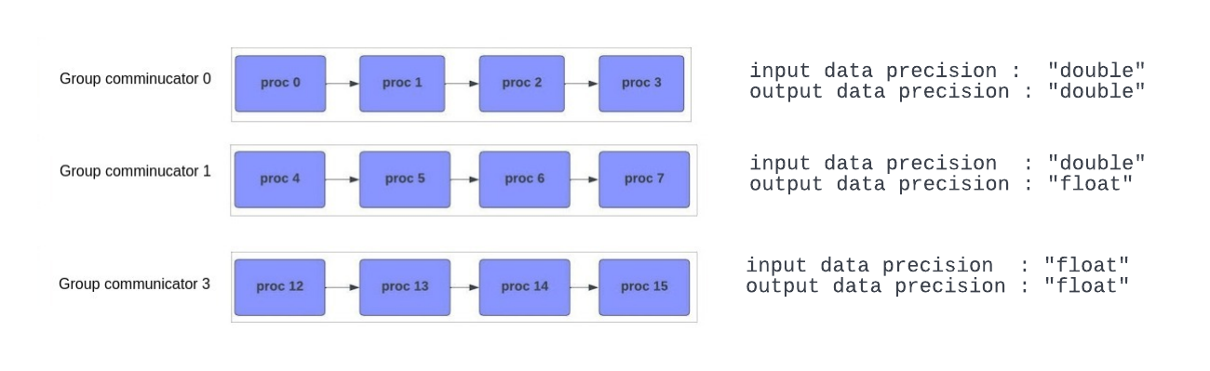
T4.2-Integration of the HPC Service toward VVUQ
Development of framework for Verification, Validation and Uncertainty Quantification (VVUQ)
Analyze the uncertainty and validate the result for multiple input precision
Integrating the parallel implementation into group communicator
21/09/22
Reporting Period 1 - Review Meeting

Slide 31
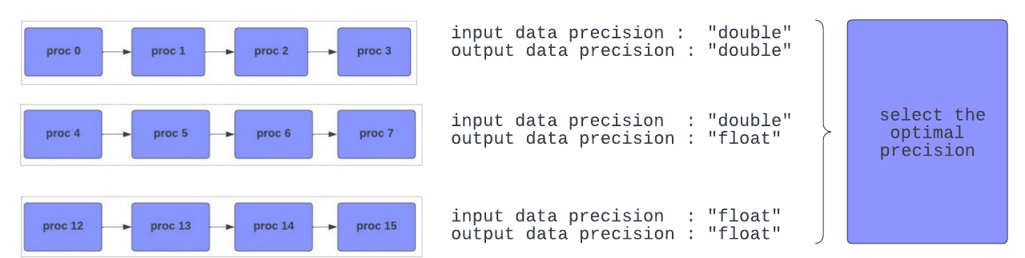
T4.2-Integration of the HPC Service toward VVUQ
Development of framework for Verification, Validation and Uncertainty Quantification (VVUQ)
Analyze the uncertainty and validate the result for multiple input precision
Integrating the parallel implementation into group communicator
21/09/22
Reporting Period 1 - Review Meeting

Slide 32

T4.2-Integration of the HPC Service toward VVUQ
Demo for HPC Interface and Verification, Validation and Uncertainty Quantification (VVUQ)
21/09/22
Reporting Period 1 - Review Meeting

