Slide 1
TRANSPARENT APPLICATION DEPLOYMENT IN A SECURE, ACCELERATED AND COGNITIVE CLOUD CONTINUUM
WP4 - Cloud and Edge Acceleration
Task4.2: Performance Maximization under Maximum Affordable Error in Cloud and Edge
High Performance Computing Center, Stuttgart-HLRS
Javad Fadaie Ghotbi
7th plenary meeting
Notes:
<number>

Slide 2
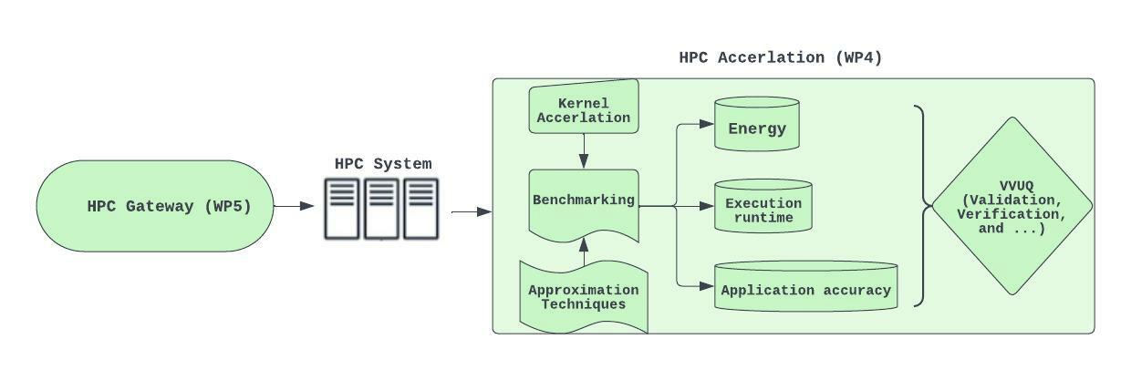
Acceleration of Kernels in the HPC System
Hybrid parallel implementation of multiple kernels
7/12/22
7th-plenary meeting
<number>

Slide 3
Acceleration of Kernels in the HPC System
Hybrid parallel implementation of multiple kernels
Parallel shared and distributed memory (OpenMP/MPI) implementation of :
Savitzky-Golay filter
KNN (K-nearest neighbor) Classification method
K-Means Clustering method
<number>
7/12/22
7th-plenary meeting

Slide 4
T4.2-Transprecision and Approximate Computing Techniques
Resolving the challenges like limited storage and computation resources
7/12/22
7th-plenary meeting
<number>

Slide 5
T4.2-Transprecision and Approximate Computing Techniques
Resolving the challenges like limited storage and computation resources
Applying the approximate computing techniques :
7/12/22
7th-plenary meeting
<number>

Slide 6
T4.2-Transprecision and Approximate Computing Techniques
Resolving the challenges like limited storage and computation resources
Applying the approximate computing techniques :
Subset of iteration of a loop are executed to reduce the total workload of a kernel
7/12/22
7th-plenary meeting
<number>

Slide 7
T4.2-Transprecision and Approximate Computing Techniques
Resolving the challenges like limited storage and computation resources
Applying the approximate computing techniques :
Subset of iteration of a loop are executed to reduce the total workload of a kernel
Reduces computation time at the cost of changing the accuracy of the result
7/12/22
7th-plenary meeting
<number>

Slide 8
T4.2-Transprecision and Approximate Computing Techniques
Resolving the challenges like limited storage and computation resources
Applying the transprecision computing techniques :
7/12/22
7th-plenary meeting
<number>

Slide 9

T4.2-Transprecision and Approximate Computing Techniques
Resolving the challenges like limited storage and computation resources
Applying the transprecision computing techniques :
Choosing different precision and minimizes execution time without losing solution accuracy
7/12/22
7th-plenary meeting
<number>

Slide 10
T4.2-Transprecision and Approximate Computing Techniques
Resolving the challenges like limited storage and computation resources
Applying the transprecision computing techniques :
Choosing different precision and minimizes execution time without losing solution accuracy
Reducing memory footprints and transmission costs
7/12/22
7th-plenary meeting
<number>

Slide 11
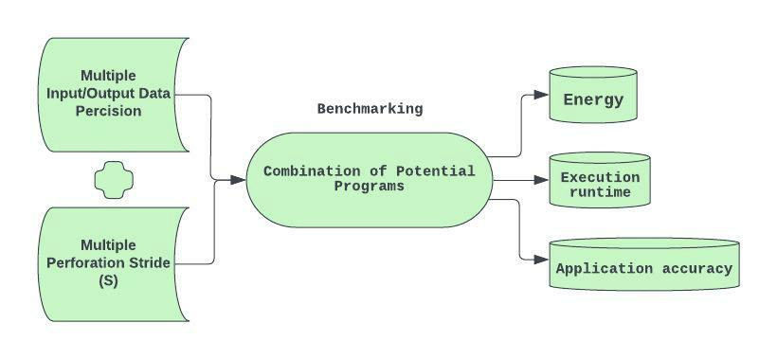


T4.2-Transprecision and Approximate Computing Techniques
Automated Benchmarking with regard to Approximation and Transprecision computing techniques.
7/12/22
7th-plenary meeting
<number>

Slide 12
T4.2-Transprecision and Approximate Computing Techniques
Automated Benchmarking with regard to Approximation and Transprecision computing techniques.
7/12/22
7th-plenary meeting
<number>

Slide 13

T4.2-Transprecision and Approximate Computing Techniques
Automated Benchmarking with regard to Approximation and Transprecision computing techniques.
7/12/22
7th-plenary meeting
<number>

Slide 14
T4.2-Transprecision and Approximate Computing Techniques
Automated Benchmarking with regard to Approximation and Transprecision computing techniques.
7/12/22
7th-plenary meeting
<number>

Slide 15

T4.2-Integration of the HPC Service toward VVUQ
Demo for automated benchmarking of kernels
7/12/22
7th-plenary meeting

Slide 16
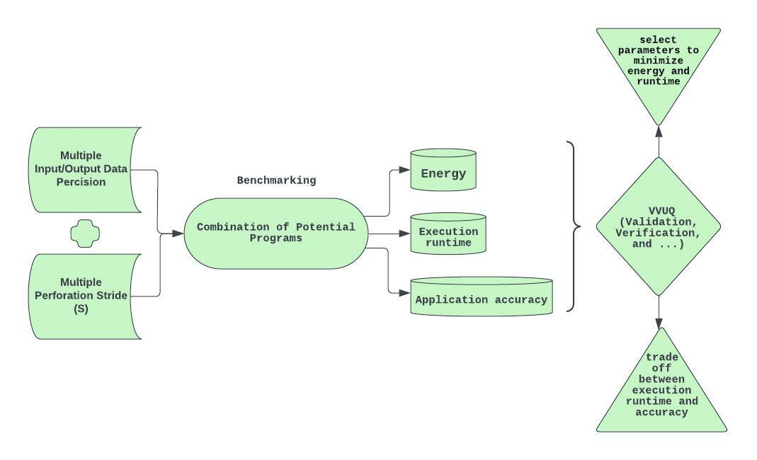
T4.2-Development of VVUQ Tool
Development of framework for Verification, Validation and Uncertainty Quantification (VVUQ)
7/12/22
7th-plenary meeting
<number>

Slide 17
T4.2-Development of VVUQ Tool
Development of framework for Verification, Validation and Uncertainty Quantification (VVUQ)
7/12/22
7th-plenary meeting
<number>

Slide 18
T4.2-Development of VVUQ Tool
Development of framework for Verification, Validation and Uncertainty Quantification (VVUQ)
Select parallel parameter to minimizes the execution runtime and energy consumption
7/12/22
7th-plenary meeting
<number>

Slide 19
T4.2-Development of VVUQ Tool
Development of framework for Verification, Validation and Uncertainty Quantification (VVUQ)
Select parallel parameter to minimizes the execution runtime and energy consumption
Analyzes trade off between the execution runtime and application accuracy
7/12/22
7th-plenary meeting
<number>

Slide 20
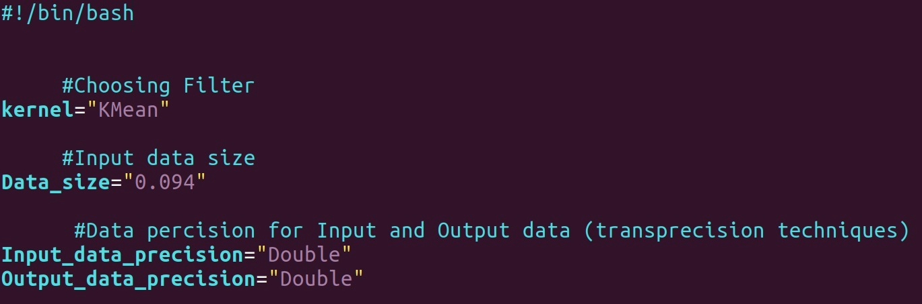
T4.2-Development of VVUQ Tool
Development of framework for Verification, Validation and Uncertainty Quantification (VVUQ)
7/12/22
7th-plenary meeting
<number>

Slide 21
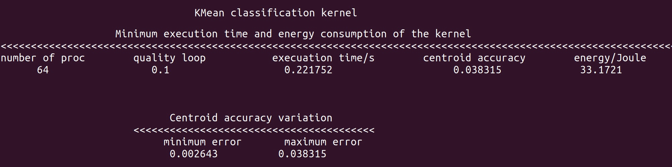
T4.2-Development of VVUQ Tool
Development of framework for Verification, Validation and Uncertainty Quantification (VVUQ)
Select parallel parameter to minimizes the execution runtime and energy consumption
7/12/22
7th-plenary meeting
<number>

Slide 22
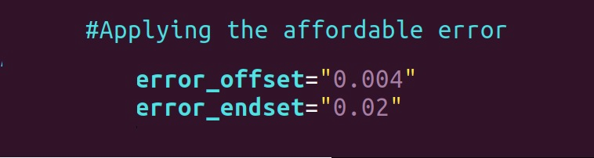
T4.2-Development of VVUQ Tool
Development of framework for Verification, Validation and Uncertainty Quantification (VVUQ)
Analyzes trade off between the execution runtime and application accuracy
7/12/22
7th-plenary meeting
<number>

Slide 23
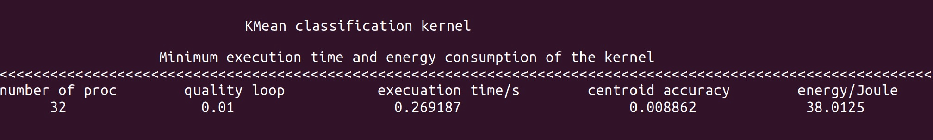
T4.2-Development of VVUQ Tool
Development of framework for Verification, Validation and Uncertainty Quantification (VVUQ)
Analyzes trade off between the execution runtime and application accuracy
7/12/22
7th-plenary meeting
<number>

Slide 24
T4.2-Next Steps
Introducing optimization in implementation of the Kernels to reduce execution time and energy consumption
Benchmarking kernels with different data sizes
Integrating the VVUQ framework to validate uncertainties in kernels parameters
21/09/22
Reporting Period 1 - Review Meeting

