Slide 1

SERRANO:
TRANSPARENT APPLICATION DEPLOYMENT IN A SECURE, ACCELERATED AND
COGNITIVE CLOUD CONTINUUM
High Performance Computing Center, Stuttgart-HLRS

Slide 2
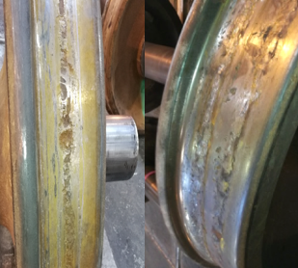
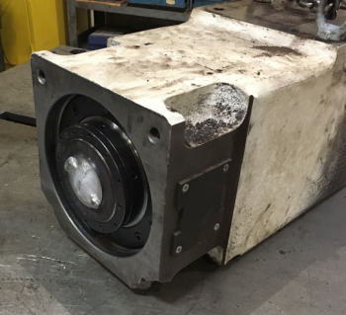
Anomaly Detection in Manufacturing Settings using SERRANO Platform
Challenges in manufacturing systems
Intensified deterioration of machine components during operations that generate aggressive vibrations
The inability to predict the failure of crucial components, such as spindles and ball screw
‹#›
13/09/23

Slide 3
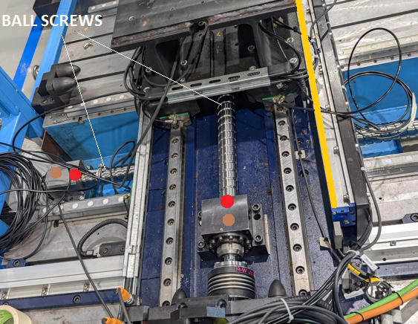
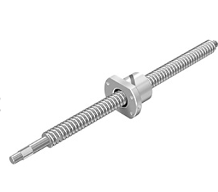
Anomaly Detection in Manufacturing Settings using SERRANO Platform
The objective is to develop a framework capable to detect anomalies in a machine's ball screws
Constantly monitor the ball screw's position and identifying failures in real-time
Achieve the capability to process huge volume of data in real-time or near real-time
Avoid interrupting machine operations for health status checks, thereby improving machine availability
‹#›
13/09/23

Slide 4
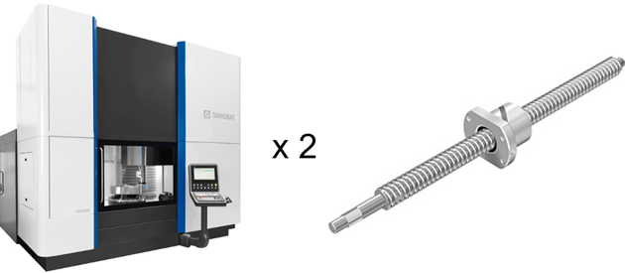
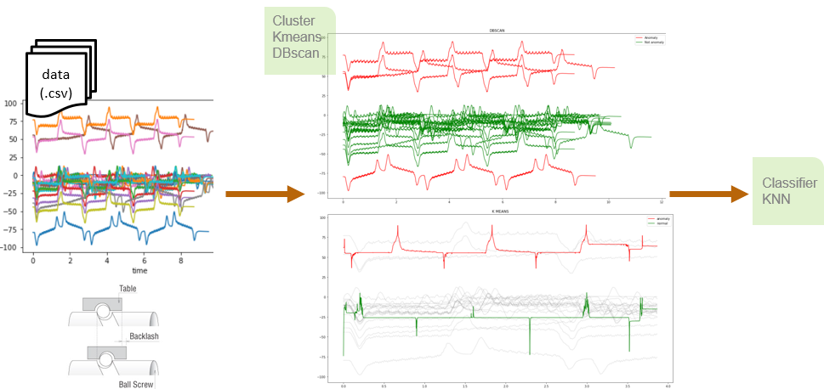
Anomaly Detection in Manufacturing Settings using SERRANO Platform
The objective is to develop a framework capable to detect anomalies in a machine's ball screws
Developing filters to effectively remove noise and smooth the signals
Transforming the time series signals into the frequency domain
Clustering and classification of signals for anomaly detection
‹#›
13/09/23

Slide 5
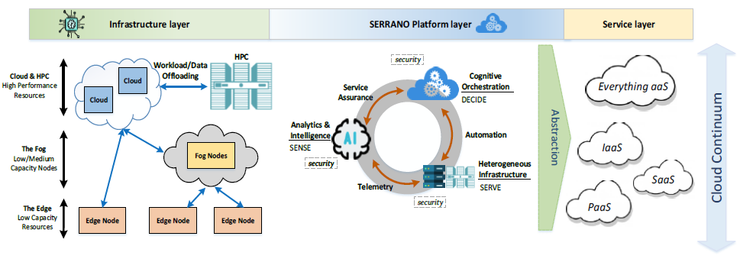
SERRANO Platform
‹#›
13/09/23

Slide 6
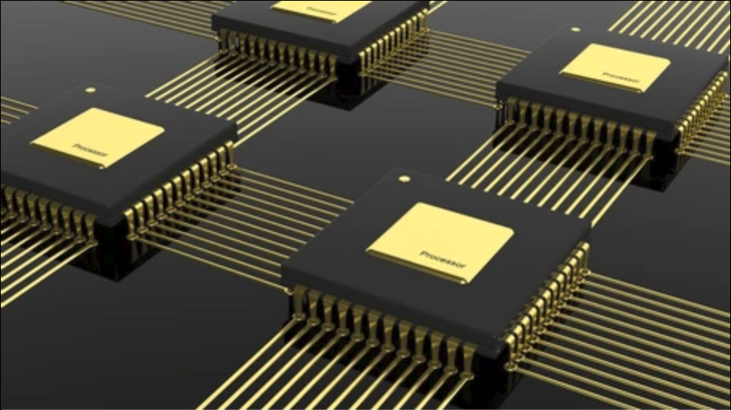
Acceleration of Kernels in HPC system
Hybrid parallel implementation of multiple kernels in the HPC system
Parallelization in shared and distributed memory (OpenMP/MPI)
Task parallelization by distributing task across multiple processes
Kalman Filter
FFT Filter
Min-Max Filter
Savitkey-Golay Filter
KNN (K-nearest neighbor) Classification method
K-Means Clustering method
‹#›
13/09/23

Slide 7
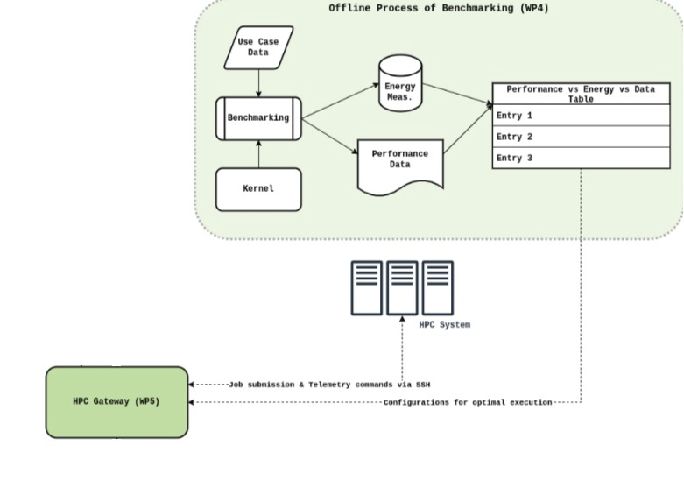
Acceleration of Kernels in HPC system
Hybrid parallel implementation of different Kernels
Parallel shared and distributed memory implementation of :
Kalman Filter
FFT Filter
Min-Max Filter
Savitkey-Golay Filter
KNN (K-nearest neighbor) Classification method
K-Means Clustering method
Performance analysis of Kernels
Applying different signals batches
‹#›
13/09/23

Slide 8
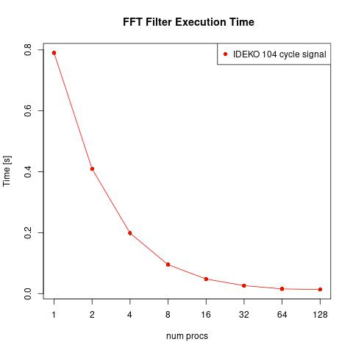
Acceleration of Kernels in HPC system
Hybrid parallel implementation of different Kernels
Parallel shared and distributed memory implementation of :
Kalman Filter
FFT Filter
Min-Max Filter
Savitkey-Golay Filter
KNN (K-nearest neighbor) Classification method
K-Means Clustering method
Performance analysis of Kernels
Applying different signals batches
Execution runtime
‹#›
13/09/23

Slide 9
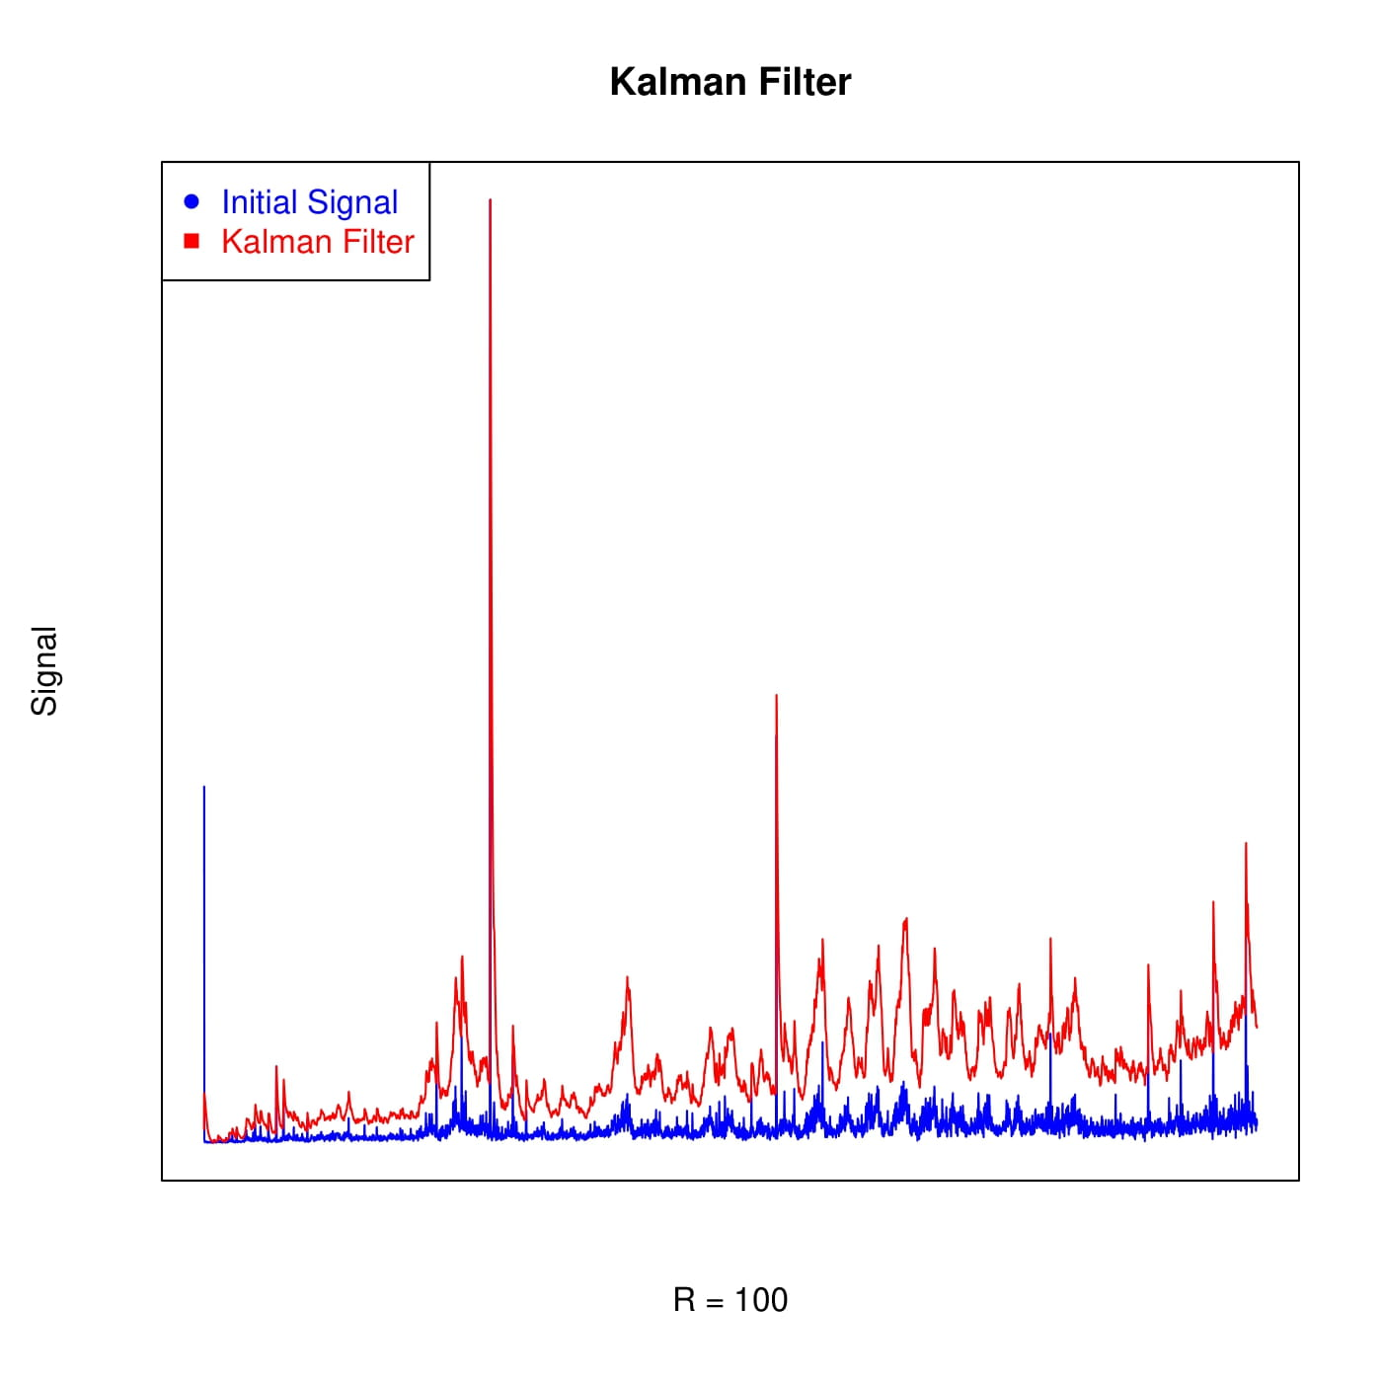
Acceleration of Kernels in HPC system
Hybrid parallel implementation of different Kernels
Parallel shared and distributed memory implementation of :
Kalman Filter
FFT Filter
Min-Max Filter
Savitkey-Golay Filter
KNN (K-nearest neighbor) Classification method
K-Means Clustering method
Performance analysis of Kernels
Applying different signals batches
Execution runtime
Application’s accuracy (error computation)
‹#›
13/09/23

Slide 10
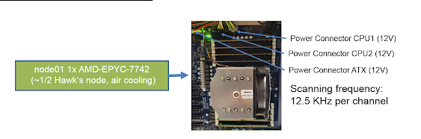
Acceleration of Kernels in HPC system
Hybrid parallel implementation of different Kernels
Parallel shared and distributed memory implementation of :
Kalman Filter
FFT Filter
Min-Max Filter
Savitkey-Golay Filter
KNN (K-nearest neighbor) Classification method
K-Means Clustering method
Performance analysis of Kernels
Applying different signals batches
Execution runtime
Application’s accuracy (error computation)
Energy consumption
‹#›
13/09/23

Slide 11
Acceleration of Kernels in HPC system
Hybrid parallel implementation of different Kernels
Parallel shared and distributed memory implementation of :
Kalman Filter
FFT Filter
Min-Max Filter
Savitkey-Golay Filter
KNN (K-nearest neighbor) Classification method
K-Means Clustering method
Performance analysis of Kernels
Applying different signals batches
Execution runtime
Application’s accuracy (error computation)
Energy consumption
Performance of FFT Filter
Signal batch | Speedup | Energy | Accuracy %
104 cycle signal | 90X | 33X | 100%
‹#›
13/09/23

Slide 12
Acceleration of Kernels in HPC system
Hybrid parallel implementation of different Kernels
Parallel shared and distributed memory implementation of :
Kalman Filter
FFT Filter
Min-Max Filter
Savitkey-Golay Filter
KNN (K-nearest neighbor) Classification method
K-Means Clustering method
Performance analysis of Kernels
Applying different signals batches
Execution runtime
Application’s accuracy (error computation)
Energy consumption
Performance of K-means
Signal batch | Speedup | Energy | Accuracy %
110 cycle signal | 59X | 44X | 95% - 100%
‹#›
13/09/23

Slide 13
Transprecision and Approximate Computing Techniques
Resolving the challenges like limited storage and computation resources
13/09/23
‹#›

Slide 14
Transprecision and Approximate Computing Techniques
Resolving the challenges like limited storage and computation resources
Applying the approximate computing techniques :
13/09/23
‹#›

Slide 15
Transprecision and Approximate Computing Techniques
Resolving the challenges like limited storage and computation resources
Applying the approximate computing techniques :
Subset of iteration of a loop are executed to reduce the total workload of a kernel
13/09/23
‹#›

Slide 16
Transprecision and Approximate Computing Techniques
Resolving the challenges like limited storage and computation resources
Applying the approximate computing techniques :
Subset of iteration of a loop are executed to reduce the total workload of a kernel
Reduces computation time at the cost of changing the accuracy of the result
13/09/23
‹#›

Slide 17
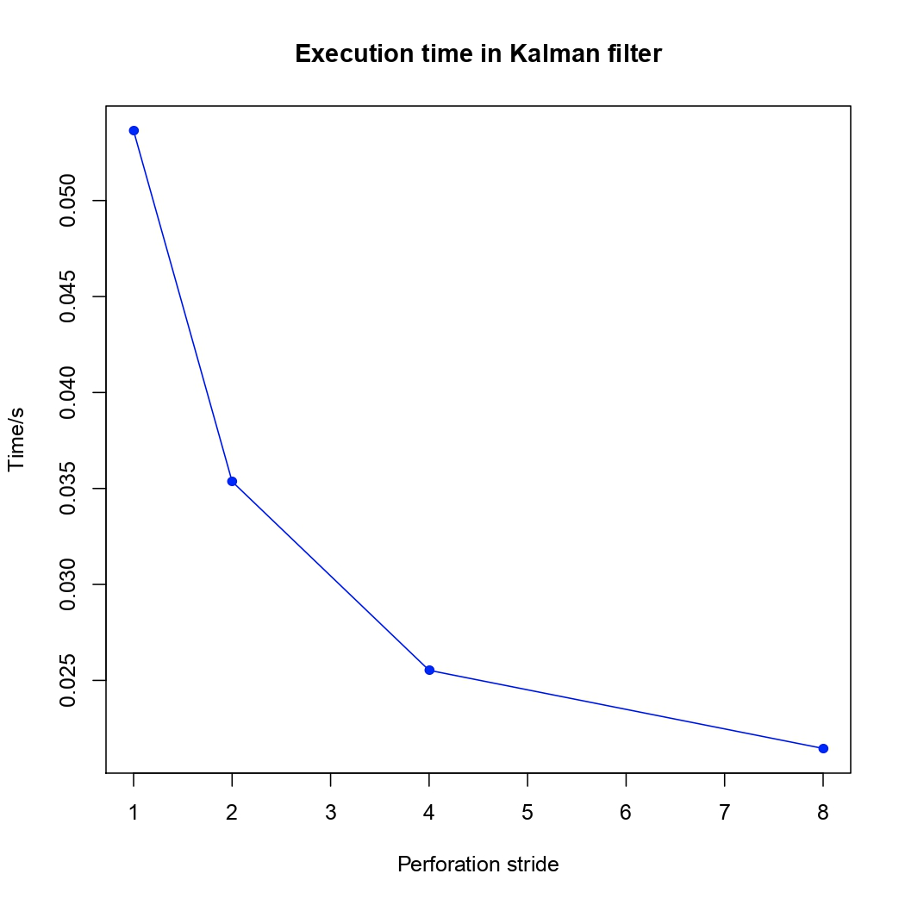
Transprecision and Approximate Computing Techniques
Resolving the challenges like limited storage and computation resources
Applying the approximate computing techniques :
Subset of iteration of a loop are executed to reduce the total workload of a kernel
Reduces computation time at the cost of changing the accuracy of the result
13/09/23
‹#›

Slide 18
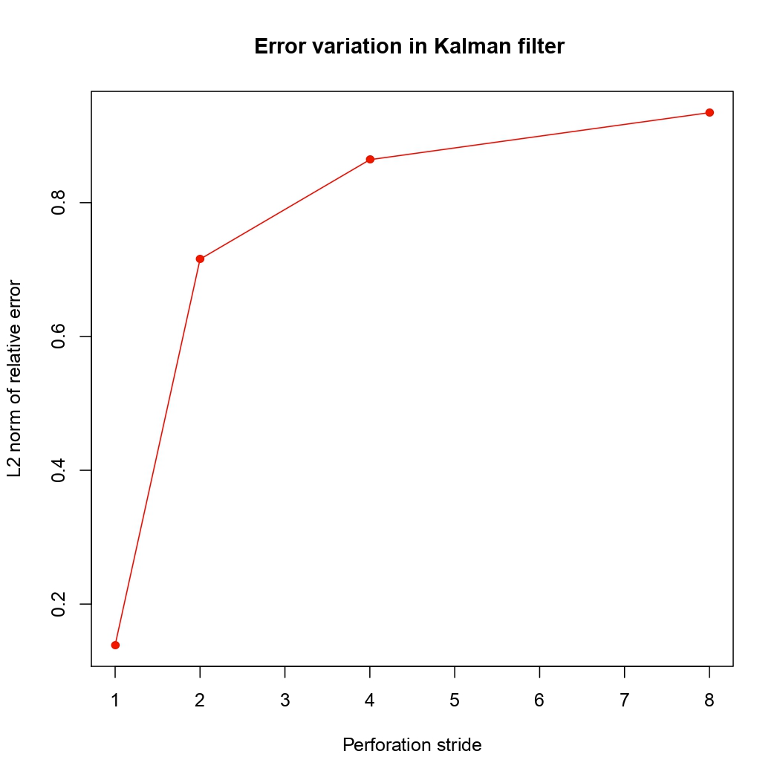
Transprecision and Approximate Computing Techniques
Resolving the challenges like limited storage and computation resources
Applying the approximate computing techniques :
Subset of iteration of a loop are executed to reduce the total workload of a kernel
Reduces computation time at the cost of changing the accuracy of the result
13/09/23
‹#›

Slide 19
Transprecision and Approximate Computing Techniques
Resolving the challenges like limited storage and computation resources
Applying the approximate computing techniques :
13/09/23
‹#›

Slide 20

Transprecision and Approximate Computing Techniques
Resolving the challenges like limited storage and computation resources
Applying the approximate computing techniques :
Choosing different precision and minimizes execution time without losing solution accuracy
13/09/23
‹#›

Slide 21
Transprecision and Approximate Computing Techniques
Resolving the challenges like limited storage and computation resources
Applying the transprecision computing techniques :
Choosing different precision and minimizes execution time without losing solution accuracy
Reducing memory footprints and transmission costs
13/09/23
‹#›

Slide 22
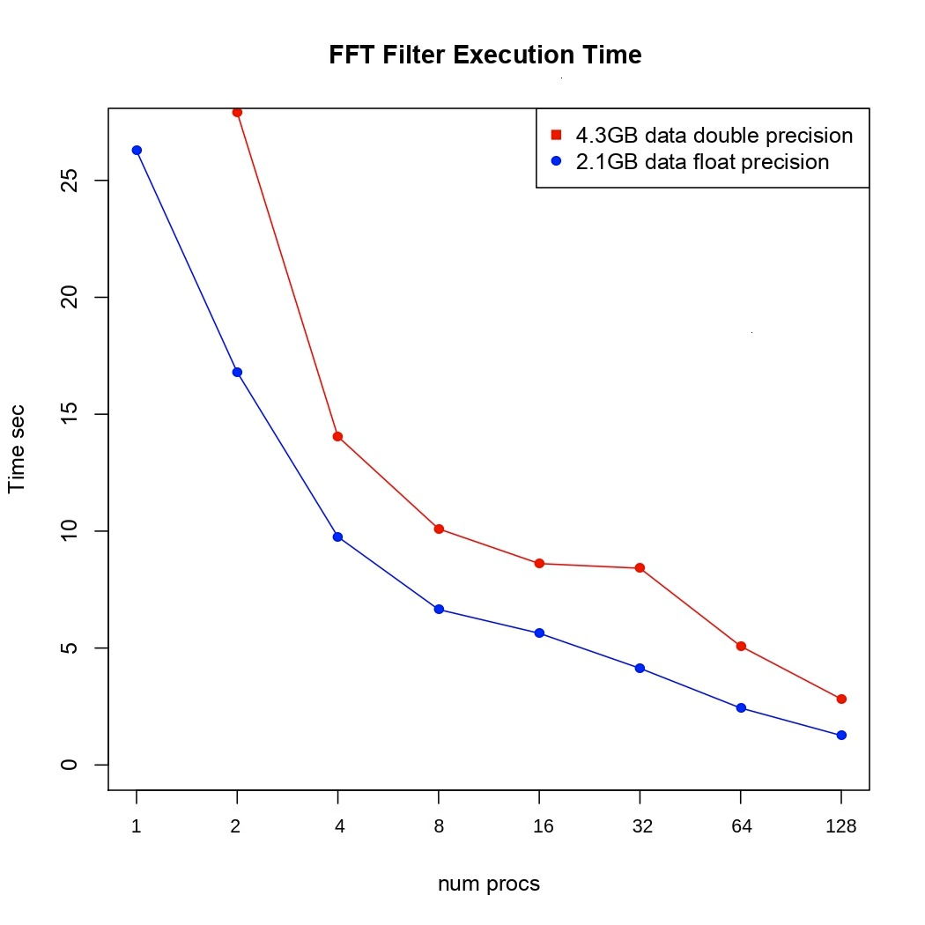
Transprecision and Approximate Computing Techniques
Resolving the challenges like limited storage and computation resources
Applying the approximate computing techniques :
Choosing different precision and minimizes execution time without losing solution accuracy
Reducing memory footprints and transmission costs
13/09/23
‹#›

Slide 23
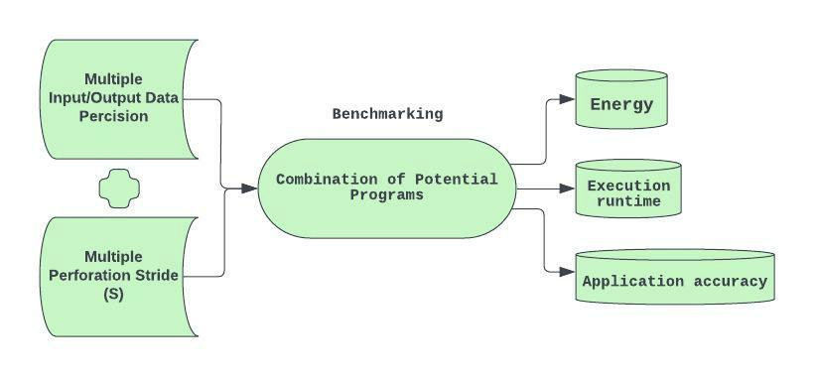
Verification, Validation and Uncertainty Quantification (VVUQ)
Automated Benchmarking with regard to Approximation and Transprecision computing techniques.
‹#›

Slide 24
Verification, Validation and Uncertainty Quantification (VVUQ)
Automated Benchmarking with regard to Approximation and Transprecision computing techniques.
‹#›

Slide 25

Verification, Validation and Uncertainty Quantification (VVUQ)
Automated Benchmarking with regard to Approximation and Transprecision computing techniques.
‹#›

Slide 26

Verification, Validation and Uncertainty Quantification (VVUQ)
Development of framework for Verification, Validation and Uncertainty Quantification (VVUQ)
‹#›

Slide 27
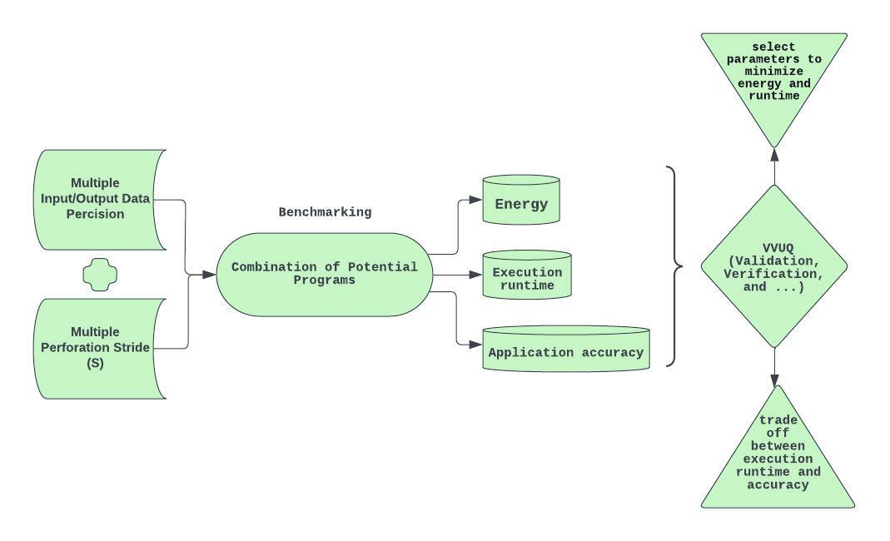
Verification, Validation and Uncertainty Quantification (VVUQ) Tool
Development of framework for Verification, Validation and Uncertainty Quantification (VVUQ)
‹#›

Slide 28
Verification, Validation and Uncertainty Quantification (VVUQ)
Development of framework for Verification, Validation and Uncertainty Quantification (VVUQ)
Select parallel parameter to minimizes the execution runtime and energy consumption
7th-plenary meeting
‹#›

Slide 29
Verification, Validation and Uncertainty Quantification (VVUQ)
Development of framework for Verification, Validation and Uncertainty Quantification (VVUQ)
Select parallel parameter to minimizes the execution runtime and energy consumption
Analyzes trade off between the execution runtime and application accuracy
‹#›

Slide 30
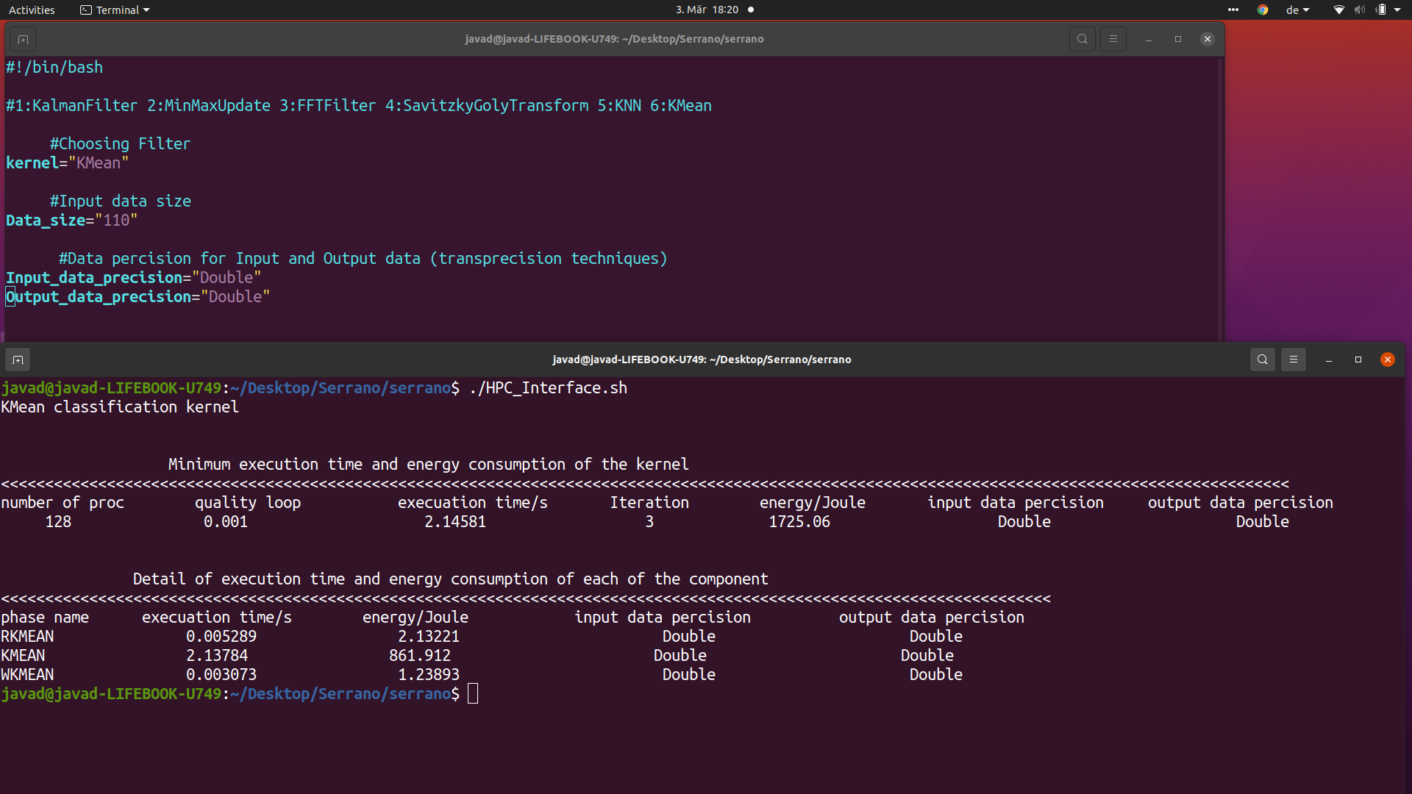
Development of Verification, Validation and Uncertainty Quantification (VVUQ) Tool
Development of framework for Verification, Validation and Uncertainty Quantification (VVUQ)
‹#›

Slide 31
Development of Verification, Validation and Uncertainty Quantification (VVUQ) Tool
Development of framework for Verification, Validation and Uncertainty Quantification (VVUQ)
Select parallel parameter to minimizes the execution runtime and energy consumption
‹#›

Slide 32
SERRANO Platform
Question ?
‹#›

