Slide 1
Why I think Kefir is interesting
By: Mohammadjavad Meghrazi

Slide 2
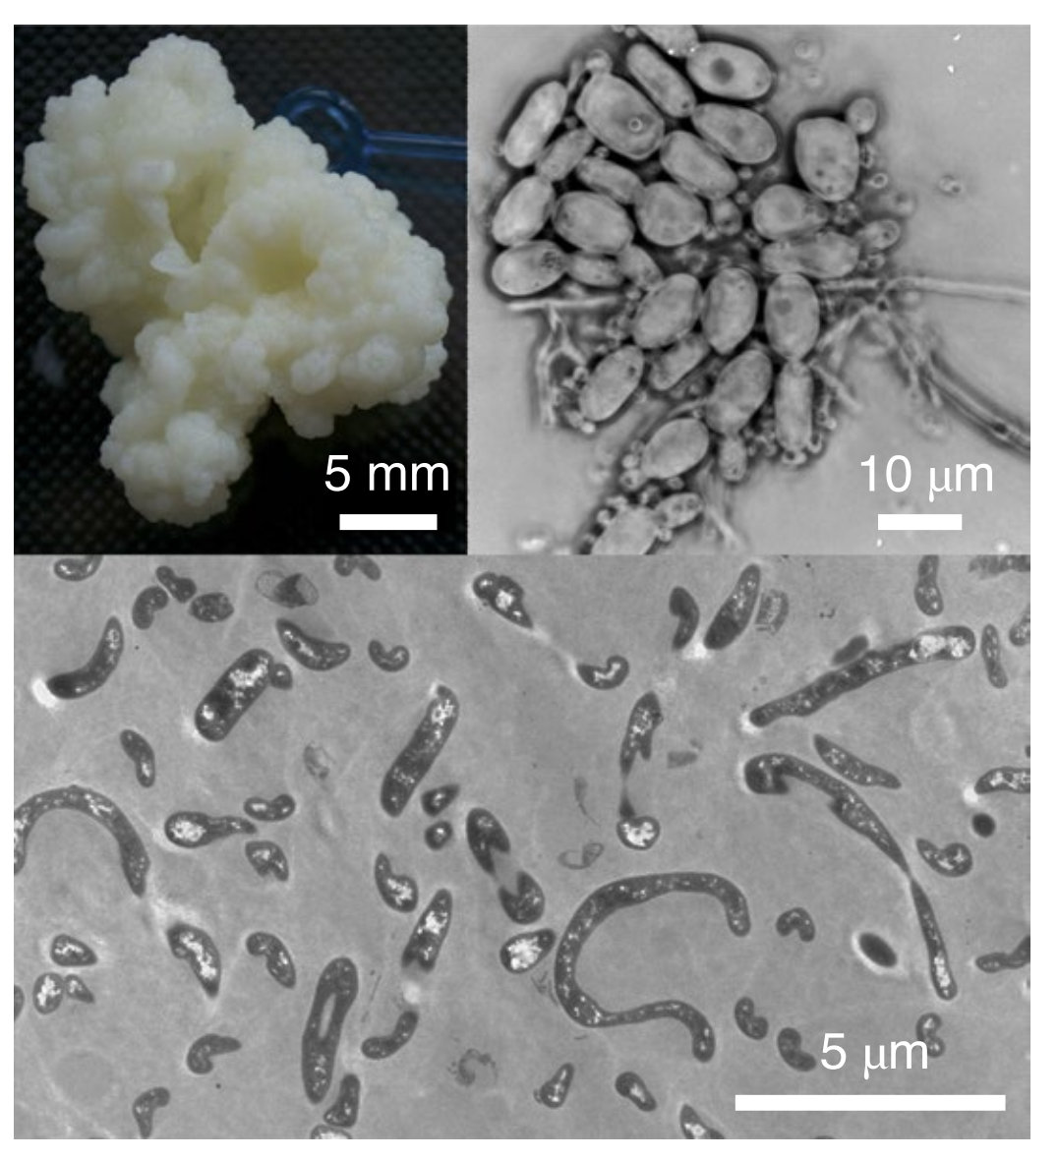
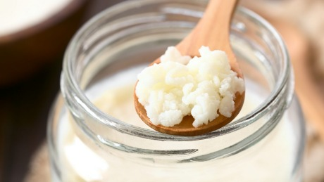
What is Kefir?

Slide 3
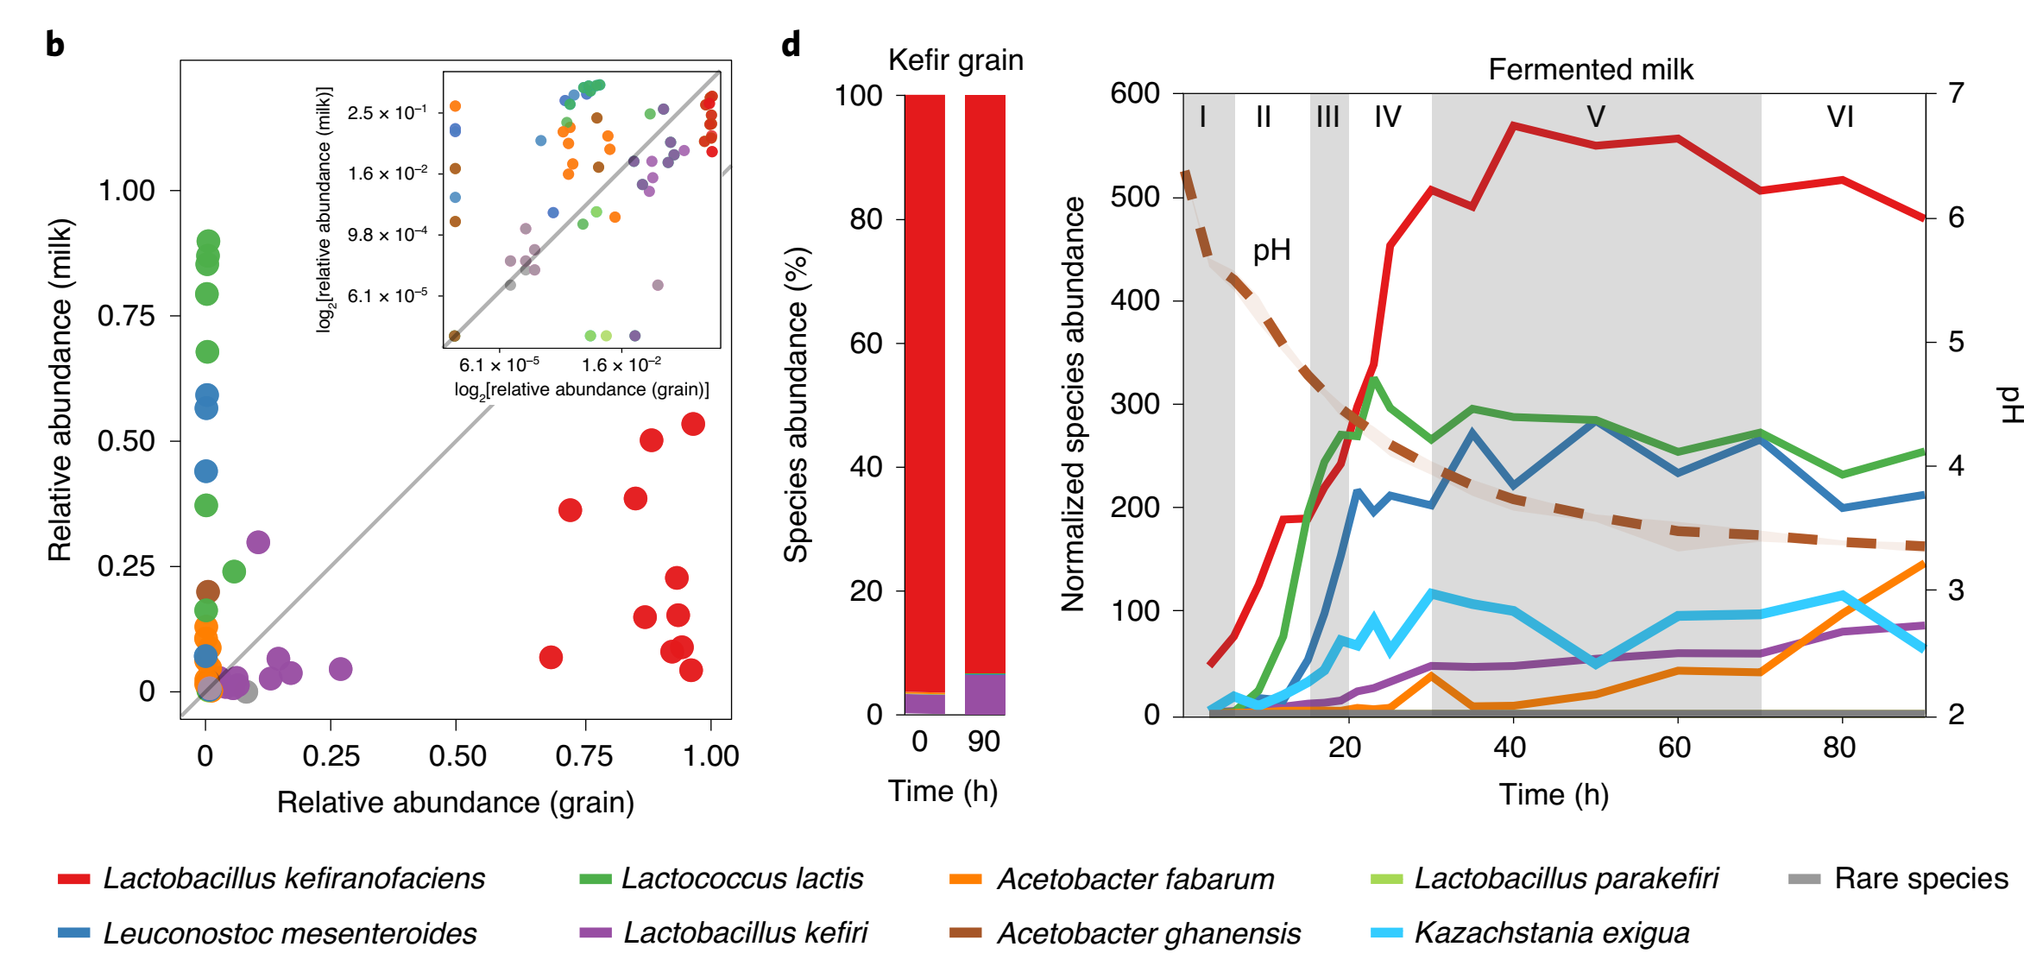
Interesting facts about Kefir

Slide 4
My questions:
A) Game theory
B) Community dynamics
C) Evolutionary engineering / de-novo synthesis
D) Possible applications
E) How has Kefir evolved?

Slide 5
A) Game theory
1- How/Why is Kefir resistant to cheaters (if really is?)
2- Role of spatial structure in altering evolutionary game
3- Role of fluctuating environment
- sequential chemostats (simultaneous packed beds?)(two-stage chemostat)

Slide 6
B) Community dynamics
1- How kefir is resistant to invasive species (If it is?)
2- How composition of species in grains remain almost constant?
3- Does fluctuating environment plays a role in maintaining community?

Slide 7
C) Evolutionary engineering / de-novo synthesis
1- How is it possible to synthesize kefir de-novo? What if we use members of an existing kefir community; can they reassemble themselves?
2- Can Kefir evolve to live in higher temperature (or on other carbon sources) and evolve community-level adaptations (not species-level)?

Slide 8
D) Possible applications
A) Effect of biodiversity hotspots on community dynamics of nearby ecosystems.
B) A zoo in the middle of a jungle! Can artificial hotspots play a role in conservation in the future?
Don’t take it serious but: C) A model of how human may be enable to make other planets habitable?!!

Slide 9
E) How has kefir evolved?
Has it evolved naturally or artificially?
Which parameters could play an important role?
Fluctuating environment?
Rapid evolution?
Stochasticity?

Slide 10
What other questions can be interesting?

Slide 11
Steps that might be beneficial
1) Studying evolution of Lichen may provide insights on how kefir has evolved?

Slide 12
Feedback from Masato
1- You can study interactions in the community based on time series:
https://www.nature.com/articles/nature25504
2- study evolution of multi-cellular organisms:
https://www.nature.com/articles/ncomms7102

Slide 13
Feedback from Dan
1- Sequential chemostat
2- papers:
https://www.nature.com/articles/nature13884 (+Other papers from the authors)
Biofilm formation from multiple species (cutting the biofilm into many sections? But cheaters keep appearing?)
https://www.nature.com/articles/nature01906
https://www.nature.com/articles/s41559-016-0015
Succession: Algae bead: https://www.researchgate.net/publication/326906139_Modular_assembly_of_polysaccharide-degrading_microbial_communities_in_the_ocean
(For Sana: Finlay)

Slide 14
Meeting with Sally (Oct 1)
Read the following paper:
https://www.sciencedirect.com/science/article/pii/S0966842X12001746
Try to write down some math:

Slide 15
Meeting with Sally (Oct 7)
I’m going to present this paper in LETS:
https://www.biorxiv.org/content/10.1101/2021.06.03.446957v1.full.pdf
I’m going to present this paper in EDG:
https://www.embopress.org/doi/pdf/10.15252/msb.202010189
Chart of my questions about Kefir:
https://lucid.app/lucidchart/46eeb6a7-3580-425e-9ef0-fe65723eceef/edit?invitationId=inv_97a08e9c-5b56-4c61-bd55-fa2395b9fed5

Slide 16
Is Kefir really interesting?
What thins can make kefir interesting?
- acting as a superorganism
result of group selection
Result of evolution in fluctuating environment
- being resistant to invasion
- Unable to form it de-novo
- how cheaters cannot dominate (but probably there should be some cheaters. Who are cheaters?)

Slide 17
What do we expect if there is group selection
Kefir disassembles in a chemostat? (If w stop group selection, it would disassemble)
- centrifugation?
What traits are beneficial to grains but not for individual members? (specifically for L.kefirofaciens)

Slide 18
How can grains form (evolutionary)
L. Kefirofaciens producing polysaccharide has a benefit. But how they overcome cheaters?
Selection for grain production is probable? Is selection for grain production equivalent of group selection?
(Group selection/becoming a superorganism) can decrease cheating. (eliminating cheaters: bad taste/larger grains)

Slide 19
My idea
I think more complex communities are observed among microbial ones. The reason could be more universal resources in microbial communities (number of resources is important) – many metabolites are involved! (actually microbes usually don’t eat each other, but do resource competition/cooperation)

Slide 20
Evolutionary vs ecological community formation/group selection? (Oct 9)
Ecological: If ratio of different members is tightly kept constant (no place for one species to dominate others). like when they are specialists and highly depend on each other (all eigenvalues are smaller than 1 except one of them). If in such conditions, rate of growth vary among different groups based on any inheritable manner, (like genetic/starting ratios) then group selection can happen. The key is there should not be an opportunity for a single species to grow independently and change the ratio in propagule? (Or if there is a change, it should be inheritable, maybe have a genetic basis?)
Metabolic modelling should be done. (Maybe taxonomic species vary in frequency but functional species don’t vary)
Predictions:
1) lower need for interspecies signaling?
2) The integrity of community totally depends on the environmental conditions (like food source/ If by adding another source of food we make another eigenvalue positive, it can ruin it)
3) how does evolution affect this? How can evolution result this? (separate communities needed/ while in kefir there might be a lot of migration?)
A)Mutations that increase the frequency of a single species in the community
B) Mutations that increase the growth of that community
C) Mutations that increase or decrease alpha

Slide 21
Things that need modelling
1- a model to show how set of parameters for group and individual selections affect the probability of fixation of mutations of type A/B

Slide 22
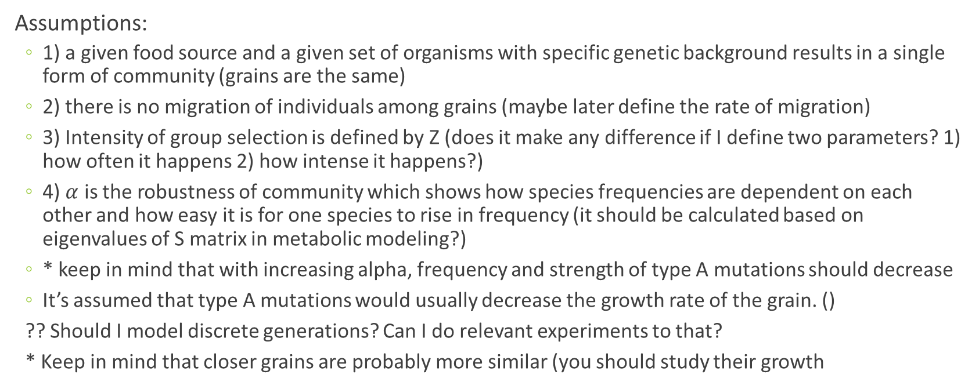
Model 1 - assumptions
Assumptions:
1) a given food source and a given set of organisms with specific genetic background results in a single form of community (grains are the same)
2) there is no migration of individuals among grains (maybe later define the rate of migration)
3) Intensity of group selection is defined by Z (does it make any difference if I define two parameters? 1) how often it happens 2) how intense it happens?)
4) $α$ is the robustness of community which shows how species frequencies are dependent on each other and how easy it is for one species to rise in frequency (it should be calculated based on eigenvalues of S matrix in metabolic modeling?)
* keep in mind that with increasing alpha, frequency and strength of type A mutations should decrease
It’s assumed that type A mutations would usually decrease the growth rate of the grain. ()
?? Should I model discrete generations? Can I do relevant experiments to that?
* Keep in mind that closer grains are probably more similar (you should study their growth

Slide 23
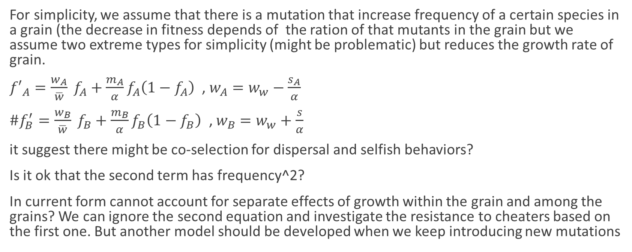
Model 1- equations
For simplicity, we assume that there is a mutation that increase frequency of a certain species in a grain (the decrease in fitness depends of the ration of that mutants in the grain but we assume two extreme types for simplicity (might be problematic) but reduces the growth rate of grain.
${f′}_{A}=\frac{w_{A}}{\overline{w}} f_{A}+{\frac{m_{A}}{α}f}_{A}\left(1−f_{A}\right)$ , $w_{A}=w_{w}−\frac{s_{A}}{α}$
${\#f}_{B}^{′}=\frac{w_{B}}{\overline{w}} f_{B}+{\frac{m_{B}}{α}f}_{B}\left(1−f_{B}\right)\text{ , }w_{B}=w_{w}+\frac{s}{α}$
it suggest there might be co-selection for dispersal and selfish behaviors?
Is it ok that the second term has frequency^2?
In current form cannot account for separate effects of growth within the grain and among the grains? We can ignore the second equation and investigate the resistance to cheaters based on the first one. But another model should be developed when we keep introducing new mutations

Slide 24

Model-2 (selection for grain size)
Grain size: $G=G_{0}+∑x_{i}s_{i}−∑x_{j}s_{j}$
Is there any community trait that affect grain size?
Should I learn slim?

Slide 25
Some thoughts
The challenge for models so far is that how the new mutant which is beneficial for the grain is trying to establish itself in it.
There are two levels of selection. First of all, because of cheaters there would be no selection pressure for a mutation that increase frequency of one species in the grain. It might results in somehow a constant composition of species in grain over time (or at least there will be no evolutionary competition between species to increase in frequency), which is kind of determined by metabolic constraints. But there might be some selection for mutations that increase the growth of grain. But still there is no mechanism for such mutations to increase in frequency.
But if the system is very local, the things might be different. The grains have a very modular structure and mutations can easily go to fixation in that small module and that module can grow faster than others. (small module size and large number of modules are important)

Slide 26
How to make predictions about group selection?
You can do it on two different levels
Construct the matrix for (species interactions/metabolic reactions). It should be in a way that only one of the eigenvalues are positive. Then you can see what sort of mutations in the matrix increase the eigenvalue and then see what happens. I mean what sort of mutations are going to fix. (it’s what we expect if only there is group selection)
The final result of evolution is something in the middle. Depending on the strength of group selection (small group size / higher dependency) and individual selection (cheating?)

Slide 27

Model 3 (Oct 14) – a new version of model 1
${f′}_{A}=\frac{w_{A}}{\overline{w}} f_{A}$ ,, $g_{A}^{′}=\frac{x_{A}}{\overline{x}}g_{A}+μ_{A} ,, w_{A}=w_{wt}+s ,, x_{A}=x_{wt}−f_{A}z$
(I think it’s hard to write the math. At least I can’t. But’ it shouldn’t be super difficult to sumulate this)

Slide 28
An idea
I shouldn’t look for traits that are deleterious to the organism but beneficial for the grain. It’s possible that grains that are better survive but organisms that are in grain do not do any cooperation. Maybe a gain, composed of competing species is the best and most robust group. (I should both consider rate of grain growth and grain disassembly?) (how should I combine milk and grain? It would be much more complex in milk) even in grain it would be very complex when conditions are changing. When the environment is changing something like kefir can grow without the condition of only one eigen-value being positive.

Slide 29
Model 4 – Matrix of different grain types
Assume there are n grain types, with different frequencies of mutations (n category of mutation frequency). If you have a vector containing weight of different grain types, you can model their growth by multiplying in a matrix accounting for selection, mutation, migration and drift?)
- make it soon and run simulations and then ask what’s the next question. Don’t wait long here. Also check Sally’s comments and try to continue model 3 in the direction that Sally said and see what will come to your mind.
- try to make more reasonable assumptions about the relationship between cheater frequency and grain fitness.
- are neighbors important?
what is the consequence of the frequencies in milk?

Slide 30
Feedback from Anna, Amy, Penny, Ali (Oct 18)
1- If we run a phylogenetic analysis (or maybe at functional-level) on Kefirs obtained from different origins can we observe meaningful patterns? (is the assumption of homology accurate?)
2- Anna: Are taxonomic groups important? Or only functions are important? Read Stillianous paper.
3- An interesting experiment would be (leh kardaning) kefir and make replicates to see if the composition of different grains are similar or not? (what determines the composition of grains? How ecological and evolutionary constraints interact?)
4- It’s counter-intuitive that u say both drift and selection are important (but I think at different levels). We should know how small the drift is?
5- The unit size is very important. How to determine it?

Slide 31
Interesting experiments
1- dissolve Kefir and see if it’s formed again
2- investigating formation of kefir in another side of the membrane which only allows individual microbes to cross.
3-

Slide 32
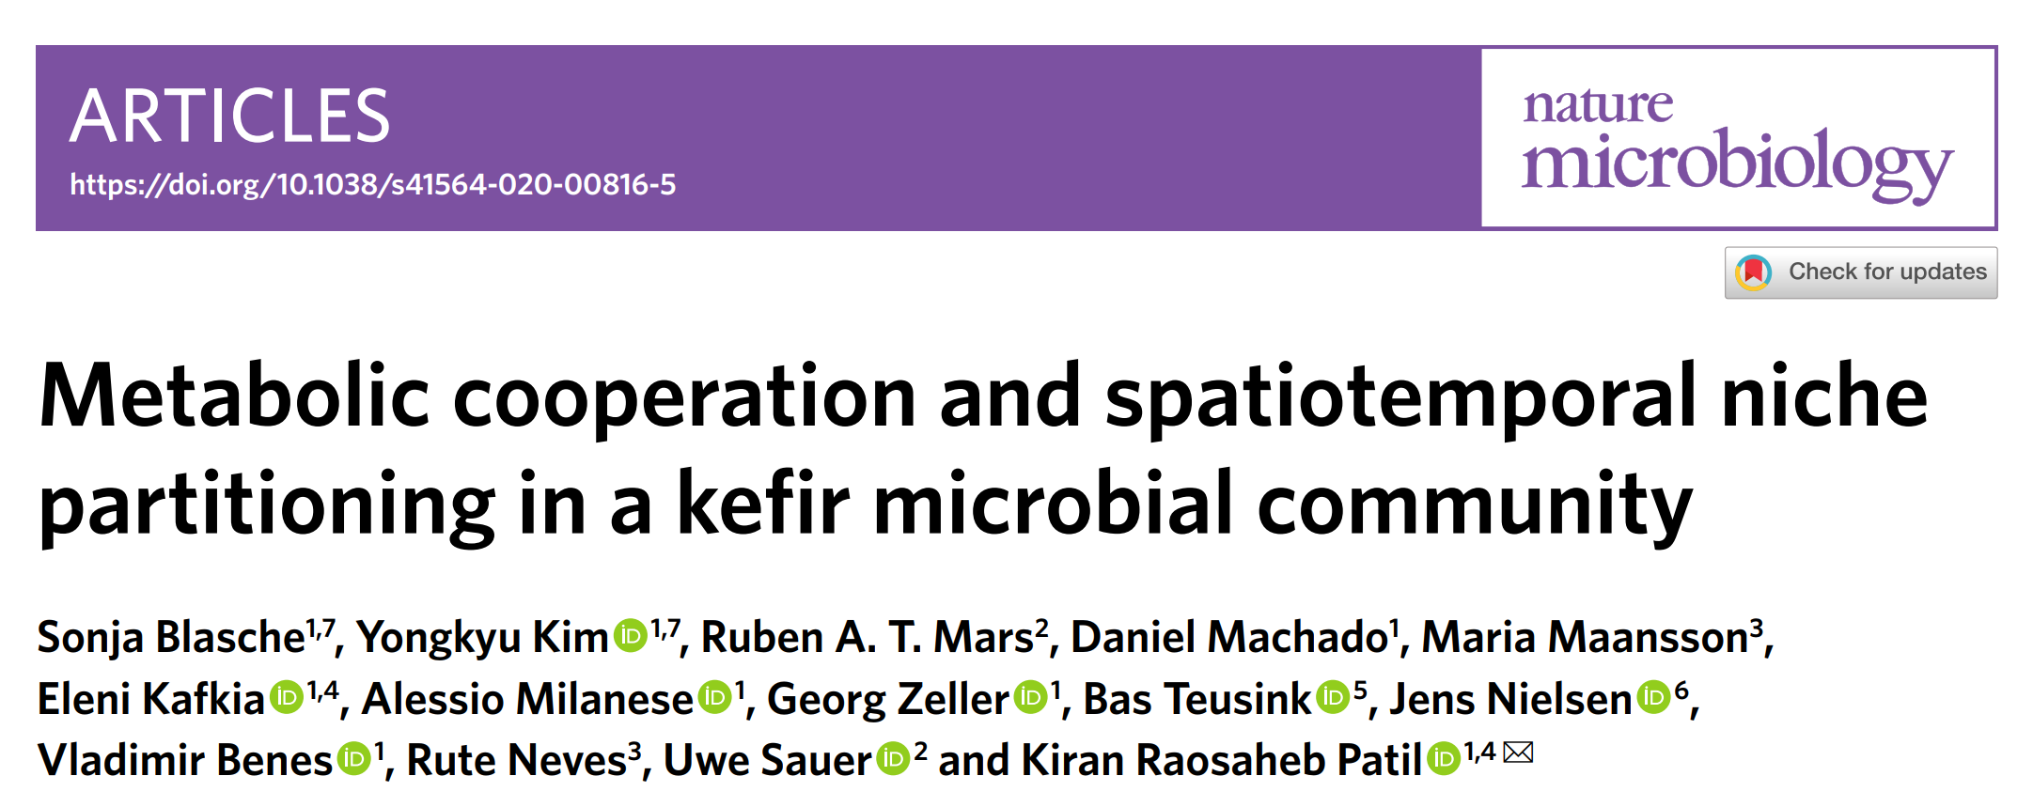
References

