Slide 1
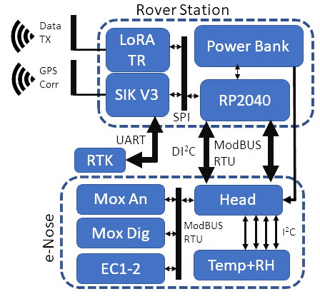
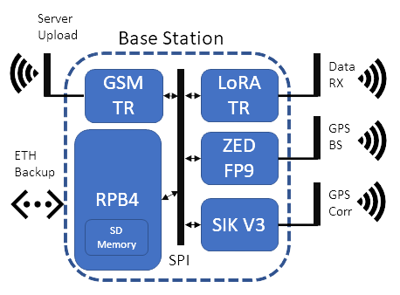
a)
b)
Fast IOMS

Slide 2
c)
FLOW_{m}
LoRA COM.
RP2040
UART
I²C
PWR MNG
RS485 BUS
MOX_{An} CH
ENS210x4
ECs CH
µC₁
µC₂
µC₃
ENS210x4
I²C
ENS160
I²C
ENS210x2
I²C
ADC
SGP41
SCD41
MOX_{Dg} CH
MODBUS RTU
TGS1
TGS2
TGS3
TGS4
NH₃
H₂S HR
H₂S LR
PID

Slide 3
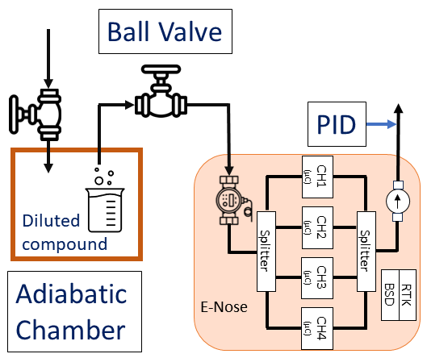
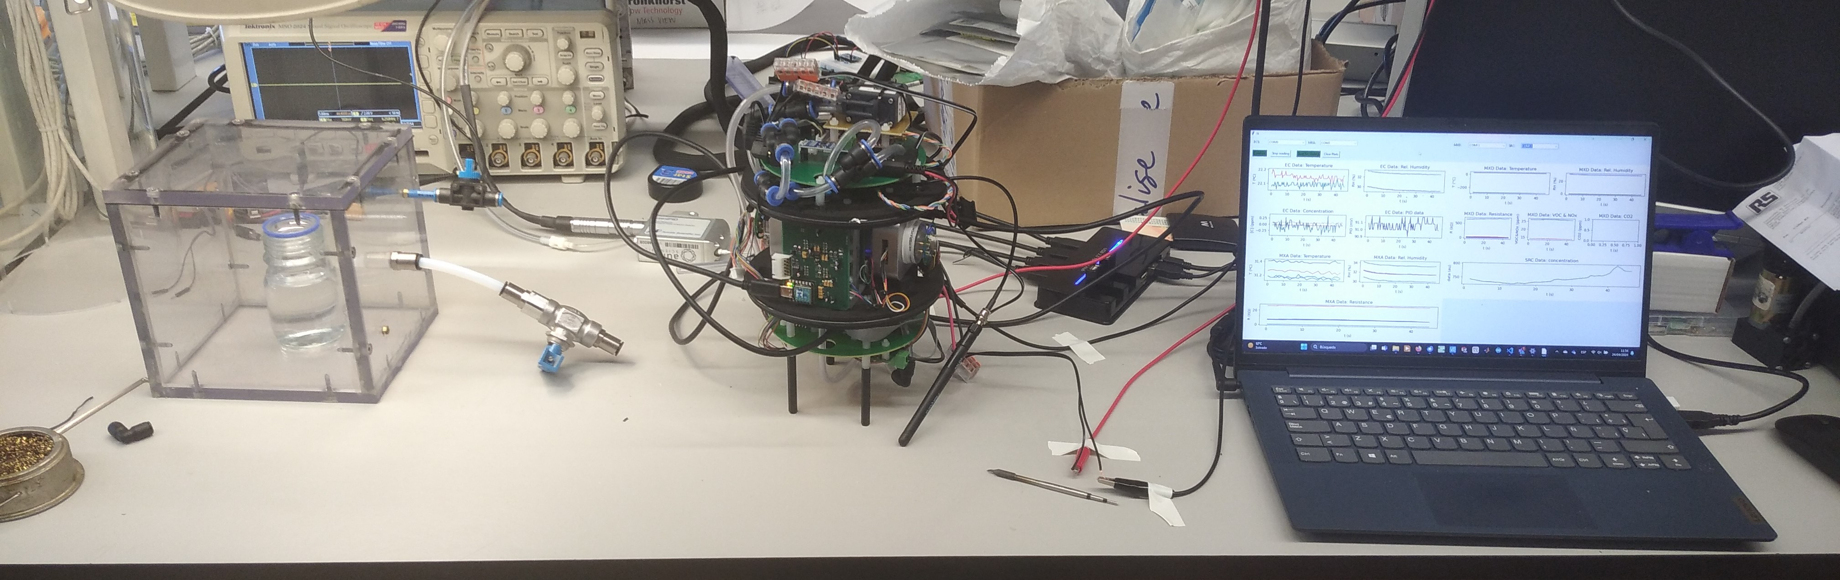
a)
b)
E-Nose
PID
Adiabatic Chamber
Ball Valve

Slide 4
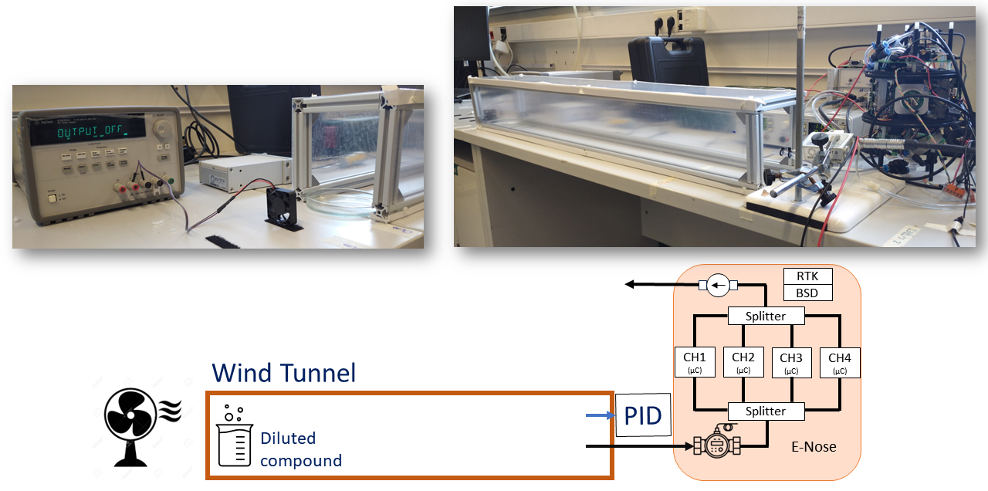
c)
Wind Tunnel Entrance
Wind Tunnel
PID Probe
Fast IOMS
Fan
d)

Slide 5
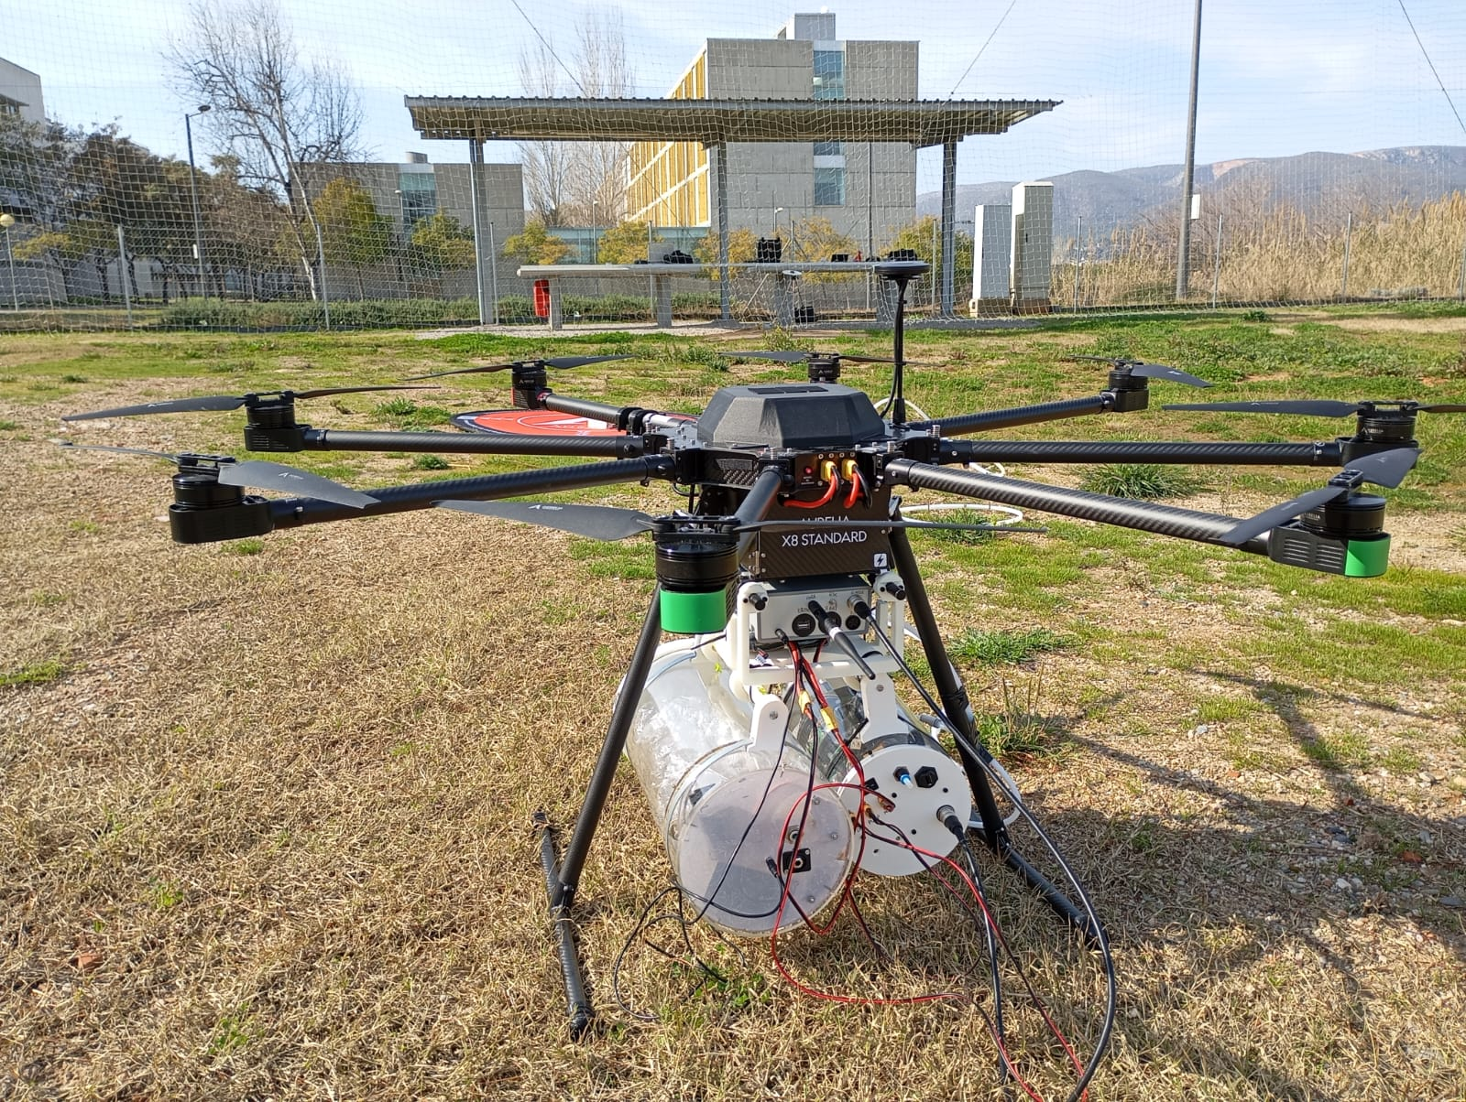
Aurelia X8
Rover Station
Fast IOMS
Bag Sampler

Slide 6
