Slide 1
DATA science week 10
Hierarchical Clustering, DBSCAN

Slide 2
CLUSTERING

Slide 3
What is a Clustering?
In general a grouping of objects such that the objects in a group (cluster) are similar (or related) to one another and different from (or unrelated to) the objects in other groups
Inter-cluster distances are maximized
Intra-cluster distances are minimized

Slide 4
Clustering Algorithms
K-means and its variants
Hierarchical clustering
DBSCAN

Slide 5
HIERARCHICAL CLUSTERING

Slide 6
Hierarchical Clustering
Two main types of hierarchical clustering
Agglomerative:
Start with the points as individual clusters
At each step, merge the closest pair of clusters until only one cluster (or k clusters) left
Divisive:
Start with one, all-inclusive cluster
At each step, split a cluster until each cluster contains a point (or there are k clusters)
Traditional hierarchical algorithms use a similarity or distance matrix
Merge or split one cluster at a time

Slide 7
Hierarchical Clustering
Produces a set of nested clusters organized as a hierarchical tree
Can be visualized as a dendrogram
A tree like diagram that records the sequences of merges or splits

Slide 8
Strengths of Hierarchical Clustering
Do not have to assume any particular number of clusters
Any desired number of clusters can be obtained by ‘cutting’ the dendogram at the proper level
They may correspond to meaningful taxonomies
Example in biological sciences (e.g., animal kingdom, phylogeny reconstruction, …)

Slide 9
Agglomerative Clustering Algorithm
More popular hierarchical clustering technique
Basic algorithm is straightforward
Compute the proximity matrix
Let each data point be a cluster
Repeat
Merge the two closest clusters
Update the proximity matrix
Until only a single cluster remains
Key operation is the computation of the proximity of two clusters
Different approaches to defining the distance between clusters distinguish the different algorithms

Slide 10
Starting Situation
Start with clusters of individual points and a proximity matrix
p1
p2
p3
p4
p5
. . .
p1
p2
p3
p4
p5
.
.
.
Proximity Matrix

Slide 11
Intermediate Situation
After some merging steps, we have some clusters
C1
C2
C3
C4
C5
C1
C2
C3
C3
C4
C4
C5
C1
Proximity Matrix
C2
C5

Slide 12
Intermediate Situation
We want to merge the two closest clusters (C2 and C5) and update the proximity matrix.
C1
C2
C3
C4
C5
C1
C2
C3
C3
C4
C4
C5
Proximity Matrix
C1
C2
C5

Slide 13
After Merging
The question is “How do we update the proximity matrix?”
C2 U C5
C1
C3
C4
C1
?
C2 U C5
? ? ? ?
C3
C3
?
C4
C4
?
C1
Proximity Matrix
C2 U C5

Slide 14
How to Define Inter-Cluster Similarity
p1
p2
p3
p4
p5
. . .
p1
Similarity?
p2
p3
p4
p5
MIN
MAX
Group Average
Distance Between Centroids
Other methods driven by an objective function
Ward’s Method uses squared error
.
.
.
Proximity Matrix

Slide 15
How to Define Inter-Cluster Similarity
p1
p2
p3
p4
p5
. . .
p1
p2
p3
p4
p5
MIN
MAX
Group Average
Distance Between Centroids
Other methods driven by an objective function
Ward’s Method uses squared error
.
.
.
Proximity Matrix

Slide 16
How to Define Inter-Cluster Similarity
p1
p2
p3
p4
p5
. . .
p1
p2
p3
p4
p5
MIN
MAX
Group Average
Distance Between Centroids
Other methods driven by an objective function
Ward’s Method uses squared error
.
.
.
Proximity Matrix

Slide 17
How to Define Inter-Cluster Similarity
p1
p2
p3
p4
p5
. . .
p1
p2
p3
p4
p5
MIN
MAX
Group Average
Distance Between Centroids
Other methods driven by an objective function
Ward’s Method uses squared error
.
.
.
Proximity Matrix

Slide 18
How to Define Inter-Cluster Similarity
p1
p2
p3
p4
p5
. . .
p1
×
×
p2
p3
p4
p5
MIN
MAX
Group Average
Distance Between Centroids
Other methods driven by an objective function
Ward’s Method uses squared error
.
.
.
Proximity Matrix

Slide 19
Hierarchical Clustering: MIN
 | 1 | 2 | 3 | 4 | 5 | 6
1 | 0 | .24 | .22 | .37 | .34 | .23
2 | .24 | 0 | .15 | .20 | .14 | .25
3 | .22 | .15 | 0 | .15 | .28 | .11
4 | .37 | .20 | .15 | 0 | .29 | .22
5 | .34 | .14 | .28 | .29 | 0 | .39
6 | .23 | .25 | .11 | .22 | .39 | 0
5
1
3
5
2
1
2
3
6
4
4
Nested Clusters
Dendrogram

Slide 20
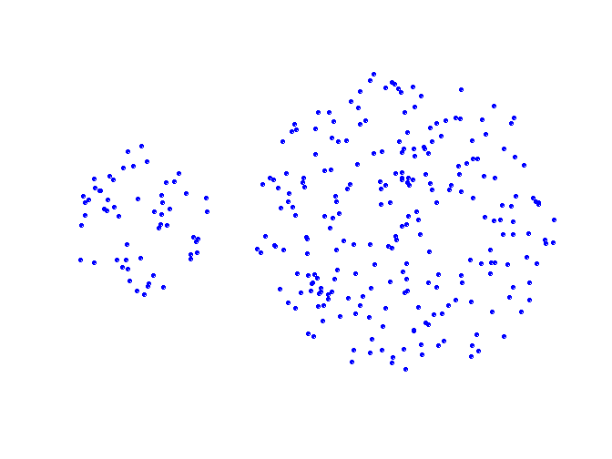
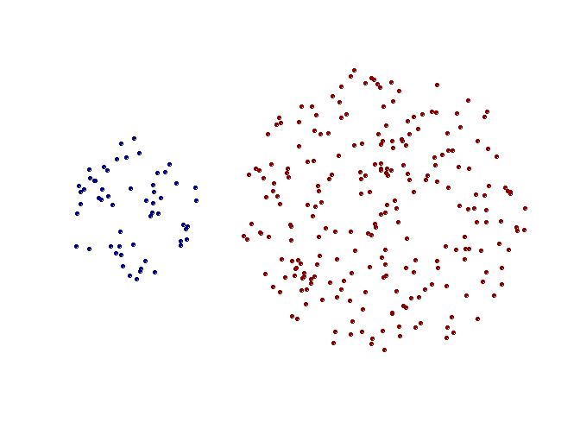
Strength of MIN
Original Points
Two Clusters
Can handle non-elliptical shapes

Slide 21
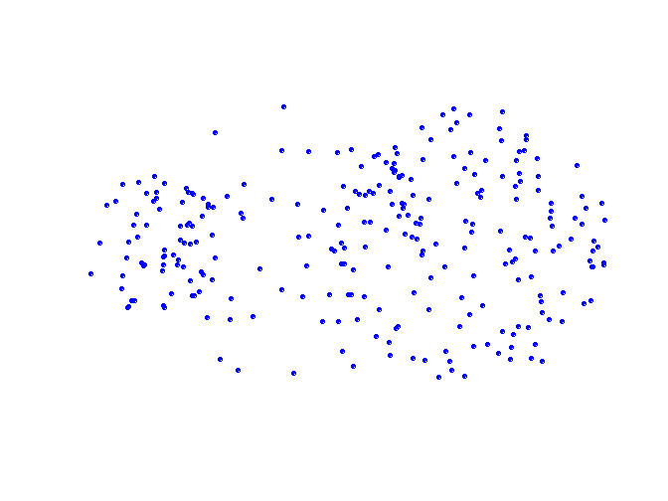
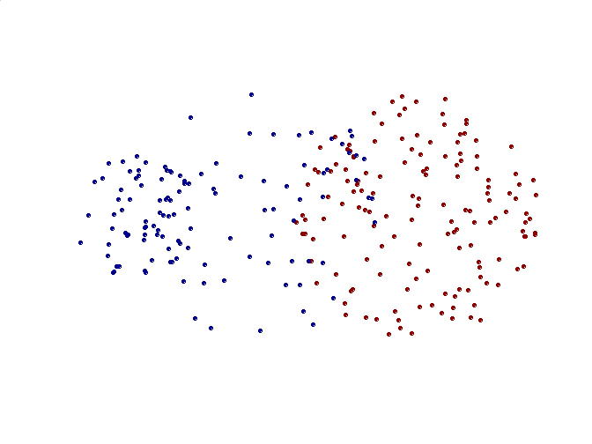
Limitations of MIN
Original Points
Two Clusters
Sensitive to noise and outliers

Slide 22
Hierarchical Clustering: MAX
 | 1 | 2 | 3 | 4 | 5 | 6
1 | 0 | .24 | .22 | .37 | .34 | .23
2 | .24 | 0 | .15 | .20 | .14 | .25
3 | .22 | .15 | 0 | .15 | .28 | .11
4 | .37 | .20 | .15 | 0 | .29 | .22
5 | .34 | .14 | .28 | .29 | 0 | .39
6 | .23 | .25 | .11 | .22 | .39 | 0
4
1
2
5
5
2
3
6
3
1
4
Nested Clusters
Dendrogram

Slide 23
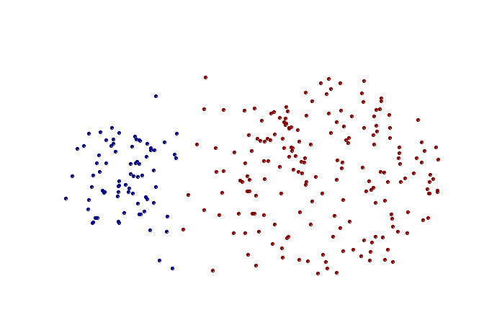
Strength of MAX
Original Points
Two Clusters
Less susceptible to noise and outliers

Slide 24
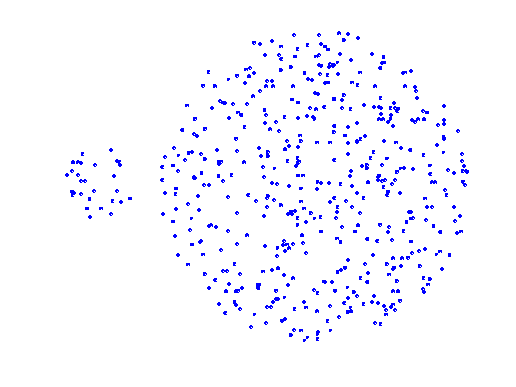
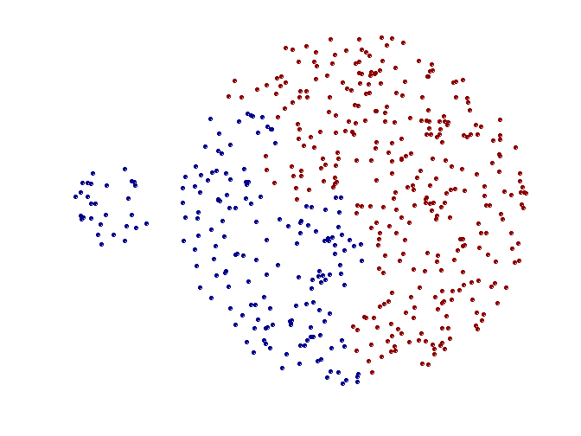
Limitations of MAX
Original Points
Two Clusters
Tends to break large clusters
Biased towards globular clusters

Slide 25
Cluster Similarity: Group Average
Proximity of two clusters is the average of pairwise proximity between points in the two clusters.
Need to use average connectivity for scalability since total proximity favors large clusters
 | 1 | 2 | 3 | 4 | 5 | 6
1 | 0 | .24 | .22 | .37 | .34 | .23
2 | .24 | 0 | .15 | .20 | .14 | .25
3 | .22 | .15 | 0 | .15 | .28 | .11
4 | .37 | .20 | .15 | 0 | .29 | .22
5 | .34 | .14 | .28 | .29 | 0 | .39
6 | .23 | .25 | .11 | .22 | .39 | 0

Slide 26
Hierarchical Clustering: Group Average
 | 1 | 2 | 3 | 4 | 5 | 6
1 | 0 | .24 | .22 | .37 | .34 | .23
2 | .24 | 0 | .15 | .20 | .14 | .25
3 | .22 | .15 | 0 | .15 | .28 | .11
4 | .37 | .20 | .15 | 0 | .29 | .22
5 | .34 | .14 | .28 | .29 | 0 | .39
6 | .23 | .25 | .11 | .22 | .39 | 0
5
4
1
2
5
2
3
6
1
4
3
Nested Clusters
Dendrogram

Slide 27
Hierarchical Clustering: Group Average
Compromise between Single and Complete Link
Strengths
Less susceptible to noise and outliers
Limitations
Biased towards globular clusters

Slide 28
Hierarchical Clustering: Problems and Limitations
Computational complexity in time and space
Once a decision is made to combine two clusters, it cannot be undone
No objective function is directly minimized
Different schemes have problems with one or more of the following:
Sensitivity to noise and outliers
Difficulty handling different sized clusters and convex shapes
Breaking large clusters

Slide 29
Divisive Hierarchical Clustering
given a dataset (d1, d2, d3, ....dN) of size N
at the top we have all data in one cluster
the cluster is split using a flat clustering method eg. K-Means etc
repeat
choose the best cluster among all the clusters to split
split that cluster by the flat clustering algorithm
until each data is in its own singleton cluster

Slide 30
DBSCAN
Density Based Spatial Clustering of Applications with Noise

Slide 31
DBSCAN: Density-Based Clustering
DBSCAN is a Density-Based Clustering algorithm
In density based clustering we partition points into dense regions separated by not-so-dense regions.
Important Questions:
How do we measure density?
What is a dense region?
DBSCAN:
Density at point p: number of points within a circle of radius Eps
Dense Region: A circle of radius Eps that contains at least MinPts points

Slide 32
eps : It defines the neighborhood around a data point i.e. if the distance between two points is lower or equal to ‘eps’ then they are considered neighbors. If the eps value is chosen too small then large part of the data will be considered as outliers. If it is chosen very large then the clusters will merge and the majority of the data points will be in the same clusters. One way to find the eps value is based on the k-distance graph.
MinPts: Minimum number of neighbors (data points) within eps radius. Larger the dataset, the larger value of MinPts must be chosen. As a general rule, the minimum MinPts can be derived from the number of dimensions D in the dataset as, MinPts >= D+1. The minimum value of MinPts must be chosen at least 3.

Slide 33
DBSCAN
Characterization of points
A point is a core point if it has more than a specified number of points (MinPts) within Eps
These points belong in a dense region and are at the interior of a cluster
A border point has fewer than MinPts within Eps, but is in the neighborhood of a core point.
A noise point is any point that is not a core point or a border point.

Slide 34
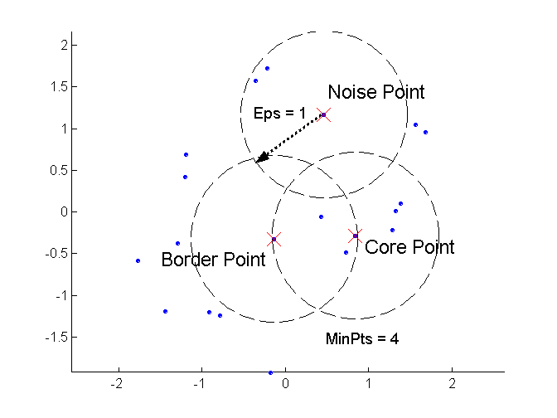
DBSCAN: Core, Border, and Noise Points

Slide 35
DBSCAN Algorithm
Label points as core, border and noise
Eliminate noise points
For every core point p that has not been assigned to a cluster
Create a new cluster with the point p and all the points that are density-connected* to p.
Assign border points to the cluster of the closest core point.

Slide 36
Density-Connected points
Density edge
We place an edge between two core points q and p if they are within distance Eps.
Density-connected
A point p is density-connected to a point q if there is a path of edges from p to q
p
p₁
q
p
q
o

Slide 37
DBSCAN Impl. Pseudocode
DBSCAN(D, eps, MinPts)
C = 0
for each unvisited point P in dataset D
mark P as visited
NeighborPts = regionQuery(P, eps)
if sizeof(NeighborPts) < MinPts
mark P as NOISE
else
C = next cluster
expandCluster(P, NeighborPts, C, eps, MinPts)
expandCluster(P, NeighborPts, C, eps, MinPts)
add P to cluster C
for each point P' in NeighborPts
if P' is not visited
mark P' as visited
NeighborPts' = regionQuery(P', eps)
if sizeof(NeighborPts') >= MinPts
NeighborPts = NeighborPts joined with NeighborPts'
if P' is not yet member of any cluster
add P' to cluster C
regionQuery(P, eps)
return all points within P's eps-neighborhood (including P)

Slide 38
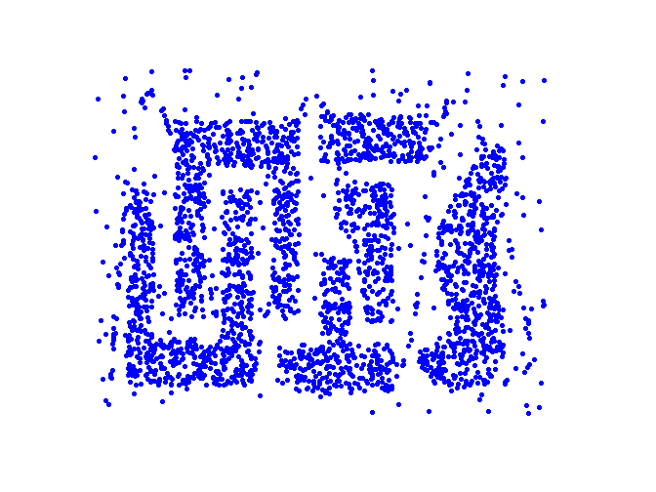
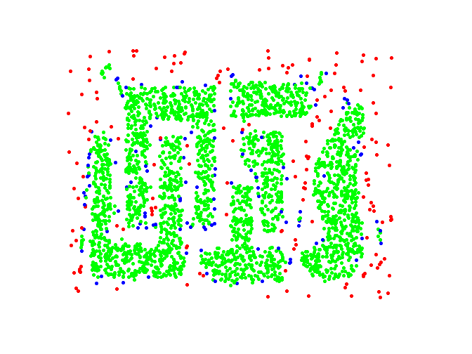
DBSCAN: Core, Border and Noise Points
Point types: core, border and noise
Original Points
Eps = 10, MinPts = 4

Slide 39
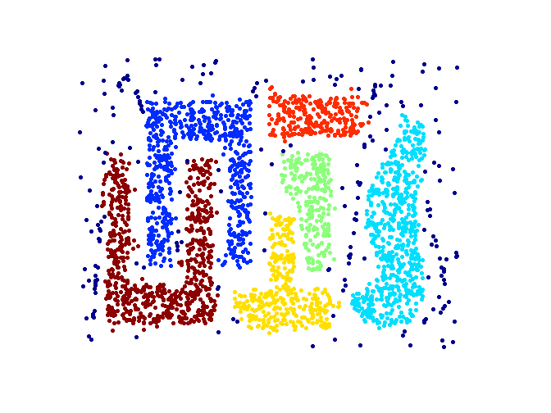
When DBSCAN Works Well
Original Points
Clusters
Resistant to Noise
Can handle clusters of different shapes and sizes

Slide 40
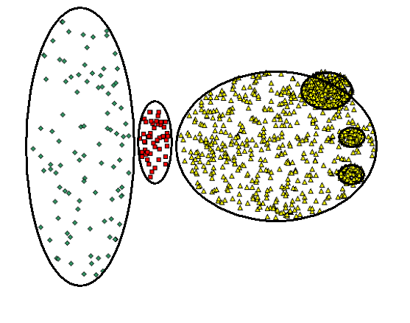
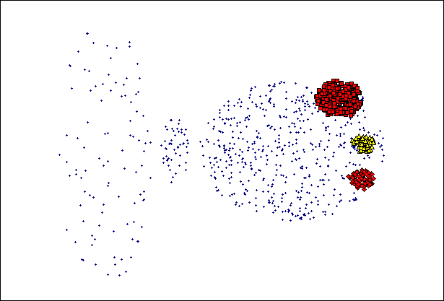
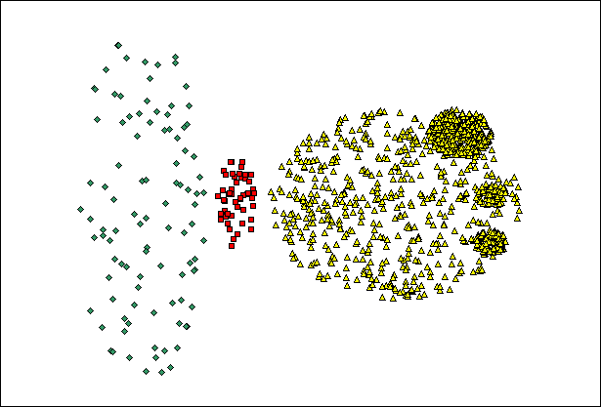
When DBSCAN Does NOT Work Well
(MinPts=4, Eps=9.75).
Original Points
Varying densities
High-dimensional data
(MinPts=4, Eps=9.92)

Slide 41
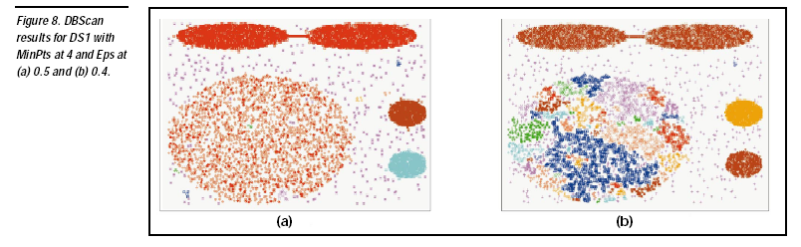

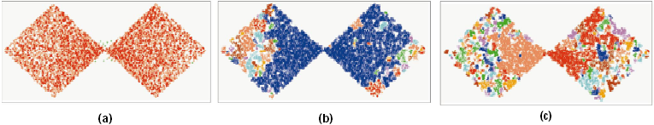
DBSCAN: Sensitive to Parameters

