Slide 1
Week 11
Basic Concepts
Regression, Classification
Instructor: Dr. Abdullah Yousafzai

Slide 2
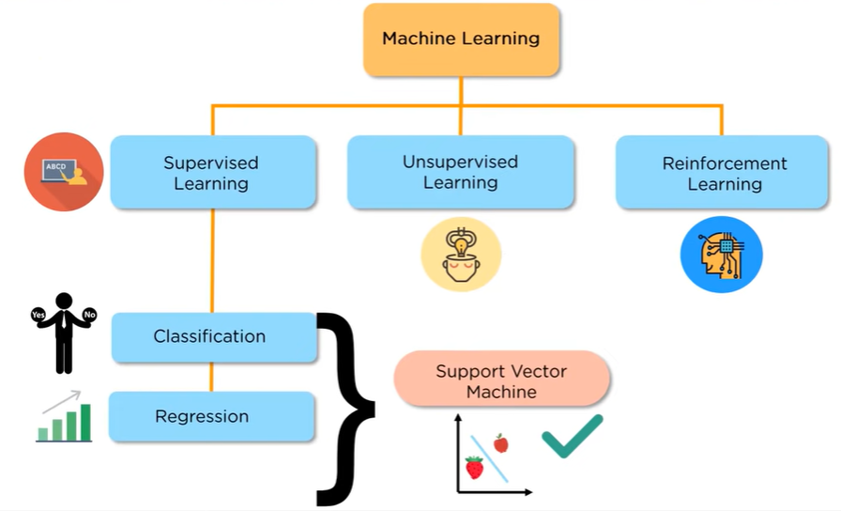
ML Landscape

Slide 3
What is Data?
Attributes
Collection of data objects and their attributes
An attribute is a property or characteristic of an object
Examples: name, date of birth, height, occupation.
Attribute is also known as variable, field, characteristic, or feature
For each object the attributes take some values.
The collection of attribute-value pairs describes a specific object
Object is also known as record, point, case, sample, entity, or instance
Objects
Size (n): Number of objects
Dimensionality (d): Number of attributes
Sparsity: Number of populated
object-attribute pairs

Slide 4
Types of Attributes
There are different types of attributes
Numeric
Examples: dates, temperature, time, length, value, count.
Discrete (counts) vs Continuous (temperature)
Special case: Binary/Boolean attributes (yes/no, exists/not exists)
Categorical
Examples: eye color, zip codes, strings, rankings (e.g, good, fair, bad), height in {tall, medium, short}
Nominal (no order or comparison) vs Ordinal (order but not comparable)

Slide 5
Example: Catching tax-evasion
Tax-return data for year 2011
A new tax return for 2012
Is this a cheating tax return?
An instance of the classification problem: learn a method for discriminating between records of different classes (cheaters vs non-cheaters)

Slide 6
Regression Analysis (overview)
Regression analysis is the idea of
analyzing a set of sample data and
establishing a relationship between two variables and
explaining how one variable is dependent upon the other
using this dependency to explain the population or for the prediction of future data

Slide 7
Regression Analysis (overview cont’d)
Regression analysis is the idea of
analyzing a set of sample data and
establishing a relationship between two variables and
explaining how one variable is dependent upon the other
using this dependency to explain the population or for the prediction of future data
Regarding the second item, we will study linear relationships.
Regarding the third item, we can extend the analysis to show how one variable is dependent upon many variables.

Slide 8
Linear relationships
When two variables have a linear relationship, we call them
X = independent variable (horizontal axis)
Y = dependent variable (vertical axis)
and describe the relationship as
Y = a + b*X
where
a = intercept
b = slope
For example,
X = Year
Y = Male Life Expectancy
a = -445.95
b = 0.2608

Slide 9
Linear Relationships (cont’d)
Y = a + b*X, where a is the intercept and b is the slope
The intercept a is the value of Y when X = 0, or the place on the vertical axis where the line crosses
The slope b describes the pitch or slope of the line
If b > 0, the line goes up from left to right; the variables have a positive relationship; “when X goes up, Y goes up”
If b < 0, the line goes down from left to right; the variables have a negative relationship; “when X goes up, Y goes down”
In regression, we will take two variables X and Y and determine the a and b that best describe the relationship between X and Y
Our starting assumption is that Y is dependent on X

Slide 10
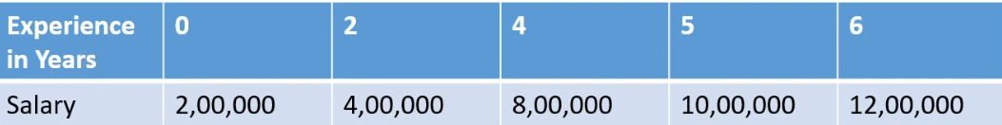
Linear Regression…. Example
What would be the salary of a person with three years of experience?

Slide 11
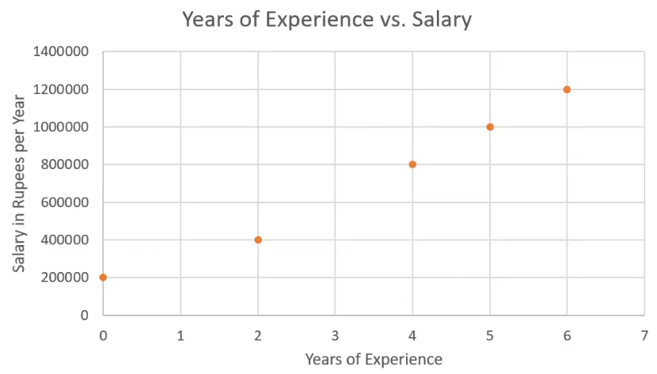
Linear Regression…. Example
What would be the salary of a person with three years of experience?

Slide 12
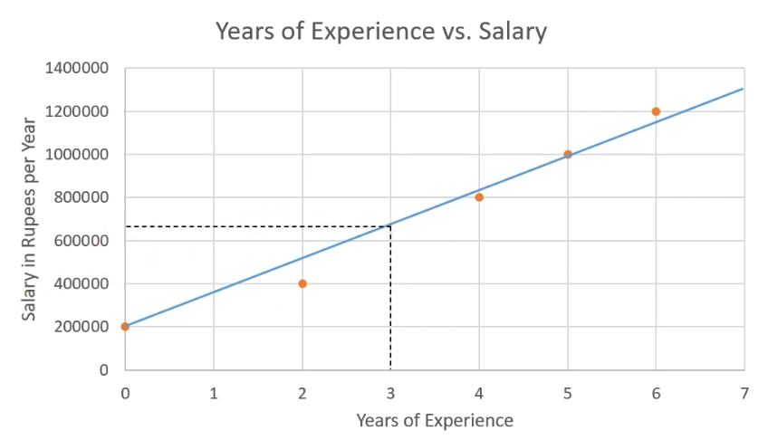
Linear Regression….
What would be the salary of a person with three years of experience?
~650000 PKR per month

Slide 13
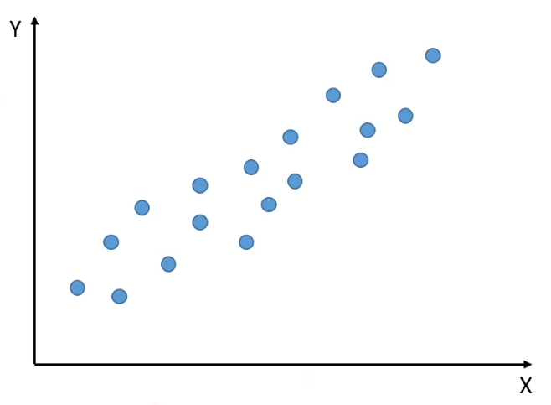
Linear Regression….
Y = mX+c
X→ X value
Y→ Y value
m→ Slope
c→ Intercept

Slide 14
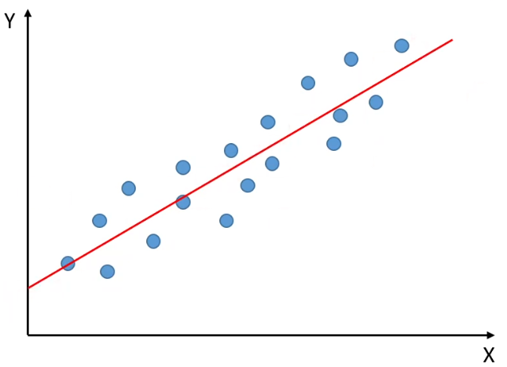
Linear Regression….
Y = mX+c
X→ X value
Y→ Y value
m→ Slope
c→ Intercept

Slide 15
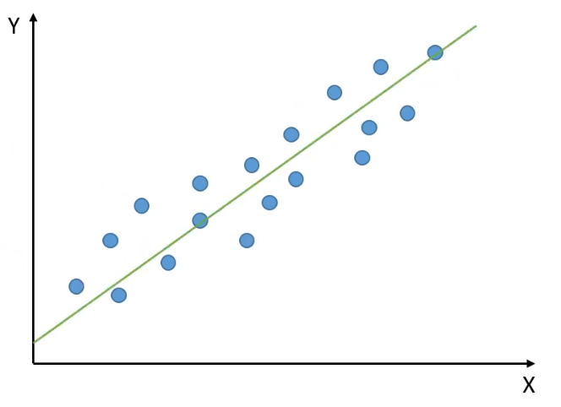
Linear Regression….
Y = mX+c
X→ X value
Y→ Y value
m→ Slope
c→ Intercept

Slide 16
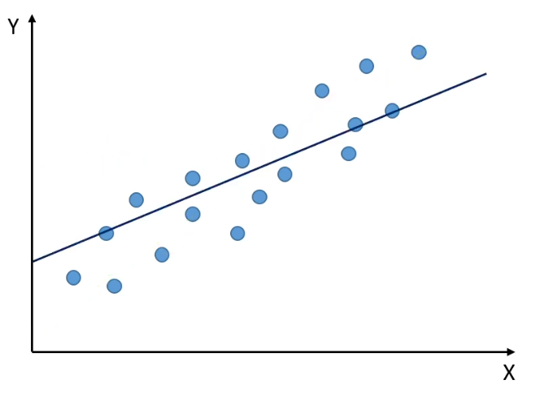
Linear Regression….
Y = mX+c
X→ X value
Y→ Y value
m→ Slope
c→ Intercept

Slide 17
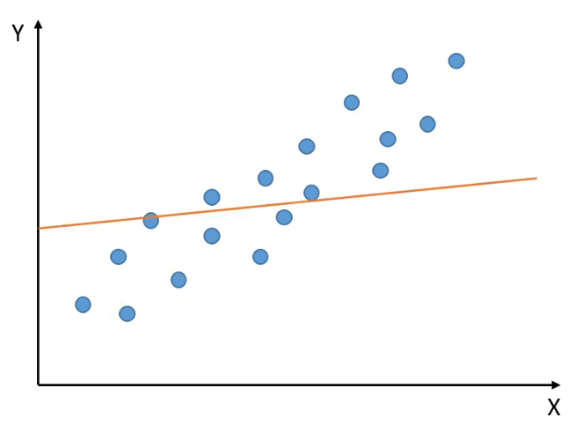
Linear Regression….
Y = mX+c
X→ X value
Y→ Y value
m→ Slope
c→ Intercept

Slide 18
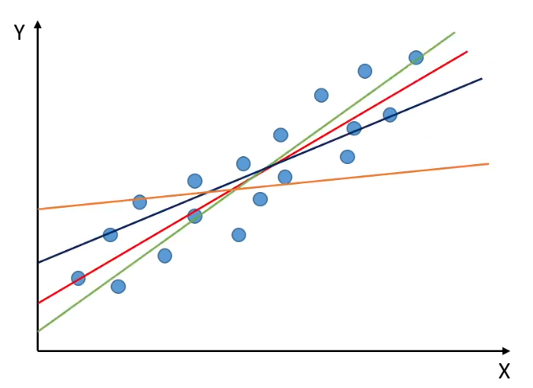
Linear Regression….
Y = mX+c
X→ X value
Y→ Y value
m→ Slope
c→ Intercept
Which one is best????

Slide 19
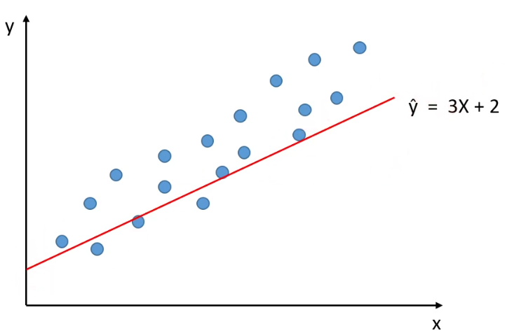
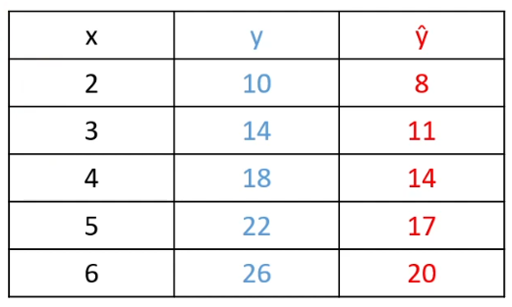
Point Estimate - Linear Regression….
Randomly assigned parameters m=3 and c=2
Y = mX+c

Slide 20
Method of Least Squares
Think about trying to fit the line Y = a + b*X to the data, for whatever values of a and b that you wish
How good is the fit?
The smaller the residuals / errors the better
X | Y actual | Y predicted | Residual | Residual²
2 | 3 | 5 + 2*2 = 9 | 3 - 9 = -6 | 36
5 | -1 | 5 + 2*5 = 15 | -1 - 15 = -16 | 256
 |  |  |  | 36 + 256 = 292
SSE = Sum of Squares Error
= amount of variability “not explained” by line

Slide 21
Method of Least Squares (cont’d)
The main goal of the least squares method is to choose a and b so that SSE is minimized

Slide 22
Method of Least Squares (cont’d)
SSR = Sum of Squares due to Regression
= amount of variability explained by the regression
SST = SSR + SSE
total variability = explained variability + unexplained variability
R² = SSR / SST
= percentage of variability in Y that is explained by X
= “sample coefficient of determination”
Because of the above equations and the definition of SST, minimizing SSE is the same as maximizing SSR and / or R²
R² is not the best measure of fit

Slide 23
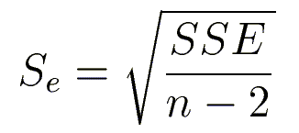
Method of Least Squares (cont’d)
A better measure of fit is…
Standard error of the estimation, denoted by S_{e}
S_{e} is the standard deviation of the residuals about their mean
The smaller SSE, the smaller S_{e}

Slide 24
Practical Trends with R² and S_{e}
When working with regression, you will often have to compare two separate regressions and try to determine which is a better model. In this case, look for
higher R² and lower S_{e}

Slide 25
A good regression model has…
A high R² value
A low S_{e} value
Slope coefficient which is not likely to equal 0
So then what makes a bad model?

Slide 26


Model parameters….
Weight: Weight decides how much influence the input will have on the output.
X – features or input variable
Y – Target or output variable
w- weight
b- bias
Bias:
Bias is the offset value given to the model.
It is used to shift the model in a particular direction.
Similar to a Y-intercept.
‘b’ is equal to “Y” when all the features values are zero.
Notes:
Offset - balancing

Slide 27
What if are more than 2 variables….
What if are more than 2 variables?

Slide 28
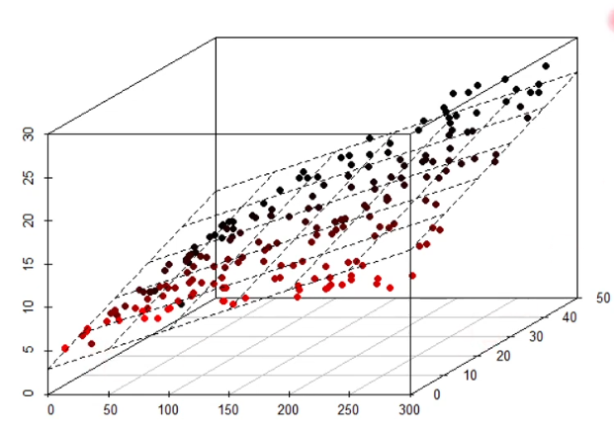

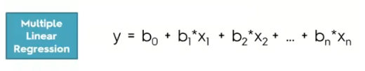
What if are more than 2 variables….
Multiple Linear Regression
Multiple linear regression is a model for predicting the value of one dependent variable based on two or more independent variables.
Salary was dependent only on experience – What about qualification?

Slide 29
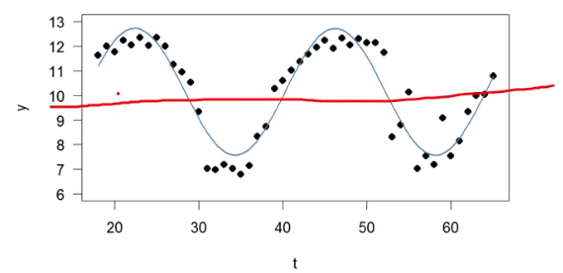
Linear Regression….
Advantages
Very simple to implement.
Perform well on data with linear relationship.
Disadvantages
Not suitable for data having non-linear relationship.
Underfitting issue
Sensitive to outliers

Slide 30
What is classification?
Classification is the task of learning a target function f that maps attribute set x to one of the predefined class labels y
categorical
categorical
continuous
class
One of the attributes is the class attribute
In this case: Cheat
Two class labels (or classes): Yes (1), No (0)

Slide 31
Examples of Classification Tasks
Predicting tumor cells as benign or malignant
Classifying credit card transactions as legitimate or fraudulent
Categorizing news stories as finance, weather, entertainment, sports, etc
Identifying spam email, spam web pages, adult content
Understanding if a web query has commercial intent or not

Slide 32
General approach to classification
Training set consists of records with known class labels
Training set is used to build a classification model
A labeled test set of previously unseen data records is used to evaluate the quality of the model.
The classification model is applied to new records with unknown class labels

Slide 33
Illustrating Classification Task

Slide 34
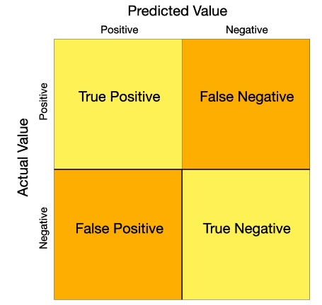
Evaluation of classification models
Confusion matrix
Counts of test records that are correctly (or incorrectly) predicted by the classification model
Predicted Class
 | Class = 1 | Class = 0
Class = 1 | f₁₁ | f₁₀
Class = 0 | f₀₁ | f₀₀
Actual Class

Slide 35
Classification Techniques
Naïve Bayes and Bayesian Belief Networks
Rule-based Methods
Decision Tree based Methods
Neural Networks
Support Vector Machines

Slide 36
NAÏVE BAYES CLASSIFIER

Slide 37
Bayes Classifier
A probabilistic framework for solving classification problems
A, C random variables
Joint probability: Pr(A=a,C=c)
Conditional probability: Pr(C=c | A=a)
Relationship between joint and conditional probability distributions
Bayes Theorem:

Slide 38
Bayesian Classifiers
Consider each attribute and class label as random variables
Evade C
Event space: {Yes, No}
P(C) = (0.3, 0.7)
Refund A₁
Event space: {Yes, No}
P(A₁) = (0.3,0.7)
Martial Status A₂
Event space: {Single, Married, Divorced}
P(A₂) = (0.4,0.4,0.2)
Taxable Income A₃
Event space: R
P(A₃) ~ Normal(μ,σ)

Slide 39
Bayesian Classifiers
Given a record X over attributes (A₁, A₂,…,A_{n})
E.g., X = (‘Yes’, ‘Single’, 125K)
The goal is to predict class C
Specifically, we want to find the value c of C that maximizes P(C=c| X)
Maximum Aposteriori Probability estimate
Can we estimate P(C| X) directly from data?
This means that we estimate the probability for all possible values of the class variable.

Slide 40
Bayesian Classifiers
Approach:
compute the posterior probability P(C | A₁, A₂, …, A_{n}) for all values of C using the Bayes theorem
Choose value of C that maximizes P(C | A₁, A₂, …, A_{n})
Equivalent to choosing value of C that maximizes P(A₁, A₂, …, A_{n}|C) P(C)
How to estimate P(A₁, A₂, …, A_{n} | C )?

Slide 41
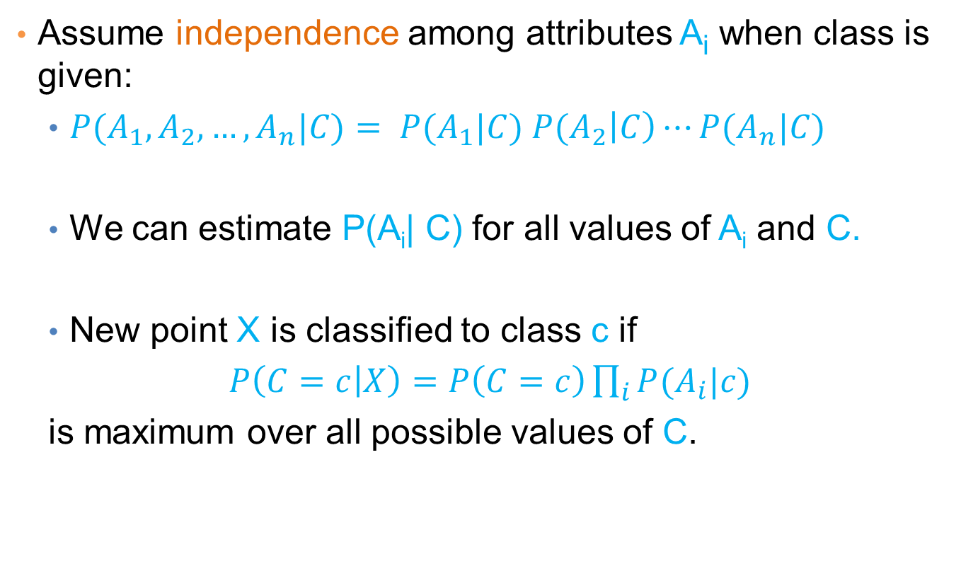
Naïve Bayes Classifier
Assume independence among attributes A_{i} when class is given:
$P(A_{1},A_{2},…,A_{n}|C)= P(A_{1}|C) P(A_{2}\left|C\right)⋯P(A_{n}|C)$
We can estimate P(A_{i}| C) for all values of A_{i} and C.
New point X is classified to class c if
$P\left(C=c | X\right)=P\left(C=c\right)\prod_{i}{P(A_{i}|c)}$
is maximum over all possible values of C.

Slide 42
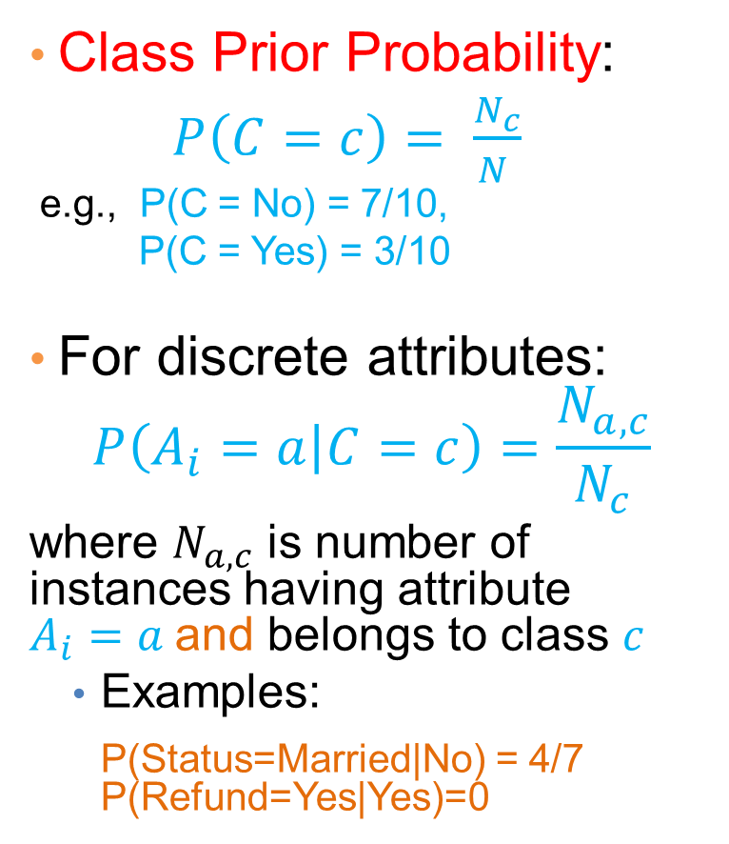
How to Estimate Probabilities from Data?
Class Prior Probability:
$P\left(C=c\right)= \frac{N_{c}}{N }$
e.g., P(C = No) = 7/10,
P(C = Yes) = 3/10
For discrete attributes:
$$P\left(A_{i}=a | C=c\right)=\frac{N_{a,c}}{N_{c}}$$
where $N_{a,c}$ is number of instances having attribute $A_{i}=a$and belongs to class $c$
Examples:
P(Status=Married|No) = 4/7 P(Refund=Yes|Yes)=0

Slide 43
How to Estimate Probabilities from Data?
For continuous attributes:
Discretize the range into bins
one ordinal attribute per bin
violates independence assumption
Two-way split: (A < v) or (A > v)
choose only one of the two splits as new attribute
Probability density estimation:
Assume attribute follows a normal distribution
Use data to estimate parameters of distribution (i.e., mean μ and standard deviation σ)
Once probability distribution is known, we can use it to estimate the conditional probability P(A_{i}|c)

Slide 44
How to Estimate Probabilities from Data?
Normal distribution:
One for each (a_{i},c_{i}) pair
For (Income, Class=No):
If Class=No
sample mean = 110
sample variance = 2975

Slide 45
Example of Naïve Bayes Classifier
Creating a Naïve Bayes Classifier, essentially means to compute counts:
Total number of records: N = 10
Class No:
Number of records: 7
Attribute Refund:
Yes: 3
No: 4
Attribute Marital Status:
Single: 2
Divorced: 1
Married: 4
Attribute Income:
mean: 110
variance: 2975
Class Yes:
Number of records: 3
Attribute Refund:
Yes: 0
No: 3
Attribute Marital Status:
Single: 2
Divorced: 1
Married: 0
Attribute Income:
mean: 90
variance: 25

Slide 46
Example of Naïve Bayes Classifier
Given a Test Record:
P(X|Class=No) = P(Refund=No|Class=No) × P(Married| Class=No) × P(Income=120K| Class=No) = 4/7 × 4/7 × 0.0072 = 0.0024
P(X|Class=Yes) = P(Refund=No| Class=Yes) × P(Married| Class=Yes) × P(Income=120K| Class=Yes) = 1 × 0 × 1.2 × 10⁻⁹ = 0
P(No) = 0.3, P(Yes) = 0.7
Since P(X|No)P(No) > P(X|Yes)P(Yes)
Therefore P(No|X) > P(Yes|X) => Class = No

Slide 47
Naïve Bayes Classifier
If one of the conditional probability is zero, then the entire expression becomes zero
Probability estimation:
N_{i}: number of attribute values for attribute A_{i}
p: prior probability
m: parameter

Slide 48
Example of Naïve Bayes Classifier
Given a Test Record:
With Laplace Smoothing
P(X|Class=No) = P(Refund=No|Class=No) × P(Married| Class=No) × P(Income=120K| Class=No) = 5/9 × 5/10 × 0.0072
P(X|Class=Yes) = P(Refund=No| Class=Yes) × P(Married| Class=Yes) × P(Income=120K| Class=Yes) = 4/5 × 1/6 × 1.2 × 10⁻⁹
P(No) = 0.7, P(Yes) = 0.3
Since P(X|No)P(No) > P(X|Yes)P(Yes)
Therefore P(No|X) > P(Yes|X) => Class = No

Slide 49
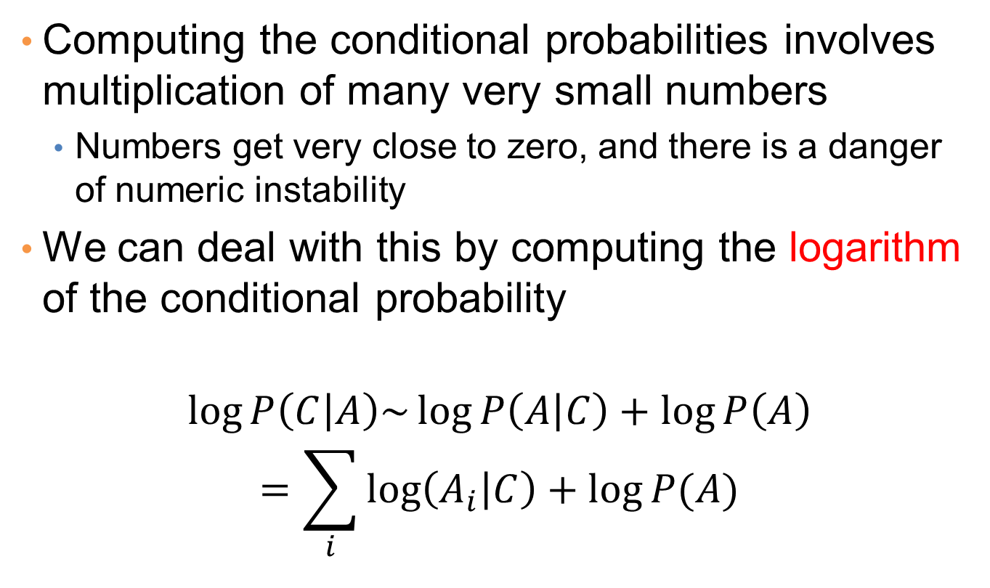
Implementation details
Computing the conditional probabilities involves multiplication of many very small numbers
Numbers get very close to zero, and there is a danger of numeric instability
We can deal with this by computing the logarithm of the conditional probability
$$\log{P\left(C | A\right)\sim \log{P\left(A | C\right)+\log{P\left(A\right)}}}$$
$$=\sum_{i}{\log\left(A_{i} | C\right)+\log{P(A)}}$$

Slide 50
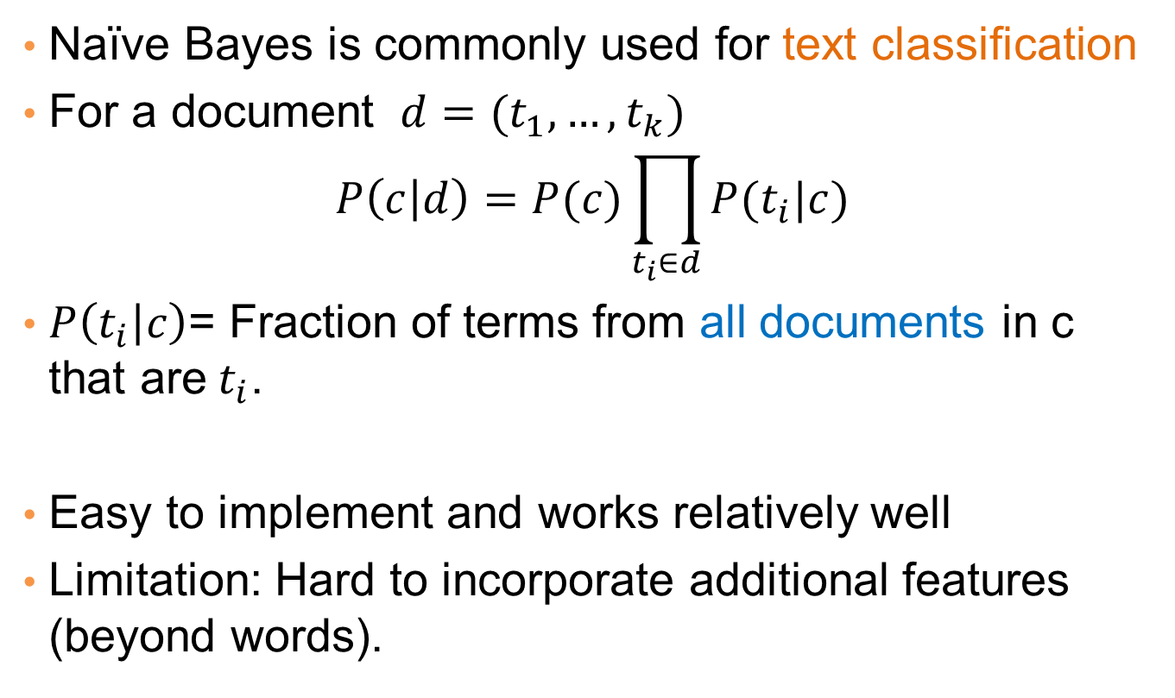
Naïve Bayes for Text Classification
Naïve Bayes is commonly used for text classification
For a document $d=(t_{1},…, t_{k})$
$$P\left(c | d\right)=P(c)\prod_{t_{i}∈d}{P(t_{i}|c)}$$
$P\left(t_{i} | c\right)$= Fraction of terms from all documents in c that are$t_{i}$.
Easy to implement and works relatively well
Limitation: Hard to incorporate additional features (beyond words).

Slide 51
Example of Naïve Bayes Classifier for Text Classification
Sentences | Actual
He likes sweets. | +ve
I am not flying to England. | -ve
She did not like Bikhram yoga. | -ve
He will come tomorrow. | +ve
They don't practice yoga. | -ve
Do positive. | +ve
He doesn't have to commute to work. | -ve
Pakistan is one of the best countries in the world. | +ve

Slide 52
Example of Naïve Bayes Classifier for Text Classification
Let assume following are the features/vocabulary:
To
Yoga
Not
Best
positive
To | Yoga | Not | Best | Positive | Class
0 | 0 | 0 | 0 | 0 | +ve
1 | 0 | 1 | 0 | 0 | -ve
0 | 1 | 1 | 0 | 0 | -ve
0 | 0 | 0 | 0 | 0 | +ve
0 | 1 | 1 | 0 | 0 | -ve
0 | 0 | 0 | 0 | 1 | +ve
1 | 0 | 1 | 0 | 0 | -ve
0 | 0 | 0 | 1 | 0 | +ve
I do not like Yoga on Sunday?
B=0 1 1 0 0
P(Pos|B)= P(Pos)*P(0|Pos)*P(1|Pos)*P(1|Pos)*P(0|Pos)*(0|Pos)
P(Neg|B)= P(Neg)*P(0|Neg)*P(1|Neg)*P(1|Neg)*P(0|Neg)*(0|Neg)

Slide 53
P (Yoga| class)
 | 0 | 1
Pos | 4/4 | 0/4
Neg | 2/4 | 2/4
Pos=4/8
Neg=4/8
P (Not| class)
 | 0 | 1
Pos | 4/4 | 0/4
Neg | 0/4 | 4/4

Slide 54
Naïve Bayes (Summary)
Robust to isolated noise points
Handle missing values by ignoring the instance during probability estimate calculations
Robust to irrelevant attributes
Independence assumption may not hold for some attributes
Use other techniques such as Bayesian Belief Networks (BBN)
Naïve Bayes can produce a probability estimate, but it is usually a very biased one
Logistic Regression is better for obtaining probabilities.

