Slide 1
Introduction to Datascience
Classification
Decision Trees

Slide 2
General approach to classification
Training set consists of records with known class labels
Training set is used to build a classification model
A labeled test set of previously unseen data records is used to evaluate the quality of the model.
The classification model is applied to new records with unknown class labels

Slide 3
Illustrating Classification Task

Slide 4
Decision Trees
Decision tree
A flow-chart-like tree structure
Internal node denotes a test on an attribute
Branch represents an outcome of the test
Leaf nodes represent class labels or class distribution.
Decision Tree learning is used to approximate discrete valued target functions, in which the learned function is approximated by Decision Tree.

Slide 5
Where should you use decision tree?
At any scenario where learning data has following traits:
The learning data has attribute value pair like in the example shown .
Target function has discreet output.
The training data might be missing or have error

Slide 6
Example of a Decision Tree
categorical
categorical
continuous
class
Splitting Attributes
Refund
Yes
No
Test outcome
NO
MarSt
Single, Divorced
Married
TaxInc
NO
< 80K
> 80K
NO
YES
Class labels
Training Data
Model: Decision Tree

Slide 7
Another Example of Decision Tree
categorical
categorical
continuous
class
MarSt
Single, Divorced
Married
NO
Refund
Yes
No
NO
TaxInc
< 80K
> 80K
NO
YES
There could be more than one tree that fits the same data!

Slide 8
Apply Model to Test Data
Test Data
Start from the root of tree.
Refund
Yes
No
NO
MarSt
Single, Divorced
Married
TaxInc
NO
< 80K
> 80K
NO
YES

Slide 9
Apply Model to Test Data
Test Data
Refund
Yes
No
NO
MarSt
Single, Divorced
Married
TaxInc
NO
< 80K
> 80K
NO
YES

Slide 10
Apply Model to Test Data
Test Data
Refund
Yes
No
NO
MarSt
Single, Divorced
Married
TaxInc
NO
< 80K
> 80K
NO
YES

Slide 11
Apply Model to Test Data
Test Data
Refund
Yes
No
NO
MarSt
Single, Divorced
Married
TaxInc
NO
< 80K
> 80K
NO
YES

Slide 12
Apply Model to Test Data
Test Data
Refund
Yes
No
NO
MarSt
Single, Divorced
Married
TaxInc
NO
< 80K
> 80K
NO
YES

Slide 13
Apply Model to Test Data
Test Data
Refund
Yes
No
NO
MarSt
Single, Divorced
Married
Assign Cheat to “No”
TaxInc
NO
< 80K
> 80K
NO
YES

Slide 14
Decision Tree Classification Task
Decision Tree

Slide 15
Tree Induction
Finding the best decision tree is NP-hard
Greedy strategy.
Split the records based on an attribute test that optimizes certain criterion.
Many Algorithms:
Hunt’s Algorithm (one of the earliest)
CART
ID3, C4.5
SLIQ,SPRINT

Slide 16
Splitting Based on Nominal Attributes
Multi-way split: Use as many partitions as distinct values.
Binary split: Divides values into two subsets. Need to find optimal partitioning.
CarType
Family
Luxury
Sports
CarType
OR
CarType
{Sports, Luxury}
{Family, Luxury}
{Family}
{Sports}

Slide 17
How to determine the Best Split
Need a measure of node impurity:
Ideas?
Non-homogeneous,
High degree of impurity
Homogeneous,
Low degree of impurity

Slide 18
Measuring Node Impurity
p(i|t): fraction of records associated with node t belonging to class i
Used in ID3 and C4.5
Used in CART, SLIQ, SPRINT.

Slide 19
Gain
Gain of an attribute split: compare the impurity of the parent node with the average impurity of the child nodes
Maximizing the gain ⇔ Minimizing the weighted average impurity measure of children nodes
If I() = Entropy(), then Δ_{info} is called information gain

Slide 20
Iterative Dichotomiser 3
aka ID3 invented by Ross Quinlan.

Slide 21
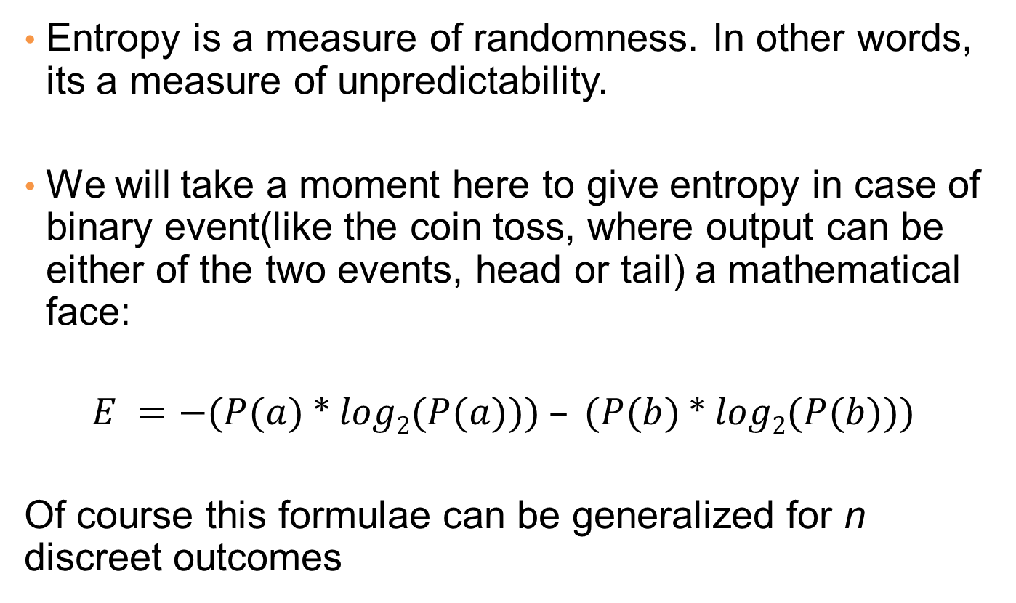
Entropy
Entropy is a measure of randomness. In other words, its a measure of unpredictability.
We will take a moment here to give entropy in case of binary event(like the coin toss, where output can be either of the two events, head or tail) a mathematical face:
$$E =−(P(a) * log2(P(a))) – (P(b) * log2(P(b)))$$
Of course this formulae can be generalized for n discreet outcomes

Slide 22
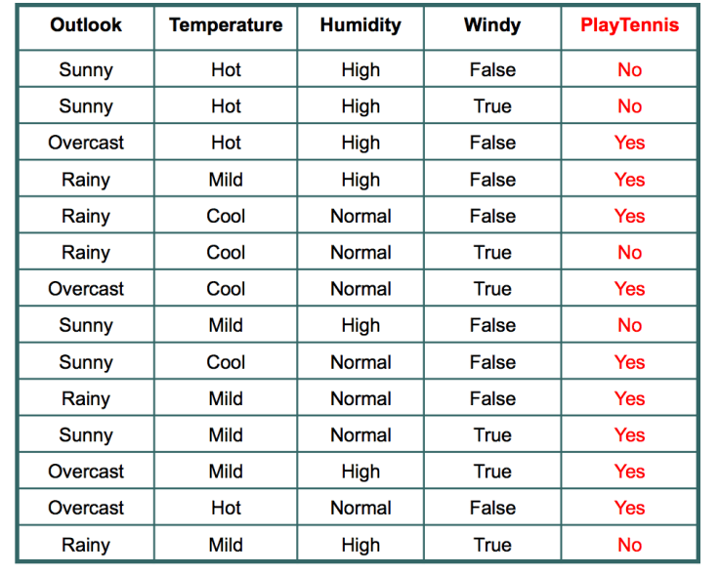
ID3 Example
A classic famous example where decision tree is used is known as Play Tennis.

Slide 23
1. Source Entropy
In the given 14 days, we played tennis on 9 occasions and we did not play on 5 occasions.
Probability of playing tennis:
Number of favorable events : 9
Number of total events : 14
Probability = (Number of favorable events) / (Number of total events)
= 9/14
= 0.642
Probability of not playing tennis:
Number of favorable events : 5
Number of total events : 14
Probability = (Number of favorable events) / (Number of total events)
=5/14
=0.357
$$E =−(P(a) ∗ log2(P(a))) – (P(b) ∗ log2(P(b)))$$

Slide 24
Entropy of every attribute
So, entropy of whole system before we proceed with other attributes is _____?.
Now, we have four features to make decision and they are:
1. Outlook
2. Temperature
3. Windy
4. Humidity
Let’s see what happens to entropy when we make our first decision on the basis of Outlook.

Slide 25
Outlook Attribute
If we make a decision tree division at this level 0 based on outlook, we have three branches possible; either it will be Sunny or Overcast or it will be Raining.
Sunny : In the given data, 5 days were sunny. Among those 5 days, tennis was played on 2 days and tennis was not played on 3 days.
What is the entropy here?
Probability of playing tennis = 2/5 = 0.4
Probability of not playing tennis = 3/5 = 0.6
Entropy when sunny
= -0.4 * log2(0.4) – 0.6 * log2(0.6)
= 0.97

Slide 26
Outlook Attribute
Overcast: In the given data, 4 days were overcast and tennis was played on all the four days. Let
Probability of playing tennis = 4/4 = 1
Probability of not playing tennis = 0/4 = 0
Entropy when overcast = 0.0
Rain: In the given data, 5 days were rainy. Among those 5 days, tennis was played on 3 days and tenis was not played on 2 days. What is the entropy here?
Probability of not playing tennis = 2/5 = 0.4
Probability of playing tennis = 3/5 = 0.6
Entropy when rainy = -0.4 * log2(0.4) – 0.6 * log2(0.6)
= 0.97

Slide 27
Outlook Attribute
Entropy among the three branches:
Entropy among three branches =
((no. of sunny days)/(total days) * (entropy when sunny)) + ((no. of overcast days)/(total days) * (entropy when overcast)) + ((no. of rainy days)/(total days) * (entropy when rainy))
= ((5/14) * 0.97) + ((4/14) * 0) + ((5/14) * 0.97)= 0.69
Reduction in randomness = entropy source – entropy of branches
= 0.940 – 0.69 = 0.246

Slide 28
Temperature
Information Gain = 0.029
Windy
Information Gain = 0.048
Humidity
Information Gain = 0.152

Slide 29
Pseudocode
1. Create feature list, attribute list.
Example: Feature List : Outlook, Windy, Temperature and Humidity
Attributes for Outlook are Sunny, Overcast and Rainy.
2. Find the maximum information gain among all the features. Assign it root node.
Outlook in our example and it has three branches: Sunny, Overcast and Rainy.
3. Remove the feature assigned in root node from the feature list and again find the maximum increase in information gain for each branch. Assign the feature as child node of each branch and remove that feature from feature list for that branch.
Sunny Branch for outlook root node has humidity as child node.
4. Repeat step 3 until you get branches with only pure leaf. In our example, either yes or no.

