Slide 1
ASSOCIATION RULES

Slide 2
Association Rule Mining
Given a set of transactions, find rules that will predict the occurrence of an item based on the occurrences of other items in the transaction
Market-Basket transactions
Example of Association Rules
{Diaper} → {Juice}, {Milk, Bread} → {Eggs,Coke}, {Juice, Bread} → {Milk},
Implication means co-occurrence, not causality!

Slide 3
Definition: Association Rule
Association Rule
An implication expression of the form X → Y, where X and Y are itemsets
Example: {Milk, Diaper} → {Juice}
Rule Evaluation Metrics
Support (s)
Fraction of transactions that contain both X and Y
the probability P(X,Y) that X and Y occur together
Confidence (c)
Measures how often items in Y appear in transactions that contain X
the conditional probability P(Y|X) that Y occurs given that X has occurred.
Example:

Slide 4
Association Rule Mining Task
Input: A set of transactions T, over a set of items I
Output: All rules with items in I having
support ≥ minsup threshold
confidence ≥ minconf threshold

Slide 5
Mining Association Rules
Two-step approach:
Frequent Itemset Generation
Generate all itemsets whose support ≥ minsup
Rule Generation
Generate high confidence rules from each frequent itemset, where each rule is a partitioning of a frequent itemset into Left-Hand-Side (LHS) and Right-Hand-Side (RHS)
Principle
Generate all nonempty subsets for each frequent itemset
For Itemset - { A, B, C } , all non empty subsets are {A,B}, {B,C}, {A,C}, {A}, {B}, {C}
For every nonempty subset S of Itemset I , output of the rule:
S --> (I - S )

Slide 6
Rule Generation
We have all frequent itemsets, how do we get the rules?
For every frequent itemset S, we find rules of the form L → S – L , where L ⊂ S, that satisfy the minimum confidence requirement
Example: L = {A,B,C,D}
Candidate rules:
A →BCD, B →ACD, C →ABD, D →ABC AB →CD, AC → BD, AD → BC, BD →AC, CD →AB, ABC →D, BCD →A, BC →AD,
If |L| = k, then there are 2^{k} – 2 candidate association rules (ignoring L → ∅ and ∅ → L)

Slide 7
Rule Generation
How to efficiently generate rules from frequent itemsets?
In general, confidence does not have an anti-monotone property
c(ABC →D) can be larger or smaller than c(AB →D)
But confidence of rules generated from the same itemset has an anti-monotone property
e.g., L = {A,B,C,D}: c(ABC → D) ≥ c(AB → CD) ≥ c(A → BCD)
Confidence is anti-monotone w.r.t. number of items on the RHS of the rule

Slide 8
Rule Generation for Apriori Algorithm
Low Confidence Rule
Pruned Rules
Lattice of rules created by the RHS

Slide 9
Rule Generation for APriori Algorithm
Candidate rule is generated by merging two rules that share the same prefix in the RHS
join(CD→AB,BD→AC) would produce the candidate rule D → ABC
Prune rule D → ABC if its subset AD→BC does not have high confidence
Essentially we are doing A Priori on the RHS

Slide 10
SIMILARITY AND DISTANCE

Slide 11
Similarity and Distance
For many different problems we need to quantify how close two objects are.
Examples:
For an item bought by a customer, find other similar items
Group together the customers of site so that similar customers are shown the same ad.
Group together web documents so that you can separate the ones that talk about politics and the ones that talk about sports.
Find all the near-duplicate mirrored web documents.
Find credit card transactions that are very different from previous transactions.
To solve these problems we need a definition of similarity, or distance.
The definition depends on the type of data that we have

Slide 12
Similarity
Numerical measure of how alike two data objects are.
A function that maps pairs of objects to real values
Higher when objects are more alike.
Often falls in the range [0,1], sometimes in [-1,1]
Desirable properties for similarity
s(p, q) = 1 (or maximum similarity) only if p = q. (Identity)
s(p, q) = s(q, p) for all p and q. (Symmetry)

Slide 13
Similarity between sets
Consider the following documents
Which ones are more similar?
How would you quantify their similarity?
apple releases new ipod
apple releases new ipad
new apple pie recipe

Slide 14
Similarity: Intersection
Number of words in common
Sim(D,D) = 3, Sim(D,D) = Sim(D,D) =2
What about this document?
Sim(D,D) = Sim(D,D) = 3
apple releases new ipod
apple releases new ipad
new apple pie recipe
Vefa rereases new book with apple pie recipes

Slide 15
Jaccard Similarity
The Jaccard similarity (Jaccard coefficient) of two sets S₁, S₂ is the size of their intersection divided by the size of their union.
JSim (C₁, C₂) = |C₁∩C₂| / |C₁∪C₂|.
Extreme behavior:
Jsim(X,Y) = 1, iff X = Y
Jsim(X,Y) = 0 iff X,Y have not elements in common
JSim is symmetric
3 in intersection.
8 in union.
Jaccard similarity
= 3/8

Slide 16
Similarity: Intersection
Number of words in common
JSim(D,D) = 3/5
JSim(D,D) = JSim(D,D) = 2/6
JSim(D,D) = JSim(D,D) = 3/9
apple releases new ipod
apple releases new ipad
new apple pie recipe
Vefa rereases new book with apple pie recipes

Slide 17
Similarity between vectors
Documents (and sets in general) can also be represented as vectors
document | Apple | Microsoft | Obama | Election
D1 | 10 | 20 | 0 | 0
D2 | 30 | 60 | 0 | 0
D2 | 0 | 0 | 10 | 20
How do we measure the similarity of two vectors?
How well are the two vectors aligned?

Slide 18
Example
document | Apple | Microsoft | Obama | Election
D1 | 1/3 | 2/3 | 0 | 0
D2 | 1/3 | 2/3 | 0 | 0
D2 | 0 | 0 | 1/3 | 2/3
Documents D1, D2 are in the “same direction”
Document D3 is orthogonal to these two
Definition. We say that 2 vectors are orthogonal if they are perpendicular to each other. i.e. the dot product of the two vectors is zero

Slide 19
Cosine Similarity
Sim(X,Y) = cos(X,Y)
The cosine of the angle between X and Y
If the vectors are aligned (correlated) angle is zero degrees and cos(X,Y)=1
If the vectors are orthogonal (no common coordinates) angle is 90 degrees and cos(X,Y) = 0
Cosine is commonly used for comparing documents, where we assume that the vectors are normalized by the document length.

Slide 20
Cosine Similarity - math
If d₁ and d₂ are two vectors, then
cos( d₁, d₂ ) = (d₁ • d₂) / ||d₁|| ||d₂|| ,
where • indicates vector dot product and || d || is the length of vector d.
Example:
d₁ = 3 2 0 5 0 0 0 2 0 0
d₂ = 1 0 0 0 0 0 0 1 0 2
d₁ • d₂= 3*1 + 2*0 + 0*0 + 5*0 + 0*0 + 0*0 + 0*0 + 2*1 + 0*0 + 0*2 = 5
||d₁|| = (3*3+2*2+0*0+5*5+0*0+0*0+0*0+2*2+0*0+0*0)^{0.5} = (42) ^{0.5} = 6.481
||d₂|| = (1*1+0*0+0*0+0*0+0*0+0*0+0*0+1*1+0*0+2*2) ^{0.5} = (6) ^{0.5} = 2.245
cos( d₁, d₂ ) = .3150

Slide 21
Similarity between vectors
document | Apple | Microsoft | Obama | Election
D1 | 10 | 20 | 0 | 0
D2 | 30 | 60 | 0 | 0
D2 | 0 | 0 | 10 | 20
cos(D1,D2) = 1
cos(D1,D3) = cos(D2,D3) = 0

Slide 22
Distance
Numerical measure of how different two data objects are
A function that maps pairs of objects to real values
Lower when objects are more alike
Minimum distance is 0, when comparing an object with itself.
Upper limit varies

Slide 23
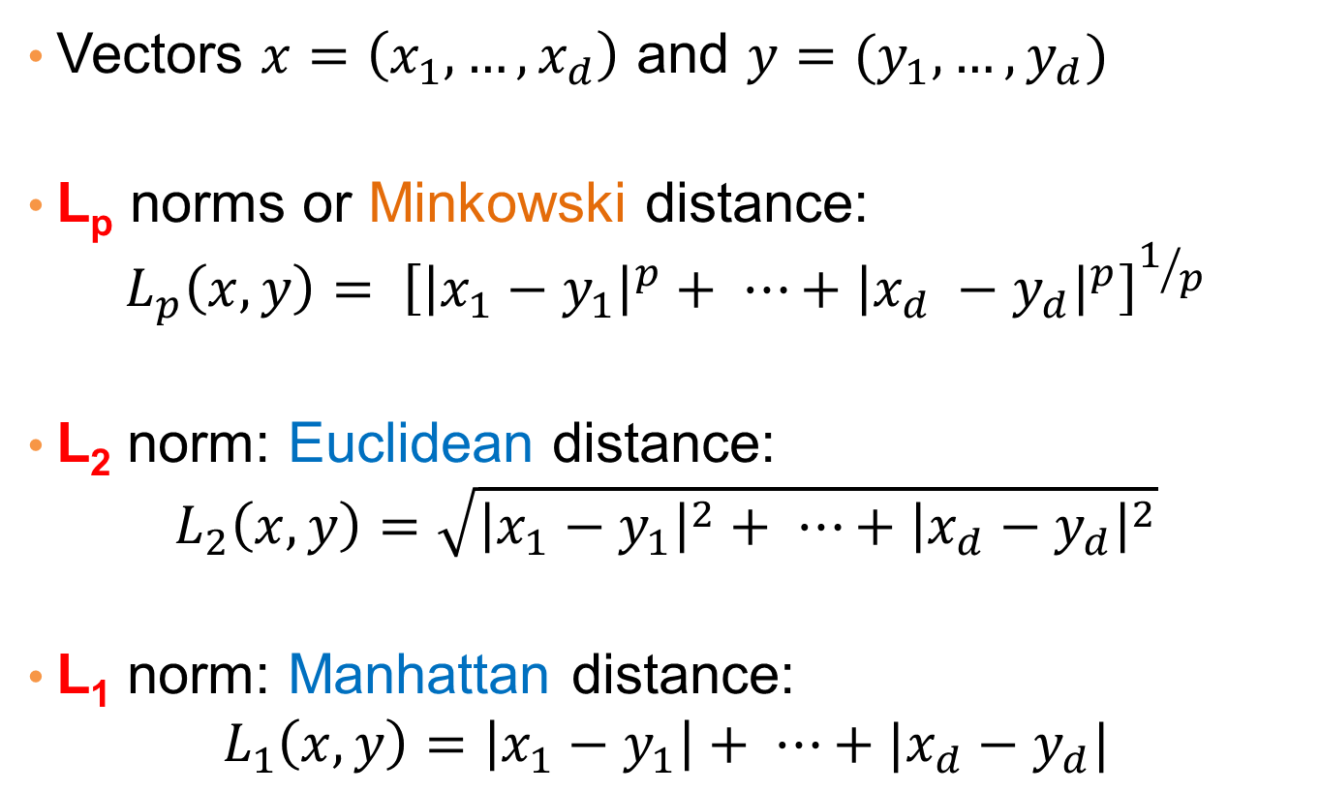
Distances for real vectors
Vectors $x=\left(x_{1},…,x_{d}\right)$ and $y=(y_{1},…,y_{d})$
L_{p} norms or Minkowski distance:
$$L_{p}\left(x,y\right)= {\left[{\left|x_{1}−y_{1}\right|}^{p}+ ⋯+{\left|x_{d} −y_{d}\right|}^{p}\right]}^{1/p}$$
L₂ norm: Euclidean distance:
$$L_{2}\left(x,y\right)=\sqrt{{\left|x_{1}−y_{1}\right|}^{2}+ ⋯+{\left|x_{d}−y_{d}\right|}^{2}}$$
L₁ norm: Manhattan distance:
$$L_{1}\left(x,y\right)=\left|x_{1}−y_{1}\right|+ ⋯+|x_{d}−y_{d}|$$
L_{p} norms are known to be distance metrics

Slide 24
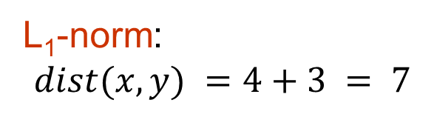
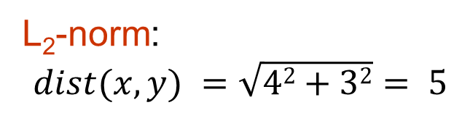
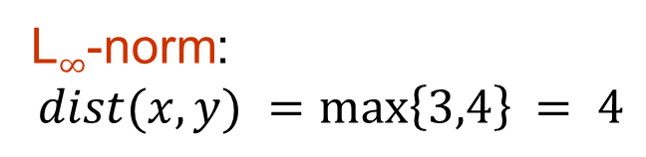
Example of Distances
y = (9,8)
L₂-norm:
$$dist(x,y) =\sqrt{42+32}= 5$$
5
3
L₁-norm:
$$dist(x,y) =4+3 = 7$$
4
x = (5,5)
L$∞$-norm:
$$dist(x,y) =\max\left\{3,4\right\}⁡= 4$$

Slide 25

Example
r
$$x= (x_{1},…,x_{n})$$
Green: All points y at distance L₁(x,y) = r from point x
Blue: All points y at distance L₂(x,y) = r from point x
Red: All points y at distance L$∞$(x,y) = r from point x

Slide 26
L_{p} distances for sets
We can apply all the L_{p} distances to the cases of sets of attributes, with or without counts, if we represent the sets as vectors
E.g., a transaction is a 0/1 vector
E.g., a document is a vector of counts.

Slide 27
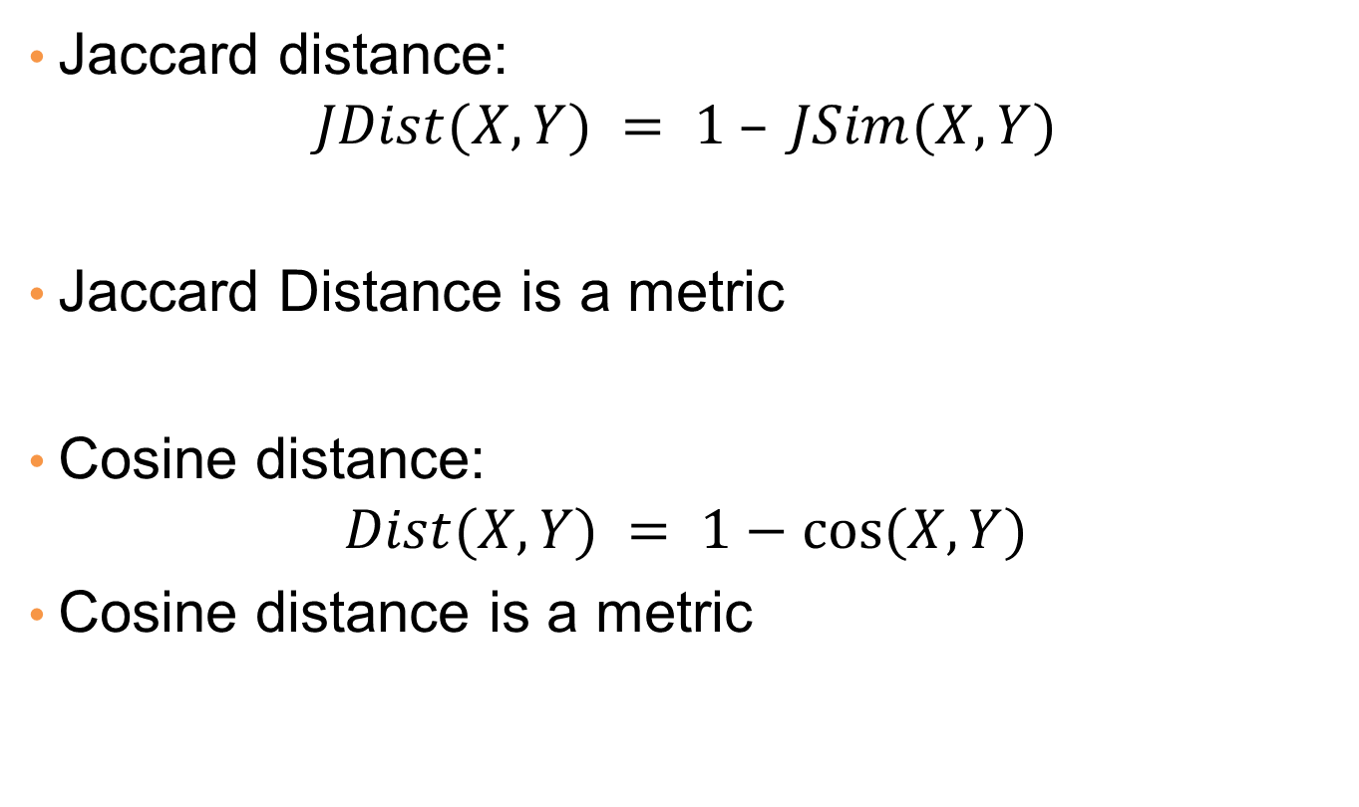
Similarities into distances
Jaccard distance:
$$JDist(X,Y) = 1 – JSim(X,Y)$$
Jaccard Distance is a metric
Cosine distance:
$$Dist(X,Y) = 1−cos⁡(X,Y)$$
Cosine distance is a metric

Slide 28
Why Jaccard Distance Is a Distance Metric
JDist(x,x) = 0
since JSim(x,x) = 1
JDist(x,y) = JDist(y,x)
by symmetry of intersection
JDist(x,y) > 0
since intersection of X,Y cannot be bigger than the union.
Triangle inequality:
Follows from the fact that JSim(X,Y) is the probability of randomly selected element from the union of X and Y to belong to the intersection

Slide 29
Hamming Distance
Hamming distance is the number of positions in which bit-vectors differ.
Example: p₁ = 10101 p₂ = 10011.
d(p₁, p₂) = 2 because the bit-vectors differ in the 3rd and 4th positions.
The L₁ norm for the binary vectors
Hamming distance between two vectors of categorical attributes is the number of positions in which they differ.
Example: x = (married, low income, cheat), y = (single, low income, not cheat)
d(x,y) = 2

Slide 30
Distance between strings
How do we define similarity between strings?
Important for recognizing and correcting typing errors and analyzing DNA sequences.
weird wierd
intelligent unintelligent
Athena Athina

Slide 31
Edit Distance for strings
The edit distance of two strings is the number of inserts and deletes of characters needed to turn one into the other.
Example: x = abcde ; y = bcduve.
Turn x into y by deleting a, then inserting u and v after d.
Edit distance = 3.
Minimum number of operations can be computed using dynamic programming
Common distance measure for comparing DNA sequences

Slide 32
Variant Edit Distances
Allow insert, delete, and mutate.
Change one character into another.
Minimum number of inserts, deletes, and mutates also forms a distance measure.
Same for any set of operations on strings.
Example: substring reversal or block transposition OK for DNA sequences
Example: character transposition is used for spelling

Slide 33
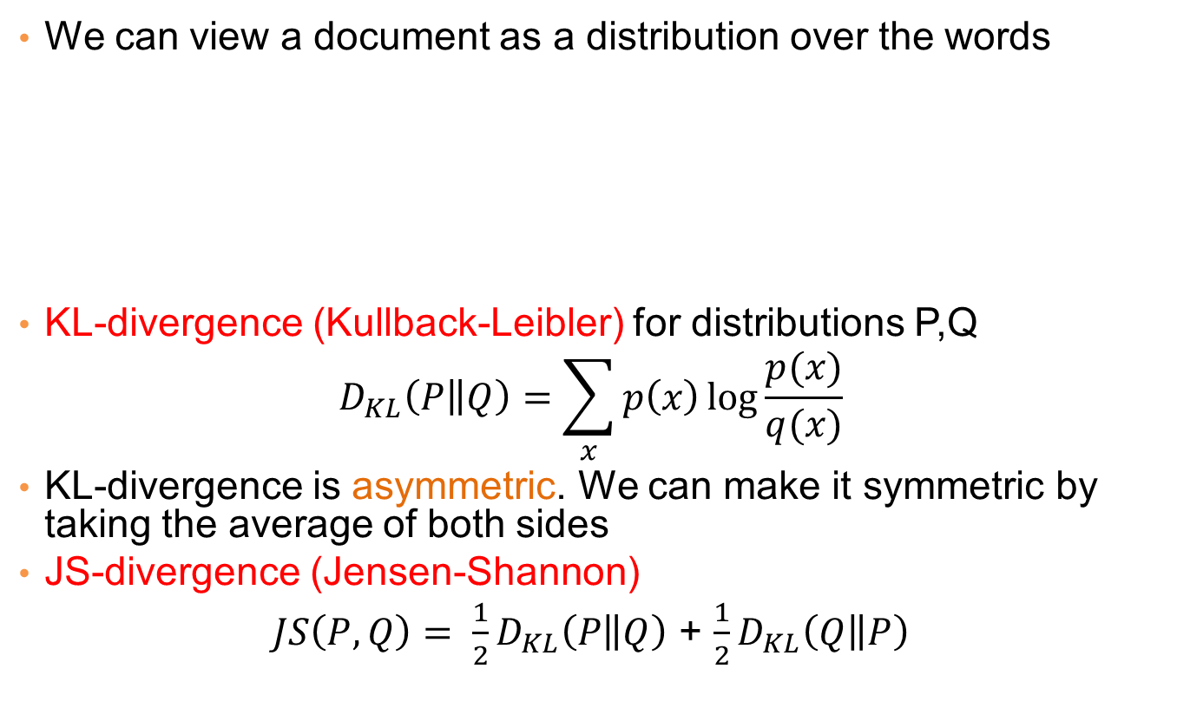
Distances between distributions
We can view a document as a distribution over the words
KL-divergence (Kullback-Leibler) for distributions P,Q
$$D_{KL}\left(P\left\|Q\right.\right)=\sum_{x}{p\left(x\right)\log{\frac{p(x)}{q(x)}}}$$
KL-divergence is asymmetric. We can make it symmetric by taking the average of both sides
JS-divergence (Jensen-Shannon)
$JS\left(P,Q\right)= \frac{1}{2}D_{KL}\left(P\left\|Q\right.\right)$ + $\frac{1}{2}D_{KL}\left(Q\left\|P\right.\right)$
document | Apple | Microsoft | Obama | Election
D1 | 0.35 | 0.5 | 0.1 | 0.05
D2 | 0.4 | 0.4 | 0.1 | 0.1
D2 | 0.05 | 0.05 | 0.6 | 0.3

