Slide 1
DATA Science Week 7
Clustering

Slide 2
K-means

Slide 3
K-means Clustering
Partitional clustering approach
Each cluster is associated with a centroid (center point)
Each point is assigned to the cluster with the closest centroid
Number of clusters, K, must be specified
The objective is to minimize the sum of distances of the points to their respective centroid

Slide 4
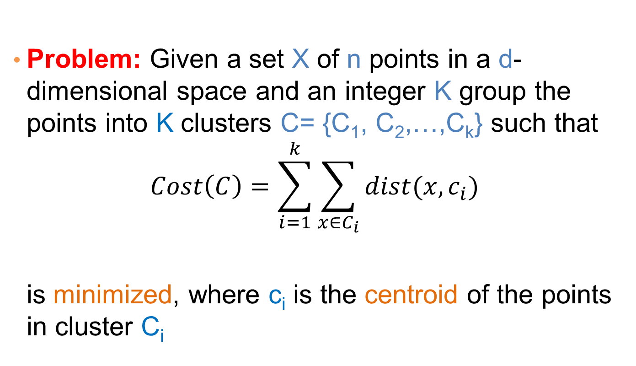
K-means Clustering
Problem: Given a set X of n points in a d-dimensional space and an integer K group the points into K clusters C= {C₁, C₂,…,C_{k}} such that
$$Cost\left(C\right)=\sum_{i=1}^{k}{\sum_{x∈C_{i}}{dist(x,c_{i})}}$$
is minimized, where c_{i} is the centroid of the points in cluster C_{i}

Slide 5
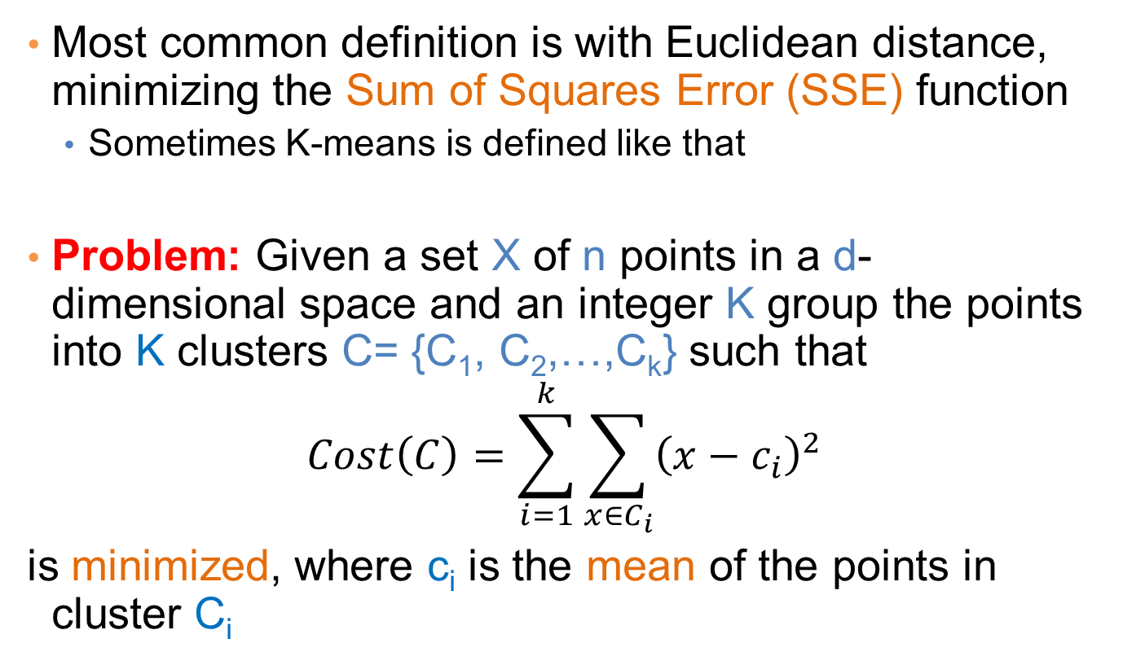
K-means Clustering
Most common definition is with Euclidean distance, minimizing the Sum of Squares Error (SSE) function
Sometimes K-means is defined like that
Problem: Given a set X of n points in a d-dimensional space and an integer K group the points into K clusters C= {C₁, C₂,…,C_{k}} such that
$$Cost\left(C\right)=\sum_{i=1}^{k}{\sum_{x∈C_{i}}{{\left(x−c_{i}\right)}^{2}}}$$
is minimized, where c_{i} is the mean of the points in cluster C_{i}
Sum of Squares Error (SSE)

Slide 6
Complexity of the k-means problem
NP-hard if the dimensionality of the data is at least 2 (d>=2)
Finding the best solution in polynomial time is infeasible
For d=1 the problem is solvable in polynomial time (how?)
A simple iterative algorithm works quite well in practice

Slide 7
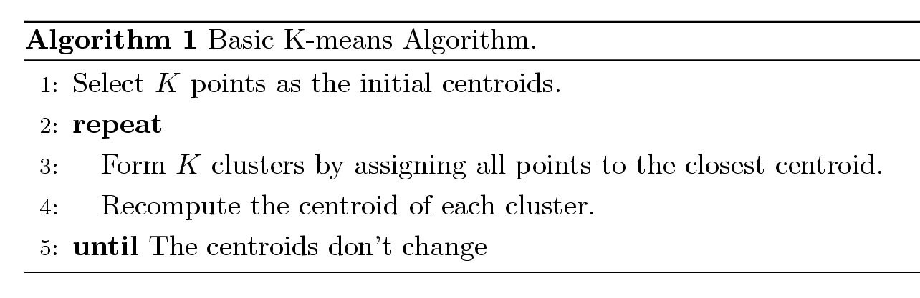
K-means Algorithm
Also known as Lloyd’s algorithm.
K-means is sometimes synonymous with this algorithm

Slide 8
K-means Algorithm – Initialization
Initial centroids are often chosen randomly.
Clusters produced vary from one run to another.

Slide 9
Two different K-means Clusterings
Original Points
Optimal Clustering
Sub-optimal Clustering

Slide 10
Importance of Choosing Initial Centroids

Slide 11
Importance of Choosing Initial Centroids

Slide 12
Importance of Choosing Initial Centroids

Slide 13
Importance of Choosing Initial Centroids …

Slide 14
Dealing with Initialization
Do multiple runs and select the clustering with the smallest error
Select original set of points by methods other than random . E.g., pick the most distant (from each other) points as cluster centers (K-means++ algorithm)

Slide 15
K-means Algorithm – Centroids
The centroid depends on the distance function
The minimizer for the distance function
‘Closeness’ is measured by Euclidean distance (SSE), cosine similarity, correlation, etc.
Centroid:
The mean of the points in the cluster for SSE, and cosine similarity
The median for Manhattan distance.
Finding the centroid is not always easy
It can be an NP-hard problem for some distance functions
E.g., median form multiple dimensions

Slide 16
K-means Algorithm – Convergence
K-means will converge for common similarity measures mentioned above.
Most of the convergence happens in the first few iterations.
Often the stopping condition is changed to ‘Until relatively few points change clusters’
Complexity is O( n * K * I * d )
n = number of points, K = number of clusters, I = number of iterations, d = dimensionality
In general a fast and efficient algorithm

Slide 17
Limitations of K-means
K-means has problems when clusters are of different
Sizes
Densities
Non-globular shapes
K-means has problems when the data contains outliers.

Slide 18
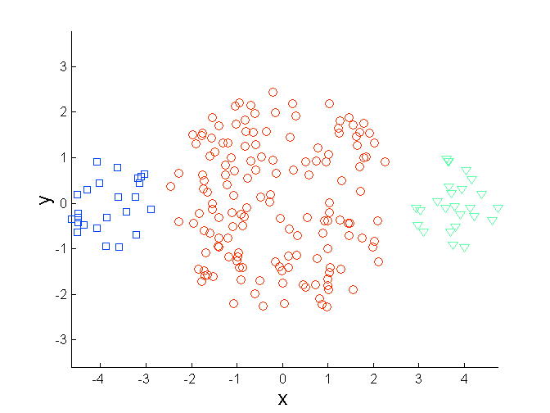
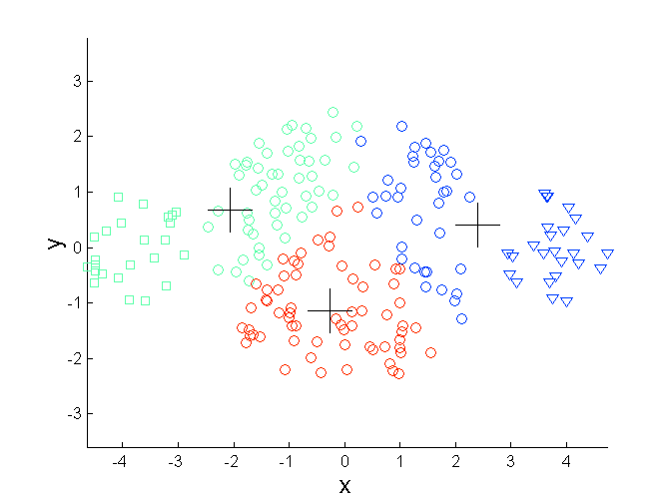
Limitations of K-means: Differing Sizes
Original Points
K-means (3 Clusters)

Slide 19
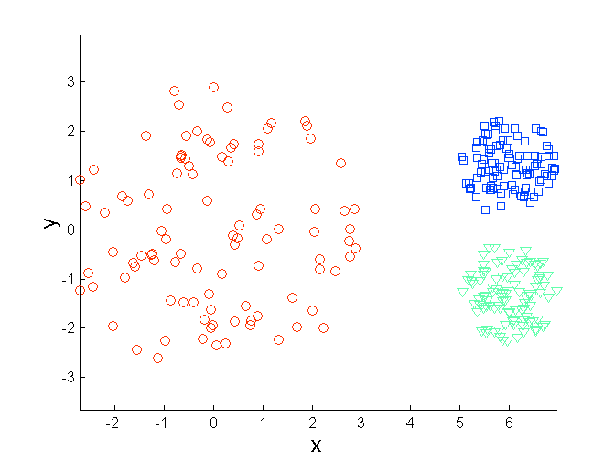
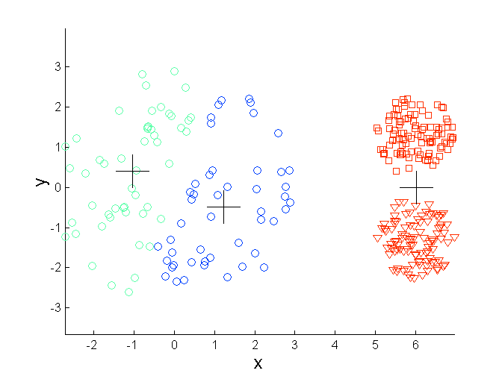
Limitations of K-means: Differing Density
Original Points
K-means (3 Clusters)

Slide 20
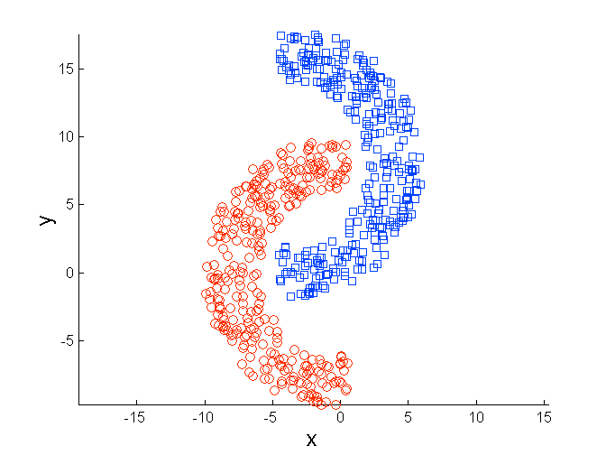
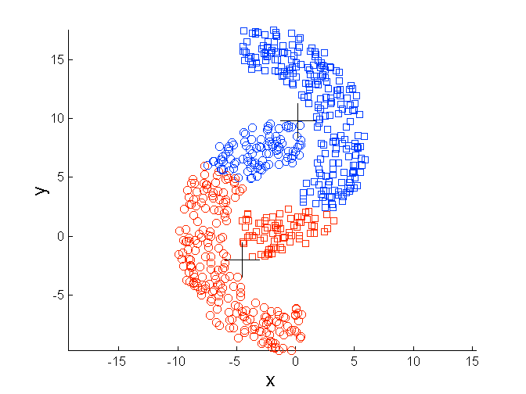
Limitations of K-means: Non-globular Shapes
Original Points
K-means (2 Clusters)

Slide 21
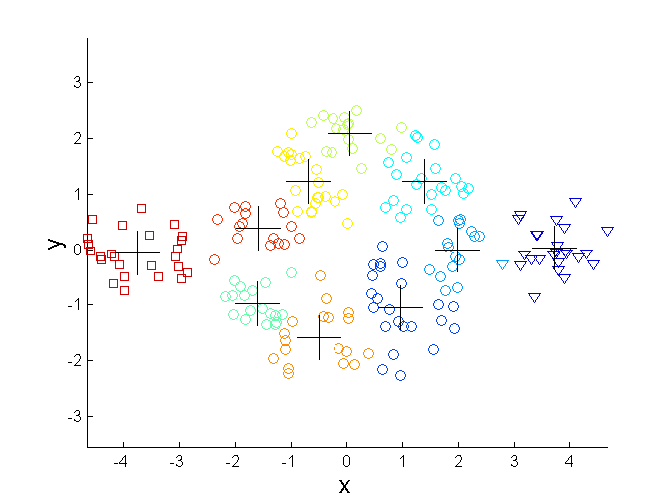
Overcoming K-means Limitations
Original Points K-means Clusters
One solution is to use many clusters.
Find parts of clusters, but need to put together.

Slide 22
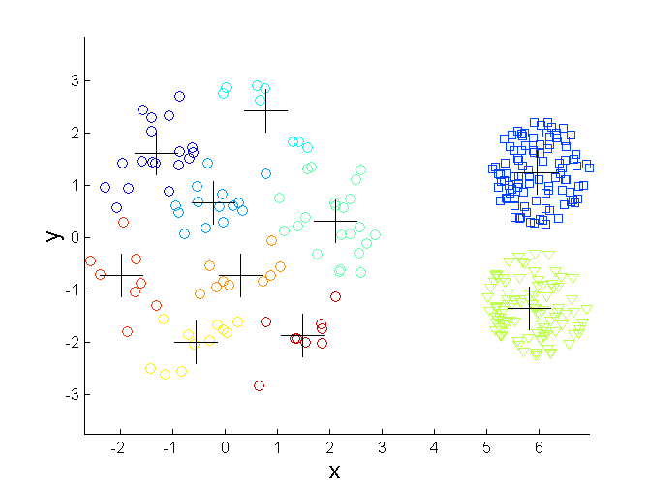
Overcoming K-means Limitations
Original Points K-means Clusters

Slide 23
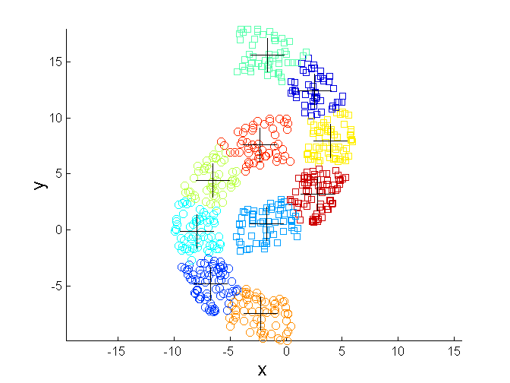
Overcoming K-means Limitations
Original Points K-means Clusters

Slide 24
Variations
K-medoids: Similar problem definition as in K-means, but the centroid of the cluster is defined to be one of the points in the cluster (the medoid).
K-centers: Similar problem definition as in K-means, but the goal now is to minimize the maximum diameter of the clusters (diameter of a cluster is maximum distance between any two points in the cluster).

