Slide 1
Polymorphism
Single entity behaves differently in different cases called polymorphism.
Same Name but different type of implementation
We can achieve polymorphism by method overloading and overriding

Slide 2
Polymorphism
Compile time polymorphism
Static polymorphism
Early binding
Run time polymorphism
Dynamic polymorphism
Late binding
Method overloading
Method Hiding
Method Overriding

Slide 3
Method signature
Method name followed by parameter type
Sum(int a, float b)
Within a class, 2 methods with same name and signature with same or different return type is not allowed by compiler.
Ex)
class A{
void sum(int a){}
int sum(int a){return 0}//compile time error

Slide 4
Method Overloading
Same method name with different method signature or parameter.
In overloading ,method resolution(calling the method) is always taken care by the compiler based on reference type.
Thus method overloading can be called as compile time polymorphism.
Since binding is performed at Complie-time it’s also known as early binding.
The behavior of the static method is decided at compile time so it’s also known as static polymorphism.
Automatic type promotion will happen to data types is called automatic type promotion in overloading.
*Byte->short->int->long->float->double
*Char->int->long->float->double
In overloading while passing the argument , exact match will get higher priority.

Slide 5
Method overriding
Same method name with same method signature or parameter.
If the child class is not satisfied with the parent class method then child class is allowed to override(rewrite) the method based on requirement, this process is called Method overriding.
Method resolution will be taken care by the JVM based on the run time object not by reference type ,so it’s also called run time polymorphism.
The behavior of a dynamic method decided at run time so it’s also known as dynamic polymorphism.
Since binding is performed at Run-time it’s also known as late binding.

Slide 6
Rules Associated with method Overriding
Method name and method signature must be same.
Until Java 1.4 Return type, method name and method signature also should be the same in the subclass overriding method, but after the introduction of covariant data type it’s not necessary to worry about the return type.
The return type of overriding method in the subclass should not be a parent of the parent method return type.
The covariant return type is applicable only for object types not for primitive types.
So with the covariant data type feature ,it is possible to override any method by changing the return type alone.

Slide 7
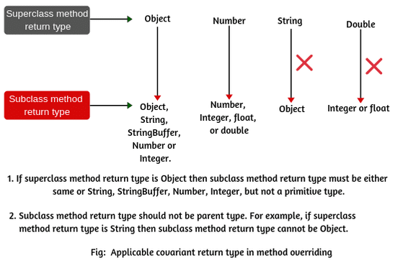
Reference for covariant type

Slide 8
Overriding is not applicable for private,final and static methods.
Overriding is not applicable for Static to non-static method and vice versa.
Overriding is applicable for non final to final methods.
Overriding is applicable for abstract to non-abstract and vice versa.
Overriding is applicable for Synchronized to non-Synchronized and vice versa.
Overriding is applicable for native to non-native and vice versa.
Overriding is applicable for strictfp to non-strictfp and vice versa.
While overriding we can’t reduce the scope of modifier but can increase the scope.
If child class method throws any checked exception then parent class method also should throw the same exception or parent.

Slide 9
If both parent and child override method is static then it’s method hiding not method over riding.The compiler will take reference object for method resolution.so it will comes under method overloading.
We can’t override var-arg method with normal method if u do then it’s overloading but can override var-arg with var-arg method.
Overriding concept only for methods not for variables.For variables resolution takes care by compiler based on reference type. It does not matter whether the variable is static or non static.
If we are copying the same variable In the child class as well in the parent class then that is called variable hiding or shadowing.

Slide 10
Difference between overloading and overriding
Overloading
overriding
Method name should be same
Parameter type should be different at least order.
Private,static,final methods can be overloaded.
Return type need not to be same.
No restriction on exceptions
Method name should be same
Parameter type should be same including order.
Private,static,final methods can’t be overridden.
Return type has to be same until Java1.4,from 1.5 co-variant type is allowed.
If child class method throws any checked exception then parent class method also should throw the same exception or parent.

Slide 11
Overloading Overriding
6. Method resolution always taken care by the compiler based on reference object.
7. It’s also called compile time polymorphism,static polymorphism or early binding.
8. Scope of the modifier does not matter here.
6. Method resolution always taken care by the JVM based on run time object.
7. It’s also called run time polymorphism,dynamic polymorphism or late binding.
8. Here We can’t reduce the scope of the modifier, either it can be equal or higher.

