Slide 1
Common Execution Architecture
  Paul Harrison
  AstroGrid consortium meeting
  Edinburgh UK
  14-15 Dec 2004

Slide 2
Plan
Background
Implementation
Demo – live integration of a new command line application!

Slide 3
Introduction
Common Execution Architecture (CEA)
An attempt to model how an application is run in the Virtual Observatory
  An application is any process that consumes or produces data
Designed primarily to work in web services environment
  A set of schema and WSDL definitions

Slide 4
Motivation
To create a model of an application
  VO infrastructure only has to deal with a single application model
  Application writers know how to interface VO
Provide higher level description than WSDL
  Restrict to manageable subset
  Provide specific semantics for astronomical Quantities
  Provide extra information - e.g. Defaults, UI info – Tie in with registry.
  Define asynchronous activities

Slide 5
Successes
Uniform interface has benefited AstroGrid components
  JES/Workflow engine
    Able to focus on what it needs to do
    JEScript
  Portal
    Workflow builder has UI auto-generated from Registry information
Have set of “out-of-the-box” components to wrap legacy applications.

Slide 6
What is CEA?
Set of interface definitions and schema
  defines the tool and its parameters
  how to execute tool
    initialize
    register listeners for logging and results
    gather remote data
    actually run
Components that implement Common Execution Controllers
  command line
  HTTP GET/POST
  reusable components – direct java

Slide 7
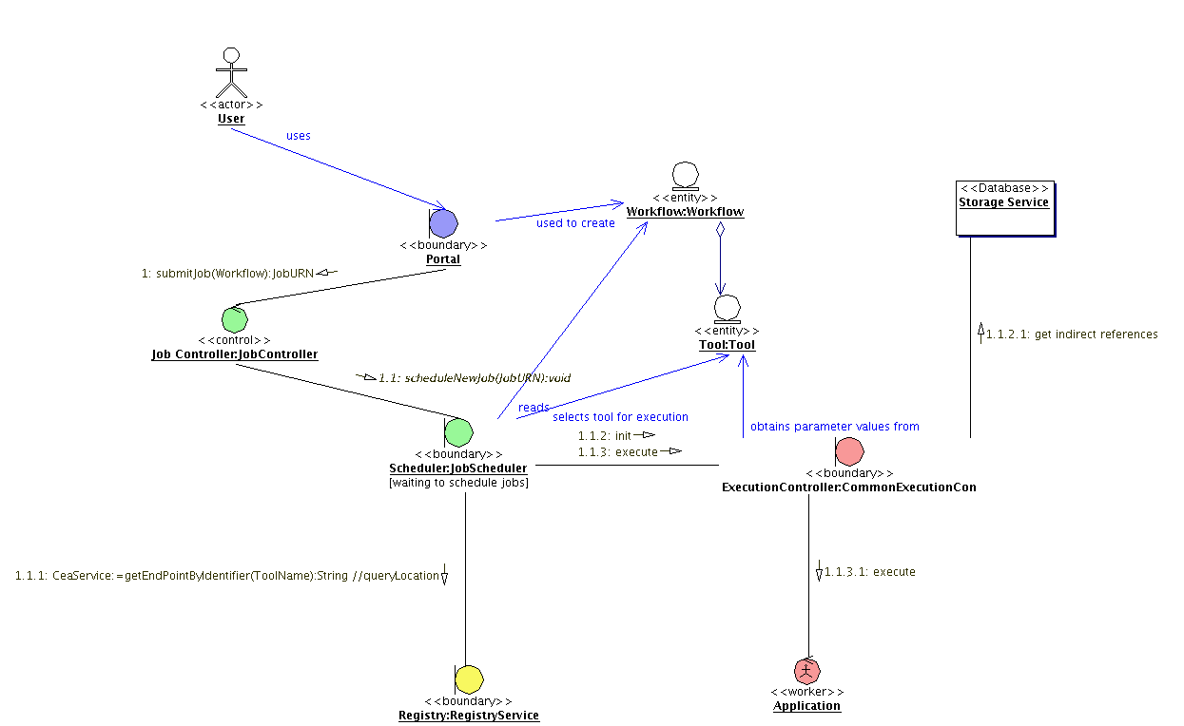
Interactions with other Components

Slide 8
Demo – Add a new Application
Look at the application
  capable of asynchronous command line operation?
Describe using CEA Schema
Configure CEC to use new description
Register this new description
Use the new application!

Slide 9
Summary
CEA creates an environment to send messages to and from applications.
See maven page
  http://www.astrogrid.org/maven/docs/HEAD/applications/

