Slide 1
Common Execution Architecture – The Future?
  Paul Harrison
  VOTech Kick Off
  Cambridge UK
  18-19 Nov 2004

Slide 2
Introduction
Common Execution Architecture (CEA)
An attempt to model how an application is run in the Virtual Observatory
  An application is any process that consumes or produces data
Designed primarily to work in web services environment
  A set of schema and WSDL definitions

Slide 3
Motivation
To create a model of an application
  VO infrastructure only has to deal with a single application model
  Application writers know how to interface VO
Provide higher level description than WSDL
  Restrict to manageable subset
  Provide specific semantics for astronomical Quantities
  Provide extra information - e.g. Defaults, UI info – Tie in with registry.
  Define asynchronous activities

Slide 4
Successes
Uniform interface has benefited AstroGrid components
  JES/Workflow engine
    Able to focus on what it needs to do
    JEScript
  Portal
    Workflow builder has UI auto-generated from Registry information
Have set of “out-of-the-box” components to wrap legacy applications.

Slide 5
Immediate Future
Consolidate
  Need to better document how to “wrap” legacy components
  Need to document workflow features
Promote as an IVOA standard.
  encourage use of interface directly by new applications

Slide 6
Possible Extensions
Could adopt some WS standards as “drop-in” replacements to parts of current architecture
  http://www.ivoa.net/twiki/bin/view/IVOA/AsynchronousActivityProposal
Include Streaming
  needs collaboration with storage services
Interface with “Grid” backends

Slide 7
Adopt DM
Currently <ParameterValue> is very simple
  Type attribute – boolean, integer, VOTable....
  <value> element
Could adopt type(s) from the Data Modelling efforts
  Quantity
  Higher level
Create inheritance hierarchy?

Slide 8
CEA Control
State of the CEA servers themselves.
  How much memory
  How many currently running jobs
  Closest MySpace filestore
  etc.
Useful for scheduling metrics

Slide 9
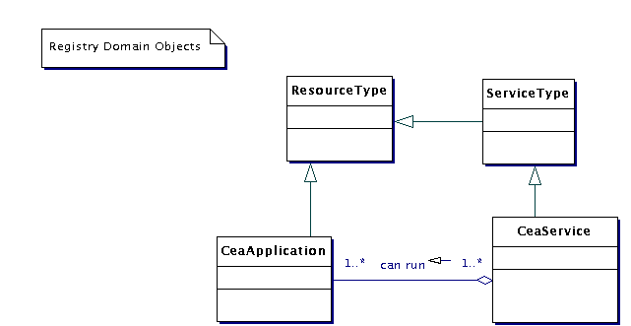
Ontologies
Currently this is all we have...

Slide 10
Summary
CEA creates an environment to send messages to and from applications.
Any more ideas gratefully received!
See maven page
  http://www.astrogrid.org/maven/docs/snapshot/applications/

