Slide 1
Common Execution Architecture
  Paul Harrison

Slide 2
Introduction
Common Execution Architecture (CEA)
An attempt to model how an appliction is run in the Virtual Observatory
  An application is any process that consumes or produces data
Designed primarily to work in web services environment
  A set of schema and WSDL definitions

Slide 3
Motivation
To create a model of an application
  VO infrastructure only has to deal with a single application model
  Application writers know how to interface VO
Provide higher level description than WSDL
  Restrict to managable subset
  Provide specific semantics for astronomical Quantities
  Provide extra information -e.g. Defaults

Slide 4
Origins
Derived from the Iteration 4 Command Line Application Controller experiences.
Created from the basic use case for an application.

Slide 5
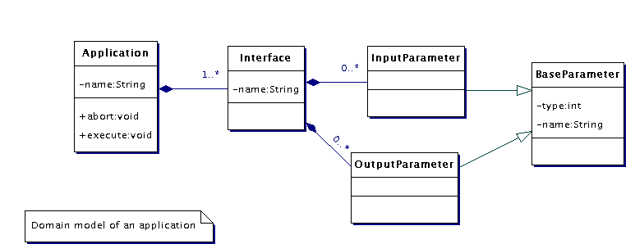
Application Model

Slide 6
Components
Application
Common Execution Controller
Invoking process
Monitoring Service
Storage Service

Slide 7
Component Interactions
UML Sequence Diagram
  The monitoring service could be same as invoking service
  The only guaranteed status message is the final one
  The results of running the application are not returned directly to the invoking process. The destination is implicit in the specification of the output parameters

Slide 8
Schema
The Schema are used both in the WSDL and registry defintions
  AGApplicationBase.xsd - basic CEA objects that are imported into both the WSDL and the Registry Schema extension.
  VOCEA.xsd This defines the VOResource extensions of CeaApplication and CeaService
  AGParameterDefinition.xsd - basic parameter definition and parameter value elements
  Workflow.xsd

Slide 9
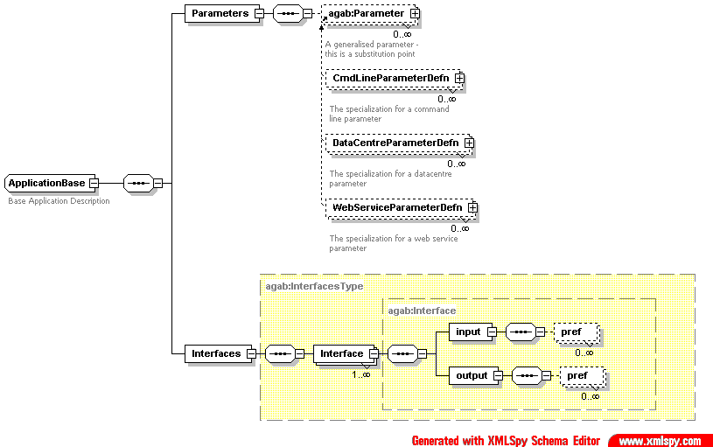
Application Schema

Slide 10
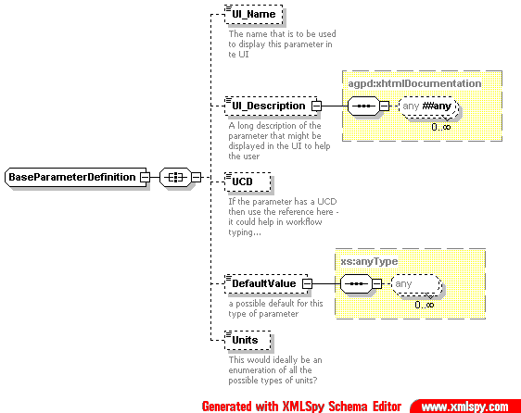
ParameterDefintion

Slide 11
Parameter Value
Simple XML object that has a value subelement with these attributes.
  Type – Descibes the data type
    Integer, VOTable, FITS file etc.
  Transport – Defines how the parameter value is to be accessed
    SOAP message, http get/put, SOAP attachments, ftp/gridftp, MySpace, local filestore

Slide 12
Deployment Scenario
UML Diagram
  Command line applications that are wrapped by specialized CommonExecutionControllers that make a compute farm
  Webservices proxy component that can act as an adapter between a generic web service and the CommonExecutionConnector interface
  Webservices proxy can be localised with a web service so that the results returned can be stored locally thus minimising network traffic

Slide 13
Summary
CEA creates an environment to send messages to and from applications.
Implemented in Itn05 in JES (next talk) and CEC for Command Line applications
See maven page http://www.astrogrid.org/maven/docs/snapshot/applications/

