Slide 1
AuditDoc – AI Powered Document Audit System
Presented by Team(J&K)
1.Javed Hussain(10300323066)
2.Khushi Kumari(10300323068)

Slide 2
INTRODUCTION
Clearly Define the Problem
Organizations handle thousands of documents daily such as invoices, contracts, reports, and financial records.
Most document auditing is still done manually, which is:
Time-consuming
Error-prone
Repetitive
Inconsistent
Manual verification increases operational costs and slows down decision-making.
Whom Does It Affect? (Target Users)
AuditDoc is designed for:
🏢 Businesses and Enterprises
📊 Finance & Accounting Teams
🏛 Compliance and Audit Departments
📄 Document Management Teams
🧑‍💼 Startups handling large digital records
Anyone dealing with high-volume document verification can benefit from automation.
Real-World Relevance
In large organizations, auditing and document verification consume significant employee hours daily. Automating even a portion of this process:
Reduces workload
Improves accuracy
Speeds up operations
Enhances productivity
This creates a strong need for an AI-powered document auditing solution like AuditDoc.

Slide 3
SOLUTION /APPROACH
How AuditDoc Solves the Problem
🔹 Automation Instead of Manual Work
AuditDoc replaces manual document checking with automated analysis, reducing human effort and errors.
🔹 Instant Structured Output
Uploaded documents are processed and converted into structured JSON results within seconds.
🔹 Intelligent Field Extraction
The system extracts important fields (e.g., invoice number, date, amount) automatically.
🔹 Confidence Scoring
Each document is assigned a confidence score to measure reliability of extracted data.
🔹 Clear Visualization
Results are displayed in an interactive dashboard with insights and organized output panels.
Key Features & Functionalities
📄 Document Upload System
⚙ Backend Processing Engine (Flask)
📊 Structured JSON and TXT Output
📈 Confidence Score Display
🎨 Modern React Dashboard UI
🔗 REST API Communication
🧩 Modular & Scalable Architecture
What Makes AuditDoc Unique?
🔹 Full-Stack Integration
Unlike simple document checkers, AuditDoc provides a complete frontend + backend solution.
🔹 Clean & Interactive UI
Most traditional tools focus only on backend processing. AuditDoc combines intelligent logic with a user-friendly dashboard.
🔹 Structured, Developer-Friendly Output
JSON output makes it easy to integrate with other enterprise systems.
🔹 Lightweight & Customizable
Built using Flask and React, making it easy to extend and deploy.

Slide 4
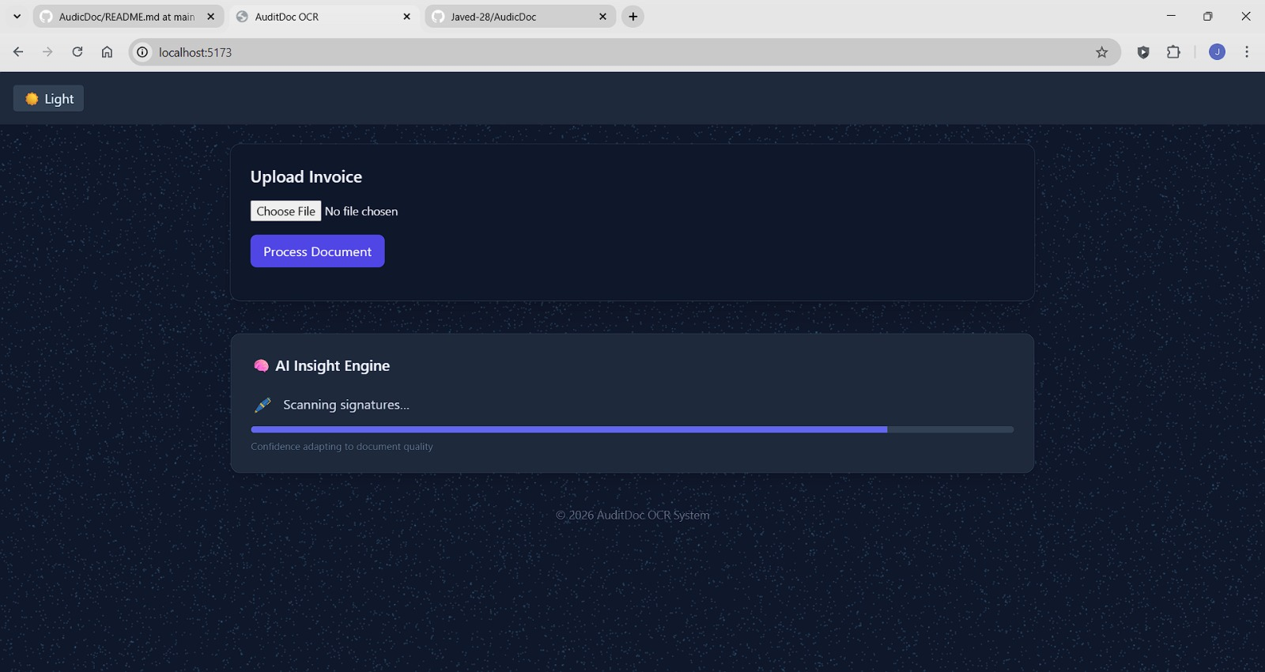
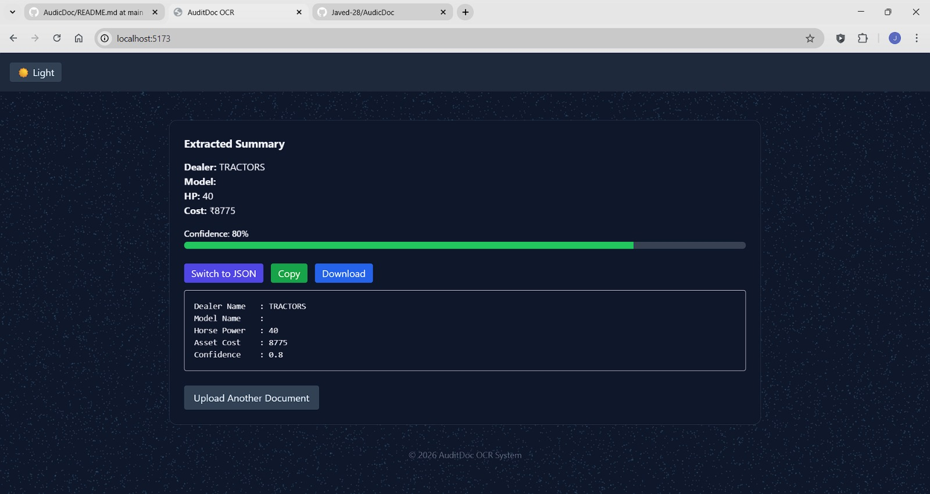

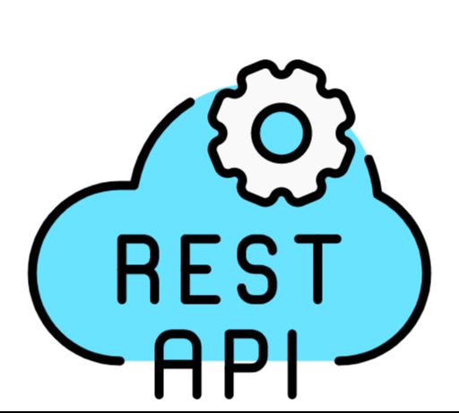






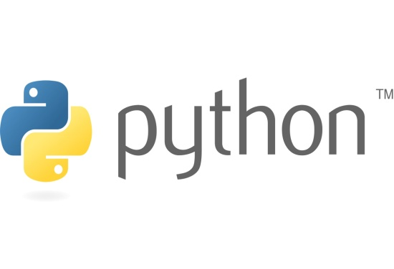
TECHNOLOGY STACK
  Python – The core backend programming language used for processing logic.
  Flask – A lightweight Python web framework used to build REST APIs.
  Tailwind CSS – A utility-first CSS framework used to design a modern and responsive UI
  React – A JavaScript library used to build dynamic and component-based user interfaces.
  Vite – A fast frontend build tool that provides optimized development and production builds.
  .PostCSS – A tool that processes CSS and enhances styling capabilities.
  JavaScript – Used for frontend logic, interactivity, and API communication.
  JSON – A structured data format used to exchange information between frontend and backend.
  REST API – A communication method that allows the frontend and backend to exchange data over HTTP.
  GitHub – A version control system used to manage and track project changes.

Slide 5
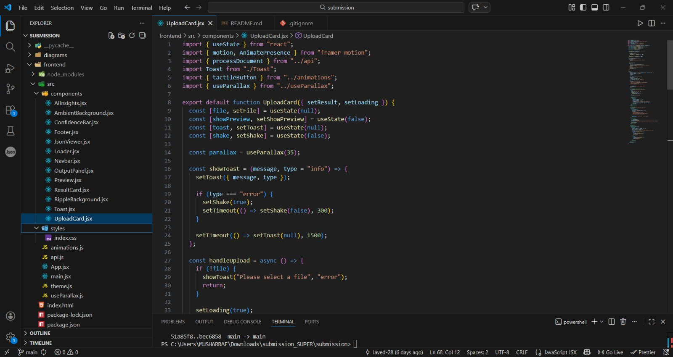
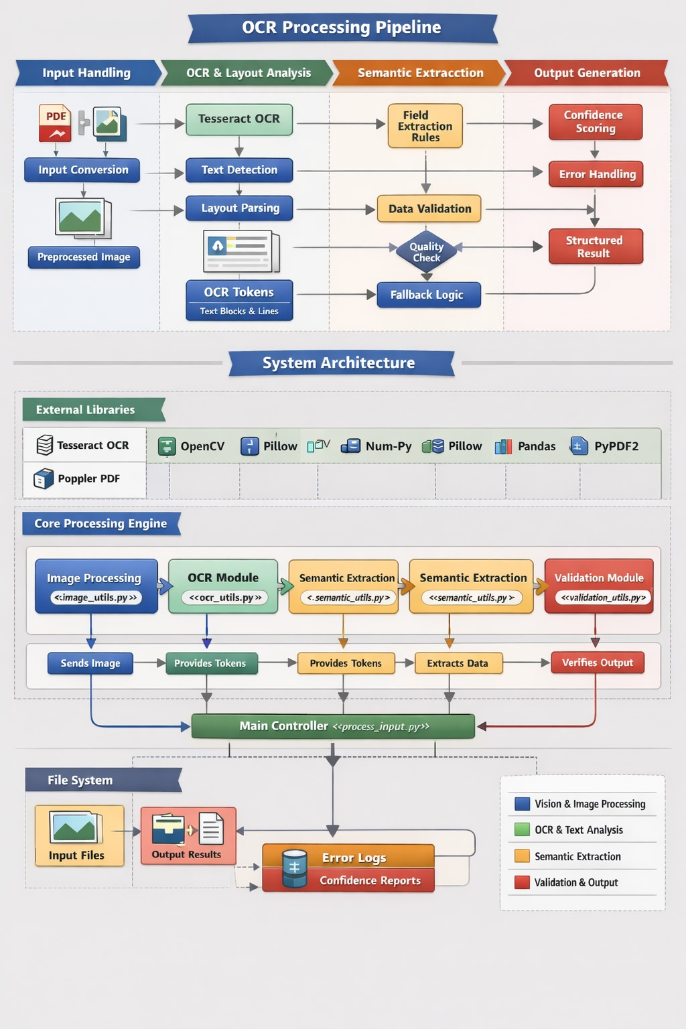
FEASIBILITY/METHODOLOGY
Feasibility of AuditDoc
1. Technical Feasibility
Built using widely used technologies (React, Flask, Python).
No expensive or rare infrastructure required.
REST API architecture makes integration simple.
Can run on a basic local server or cloud platform.
3. Operational Feasibility
Simple user interface.
Minimal training required.
Easily adoptable by finance and audit teams.
Improves workflow efficiency.
4. Scalability Feasibility
Modular frontend-backend architecture.
Can be deployed on cloud infrastructure.
Can support database integration and multi-user systems.
2. Economic Feasibility
Uses open-source tools (React, Flask, Tailwind CSS).
No licensing cost required.
Low development cost.
Can reduce operational cost by automating manual auditing.

Slide 6
CONCLUSION
AuditDoc was developed to address the challenge of manual and time-consuming document auditing.
The project demonstrates how automation can simplify repetitive verification tasks.
By integrating React and Flask, a complete full-stack solution was successfully built.
The system processes documents efficiently and generates structured outputs.
It improves accuracy while reducing human effort.
The interactive dashboard makes results easy to understand.
The architecture is modular and scalable for future enhancements.
This project reflects practical implementation of modern web technologies.
It also highlights problem-solving and system design skills.
Overall, AuditDoc lays a strong foundation for intelligent document automation solutions.

Slide 7
THANK YOU
TEAM (J&K)

