Slide 1
CS174A Lecture 2

Slide 2
Last Lecture Recap
Intro to Computer Graphics
Applications
History
First few animated games, interactivity
Examples of 3D animated movies
Realism
Special effects
Compositing
Cartoons

Slide 3
Last Lecture Recap (contd.)
Areas
Flight simulation
CAD
Modeling with clay
Scientific visualization
Architectural visualization
Information visualization
Art, texture mapping

Slide 4
Last Lecture Recap (contd.)
Elements of CG
Modeling: points, lines, polygons, curves, surfaces, voxels, plant, smoke, cloth
Rendering: 3D scene, lights, point-of-view, shading, visibility, projection
Animation: key-frame, procedural, behavioral, physics-based, motion capture
Interaction: gaming, VR

Slide 5
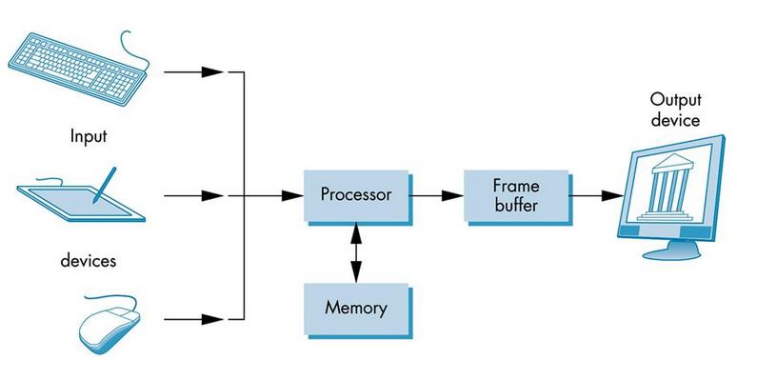
A Basic Graphics System
Input devices
CPU vs. GPU
Computing & rendering system
Output devices

Slide 6
Input Devices
Keyboard
Mouse
Game controller
Tablet & Pen
Other sensors
Data glove
Sound
Gesture
Etc.

Slide 7
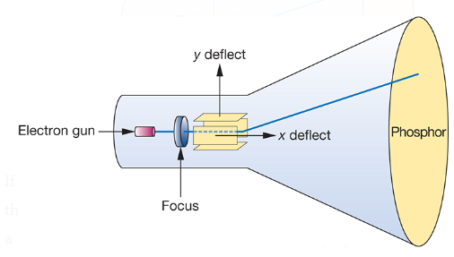
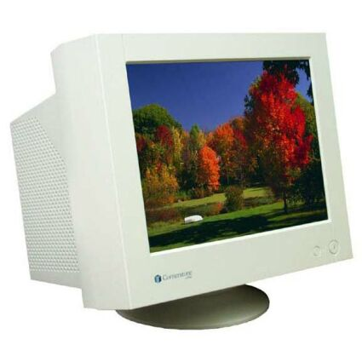
Output Devices
CRT (Cathode Ray Tube)
Electrons strike Phosphor coating and emits light
Direction of beam controlled by deflection plates
Random-scan, calligraphic or vector CRT
Moving beam to new location
Refresh rate: 60 Hz – 85 Hz

Slide 8
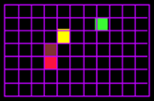
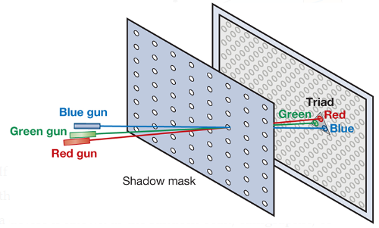
Output Devices (Contd.)
Raster CRTs (n x m phosphor)
Framebuffer
1 bit: 2 levels only, b/w
8 bits: gray scale, 256 gray levels or colors
8 bits per color (RGB) = 24 bits = 16K colors
12 bits per color: HDR
3 different colored Phosphors: triads
Shadow mask
Interlaced vs. Non-Interlaced displays
Interlaced: used in commercial TV
Single vs. double buffering

Slide 9
Output Devices (Contd.)
Screen Resolutions of Raster CRTs (n x m phosphor)
TV: 640x480 pixels
HD: 1920x1080
35mm: 3000x2000

Slide 10
Output Devices (Contd.)
Memory Time & Space Requirements
Screen resolution = n x m
Refresh rate = r Hz
Interlaced vs. non-interlaced
Color depth = b bits/pixel
If non-interlaced, memory read time = 1 / (n * m * r) secs
If interlaced, memory read time = 2 / (n * m * r) secs
Memory space per second = (n * m * b * r) / 8 bytes

Slide 11
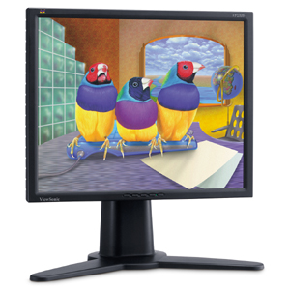
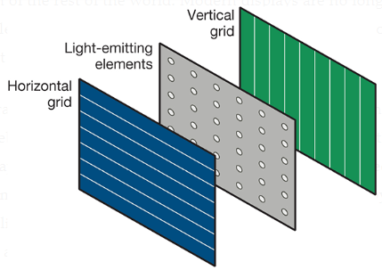
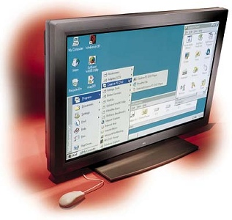
Output Devices (Contd.)
Flat Screen Displays
Raster based: active matrix with transistors at grid points
LEDs: light emitting diodes
LCDs: polarization of liquid crystals
Plasma: energize gases to glow plasma

Slide 12
Output Devices (Contd.)
Other Output Devices
Printers & Plotters: raster based, no refresh
Stereo Displays: 3D TVs/movies, fast switching of left and right eye polarized images

Slide 13
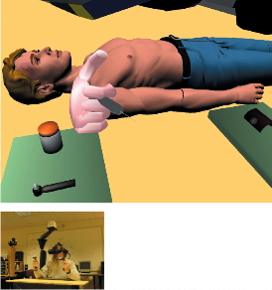
Output Devices (Contd.)
VR (Virtual Reality)
Flat panel technology
Stereoscopic
Foveated Rendering: hi-res where viewer is focusing, lo-res elsewhere
Track body, finger, and head locations
Other input devices: force sensing gloves, sound

Slide 14
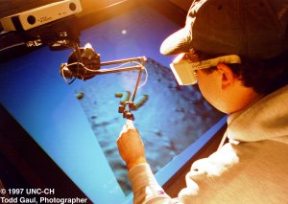
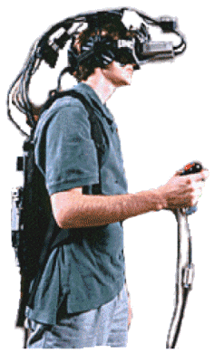
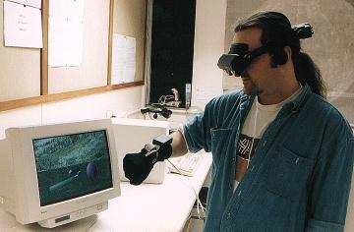
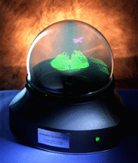
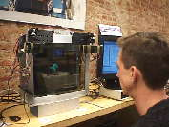
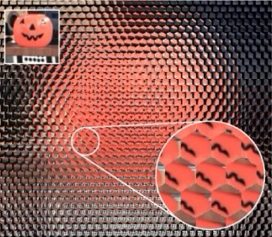
Exotic Display Devices
Head-Mounted
Immersive
Holographic
Autostereoscopic
Volumetric

Slide 15
SIGGRAPH 2018 Research Trailers
May 2018:
https://www.youtube.com/watch?v=t952yS8tcg8
November 2018:
https://www.youtube.com/watch?v=wdKpXvF_3AU

Slide 16
SIGGRAPH 2017 Research Trailers
May 2017:
https://www.youtube.com/watch?v=3OGKh_9Rj_8
November 2017:
https://www.youtube.com/watch?v=5YvIHREdVX4

Slide 17
One Example of today’s industry “hacks”
https://www.youtube.com/watch?v=ct3vWWl86f8
Tools packaged with production software suites
Video does not claim to use any math that converges to real-life physics formulas
Approximation is not convergence!

Slide 18
The Difficulties of Learning Computer Graphics
(And teaching it!)

Slide 19
Background
Most of today’s approaches to creating a low-level, math-based graphics program come with a substantial learning curve
Numerous complex steps
In terms of preparation and learning, it is costly to build prototypes using low-level 3D graphics programs today

Slide 20
Background
A common alternative is to:
Forgo low-level control
Employ overpowered industrial tools to wrap basic graphics functionality
Simple mathematics of projecting 3D triangles onto a 2D plane of pixels

Slide 21
Background
Graphics beginners are faced with long lists of setup steps
Especially in the case of newer "shader-based" approaches
These approaches are both more complex and harder to learn

Slide 22
Background
The graphics learning curve is extreme
Drawing just a single triangle requires:
Secondary "shader" programs
Multiple types of GPU memory management
At least three computer languages (in the case of WebGL)

Slide 23
WARNING
Graphics tutorials online abound that still use outdated “pre-shader” coding paradigms
They're alluring due to their simplicity
However, support for their older commands has been:
Removed from new graphics cards
Never existed in web browser implementations
Eventually it dawns on newcomers that they must commit to learning the new way

Slide 24
Background
Mandatory setup steps initialize the graphics card (GPU):
Give it the shader program code
Give it raw data buffers pertinent to the 3D scene
Obtain pointers to these in GPU memory

Slide 25
Background
Even after setup:
All the subsequent shape-drawing actions of the programmer are still cluttered with boilerplate code
Loading and switching between pointers to the GPU
Nothing is drawn without these steps; there is no built-in way to organize them

Slide 26
Background
Common graphics card interfaces exposed for doing the above steps are called:
DirectX
OpenGL
More widely available and more prevalent in education

Slide 27
Background
Regardless, graphics methods all follow a similar pattern
The phrase ``OpenGL program'' is widely taken to imply C++ due to the ubiquity of the language in early graphics education, but it need not be:
Python, Java, and JavaScript can make the same OpenGL calls

Slide 28
Background
C++
Python
JavaScript
Java
3D Graphics programming in one language feels familiar in all the others

Slide 29
Background
JavaScript is currently the only means of running code on browsers inside of web pages
When JavaScript is used, the OpenGL commands are called WebGL
They are still the same API function calls as would appear in C++

Slide 30
Your Textbook
Edward Angel’s “Interactive Computer Graphics...with WebGL” is the leading gentle introduction for those wanting to do graphics programming
Used at:
UCLA and other schools
SIGGRAPH’s official intro course
Has supplemental code and links to demos that run on the web
Chapter 2 is a suggested organization of WebGL programs
hello world
Other web tutorials share program structure

Slide 31
Edward Angel's The Case for Teaching Computer Graphics with WebGL: A 25-Year Perspective
Described his rationale for eventually moving his helpful C++ based libraries over to WebGL
Worsening learning curve of C++ graphics setup
Difficulty in setting up uniform C++ compiling environments for all students
Your all’s inconsistent hardware

Slide 32
Edward Angel's The Case for Teaching Computer Graphics with WebGL: A 25-Year Perspective
He found that WebGL has:
Comparable performance to C++
The advantages of a standardized environment on all platforms (including phones)
An interpreted code engine that aids development
Advanced coding tools built right into modern web browsers

Slide 33
Sounds good
WebGL is the current best platform for graphics training
Code examples on the web are more easily:
Run as demos
Analysed
Packaged with inline tutorials
Compiled to any machine
Debugged
Hosted
Shared
Remixed

Slide 34
JavaScript
JavaScript's functional programming styles
Specific graphics applications
Also tend toward smaller total source code

Slide 35
JavaScript
We make full use of the 2015 “es6” version of JavaScript
Adds further brevity and power to the language
Be sure to include “es6” in all Google searches!!
Performance workarounds such as WebAssembly and Emscripten can run at near native speeds
JavaScript's benefits for prototyping and sharing code on the web are clear

Slide 36
Example sites that allow graphics programming right inside the browser
JSFiddle
Dwitter
WebGL Playground
Shadertoy
The 174a web server

Slide 37
The Textbook’s web demos
https://www.cs.unm.edu/~angel/WebGL/7E/Common/

Slide 38
Linear Algebra Review

Slide 39
Linear Algebra: The Algebra of Vectors and Matrices (and Scalars)
Vector spaces
Matrix algebra
Coordinate systems
Affine transformations

Slide 40
Vectors
N-tuple of scalar elements
Vector:
Bold lower-case
Scalar:
Italic lower-case
Notes:
\documentclass{slides}\pagestyle{empty}
\begin{document}
\begin{eqnarray*}
& & {\bf v} = (x_1,x_2,\dots,x_n), \;\; x_i \in \Re \\
\end{eqnarray*}
\end{document}

Slide 41
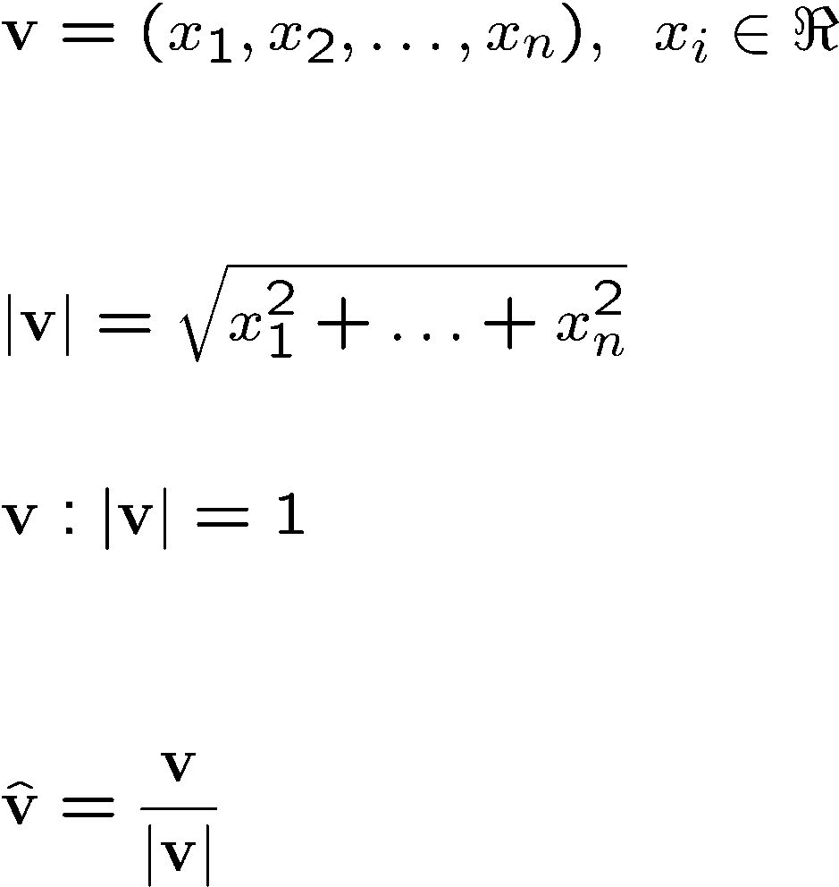
Vectors
N-tuple:
Magnitude:
Unit vectors
Normalizing a vector
Notes:
\documentclass{slides}\pagestyle{empty}
\begin{document}
\begin{eqnarray*}
& & {\bf v} = (x_1,x_2,\dots,x_n), \;\; x_i \in \Re \\
~\\
~\\
& & |{\bf v}| = \sqrt{x_1^2+\dots+ x_n^2}
~\\
~\\
& & {\bf v}: |{\bf v}| =1 \\
~\\
~\\
& & \hat{\bf v} = \frac{\bf v} {|{\bf v}|}
\end{eqnarray*}
\end{document}

Slide 42
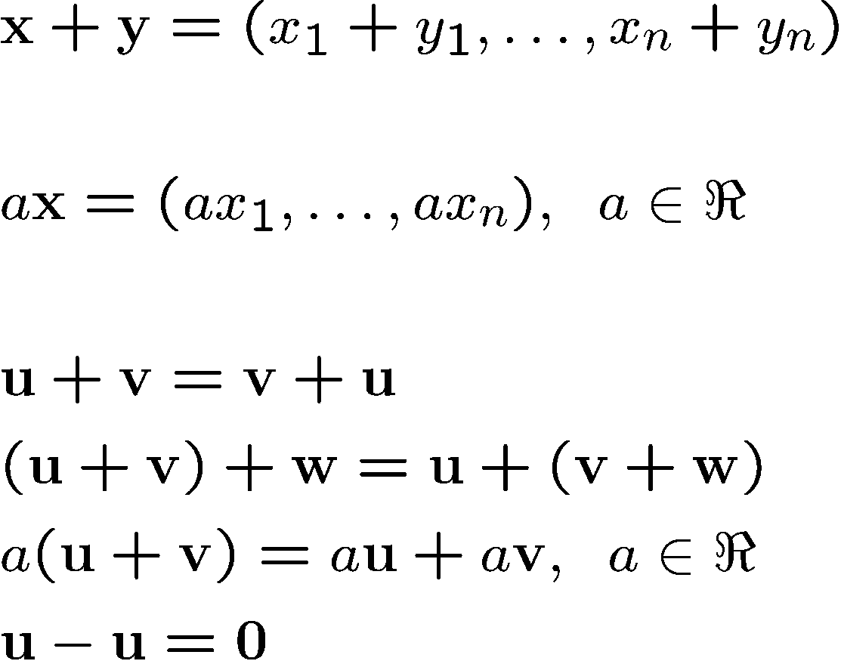
Operations with Vectors
Addition
Multiplication with scalar (scaling)
Properties
Notes:
\documentclass{slides}\pagestyle{empty}
\begin{document}
\begin{eqnarray*}
& &{\bf x}+{\bf y} = (x_1+y_1,\dots, x_n+y_n) \\
~\\
& & a{\bf x} = (ax_1,\dots, ax_n), \;\; a \in \Re \\
~\\
& & {\bf u} + {\bf v} = {\bf v}+{\bf u} \\
& & ({\bf u} + {\bf v}) + {\bf w} = {\bf u} + ({\bf v} + {\bf w}) \\
& & a({\bf u} + {\bf v}) = a{\bf u} + a{\bf v}, \;\; a \in \Re \\
& & {\bf u} - {\bf u} = {\bf 0}
\end{eqnarray*}
\end{document}

Slide 43
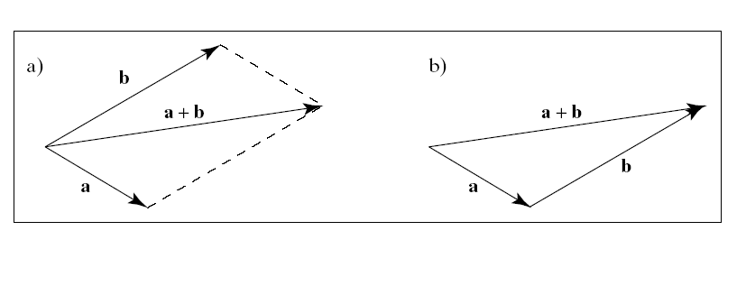
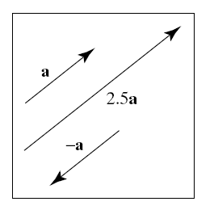
Visualization of 2D and 3D Vectors
Addition
Scaling

Slide 44
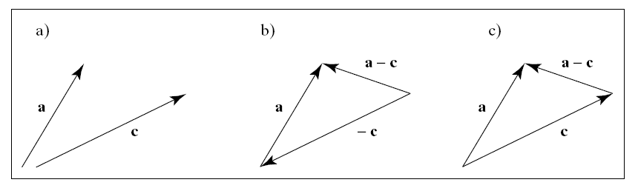
Subtraction
Adding the negatively scaled vector

Slide 45
Linear Combination of Vectors
Definition
A linear combination of the m vectors v₁,…,v_{m} is a vector of the form:
w = a₁v₁ +…+ a_{m}v_{m}, a₁,…,a_{m} in R

Slide 46
Special Cases
Linear combination
w = a₁v₁+…a_{m}v_{m}, a₁,…,a_{m} in R
Affine combination:
A linear combination for which a₁+…+a_{m}=1
Convex combination
An affine combination for which a_{i}≥0 for i=1,…,m

Slide 47
Linear Independence
For vectors v₁,…,v_{m}
If a₁v₁+…+a_{m}v_{m}=0 iff a₁=a₂=…=a_{m}=0
then the vectors are linearly independent

