Slide 1
CS174A Lecture 3

Slide 2
Announcements & Reminders
Project assignment #1 due by Sunday midnight (10/6/19)
Project #2 will be discussed during tomorrow’s TA session
Start forming your project teams (team size: 3-4)
Remember: project expectations scale with team size
Project proposals & teams due by 10/29/19, final proposals due by 11/5/19
I regularly update syllabus, make sure you’re using the latest one
Google form in Piazza: https://forms.gle/Yne8PYVbfGp2vj6j9
My post-lecture office location
PTE numbers

Slide 3
Last Lecture Recap
A Basic Graphics System
Input devices: keyboard, mouse, tablet, touchscreens
CPU/GPU
Frame Buffer: resolution, single vs. double buffering, color depth, interlaced vs. non-interlaced, refresh rate
Output devices: CRT (random-scan & raster), flat-panel (LED, LCD, Plasma), printers, plotters, head-mounted devices, stereo displays
Linear Algebra
Vectors: magnitude, unit vector, normalizing, addition, multiplication, properties
Linear combination of vectors: affine, convex, linear independence

Slide 4
Next Up
Finish up vectors: basis vectors, dot product, cross product
Matrices: square, zero, identity, symmetric, matrix operations
Coordinate systems
Homogeneous representations of points and vectors
Representing shapes: lines, circles
Transformations: translation, scaling, rotation, shear

Slide 5
Generators and Base Vectors
How many vectors are needed to generate a vector space?
Any set of vectors that generate a vector space is called a generator set
Given a vector space R^{n} we can prove that we need minimum n vectors to generate all vectors v in R^{n}
A generator set with minimum size is called a basis for the given vector space

Slide 6
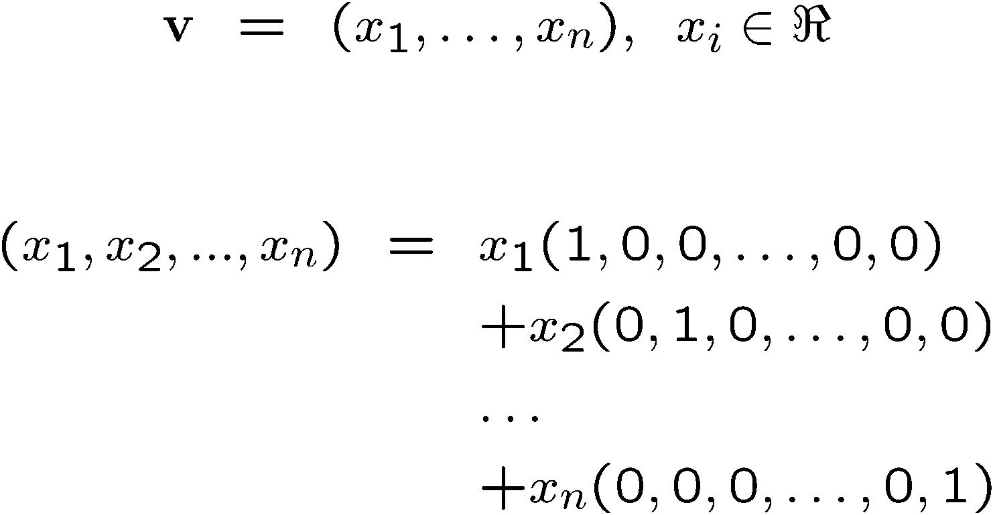
Standard Unit Vectors
Notes:
\documentclass{slides}\pagestyle{empty}
\begin{document}
\begin{eqnarray*}
{\bf v} & = & (x_1,x_2,\dots,x_n),\;\; x_i \in \Re \\
\end{eqnarray*}
\begin{eqnarray*}
(x_1,...,x_n) & = & x_1(1,0,0,\dots,0,0) \\
& & +x_2(0,1,0,\dots,0,0)\\
& & \dots \\
& & +x_n(0,0,0,\dots,0,1)\\
\end{eqnarray*}
\end{document}

Slide 7
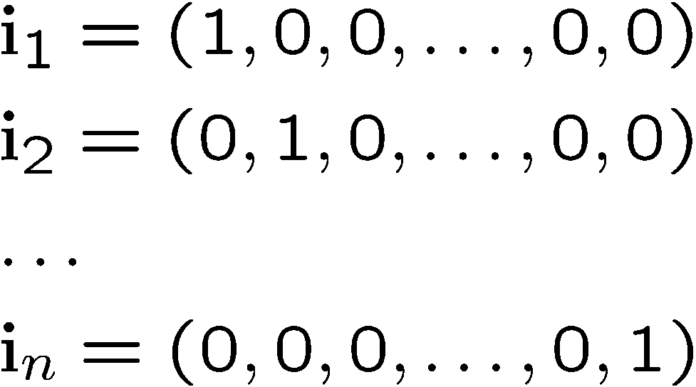
Standard Unit Vectors
For any vector space R^{n}:
The elements of a vector v in R^{n} are the scalar coefficients of the linear combination of the basis vectors
Notes:
\documentclass{slides}\pagestyle{empty}
\begin{document}
\begin{eqnarray*}
& & {\bf i}_1 = (1,0,0,\dots,0,0) \\
& & {\bf i}_2= (0,1,0,\dots,0,0)\\
& & \dots \\
& & {\bf i}_n= (0,0,0,\dots,0,1)\\
\end{eqnarray*}
\end{document}

Slide 8
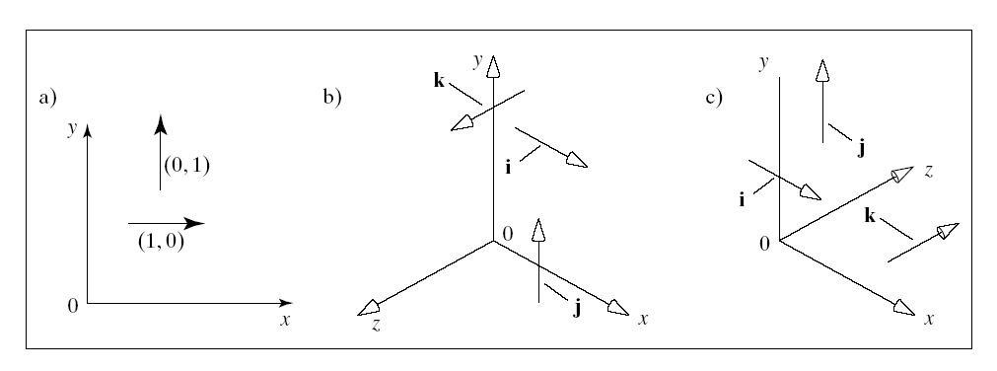
Standard Unit Vectors in 2D & 3D
i = (1,0)
j = (0,1)
i = (1,0,0)
j = (0,1,0)
k = (0,0,1)
Right handed
Left handed

Slide 9
Representation of Vectors Through Basis Vectors
Given a vector space R^{n},
a set of basis vectors B {b_{i} in R^{n}, i=1,…n} and
a vector v in R^{n}
we can always find scalar coefficients such that:
v = a₁b₁+…+a_{n}b_{n}
So, vector v expressed with respect to B is:
v_{B} = (a₁,…,a_{n})
Notes:
By definition of what a basis is.

Slide 10
Dot Products in Graphics
The problem dot products solve in graphics:
Dot with a vector of coefficients. Now you have a linear function that maps a point onto a scalar
3x + 4y + 5z = ?
Predictable effect as you adjust a coordinate

Slide 11
Dot Products and Matrices
What if we want a function that produces not a scalar, but a new point?
This would become a tool for moving points somewhere new!
How do we generate three scalar outputs instead of one?

Slide 12
Dot Products in Graphics
Another problem dot products solve: Comparing Vectors
Trig measurements!

Slide 13
Dot Product and Perpendicularity
From Property 5:
a · b > 0
a · b = 0
a · b < 0

Slide 14
Perpendicular Vectors
Definition
Vectors a and b are perpendicular iff a·b=0
Also called “normal” or “orthogonal” vectors
It is easy to see that the standard unit vectors form an orthogonal basis:
I∙j=0, j∙k=0, I∙k=0

Slide 15
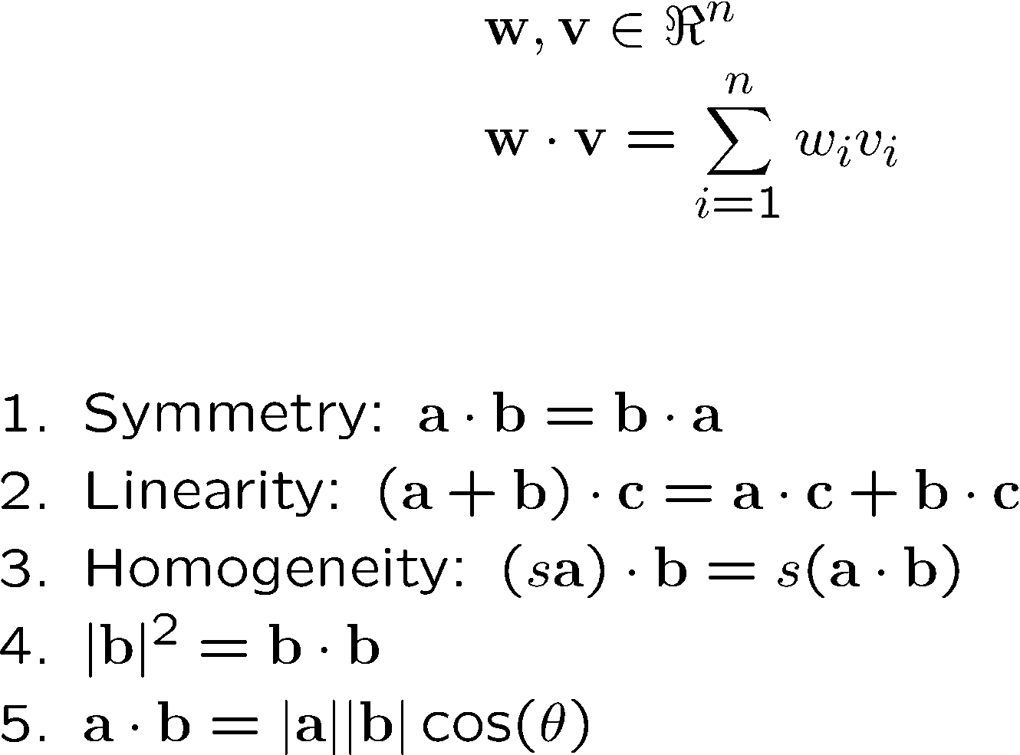
Dot (Scalar) Product
Definition:
Properties
Notes:
\documentclass{slides}\pagestyle{empty}
\begin{document}
\begin{eqnarray*}
& & {\bf w},{\bf v} \in \Re^n \\
& & {\bf w \cdot v} = \sum^n_{i=1} w_iv_i
~\\
~\\
\end{eqnarray*}
Summetry: ${\bf a \cdot b} = {\bf b \cdot a}$ \\
Linearity: ${(\bf a + b) \cdot c} = {\bf a \cdot c} + {\bf b \cdot c}$\\
Homogeneity: $(s{\bf a) \cdot b} = s ({\bf a \cdot b})$ \\
$|{\bf b}|^2 = {\bf b \cdot b}$
\end{document}

Slide 16
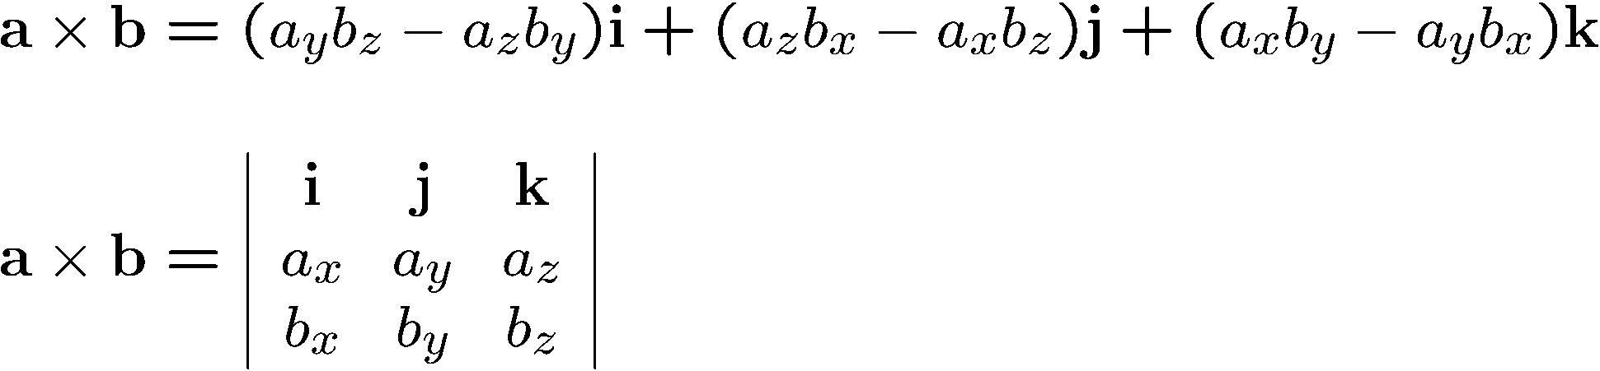
Cross (Vector) Product
Defined only for 3D vectors and with respect to the standard unit vectors
Definition
Notes:
\documentclass{slides}\pagestyle{empty}
\begin{document}
\begin{eqnarray*}
& & {\bf a} \times {\bf b} = (a_yb_z - a_zb_y) {\bf i} +
(a_zb_x - a_xb_z) {\bf j} +
(a_xb_y - a_yb_x) {\bf k} \\
~\\
& & {\bf a} \times {\bf b} =
\left|
\begin{array}{ccc}
{\bf i} & {\bf j} & {\bf k} \\
a_x & a_y & a_z \\
b_x & b_y & b_z \\
\end{array} \right|
\end{eqnarray*}
\end{document}

Slide 17
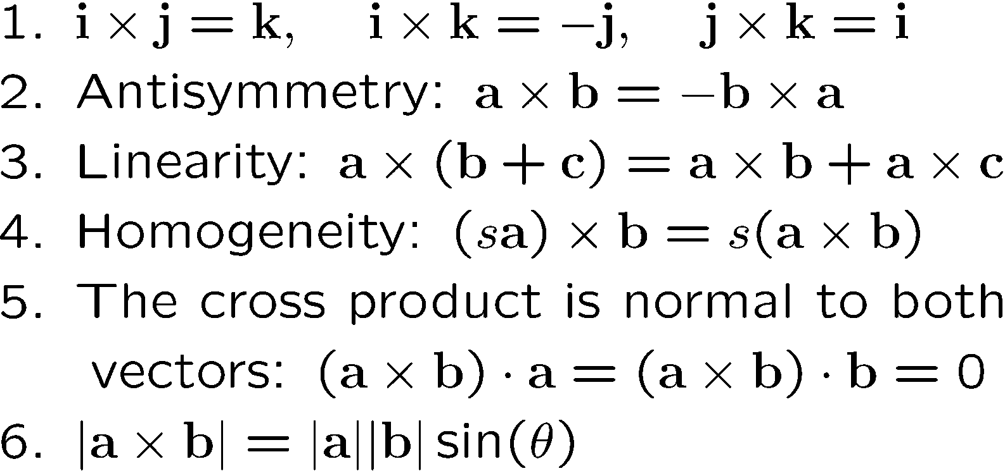
Properties of the Cross Product
Notes:
\documentclass{slides}\pagestyle{empty}
\begin{document}
1. ${\bf i} \times {\bf j} = {\bf k}, {\bf i} \times {\bf j}
= {\bf k}, {\bf i} \times {\bf j} = {\bf k}.$ \\
2. Antisymmetry: $ {\bf a} \times {\bf b} = -{\bf b} \times {\bf a}$.\\
3. Linearity: $ {\bf a} \times ({\bf b} + {\bf c}) =
{\bf a} \times {\bf b} + {\bf a} \times {\bf c}$.\\
4. Homogeneity: $(s{\bf a}) \times {\bf b} = s({\bf a} \times {\bf b})$.\\
5. The cross product is normal to both vectors:
$({\bf a} \times {\bf b}) \cdot {\bf a} = 0$ and
$({\bf a} \times {\bf b}) \cdot {\bf b} = 0$. \\
6. ${\bf a} \times {\bf b} = |{\bf a}||{\bf b}|sin(\theta)$.
\end{document}

Slide 18
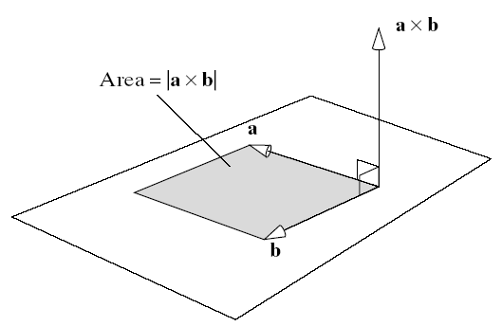
Geometric Interpretation of the Cross Product

Slide 19
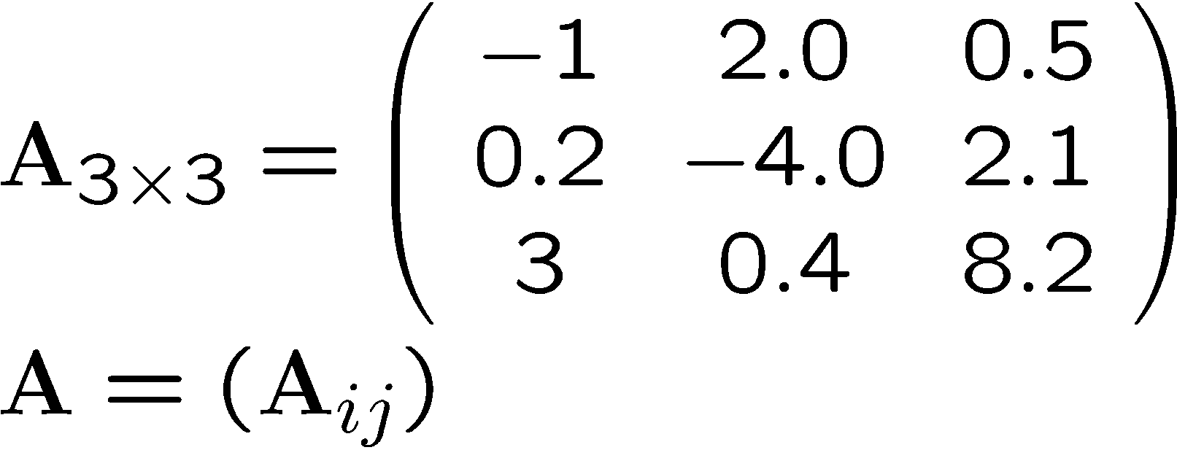
Matrices
Rectangular arrangement of scalar elements
Matrix:
Bold upper-case
Notes:
\documentclass{slides}\pagestyle{empty}
\begin{document}
\[ A_{3 \times 3} = \left ( \begin{array}{ccc}
-1 & 2.0 & 0.5 \\
0.2 & -4.0 & 2.1 \\
3 & 0.4 & 8.2 \\
\end{array} \right)
\]
\end{document}

Slide 20
Special Square (n x n) Matrices
Zero matrix: A_{ij} = 0 for all i,j
I_{ii} = 1 for all i
Identity matrix: I_{n} =
I_{ij} = 0 for i ≠ j
Symmetric matrix: (A_{ij} ) = (A_{ji} )

Slide 21
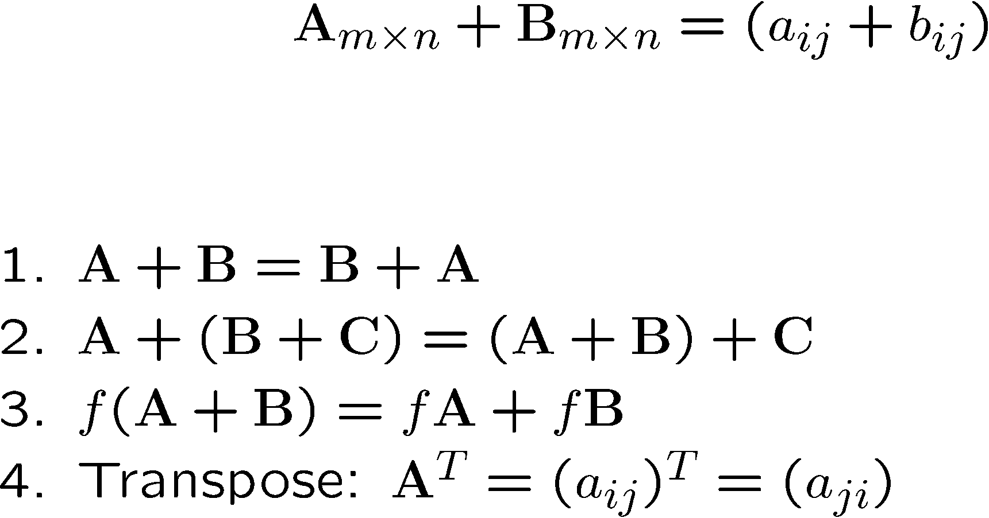
Operations with Matrices
Addition:
Properties:
Notes:
\documentclass{slides}\pagestyle{empty}
\begin{document}
\begin{eqnarray*}
& & A_{m \times n} + B_{m \times n} = (a_{ij} + b_{ij})
\end{eqnarray*}
~\\
~\\
1. $A+B = B + A$.\\
2. $A + (B+C) = (A+B) + C$.\\
3. $f(A+B) = fA+fB$.\\
4. Transpose: $A^T = (a_{ij})^T=(a_{ji})$.
\end{document}

Slide 22
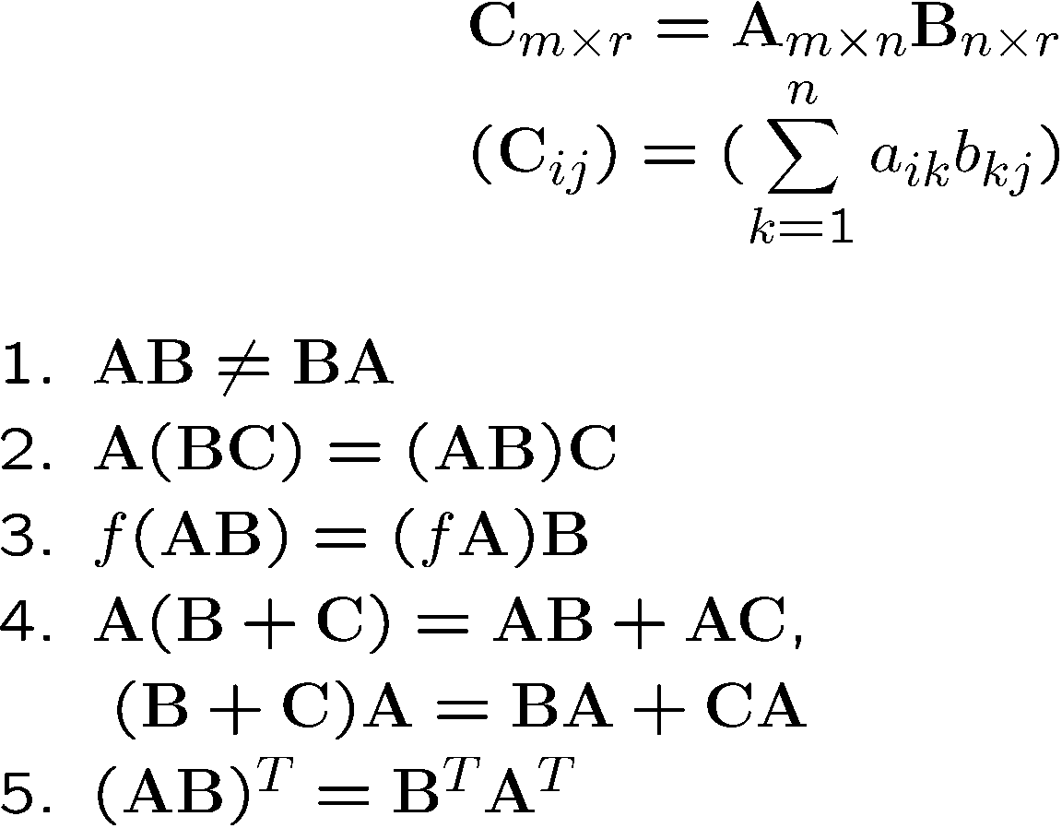
Multiplication
Definition:
Properties:
Notes:
\documentclass{slides}\pagestyle{empty}
\begin{document}
\begin{eqnarray*}
& & C_{m \times l} = A_{m \times n} B_{n \times r} \\
& & (C_{ij}) = (\sum_k^n a_{ik}b_{kj})\\
\end{eqnarray*}
1. $AB \neq BA$.\\
2. $A (BC) = (AB)C$.\\
3. $f(AB) = (fA)B$.\\
4. $A(B+C) = AB+AC$, \\
$(B+C)A = BA+CA$.\\
5. $(AB)^T = B^TA^T$.
\end{document}

Slide 23
Inverse of a Square Matrix
Definition
MM⁻¹ = M⁻¹M = I
Important property
(AB)⁻¹= B⁻¹ A⁻¹

Slide 24
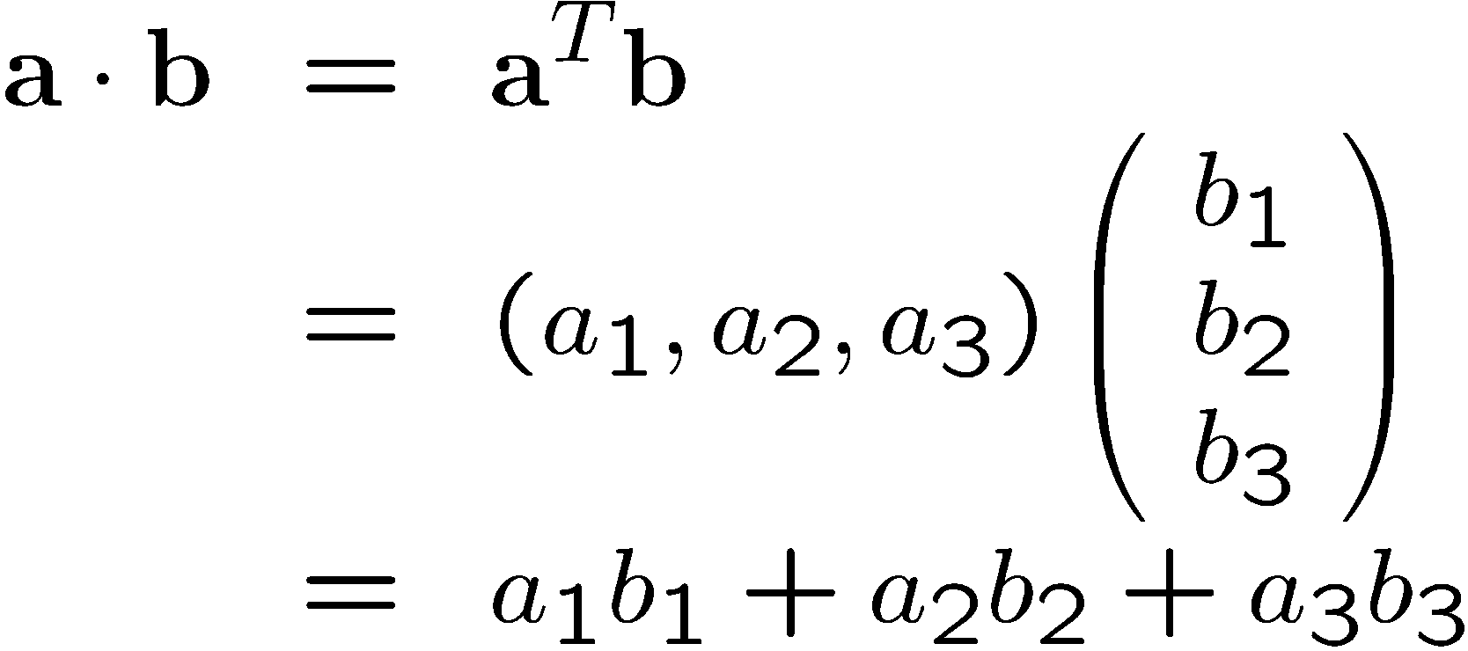
Dot Product as a Matrix Multiplication
Representing vectors as column matrices:

