Slide 1
CS174A Lecture 4

Slide 2
SIGGRAPH trailers from 2016
Going backwards,
https://www.youtube.com/watch?v=l1KO-lnHfps
And
https://www.youtube.com/watch?v=dQBJ0r5Pj5s

Slide 3
Today on https://www.dwitter.net/
Today on https://www.shadertoy.com/slideshow

Slide 4
Announcements & Reminders
Project #2 due on Sunday 10/20/19 midnight
PTE numbers
Team project info posted on Piazza

Slide 5
Team Project
General Info
Team sizes: 3-6
Expectations scale with size, e.g., for teams of >2, we expect advanced graphics like shadows, reflections, physics, picking, scene graphs, etc.
For example, 3 members = 1 advanced feature, 4 members = 2, 5 members = 3, etc.
Project must include basic topics of course at least through end-October; it should have interactive graphics
You can use tinygraphics, but no external libraries or frameworks are allowed
Projects assignments 1-4 should provide you the background needed for your project
Project discussions will occur during Friday TA sessions

Slide 6
Team Project
Due Dates
10/29/19: first draft of project proposals and team members
11/05/19: final version of project proposals
12/01/19: team projects due
12/03/19 and 12/05/19: project presentations in regular class
Grading (total: 600 points)
Instructor: 200 points
TAs: 200 points (100 points each TA)
Team: 100 points
Class: 100 points

Slide 7
Last Lecture Recap
Primitives: points, vectors
Vectors
Basis vectors
Dot and cross products
Coordinate Systems
LH CS, RH CS
Matrices
Square, zero, identity, symmetric, matrix operations, matrix properties
Homogeneous Representation of Points & Vectors

Slide 8
Next Up
Transformations: translation, scaling, rotation, shear
Shapes: lines, circles, polygons (triangles), polyhedrons
Spaces:
Model space
Object/world space
Eye/camera space
Screen space

Slide 9
Points vs Vectors
What is the difference?
Points have location, but no size or direction
Vectors have size and direction, but no location
Problem: We represent both as 3-tuples

Slide 10
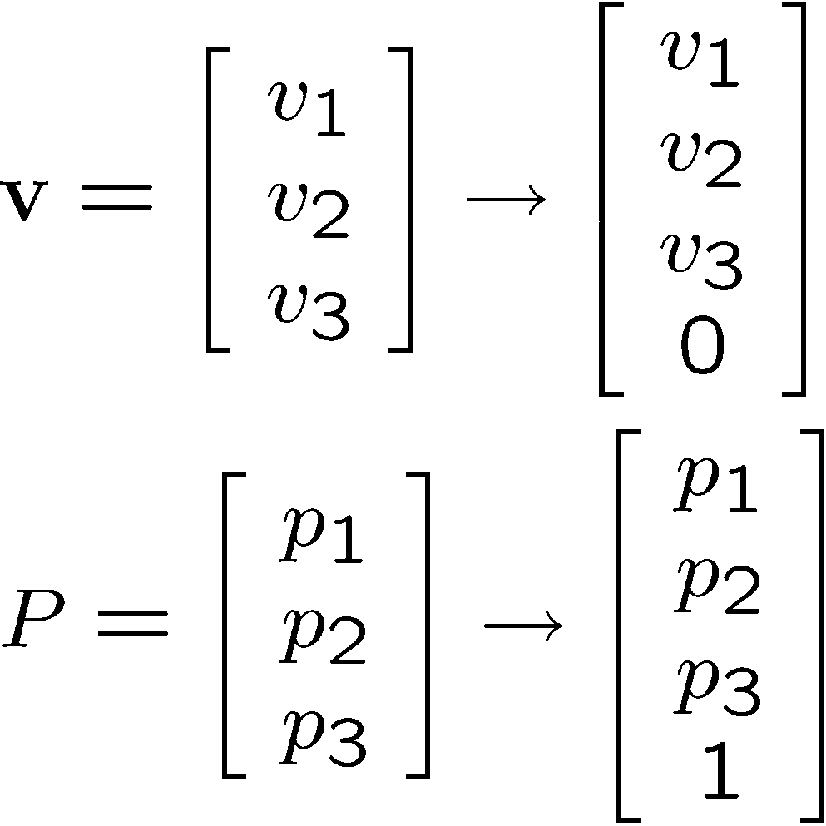
Homogeneous Representation
Convention: Vectors and Points are represented as 4x1 column matrices, as follows:

Slide 11
Switching Representations
Normal to homogeneous:
Vector: append as fourth coordinate 0
Point: append as fourth coordinate 1

Slide 12
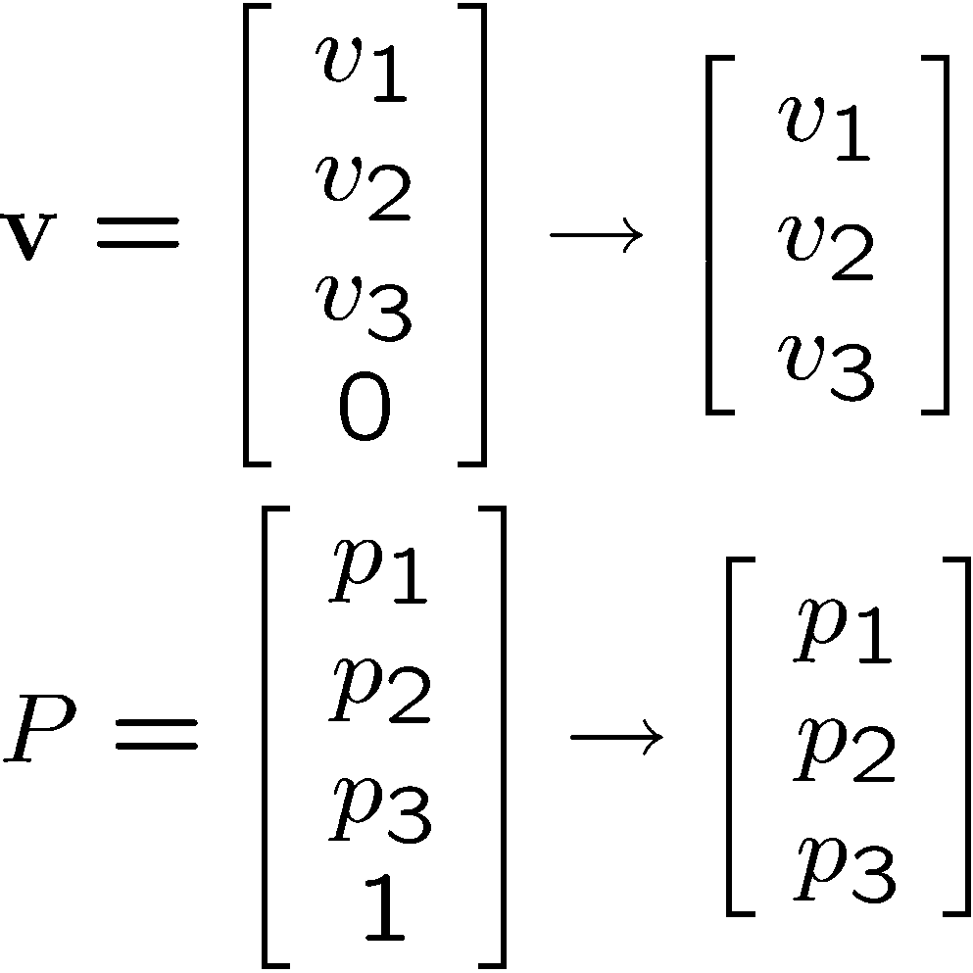
Switching Representations
Homogeneous to normal:
Vector: remove fourth coordinate (0)
Point: remove fourth coordinate (1)

Slide 13
Relationship Between Points and Vectors
A difference between two points is a vector:
Q – P = v
We can consider a point as a base point plus a vector offset:
Q = P + v
Q
P
v

Slide 14
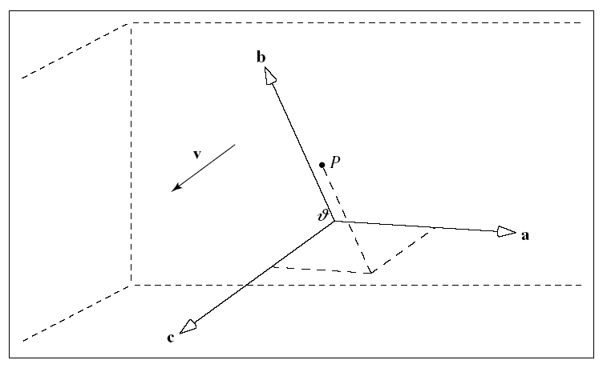

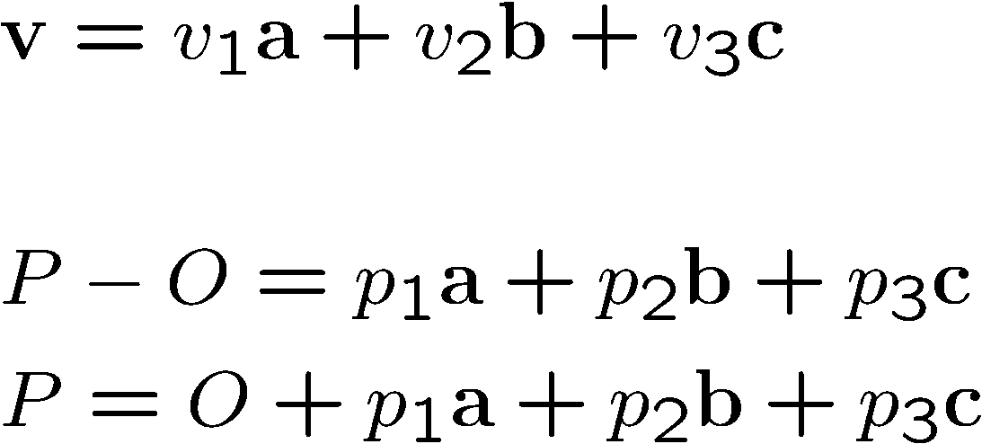
Coordinate Systems
Defined by: a,b,c,O

Slide 15
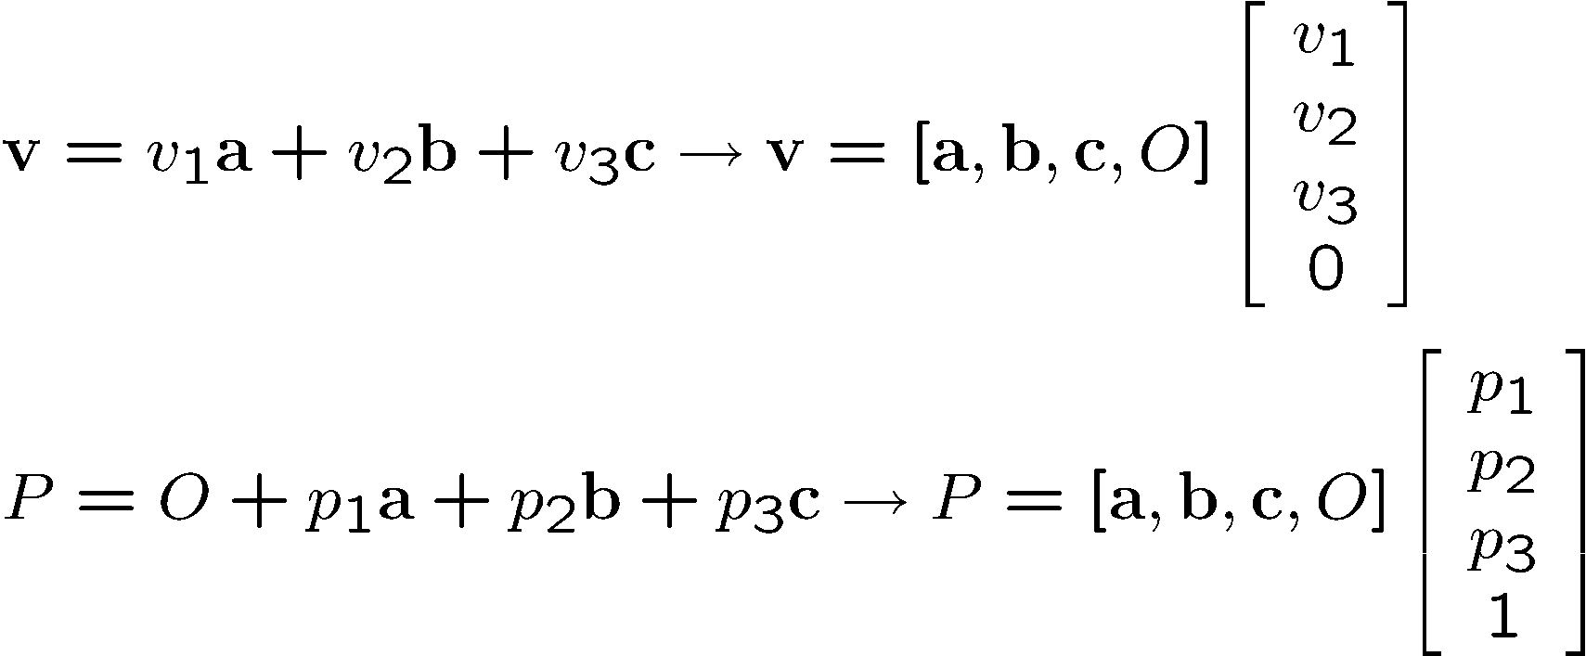

Homogeneous Representation of Points and Vectors

Slide 16
Does the Homogeneous Representation Support Operations?
Operations :
v + w = [v₁,v₂,v₃,0]^{T} + [w₁,w₂,w₃,0]^{T} = [v₁ + w₁, v₂ + w₂, v₃ + w₃, 0]^{T} Vector
av = a[v₁,v₂,v₃,0]^{T} = [av₁, av₂, av₃, 0]^{T} Vector
av + bw = a[v₁,v₂,v₃,0]^{T} + b[w₁,w₂,w₃,0]^{T} = [av₁ + bw₁, av₂ + bw₂, av₃ + bw₃, 0]^{T} Vector
P + v = [p₁, p₂, p₃, 1]^{T} + [v₁, v₂, v₃, 0]^{T} = [p₁ + v₁, p₂ + v₂, p₃ + v₃, 1]^{T} Point
P – Q = [p₁,p₂,p₃,1]^{T} – [q₁,q₂,q₃,1]^{T} = [p₁ – q₁, p₂ – q₂, p₃ – q₃, 0]^{T} Vector

Slide 17
Linear Combination of Points
Points P, Q scalars a, b:
aP + bQ = a [p₁, p₂, p₃,1]^{T} + b[q₁, q₂, q₃,1]^{T} = [ap₁+bq₁, ap₂+bq₂, ap₃+bq₃, a+b]^{T}
What is this?

Slide 18
Linear Combination of Points
Points P, Q scalars a, b:
aP + bQ = a [p₁, p₂, p₃,1]^{T} + b[q₁, q₂, q₃,1]^{T} = [ap₁+bq₁, ap₂+bq₂, ap₃+bq₃, a+b]^{T}
What is it?
If (a + b) = 0 then vector!
If (a + b) = 1 then point!
Otherwise, ??

Slide 19
Affine Combinations of Points
Definition:
n points P_{i}: i = 1,…,n
n scalars a_{i}: i = 1,…,n
a₁P₁+ … + a_{n}P_{n} iff a₁+ …+a_{n} = 1
Example (n = 2): 0.5P₁ + 0.5P₂
Example (n = 2): (1-s)P₁ + sP₂
Example (n = 3): (1-s-t)P₁ + sP₂ + tP₃

Slide 20
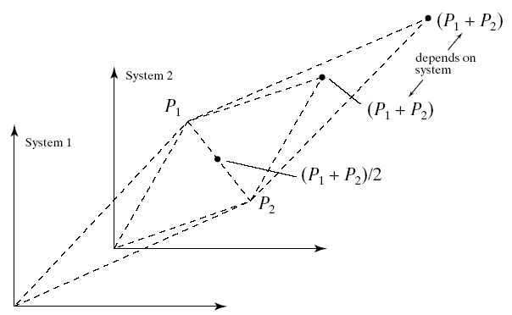
Geometric Interpretation

Slide 21
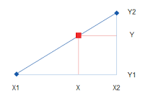
Exercise:
List some points along a line from one point to another - This process is called convex interpolation

Slide 22
Linear interpolation (2 points)
The formula to do that is quite short:
p_{interpolated} = (1-a) * p₁ + a * p₂
It’s only an interpolation (and called “convex”) if 0<=a<=1
Otherwise it's an extrapolation
You’ll be seeing that equation a lot

Slide 23
Linear interpolation (2 points)
The formula to do that is quite short:
p_{interpolated} = (1-a) * p₁ + a * p₂
Let (a) vary from 0 to 1 in steps - this is a parametric equation.
Or we could imagine a parameter time (t) rather than (a) -- at each time t between 0 sec and 1 sec we reach a different point on the line segment. Now it’s animated.

Slide 24
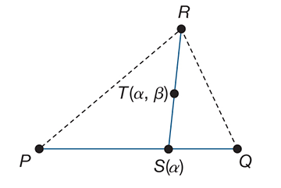
Linear interpolation (3 points = plane)
Interpolation between 3 points
S(a) = (1-a) * P + a * Q
T(a,b) = (1-b) * S + b * R
T(a,b) = (1-b) * [(1-a) * P + a * Q] + b * R

Slide 25
Making Shapes in Code
Computer graphics in practice

Slide 26
Summary
Modeling
Discretizing shapes (Vertices)
Geometry
Data structures
Indexing

Slide 27
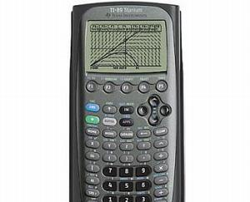
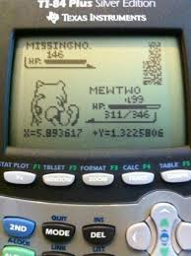
We'll make shapes out of math.
We're mostly trying to draw functions that are not linear or even polynomial.

Slide 28
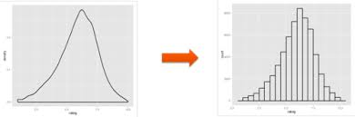

Discretization
We don't know how to tell a computer to draw most shapes because of their complicated non-linear formulas.
Instead, we linearize those shapes: Break them up into a finite number of line segments between N discrete points
Piecewise planar shapes:

Slide 29
Polygon
Collection of points connected with lines
Vertices: v₁,v₂,v₃,v₄
Edges: e₁ = v₁v₂ e₂ = v₂v₃ e₃ = v₃v₄ e₄ = v₄v₁
v₁
v₄
v₂
v₃

Slide 30
Polygons
Open / closed
Planar / non-planar
Filled / wireframe
Convex / concave
Simple / non-simple

Slide 31
Triangles
The most common primitive
Simple
Convex
Planar

Slide 32
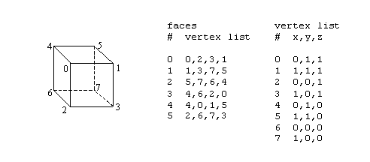
Polygonal Models / Data Structures
Indexed face set

Slide 33
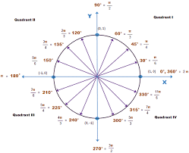
Let's list N points around a circle.
First point: (1,0,0)

Slide 34
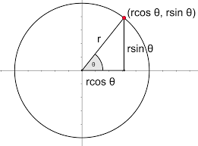
Let's list N points around a circle.
x = r*cos(Θ), y = r*sin(Θ) where theta is as shown below.
Using Θ as a variable input parameter, take N tiny steps from 0...2*PI.

Slide 35
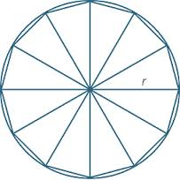
Triangles
We want to draw the whole 2D area, not just some points
Simplest 2d shape (remove any points and it will make it 1d) - this makes triangles the "2D simplex"

Slide 36
Triangles
List the points in triangle order - two approaches:
Sort list into triples of points
(0,0), (1,0),(0.479, 0.878), (0,0), (0.479, 0.878), (0.841,0.540)...
Repeats are evident here
Or, make a separate list of sorted triples of indices
Indices are shorter to write, so more triangles can fit in a CPU cache:
0,1,2,0,2,3,0,3,4,0,4,5,0,5,6,0,6,7...

