Slide 1
CS174A Lecture 5

Slide 2
Announcements & Reminders
Project #2 due on Sunday 10/20/19 midnight
PTE numbers
Team project info posted on Piazza (updated)

Slide 3
Team Project Proposal Template
Approximately 1 page
What is the theme (or story) of your animation?
What topics learnt in the course is used and how?
What interactivity will you use?
What advanced features you’ll be implementing?
List of team members

Slide 4
Last Lecture Recap
Homogeneous Representation of Points & Vectors
Shapes: lines, circles, polygons (triangles), polyhedrons
Interpolations: convex (alphas >= 0), affine (sum of alphas = 1)
Transformations: translation, scaling, rotation, shear

Slide 5
Next Up
Interpolations: linear, affine, convex & their properties
Polygons (triangles)
Transformations: finish up rotations & shear, inverse, examples
Spaces:
Model space
Object/world space
Eye/camera space
Screen space
Shaders

Slide 6
SIGGRAPH trailers from 2015
Going backwards,
https://www.youtube.com/watch?v=RvXtjANeujA
And
https://www.youtube.com/watch?v=XrYkEhs2FdA

Slide 7
“WebGL playground” site
Organizes whole WebGL program in one file in an online textbox
Edit, save, remix existing programs
Small one: http://webglplayground.net/?template=webgl1
Big one: http://webglplayground.net/?template=reactiondiffusion

Slide 8
Properties of Affine Interpolations & Transformations
Preservation of affine combinations of points
Preservation of lines and planes
Preservation of parallelism of lines and planes
Relative ratios are preserved
Translations, rotations, scaling and shear are affine tranforms

Slide 9
Linear Operations
Makes sense for linear as well as affine:
Addition of 2 vectors
Multiplication of vector by a scalar
Addition of a vector and a point
Doesn’t make sense for linear, but ok for affine:
Addition of 2 points
Multiplication of a point by a scalar

Slide 10
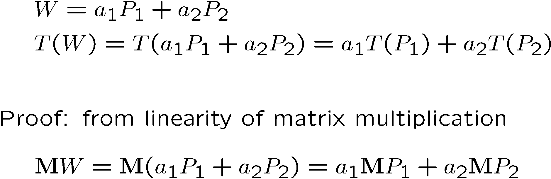
Affine Combinations of Points

Slide 11
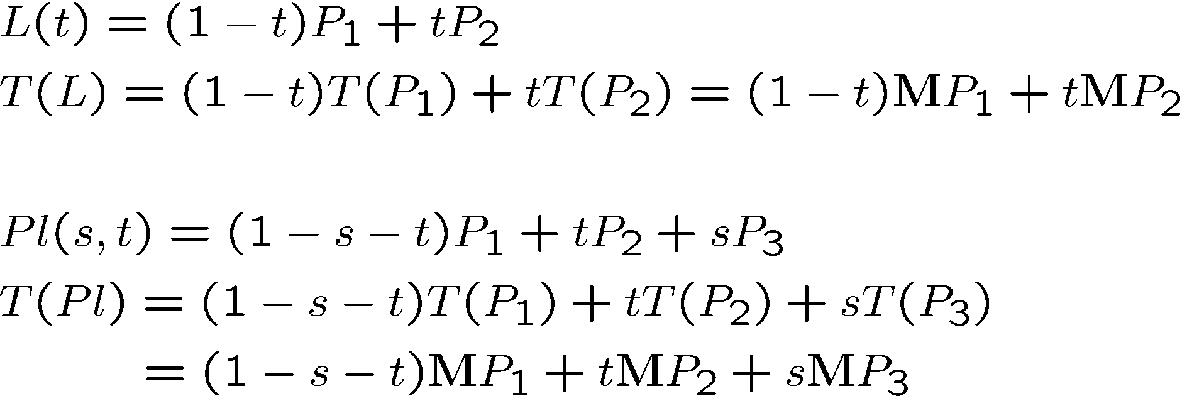
Preservations of Lines and Planes

Slide 12
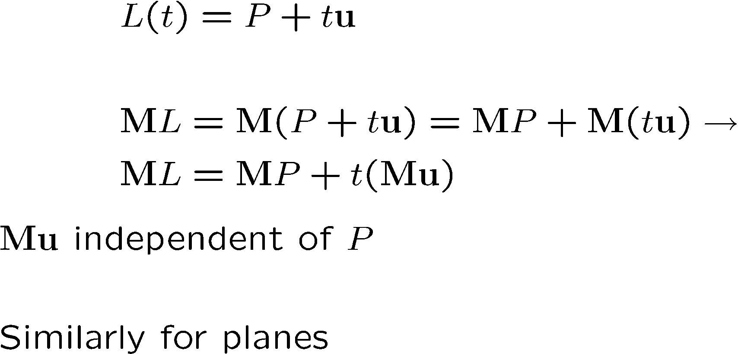
Preservation of Parallelism

Slide 13
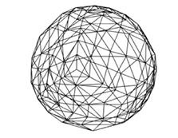
Polygons
An ordered sequence of vertices
Simple vs. Complex
Issue with Complex: hard to deal with self-intersecting polygons
Convex vs. Concave
Issue with Concave: point-inside-polygon test will fail in some cases
Issue with Concave: normal will point in wrong direction at concave vertices
Planar vs. Non-Planar
Issue with Non-Planar: normal are different at different locations on the non-planar face
Tessellation (any poly) vs. Triangulation (only triangles)

Slide 14
Why Triangles?
Ordered list of 3 non-collinear vertices
They are simple
They are planar
They are convex
Modern GPUs: 100M triangles/sec
Shading, lighting, texture mapping all in GPU
WebGL uses triangles only for rendering

Slide 15
Matrix Intro
Types of matrices found in graphics

Slide 16
What do we do with our point lists?
Immediate mode rendering: Send them one at a time to GPU to draw every point of every triangle. Bad
Retained mode: Store them all in a data structure
Now we can store one matrix to represent the whole shape’s movement/positioning, instead of repeating ourselves on the point-by-point level
Can draw the same shape in many places this way
Better yet: Load the data onto the GPU once and re-use it there
Fewer slow GPU communications

Slide 17
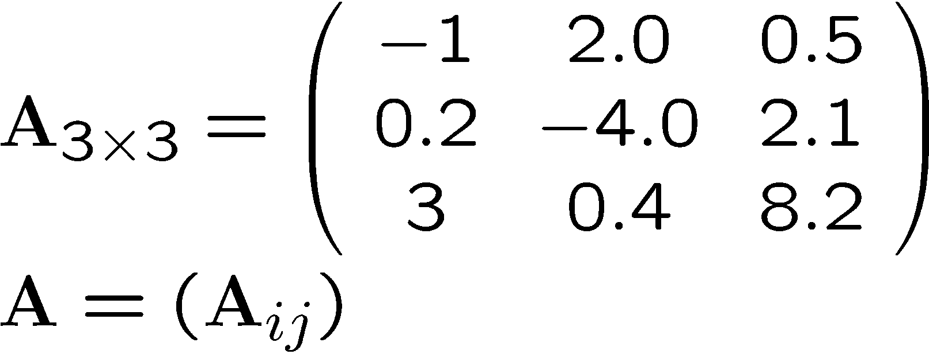
Matrix Refresher
Rectangular arrangement of scalar elements
Matrix:
Bold upper-case
Notes:
\documentclass{slides}\pagestyle{empty}
\begin{document}
\[ A_{3 \times 3} = \left ( \begin{array}{ccc}
-1 & 2.0 & 0.5 \\
0.2 & -4.0 & 2.1 \\
3 & 0.4 & 8.2 \\
\end{array} \right)
\]
\end{document}

Slide 18

What does a matrix mean?
A system of (first order) equations
Our mathematical tool to tweak 3D functions or point clouds with
Remember that a matrix is shorthand:

Slide 19
Reminder: Matrix Multiplication
A * B = M
Each cell of M is going to be a dot product of one row of A and one column of B.
Remember the rule:
Row size comes from A, column size comes from B
If B is just a vector (1 column), that’s fine, M will be too

Slide 20
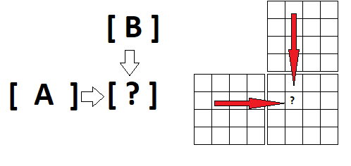
Reminder: Matrix Multiplication
It’s helpful to line up A and B offset when you write them down

Slide 21
Inverse of a Square Matrix
Definition
MM⁻¹ = M⁻¹M = I
Important property
(AB)⁻¹= B⁻¹ A⁻¹

Slide 22
Matrix Concepts
In Graphics: Guiding a shape into place in a scene
A few common graphics matrices perform movement, or “warp” space
What kind? Recall elementary row operations

Slide 23
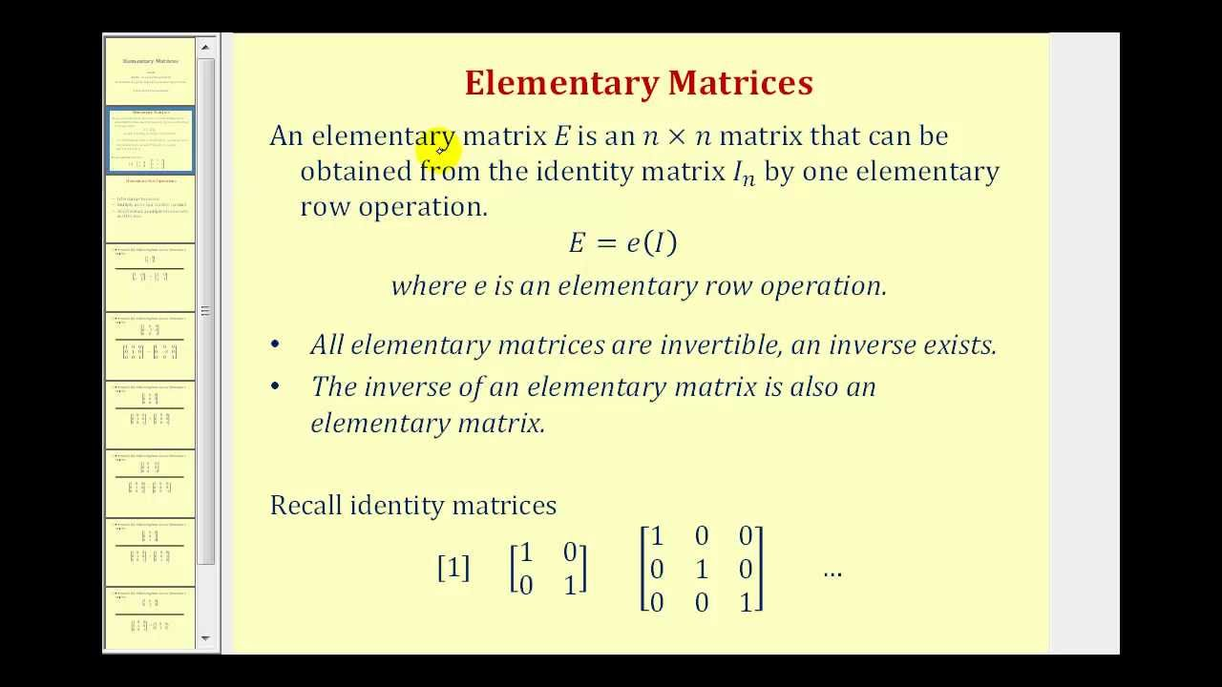

Slide 24
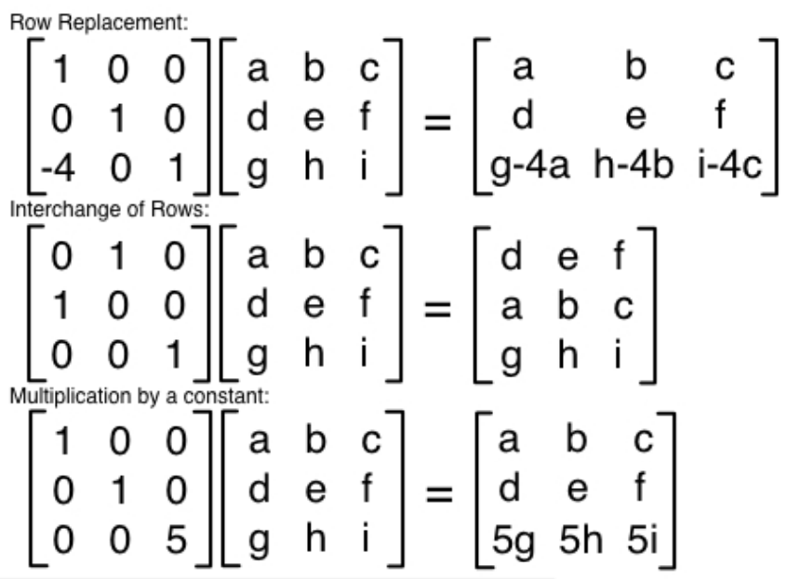

Slide 25
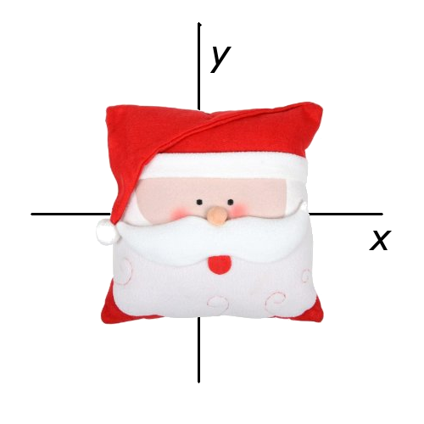
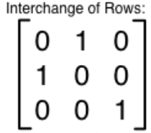

What if we apply e₁ to all the points of an image?

Slide 26
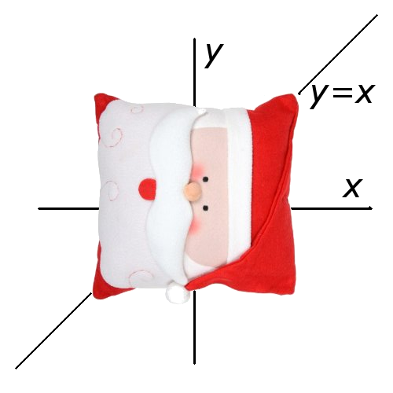
What if we apply e₁ to all the points of an image?
Our axes swap
new_{x}=y, new_{y}=x
Matrix form of that:

Slide 27
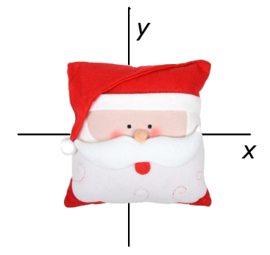
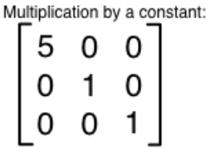
What if we apply e₂ to all the points of an image?

Slide 28
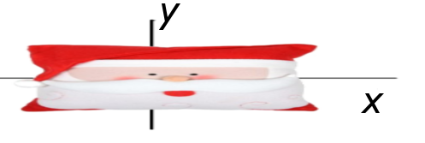
What if we apply e₂ to all the points of an image?
We get a scale.
new_{x}= 5x
Matrix form of that:

Slide 29
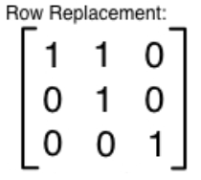
What if we apply e₃ to all the points of an image?

Slide 30
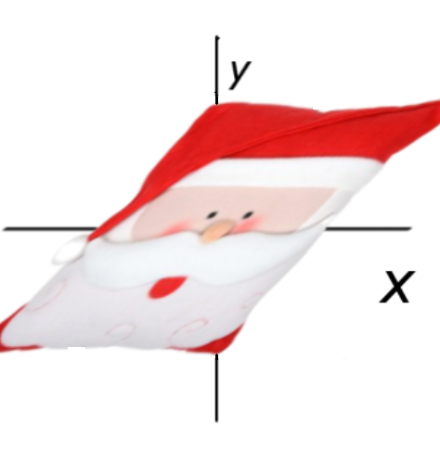
What if we apply e₃ to all the points of an image?
We get a “shear.”
new_{x}= x + y
Matrix form of that:

Slide 31

Rotation Matrices
A rotation is two shears.
But certain properties have to hold. This one is not a pure rotation matrix (it has some scaling effect too). Rotations have to have determinant = 1.

Slide 32

Rotation Matrices
A rotation also has to have orthogonal columns. This one passes that!
Our simpler shear matrix from earlier did not (check the columns):

Slide 33

Rotation Matrices
This one is more like it. Trig identities ensure this matrix always has determinant=1. The two columns are also always perpendicular. Suppose theta is 45 degrees:

Slide 34

Rotation Matrices
This one is more like it. Trig identities ensure this matrix always has determinant=1. The two columns are also always perpendicular. Suppose theta is 45 degrees:

Slide 35

Rotation Matrices
Let’s try our rotation matrix, but we don’t want to multiply ugly radicals so let’s combine it with a scale matrix for testing.
There, much better to work with. (This was our matrix from earlier that had a scaling influence).

Slide 36
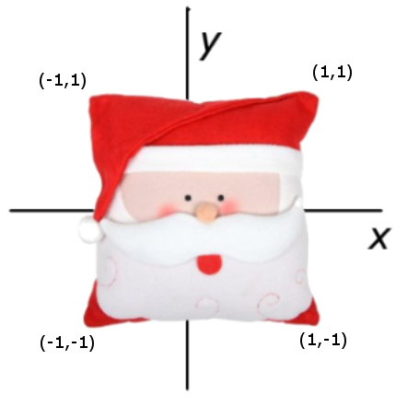

Rotation Matrices
What it means:

Slide 37
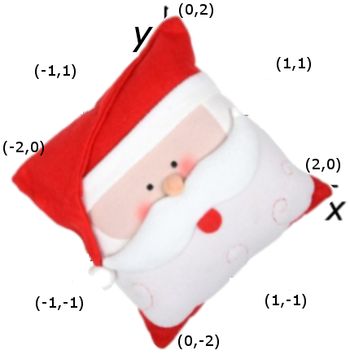
Rotation Matrices
What it means:

Slide 38
All this time...
SANTA’S NOSE HAS NEVER LEFT THE ORIGIN (!!!)
None of these operations have resulted in translation (sliding all of the points at once somewhere else)

Slide 39
Translation Matrices
Every matrix we’ve discovered using the elementary ones only has a linear effect, stretching and warping the image around the origin
Why can’t we accomplish translation of Santa to other places with our current machinery?

Slide 40
Translation Matrices
Every point always takes a contribution of x_{old}, y_{old}, and z_{old} to get its value
The origin point (0,0,0) will always contribute zero to each axis for the new point, mapping onto itself.
We need to be able to take a component of some other quantity besides x_{old}, y_{old}, and z_{old}
Our vector we’re multiplying needs to grow by 1 term.
Let’s supply an extra constant. Use 1.

Slide 41

Translation Matrices
Solution:
One of the components that contributes to the answer is now the constant 1, which we can pull from even when all others are zero. This allows us to move the picture.

Slide 42
Translation Matrices
We’d like our new vector to have “1” in the 4th coordinate as well, so we can use matrices on it right away.
What does our matrix have to be like to ensure that will happen?

Slide 43

Translation Matrices
Solution:
This 4th row is an equation that literally says “1_{new}=1_{old}”.

Slide 44
Linear Vs. Affine Transformations
A linear transformation only takes linear combinations of x, y, and z.
Santa’s nose stays on the origin forever.
An *affine* transformation is more general and more powerful.
It’s called an affine transformation because it preserves affine combinations (line segment interpolations don’t get messed up before vs. after).

Slide 45

Translation Matrices
3D translations are the reason we use 4x4 matrices instead of 3x3.
Let’s do one:

Slide 46
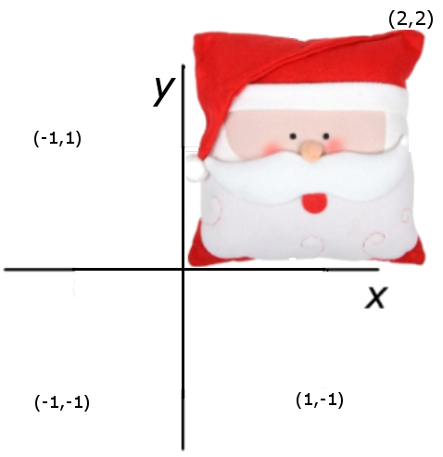
Translation Matrices
3D translations are the reason we use 4x4 matrices instead of 3x3.
Let’s do one:

Slide 47
Summary: Affine is Useful
Affine transformations are the main modeling tool in graphics
They are applied as matrix multiplications
Any affine transformation can be performed as a series of elementary affine transformations
We can now do object placement
Model entire scenes

Slide 48
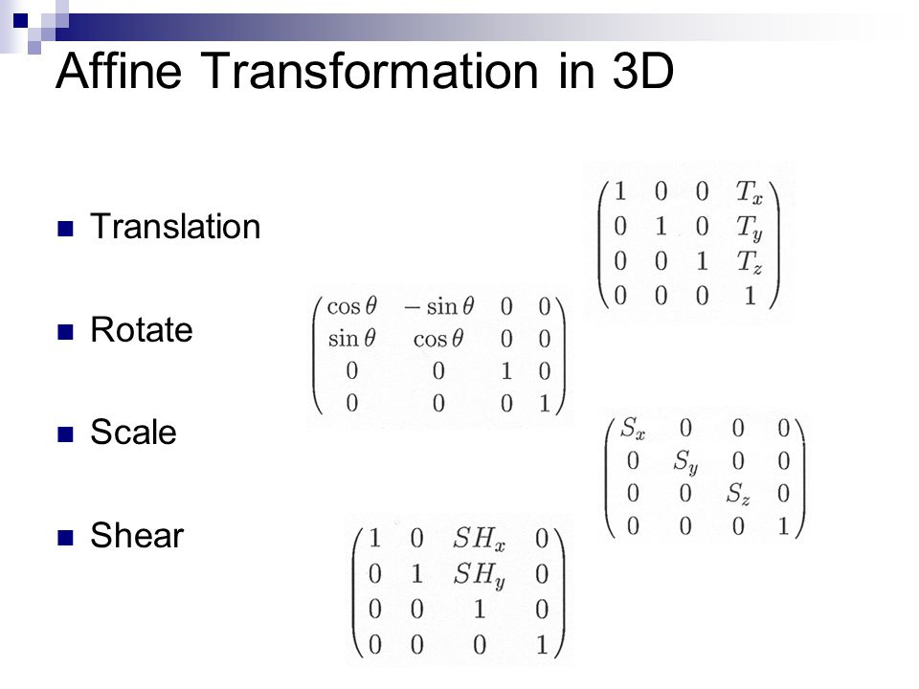

Slide 49
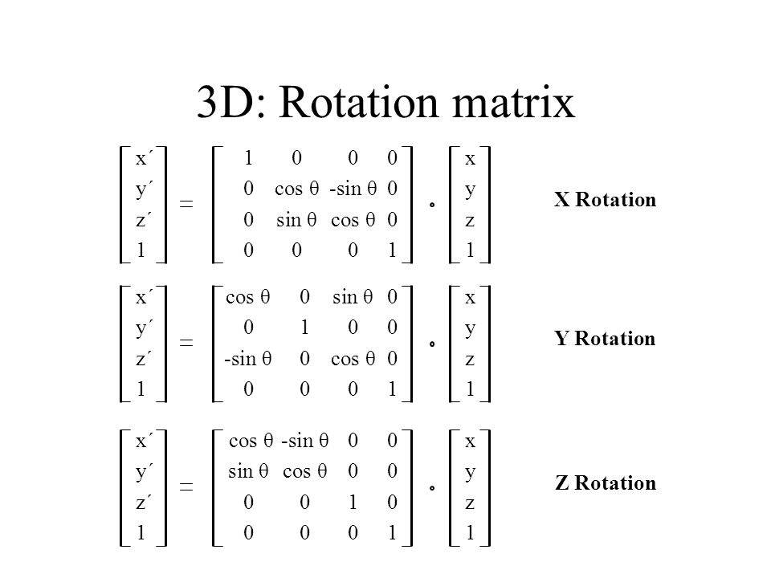
Rotation Matrices

Slide 50
Affine Transforms Review

Slide 51
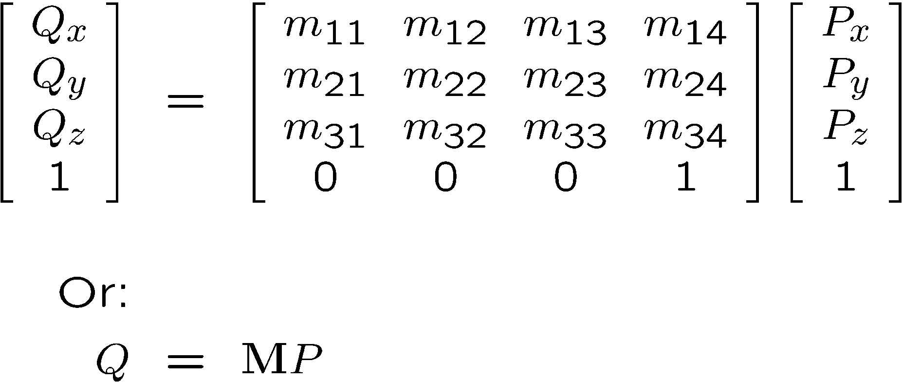
Affine Transformations in 3D
General form

Slide 52
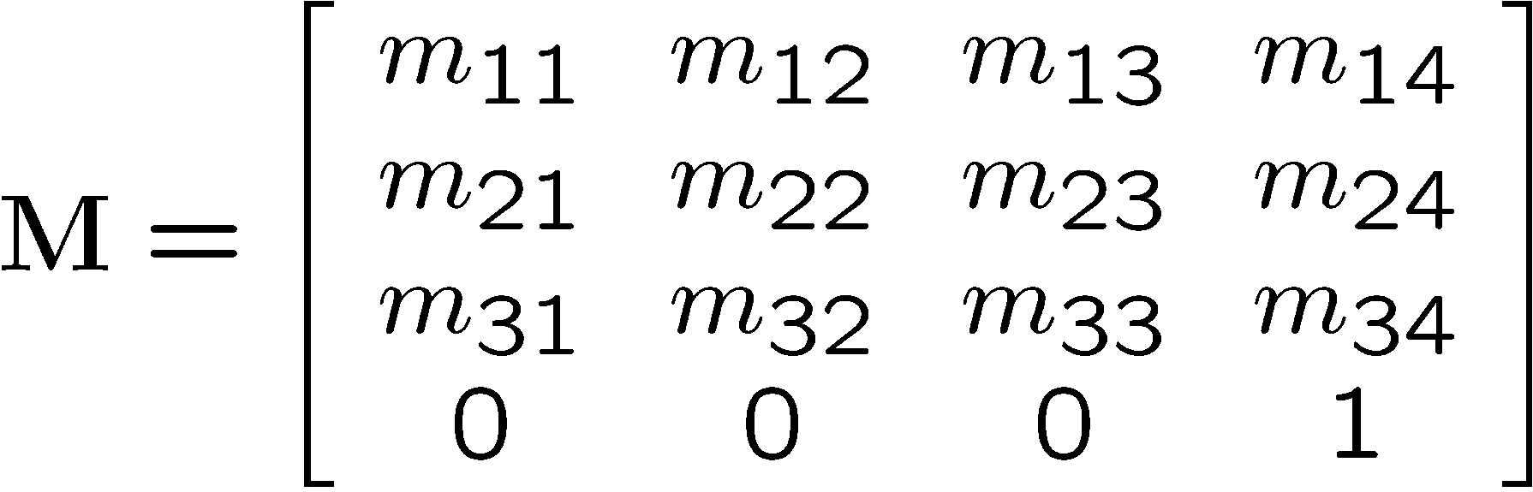
General Form
Rotation / Scaling / Shearing
Translation

Slide 53
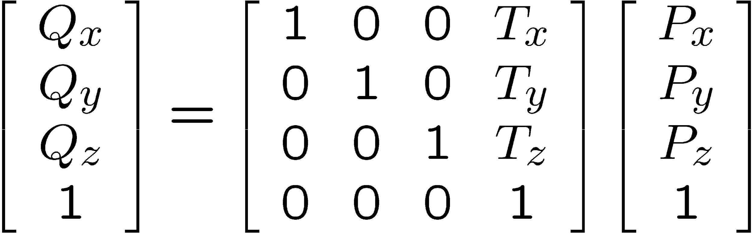
Elementary 3D Affine Transformations
Translation

Slide 54
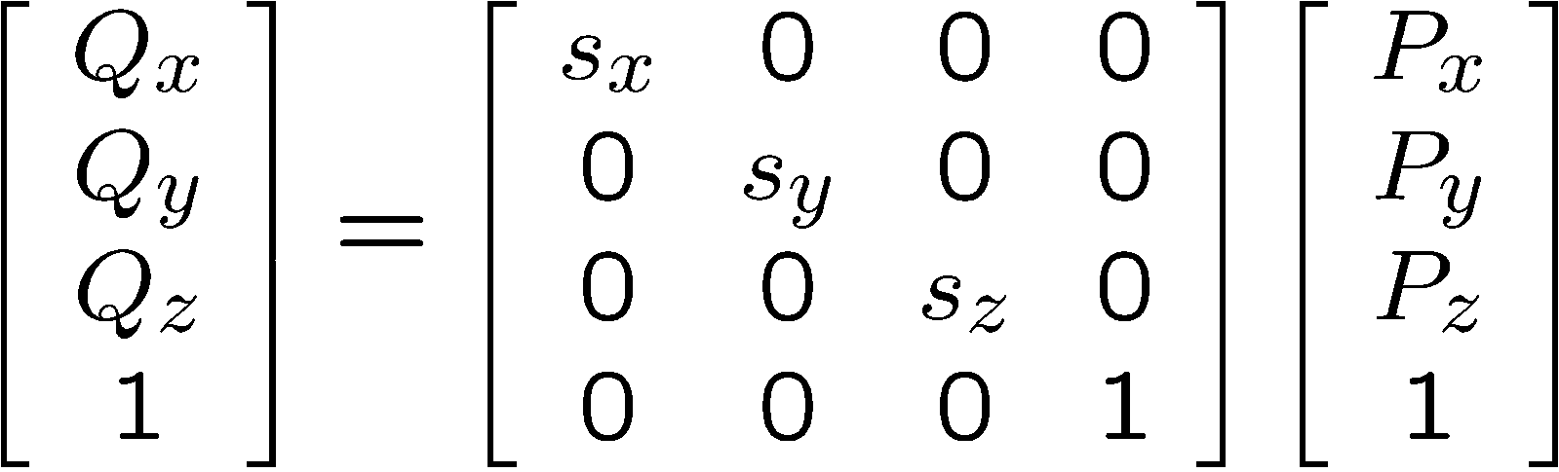
Scaling Around the Origin

Slide 55
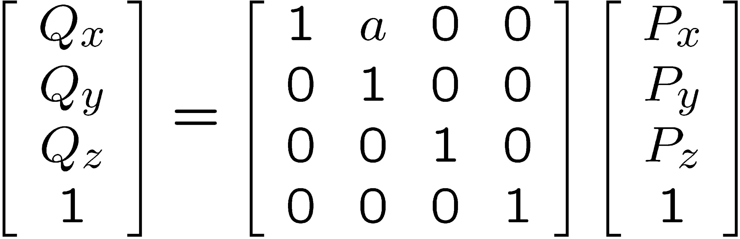
Shear Around the Origin
Along x-axis

Slide 56
3D Rotation
Various representations possible
Decomposition into axis rotations
x-roll, y-roll, z-roll
Counterclockwise positive angle assumption

Slide 57
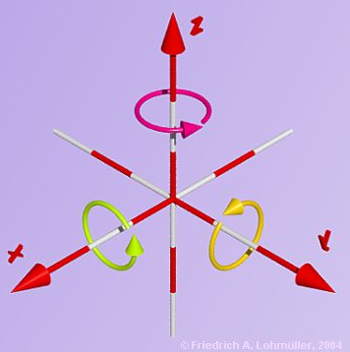
Three Axes to Rotate Around

Slide 58
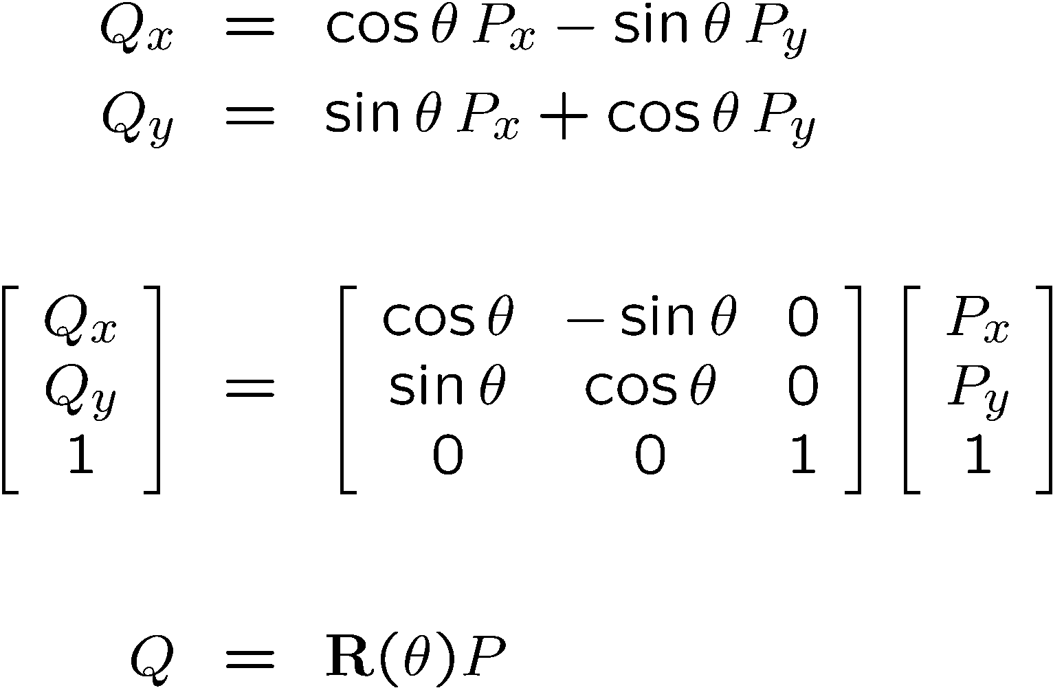
Reminder: 2D Rotation
In matrix form:
Or:

Slide 59
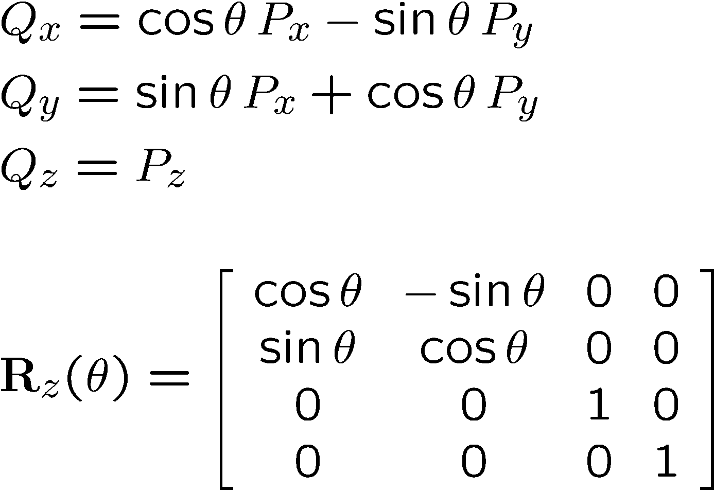
Z-Roll

Slide 60
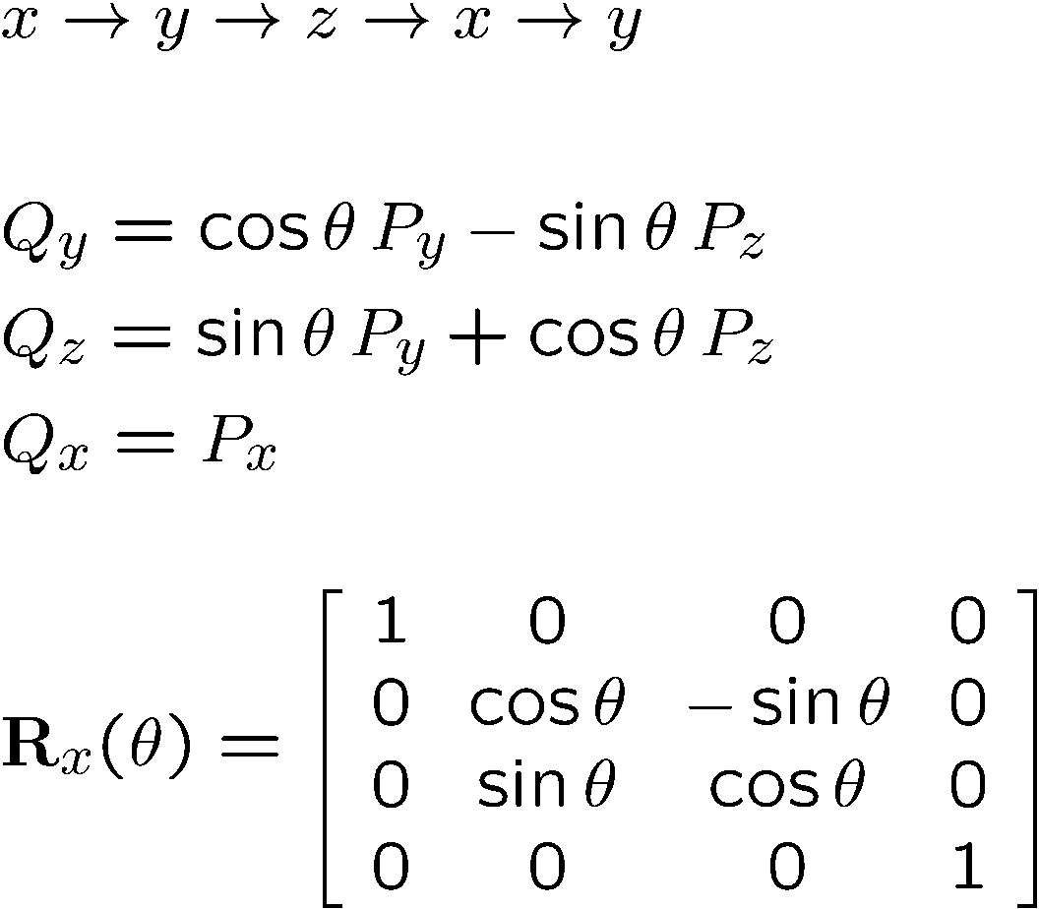
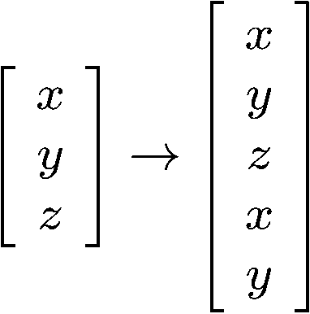
X-Roll
Cyclic indexing

Slide 61
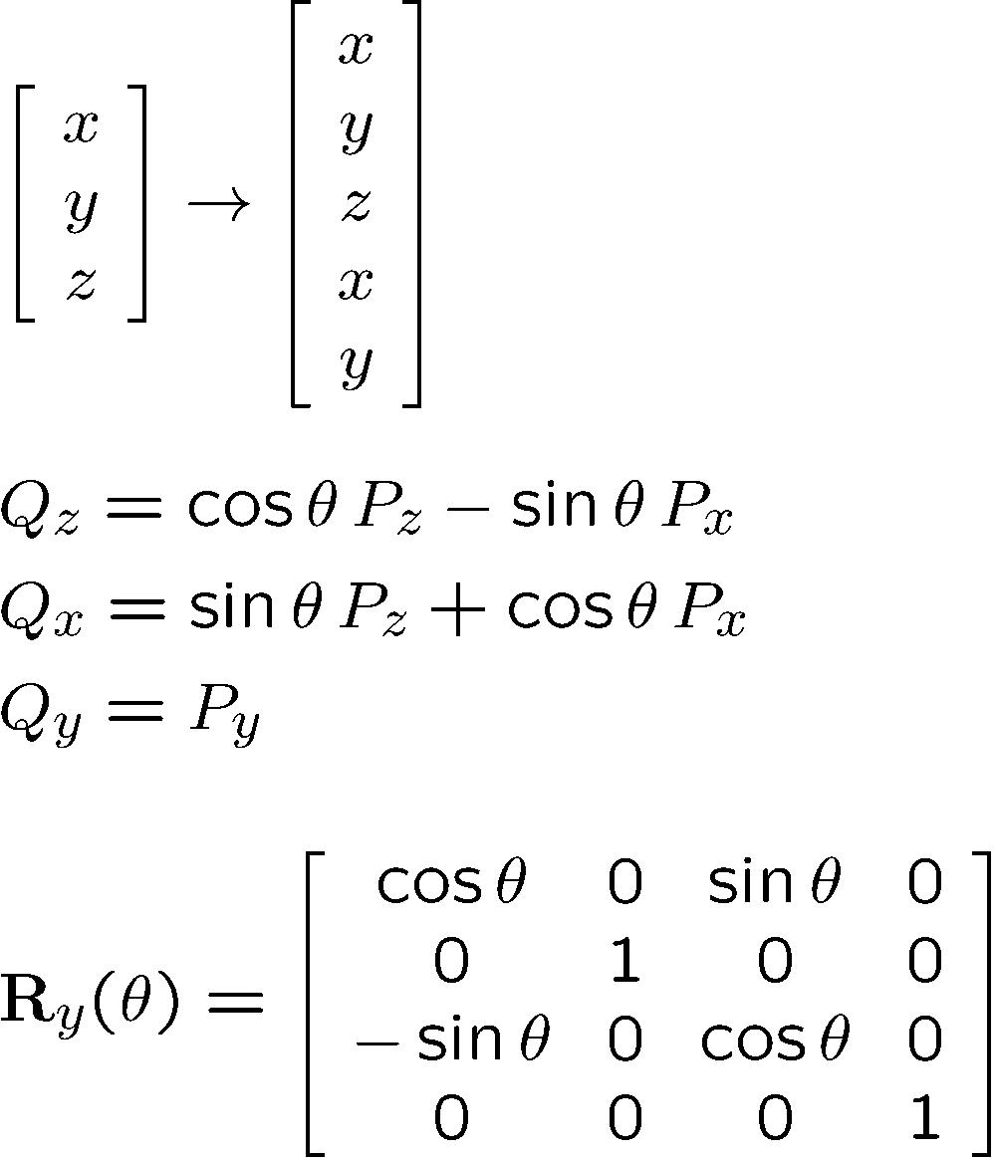
Y-Roll

Slide 62
Inverse of a Transformation
Inverse transformation: Q = MP, P = M⁻¹Q
We can use Cramer’s rule to invert M, or we can be smarter about it
M
Q
P
M⁻¹

Slide 63
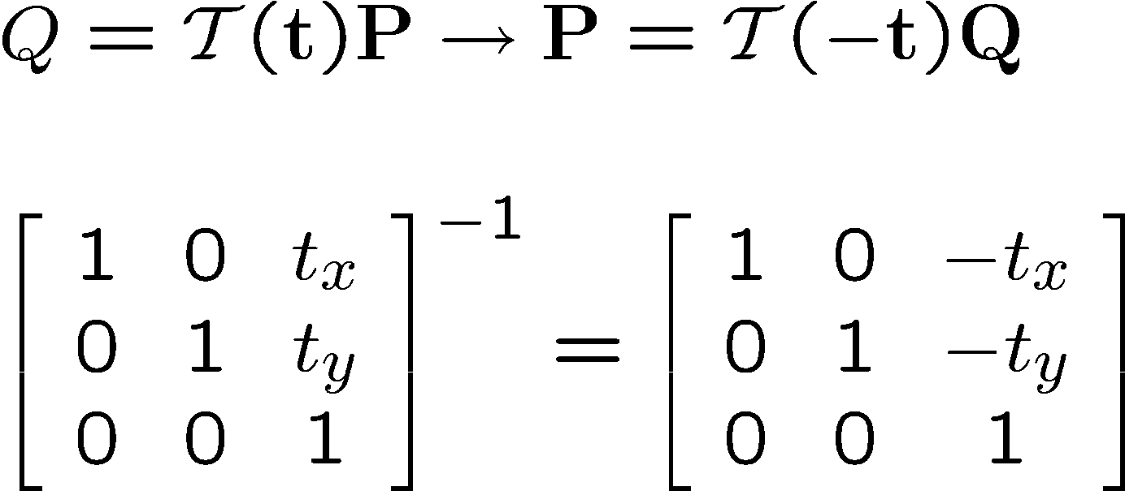
Inverse of Translation

Slide 64
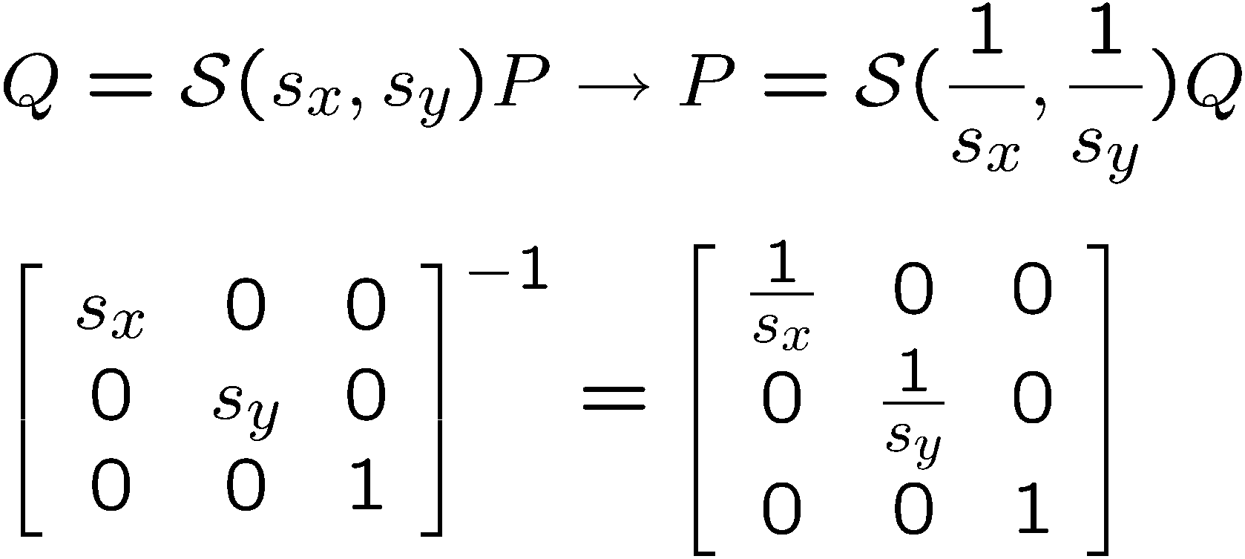
Inverse of Scaling

Slide 65
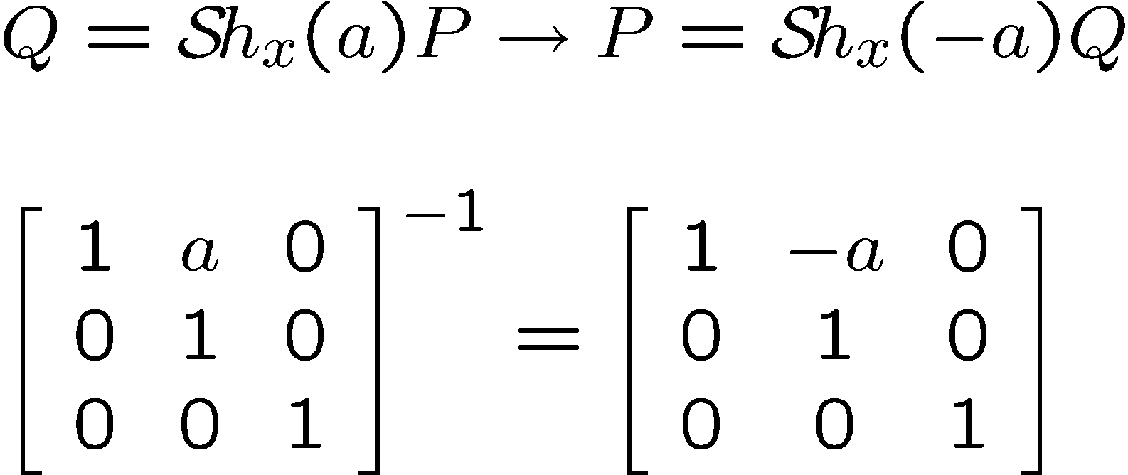
Inverse of a Shear in x

Slide 66
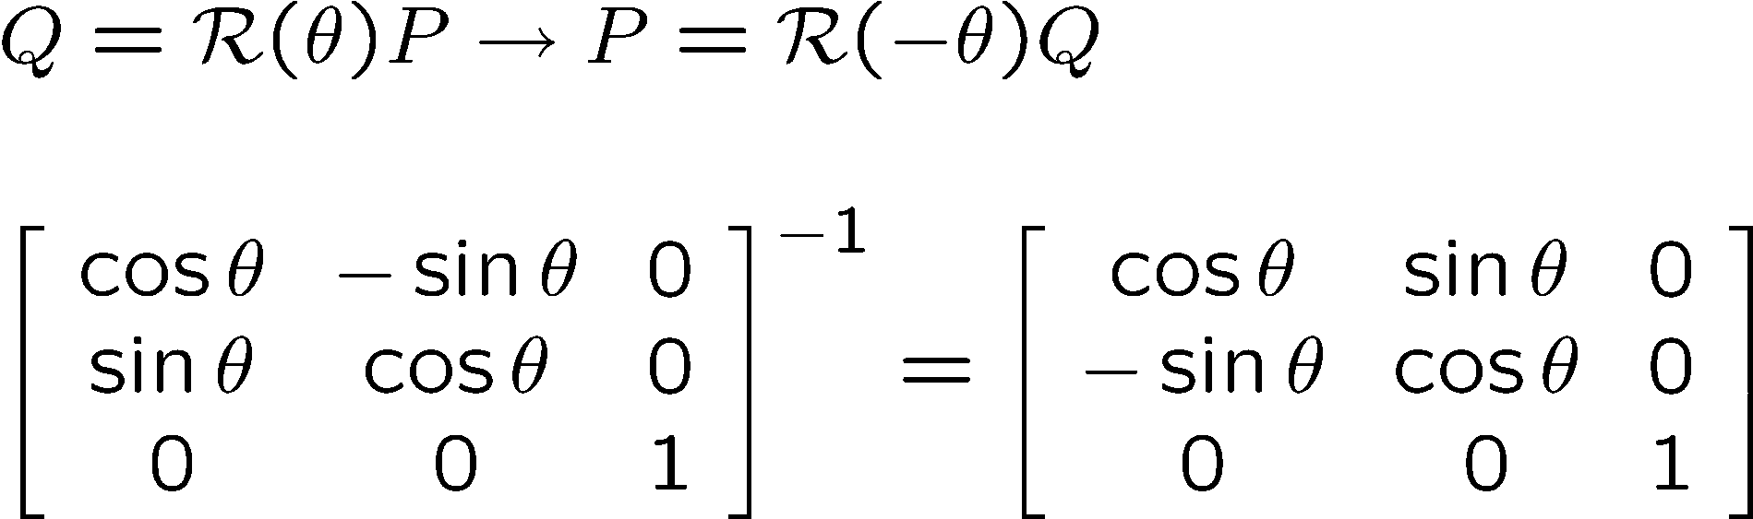
Inverse of Rotation

Slide 67
Inversion of Transformations
Translation: T⁻¹(t_{x},t_{y},t_{z}) = T(-t_{x},-t_{y},-t_{z})
Rotation: R⁻¹_{axis}(θ) = R_{axis}(-θ)
Scaling: S⁻¹(s_{x},s_{y},s_{z}) = S(1/s_{x},1/s_{y},1/s_{z})
Shearing: Sh⁻¹(a) = Sh(-a)

Slide 68
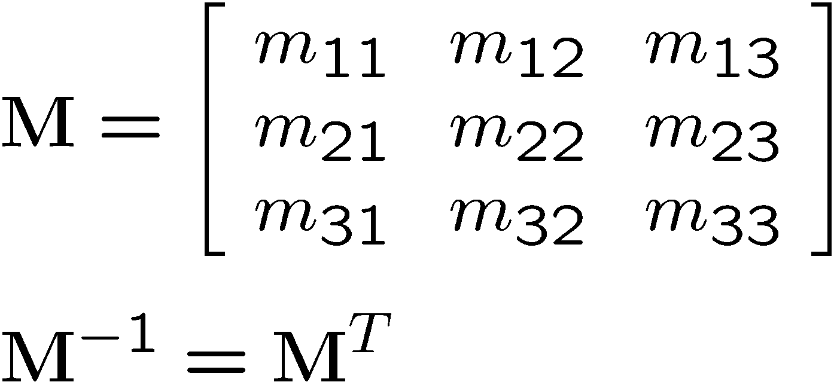
Inverse of Rotations
Pure rotation only, no scaling or shear
Since the rotation matrix M is an orthonormal matrix

Slide 69
Composition of 3D Affine Transformations
The composition of affine transformations is an affine transformation
Any 3D affine transformation can be performed as a series of elementary affine transformations

