Slide 1
CS174A Lecture 6

Slide 2
Announcements & Reminders
Project #2 due on Sunday 10/20/19 midnight
Team project info posted on Piazza
Midterm: Oct 29

Slide 3
Last Lecture Recap
Polygons (triangles)
Transformations: translation, scaling, rotation, shear

Slide 4
Next Up
Examples of transformations
Spaces:
Model space
Object/world space
Eye/camera space
Screen space
Projections: parallel and perspective
Lighting
Flat and Smooth Shading

Slide 5
SIGGRAPH trailers from 2014
Going backwards,
https://www.youtube.com/watch?v=s8lzXMWMngU
And
https://www.youtube.com/watch?v=u3Z1hDwGEmM

Slide 6
Affine Transformations
Examples: translations, rotations, scaling, shear
Preserves:
Collinear points
Planarity
Parallelism of lines and planes
Relative ratios of edge lengths

Slide 7
Rigid Body Transformations
Examples: translations and rotations
Preserves lines, angles and distances

Slide 8
Examples of Tranformation Composition
Rotation followed by translation vs. translation followed by rotation
Commutative and associative properties
Rotation about a random point (not the origin)
Rotation about a random axis
Transforming a vector/normal
For vertices/points transformation matrix = M
For normals = (M^{T})⁻¹

Slide 9
Matrix Order
Remember the rules:
Non-Commutativity:
ABCDE != BACDE != EDCBA
Matrix products can only be written in one left-right order. Changing the order changes the answer.
Associativity:
Matrix products can be evaluated in any left-right order you want, though.
ABCDE = A(B(C(DE))) = (((AB)C)D)E

Slide 10
Matrix Multiplication is NOT commutative.
Given Matrix A and Matrix B that are non-trivial nor diagonal,
AB != BA

Slide 11
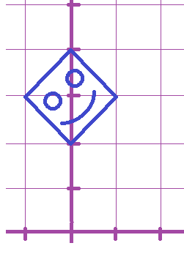

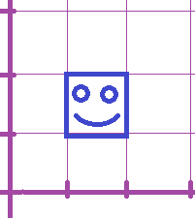


Matrix Multiplication is NOT commutative.
Remember our old rotation matrix:

Slide 12

Matrix Multiplication is NOT commutative.
Suppose we modify it with a non-uniform scale matrix from the left:
Where do the corners of the face go if we use this one?

Slide 13

Matrix Multiplication is NOT commutative.
Suppose we modify it with a non-uniform scale matrix from the left:
Where do the corners of the face go if we use this one?

Slide 14


Matrix Multiplication is NOT commutative.
Suppose we modify it with a non-uniform scale matrix from the left:
Where do the corners of the face go if we use this one?

Slide 15
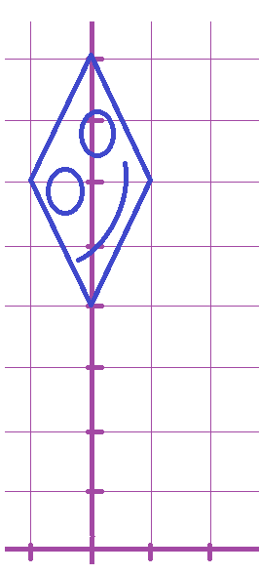




Matrix Multiplication is NOT commutative.
Suppose we modify it with a non-uniform scale matrix from the left:
We sheared it!

Slide 16
Matrix Multiplication is NOT commutative.
Let’s try the product the other way around now...

Slide 17

Matrix Multiplication is NOT commutative.
Suppose we modify it with a non-uniform scale matrix from the right:
Where do the corners of the face go if we use this one?

Slide 18

Matrix Multiplication is NOT commutative.
Suppose we modify it with a non-uniform scale matrix from the right:
Where do the corners of the face go if we use this one?

Slide 19


Matrix Multiplication is NOT commutative.
Suppose we modify it with a non-uniform scale matrix from the right:
Where do the corners of the face go if we use this one?

Slide 20

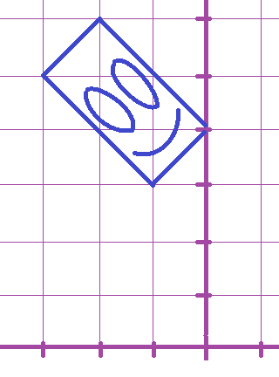



Matrix Multiplication is NOT commutative.
Suppose we modify it with a non-uniform scale matrix from the right:
We didn’t shear it!

Slide 21
Matrix Order
Remember the rules:
Non-Commutativity:
ABCDE != BACDE != EDCBA
Matrix products can only be written in one left-right order. Changing the order changes the answer.
Associativity:
Matrix products can be evaluated in any left-right order you want, though.
ABCDE = A(B(C(DE))) = (((AB)C)D)E

Slide 22
Rotation Around an Arbitrary Axis
Euler’s theorem:
Any rotation or sequence of rotations around a point is equivalent to a single rotation around an axis that passes through the point
Let’s derive the transformation matrix for rotation around an arbitrary axis u

Slide 23
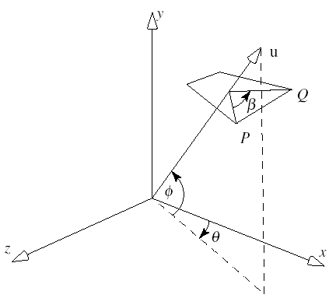
Rotation Around an Arbitrary Axis
Vector (axis): u = [u_{x}, u_{y}, u_{z}]^{T}
Rotation angle: β
Point: P
Method:
Two rotations to align u with x-axis
Do x-roll by β
Undo the alignment

Slide 24
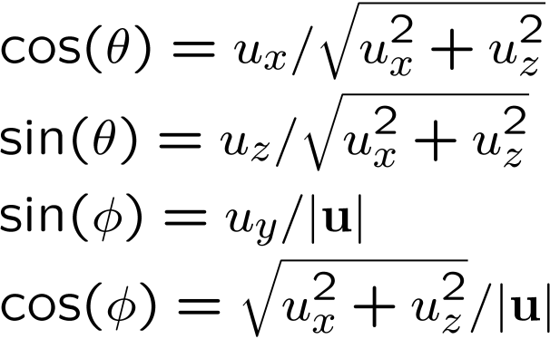
Derivation
R_{z}(-φ) R_{y}(θ)
R_{x}(β)
R_{y}(-θ) R_{z}(φ)
All together: R_{u}(β) =
R_{y}(-θ) R_{z}(φ) R_{x}(β) R_{z}(-φ) R_{y}(θ)
We should add translation too if the axis is not through the origin
Notes:
An arbitrary rotation can be represented by a product of five matrices based on three angles.

Slide 25
Transformations of Coordinate Systems
Coordinate systems consist of basis vectors and an origin (point)
They can be represented as affine matrices
Therefore, we can transform them just like points and vectors
This provides an alternative way to think of transformations:
As changes of coordinate systems

Slide 26
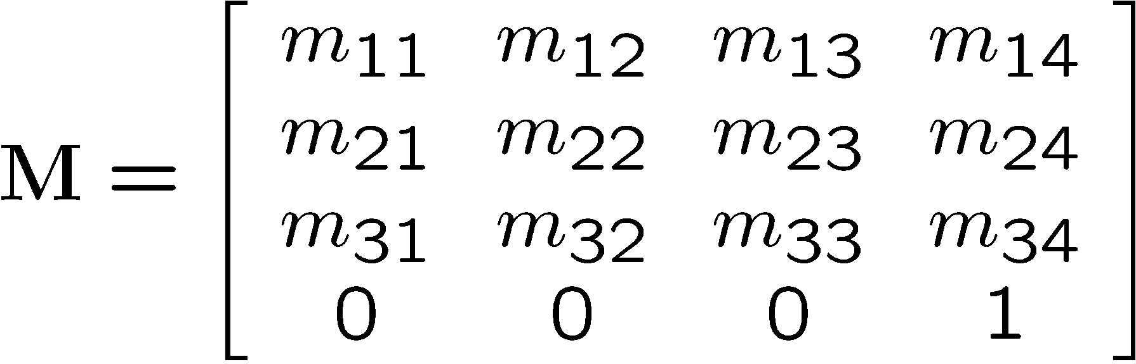
Remember
Transformations are represented
by affine matrices
Coordinate systems too:
Rotate/Scale/Shear
Translate
Basis
Vector 1
Basis
Vector 2
Basis
Vector 3
Origin
Point

Slide 27
Transforming a Point by Transforming Coordinate Systems

Slide 28
Transforming a Point by Transforming Coordinate Systems
T₁

Slide 29
Transforming a Point by Transforming Coordinate Systems
T₂
T₁

Slide 30
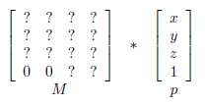
Matrix Review
All the objects you draw on screen are drawn one vertex at a time, by starting with the vertex's xyz coordinate and then multiplying by a matrix to get the final xy coordinate on the screen.

Slide 31
Transforms
Before that matrix, the xyz coordinate is always some trivial value like (.5, .5, .5)
In the reference system of the shape itself
For example, a cube's own coordinates for its corners
After that matrix, it's some different xy pixel coordinate denoting where that vertex will show up on the screen.
And z for depth, and a fourth number for translations / perspective effects
That mapping is all that the transform does.

Slide 32
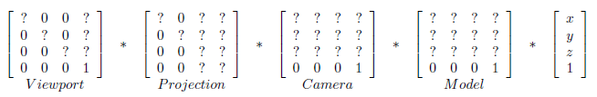
Transform Process
The transform is always just one 4x4 matrix.
But calculating what it should be involves multiplying out a big chain of intermediate special matrices. That chain is always: equation:

Slide 33
Transform Process
Note: We never actually see the viewport matrix.
The viewport matrix is automatically applied for you at the end of the vertex shader.
Early during initialization, javascript set it up, calling gl.viewport(x,y,width,height).
All the other special matrices you do manage.

Slide 34
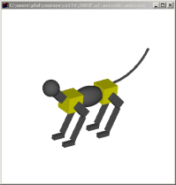
Graphics Pipeline
OCS
WCS
M⁻¹_{cam}
VCS
CCS
Modeling transformations
Viewing transformation
Projection transformation
Viewport transformation
Perspective division
NDCS
DCS

Slide 35
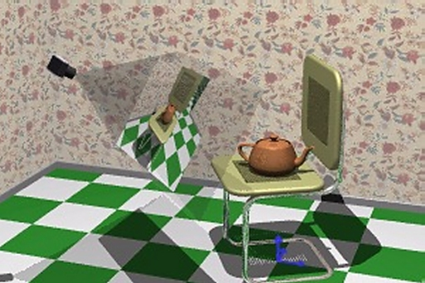
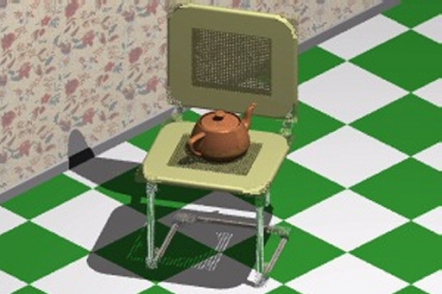
Rendering a 3D Scene From the Point of View of a Virtual Camera

Slide 36
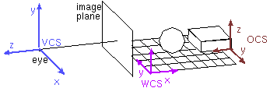
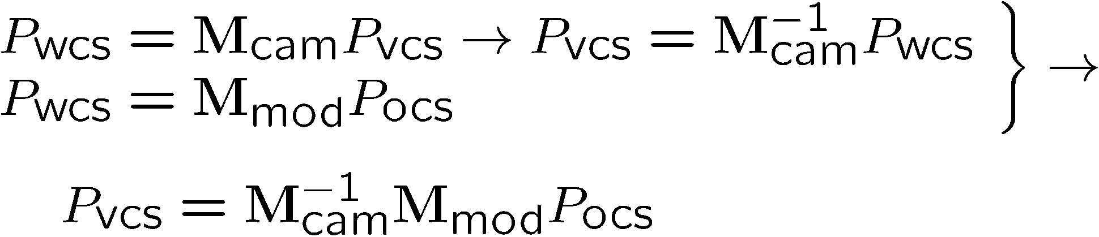
Camera Transformation
Transforms objects to camera coordinates
OpenGL Modelview matrix
Modelview Transformation

Slide 37
Transform Process
The camera matrix is very much like the model transform matrix for placing shapes. But:
The shape being placed is the scene’s observer
You actually use the inverse matrix of what you would have done to a 3D model of an actual camera

